Slide 1
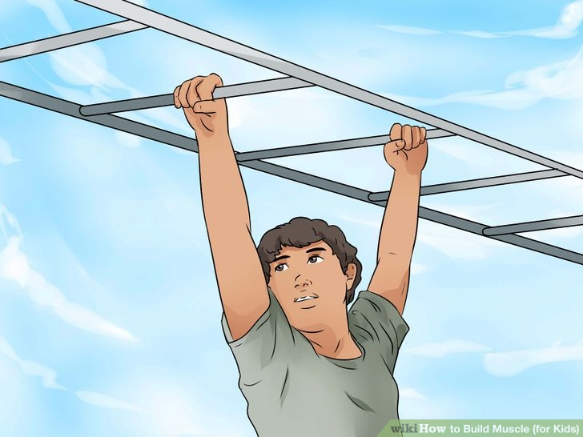
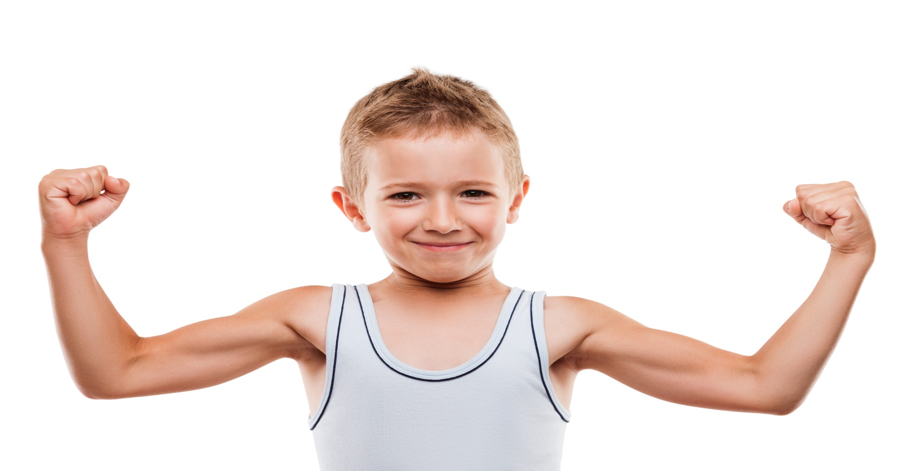
THE MUSCULAR SYSTEM
Unit 5: Lesson 7

Slide 2
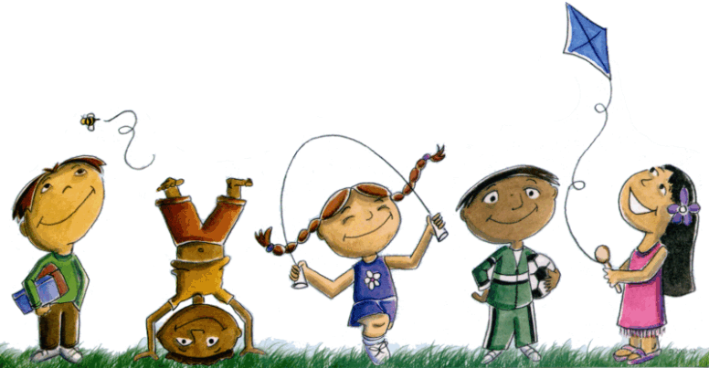
We are learning to:
Find and use the “OU” sound
Use the pronouns: this, that, these, those
Use “Have” in the plus infinitive (have to…, has to….)
Understand the muscular system

Slide 5
LET’S KEEP PRACTICING THESE SOUNDS

Slide 6
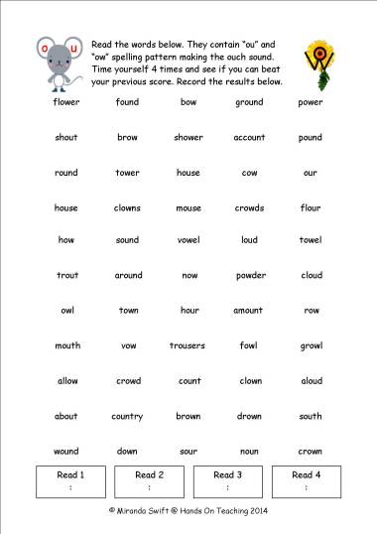
More Practice!

Slide 7
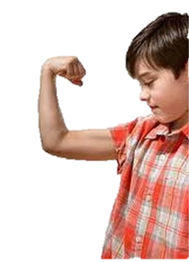
THE MUSCULAR SYSTEM

Slide 8
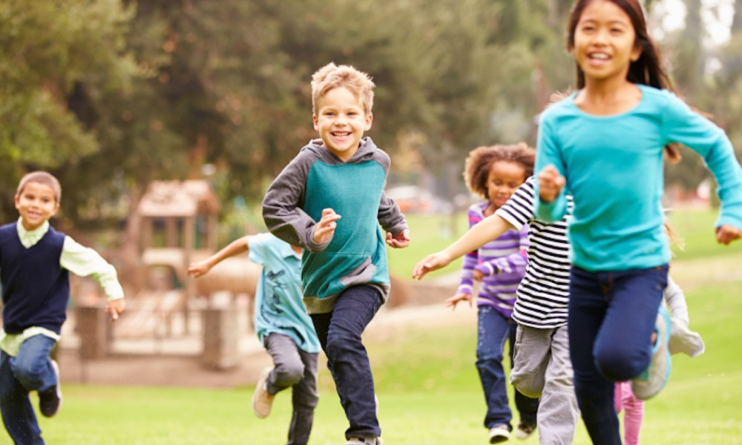
The muscular system helps the body move. Different muscles move different parts of the body.

Slide 9
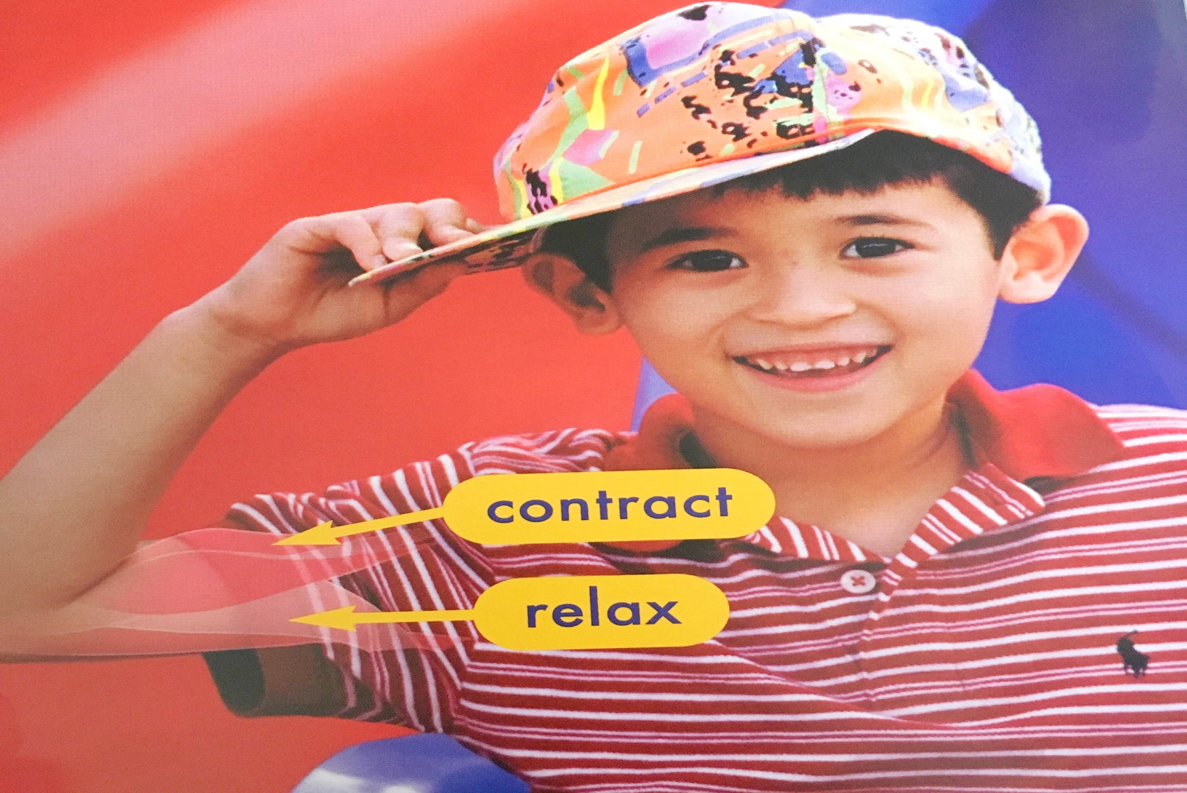
Most muscles work in pairs. One muscle contracts when the other muscle relaxes. This action causes a part of the body to move.

Slide 10
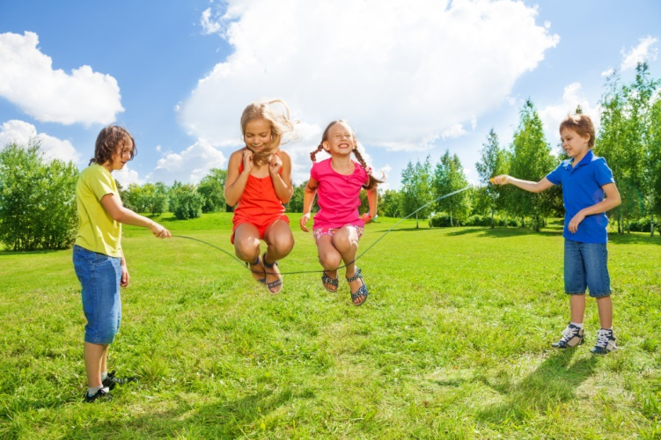
Legs have many pairs of large muscles. Leg muscles help people jump.

Slide 11
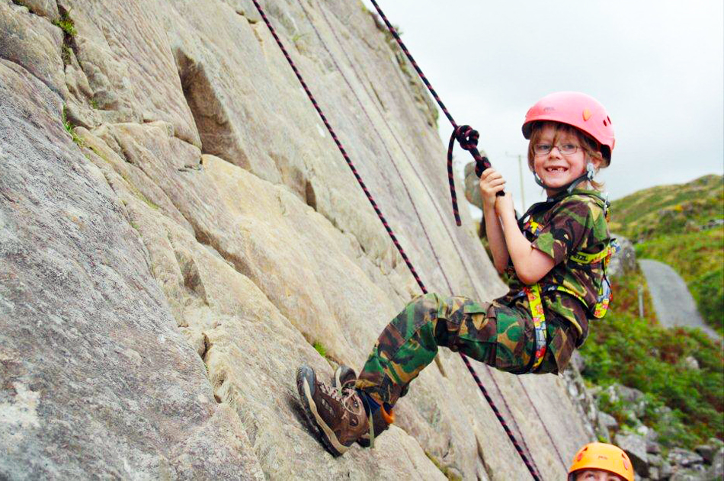
Large muscles in the arms and back work together. These muscles help people climb.

Slide 12
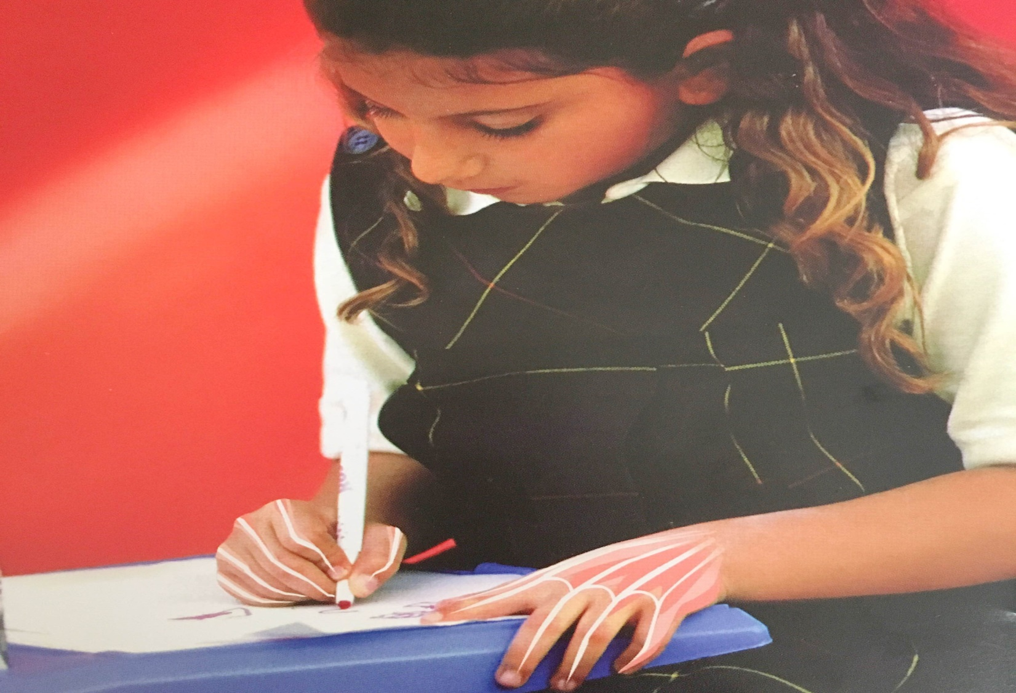
Small muscles in the hands work together. Hand muscles help people draw.

Slide 13
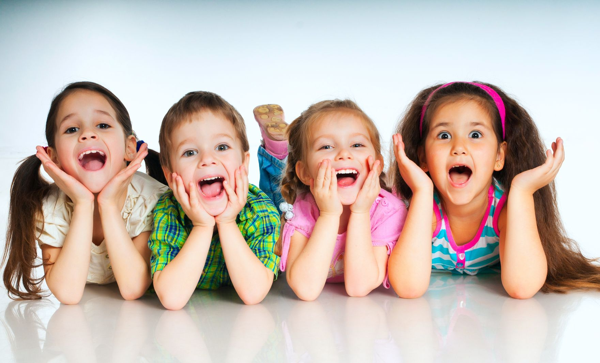
Small muscles in the face work together. Face muscles help people smile.

Slide 14
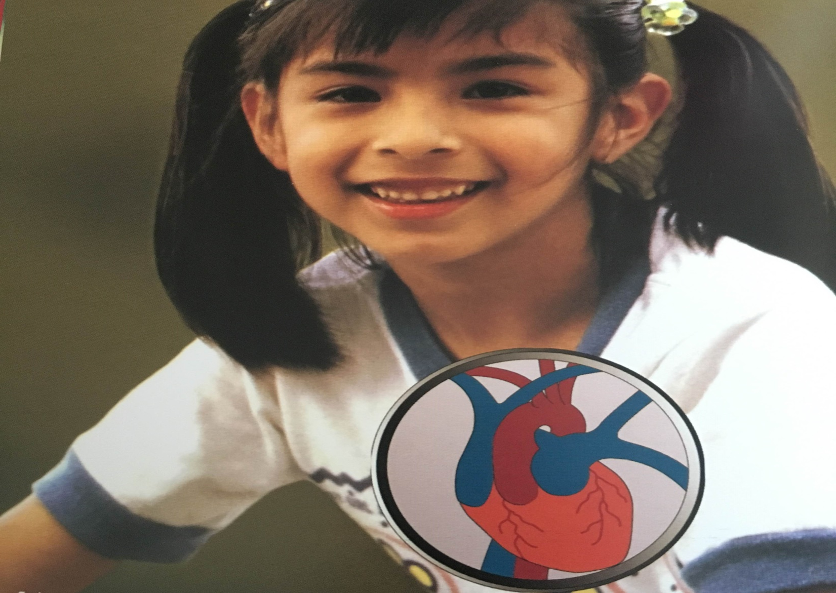
Some muscles work all the time. The heart is a muscle. It pumps blood through the body.

Slide 15
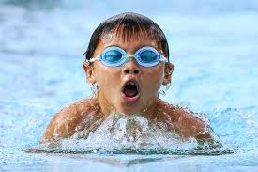
Sometimes many muscles in the body work together. People use many muscles when they swim.

Slide 16
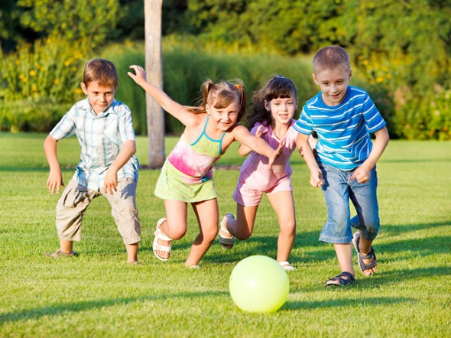
Exercise keeps muscles healthy. Muscles grow stronger when they are used so be sure to exercise everyday!

Slide 17
DEMONSTRATIVE PRONOUNS
Let’s practice using items in our houses!

Slide 18
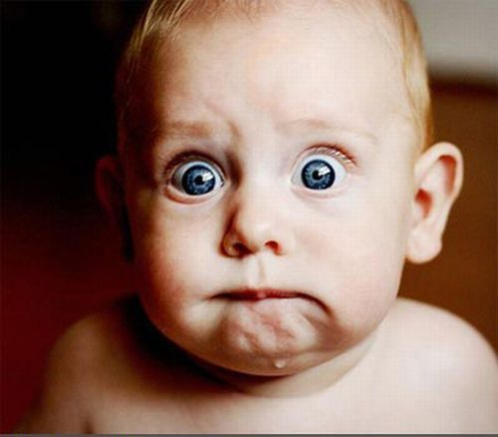
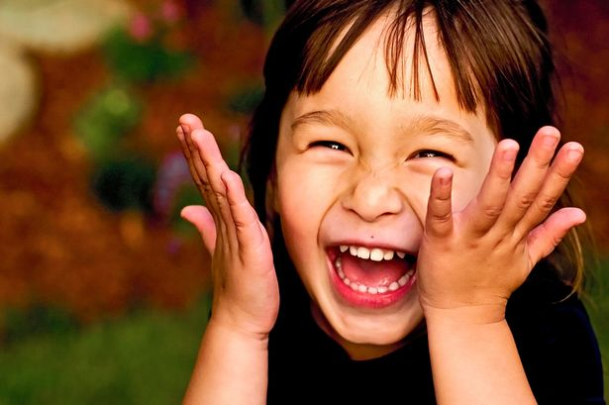
HAVE, HAS
He has black hair.
She has red hair.

Slide 19
LET’S PRACTICE
Describe 3 things that you have at your house:
Describe something that your best friend has:

Slide 20
Have To… Has to….
I have to go to school.
You have to wear your uniform.
We have to be on time.
They have to prepare for the Chinese New Year celebrations.
She has to visit her grandmother.
He has to practice the piano.
Let’s practice by talking about things that we have to do this week!

Slide 21
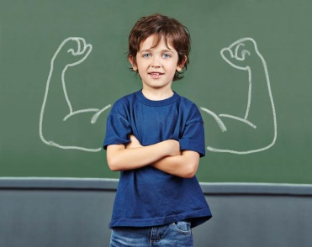
A QUICK RECAP OF TODAY’S LEARNING GOALS
Notes:
https://learnenglishkids.britishcouncil.org/sites/kids/files/attachment/grammar-games-have-got-worksheet.pdf

Slide 22
Homework

