Slide 1


Lesson 8: A REVIEW

Slide 2
Today we are learning to review:
the OU, OW and OO sounds
Ordered and unordered lists
Prepositions
Sorting
Have/Has and This/That

Slide 3
OU and OW Sounds

Slide 4


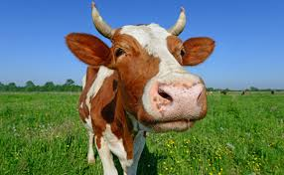
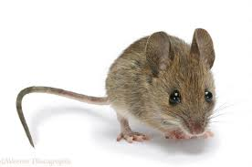


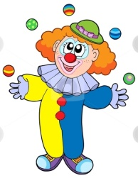

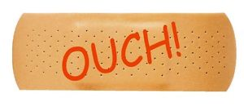
“OW” WORDS
“OU” WORDS

Slide 5
Notes:
Can we put these words into sentences?

Slide 6
Let’s create silly sentences using two or more OU and OW words we have learned!

Slide 7
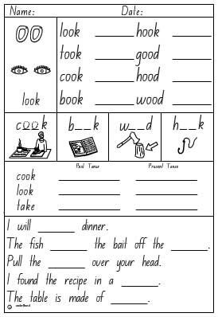
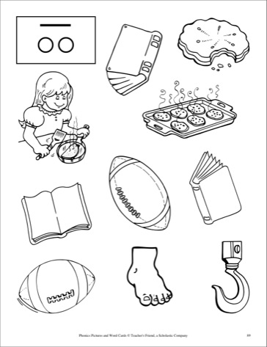
The “OO” family of words-Let’s review

Slide 8
SHOW
AND
TELL

Slide 9
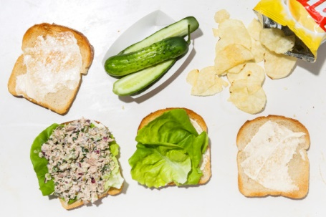
Create an ordered list for this photo:

Slide 10
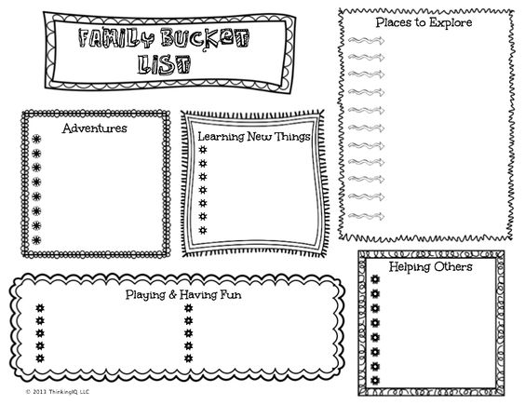
UNORDERED LISTS
Create a family wish list this week!

Slide 11
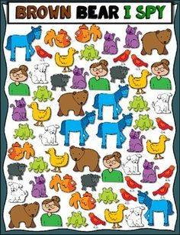
How many ways can you sort these shapes?
______
______
______

Slide 12
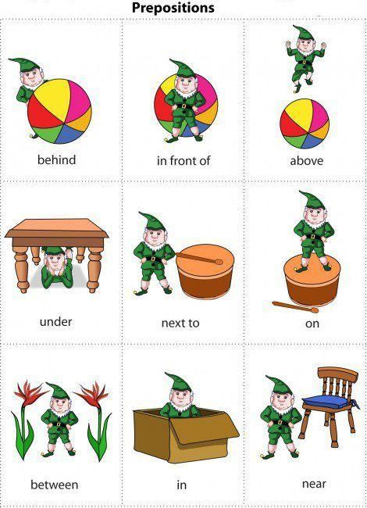
Preposition Scavenger Hunt
Find objects in the next picture that shows each of these prepositions!

Slide 13
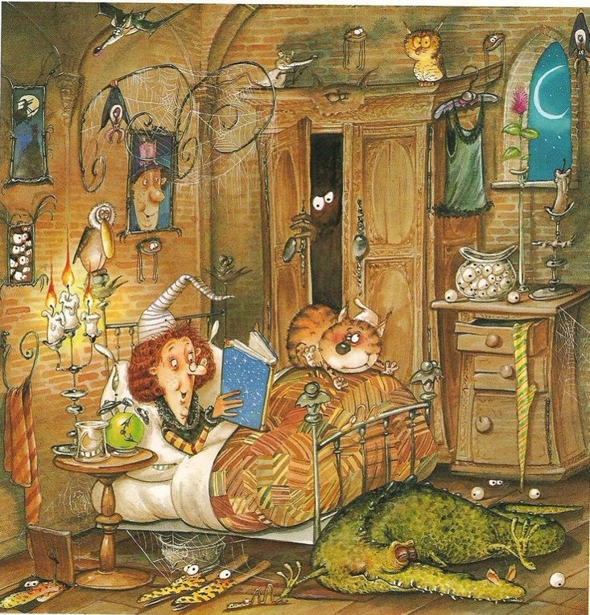
A Witches Bedtime…

Slide 14
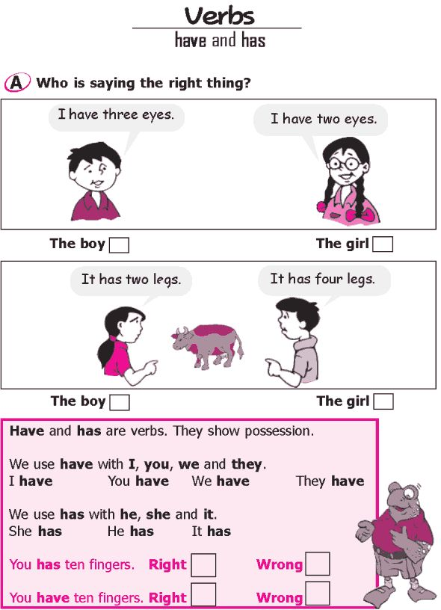
HAVE/HAS
Notes:
Have students play “guess who to ask questions using have/has and this/that?

Slide 15
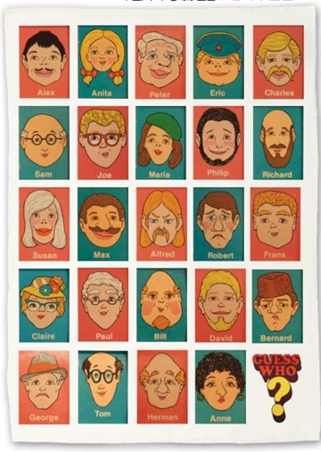
Guess Who?

Slide 16
Homework

