Slide 1


Lesson 8: A REVIEW

Slide 2
Today we are learning to review:
the OU, OW and OO sounds
Ordered and unordered lists
Prepositions
Sorting
Have/Has and This/That

Slide 3
OU and OW Sounds

Slide 4


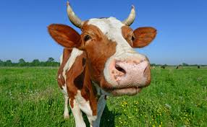
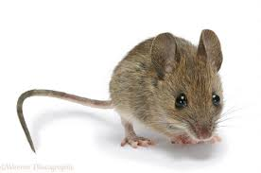


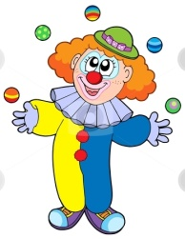


“OW” WORDS
“OU” WORDS

Slide 5
Notes:
Can we put these words into sentences?

Slide 6
Let’s create silly sentences using two or more OU and OW words we have learned!

Slide 7
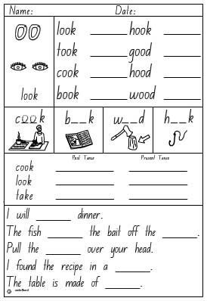
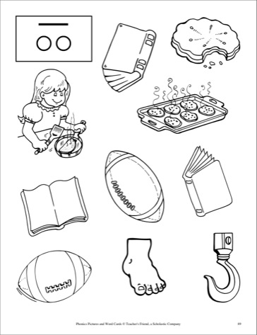
The “OO” family of words-Let’s review

Slide 8
SHOW
AND
TELL
Notes:
SHOW AND TELL: Students can do a show and tell. Have them find an object that they want to discuss and each can share it. Bonus points for students who find an object with the “ow” sound in it. Ex. “bow”

Slide 9
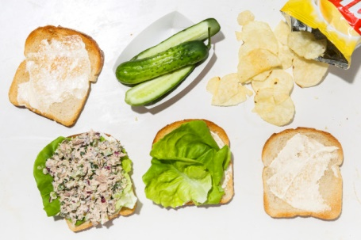
Create an ordered list for this photo:

Slide 10
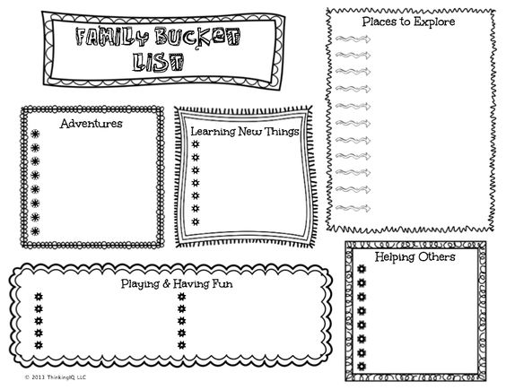
UNORDERED LISTS
Create a family wish list this week!

Slide 11
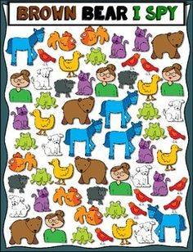
How many ways can you sort these shapes?
______
______
______

Slide 12
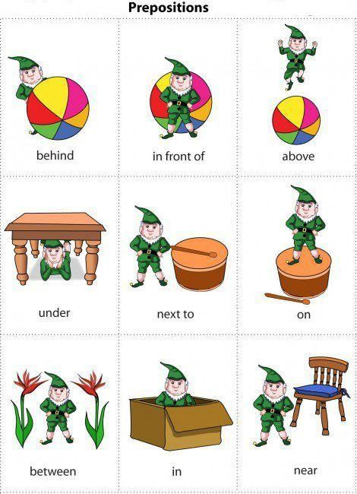
Preposition Scavenger Hunt
Find objects in the next picture that shows each of these prepositions!

Slide 13
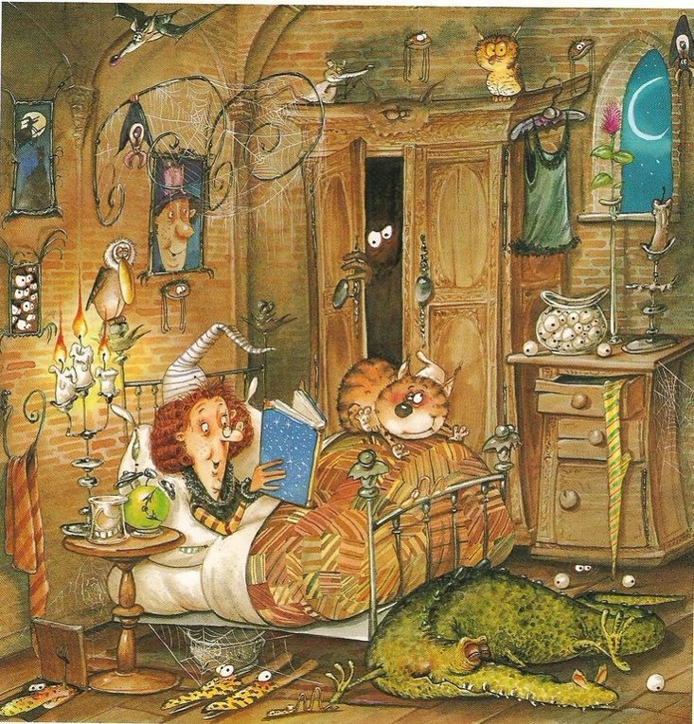
A Witches Bedtime…

Slide 14
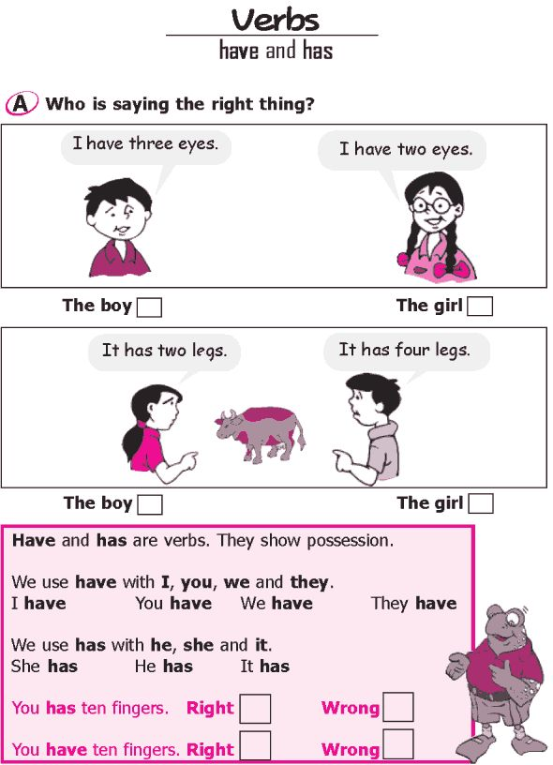
HAVE/HAS
Notes:
Have students play “guess who to ask questions using have/has and this/that?

Slide 15
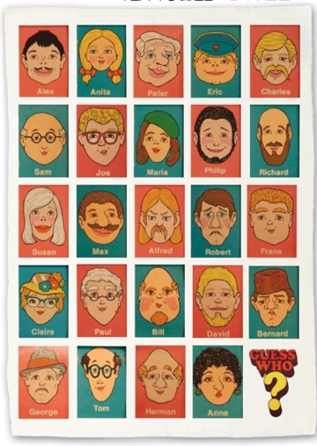
Guess Who?

Slide 16
Homework

