Slide 1
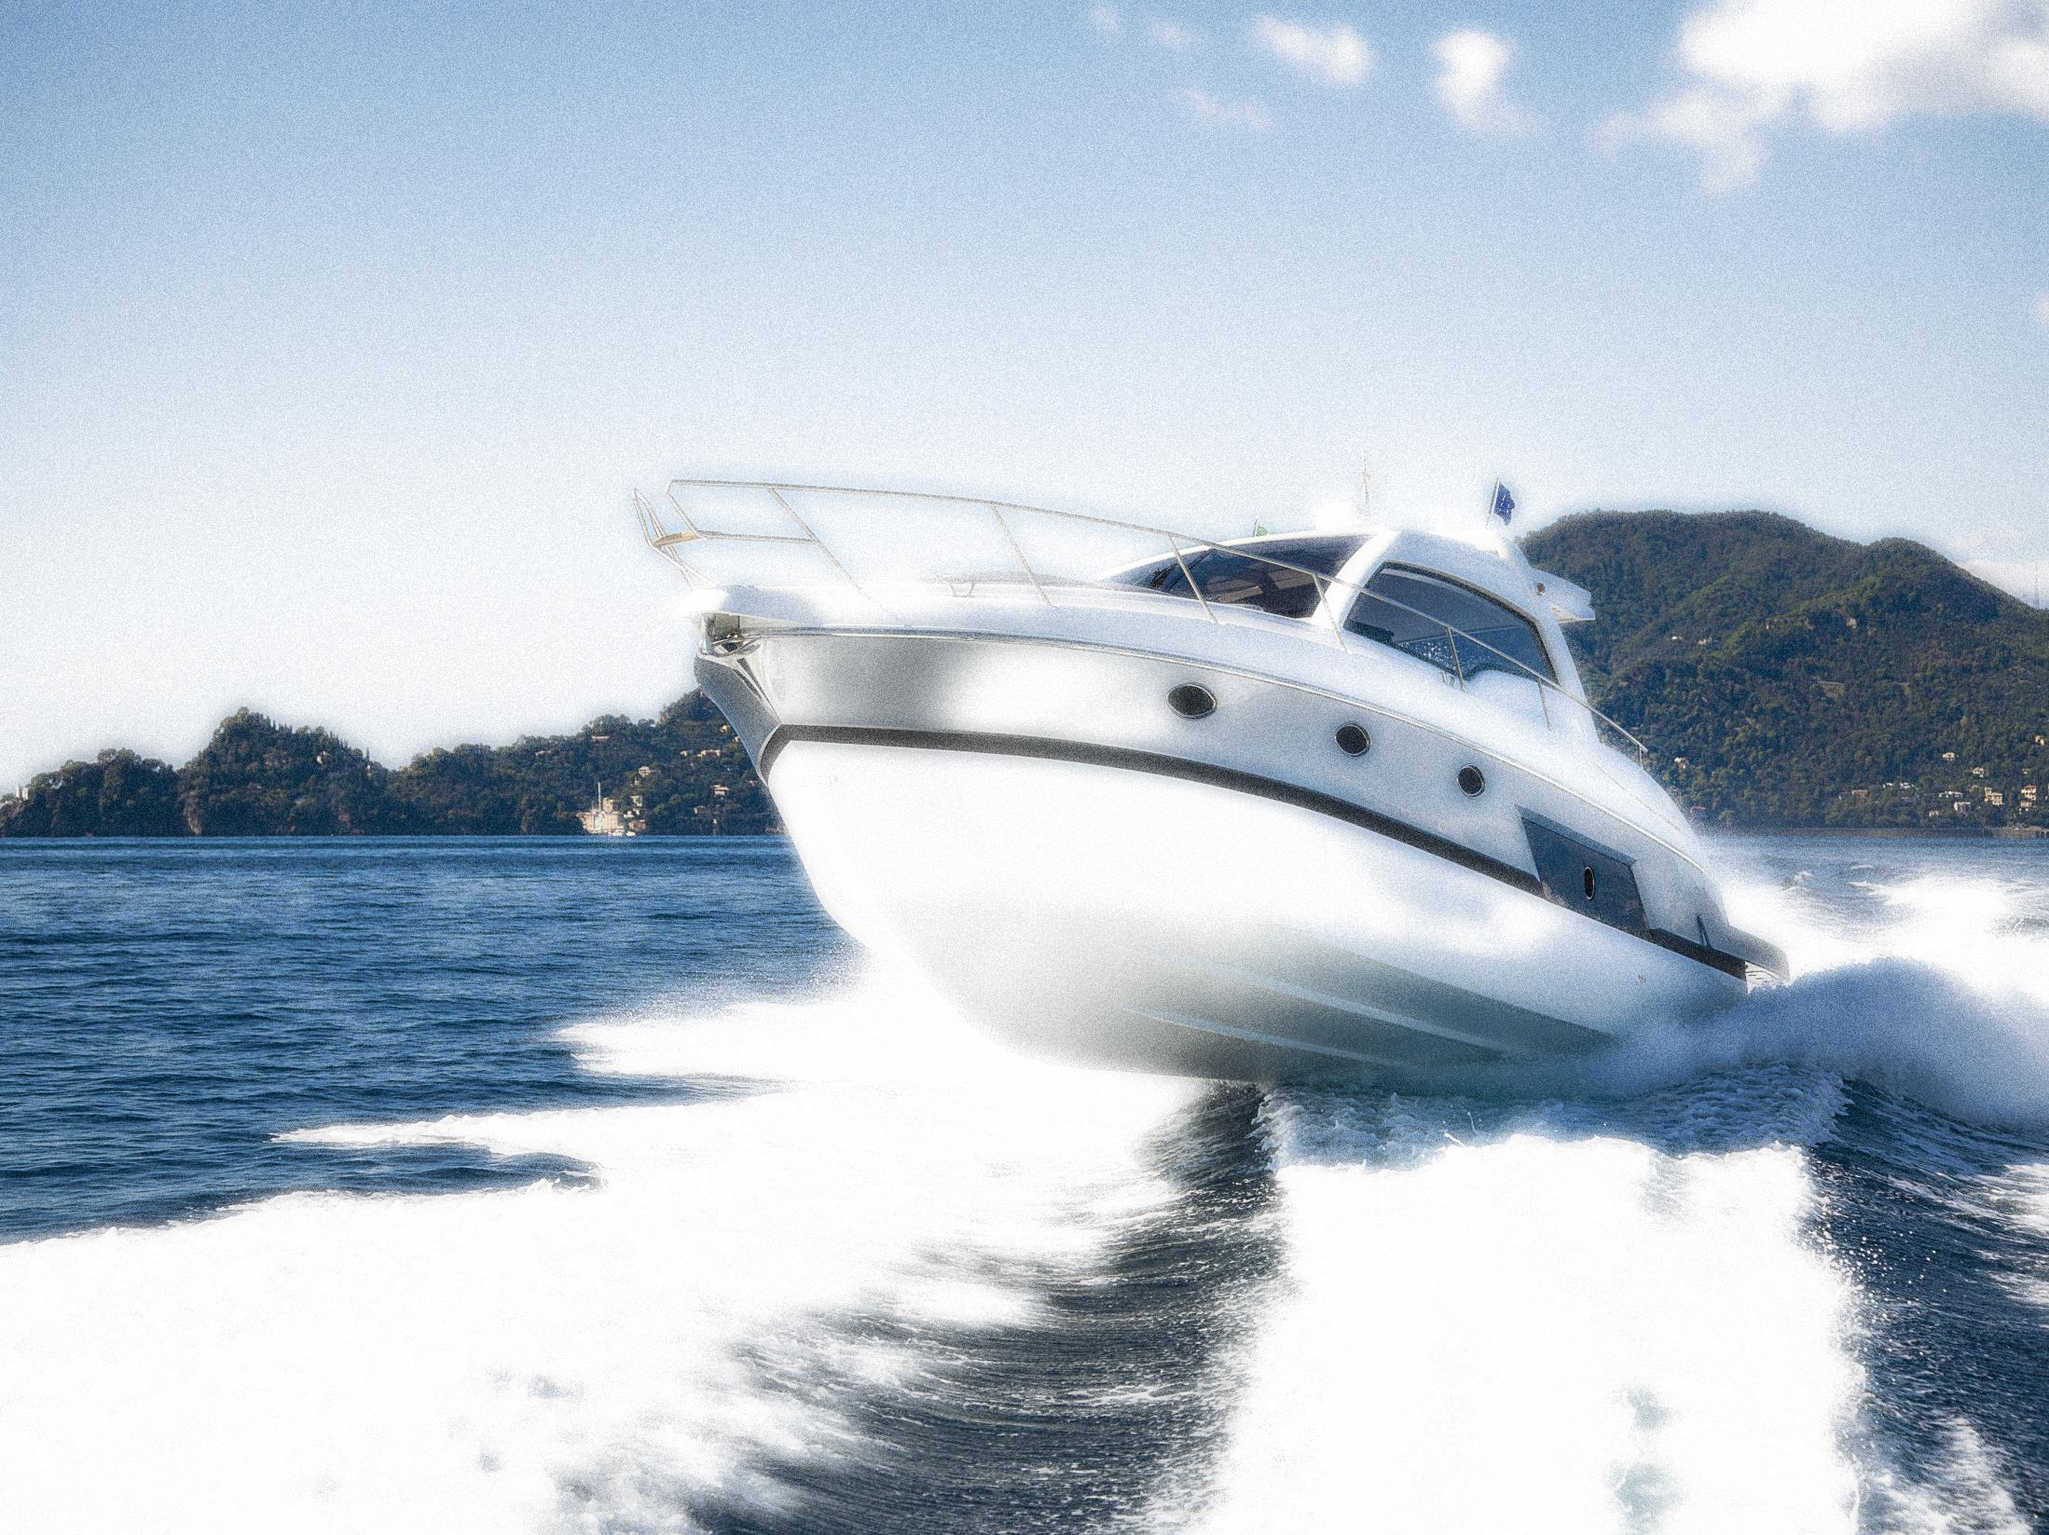
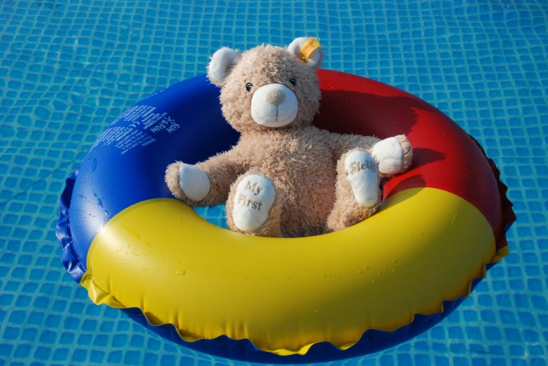
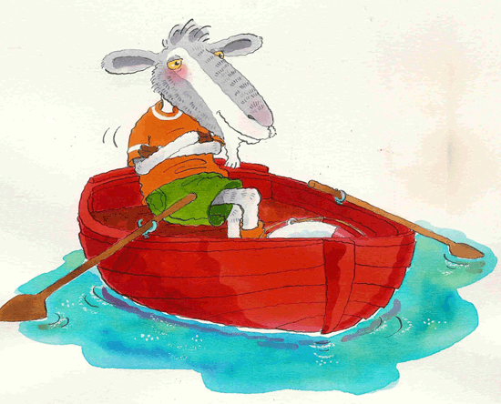
Safety in the Water
Lesson 9
The “OA” sound
Directions: This, that, these, those
Prepositions: Opposites, near, far

Slide 2
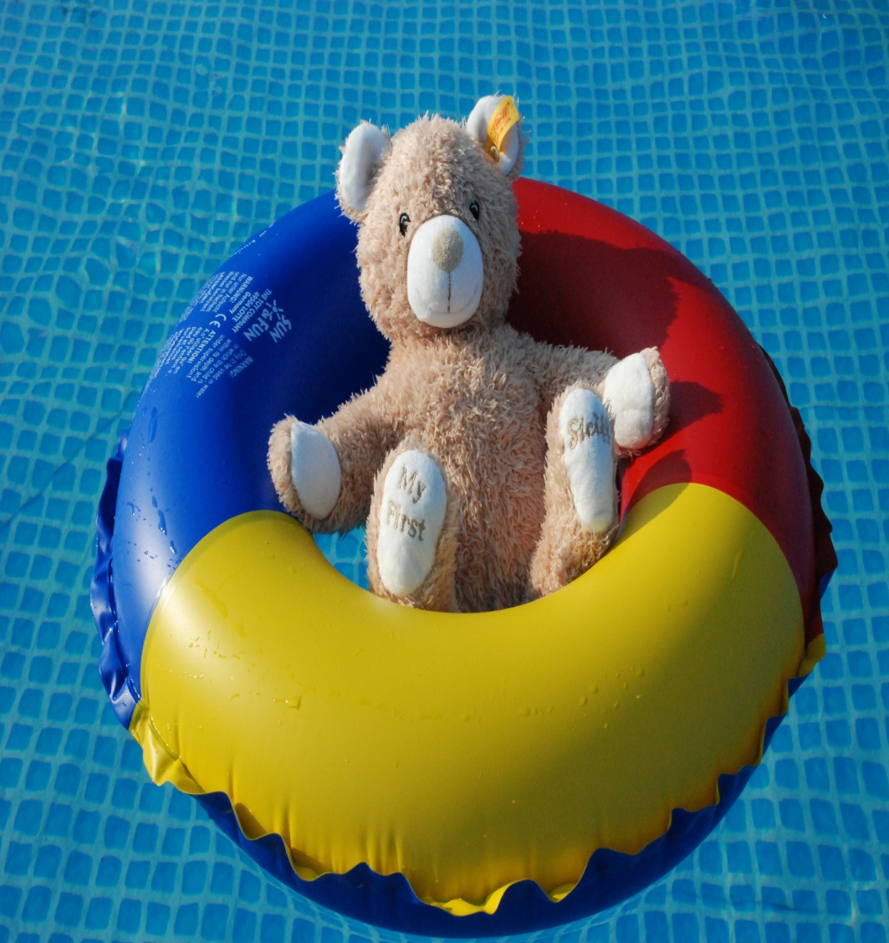
We Will be Learning
1.) The “oa” sound
2.) Directions: this, that, these, those
3.) Prepositions: opposite and near
4.) Health and safety: Water safety

Slide 3
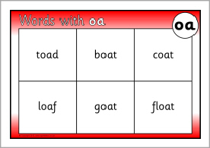
The “OA” Sound

Slide 4
“OA” Let’s Practice

Slide 6
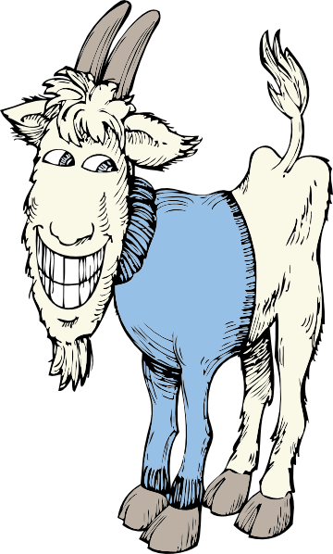
Some silly rhymes

Slide 7
Could you? Would you? With a goat? Could you? Would you? On a boat?

Slide 8
How might you ask for the apple?

Slide 10
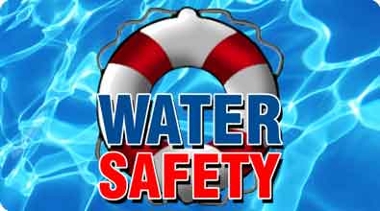

Slide 11
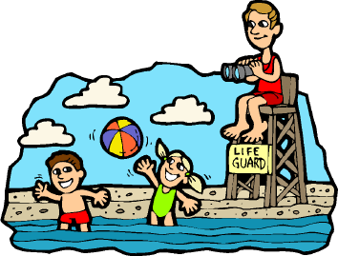
When it’s super hot outside, you cool off in the water. But let’s go over some water safety rules before you jump in!

Slide 12
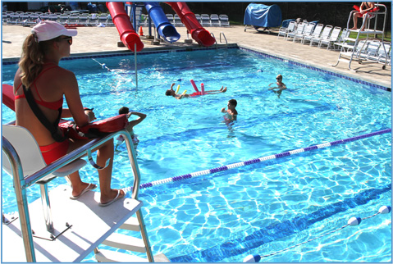
First, you should always check to be sure that there is a lifeguard on duty. Next, you need a swimming buddy. If you are in trouble, he can tell the lifeguard.

Slide 13
When you are at the pool you can only dive in water that is deep enough and you should never run.

Slide 14
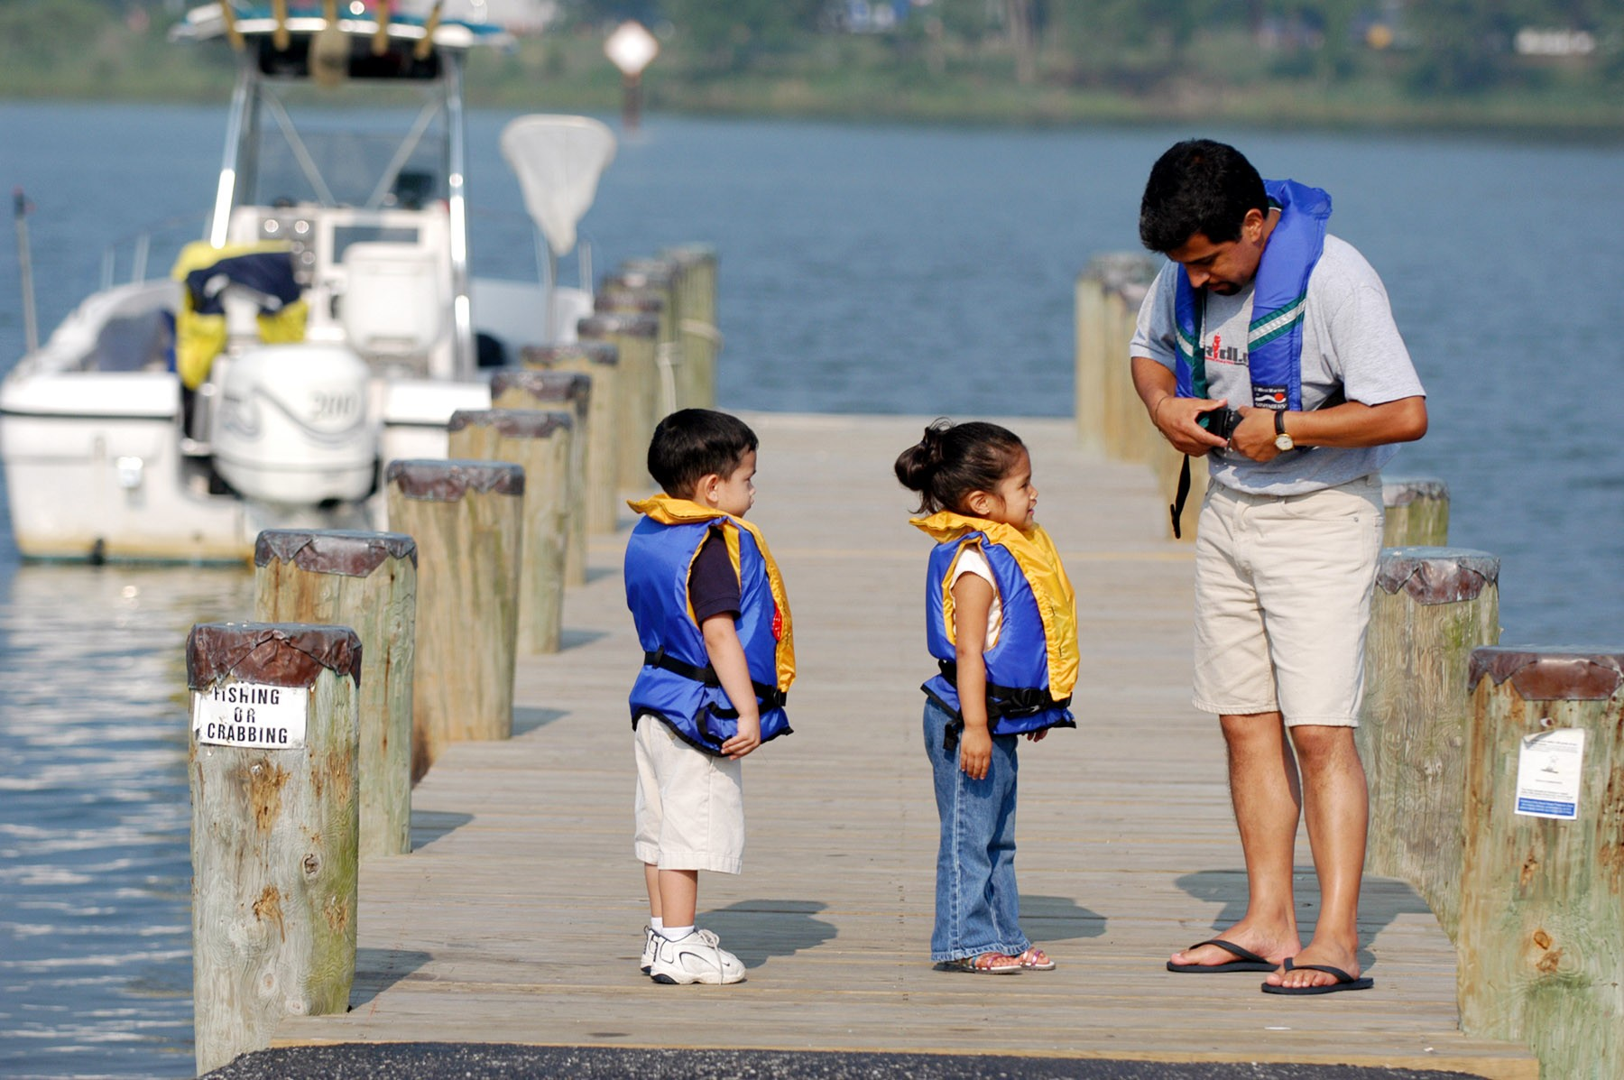
Boat safety is a little bit different. Everybody needs a life jacket and you must stay seated while the boat is moving.

Slide 15
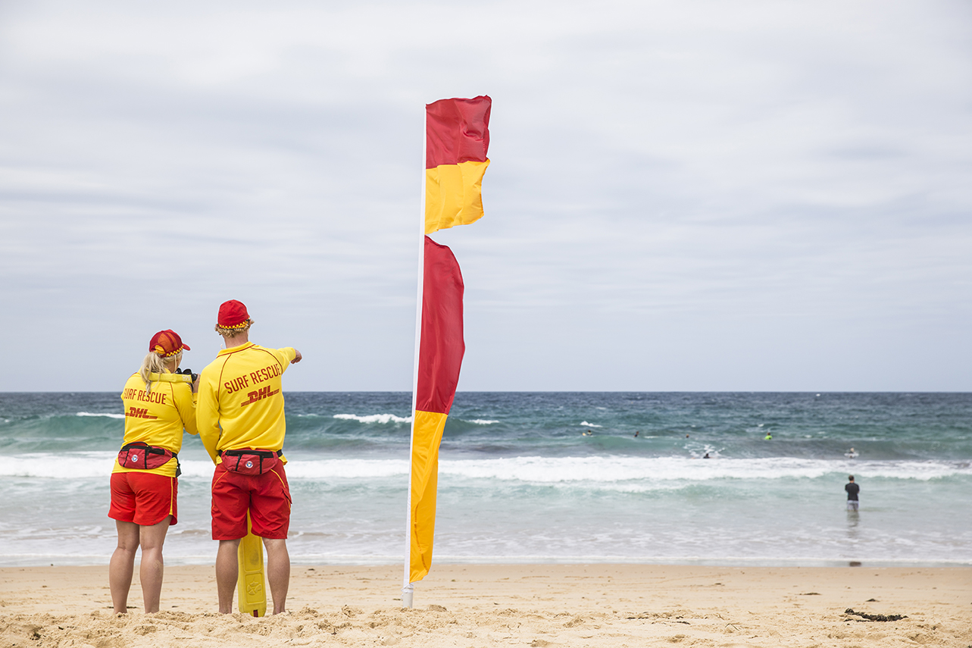
The Ocean has waves, currents, and animals. Flags show when it is unsafe to enter the water.

Slide 16
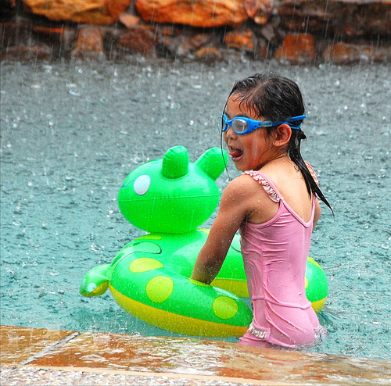
Uh-oh! A storm! Never swim when there is lightening. It is very dangerous.

Slide 17
Ah, safe and dry! Swimming is fun, just be sure to do it safely!

Slide 18
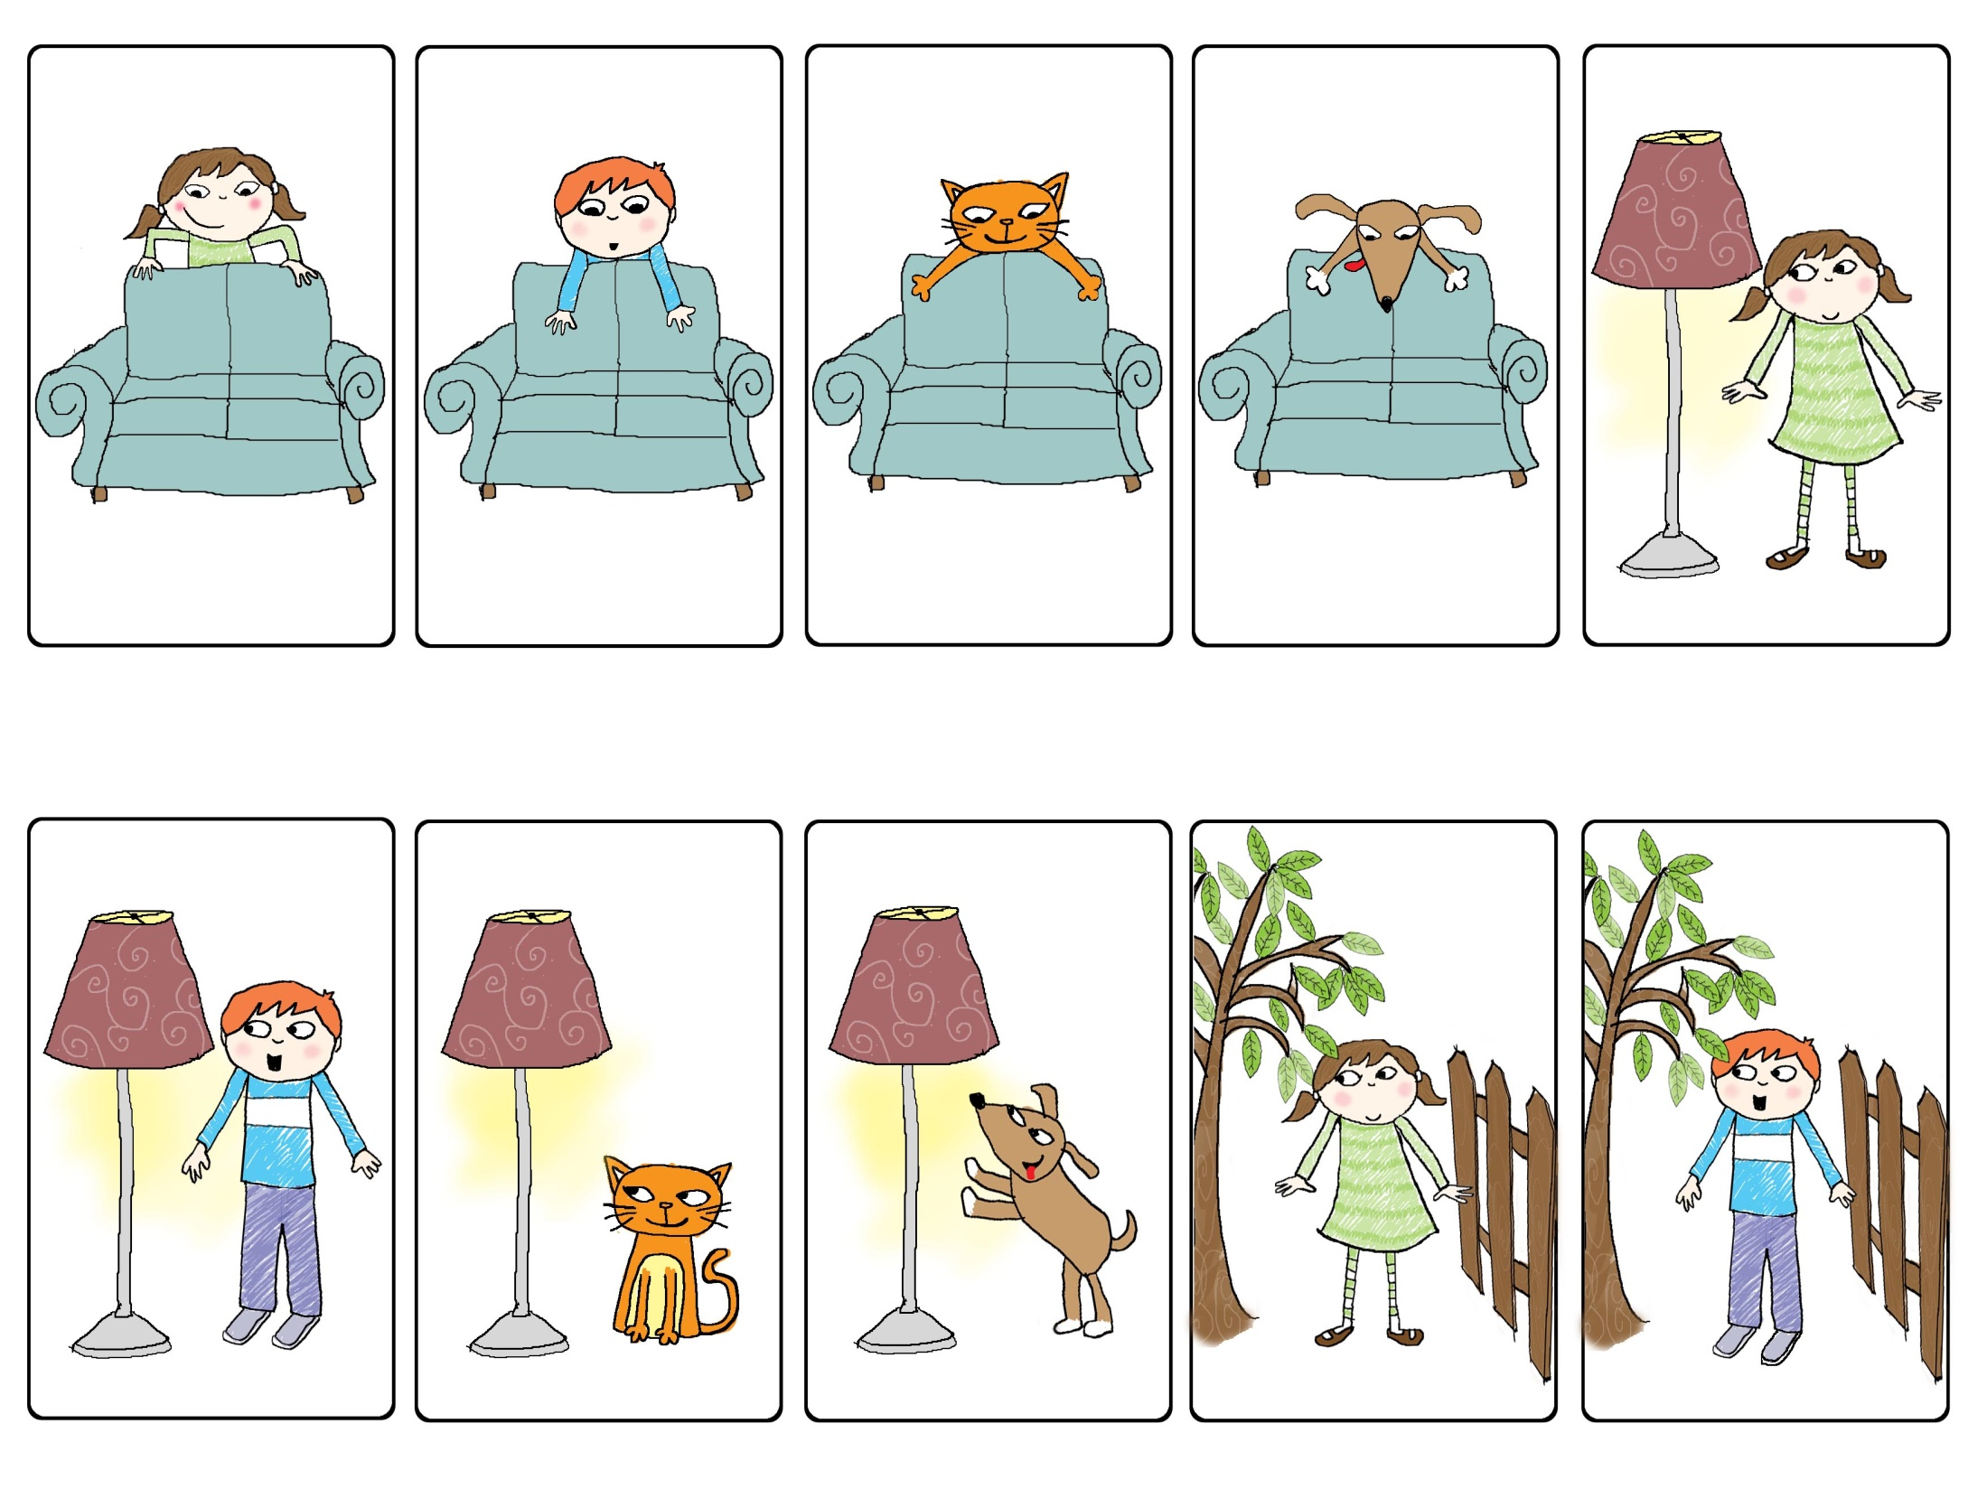
Notes:
.

Slide 19
Notes:
.

Slide 21
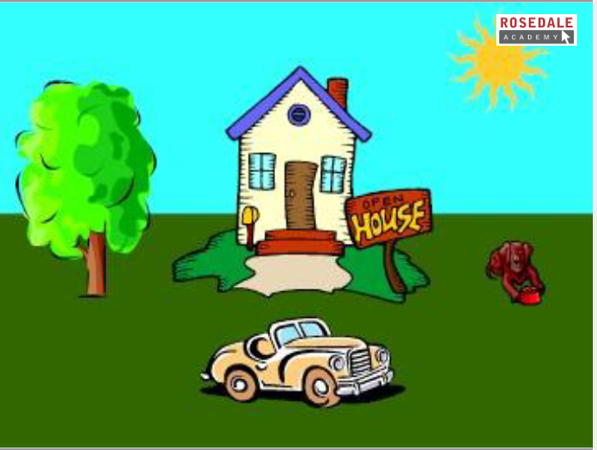
Notes:
.

Slide 22
Let’s Review!
1.) The “oa” sound
2.) Directions: this, that, these, those
3.) Prepositions: opposite and near
4.) Health and safety: Water safety

