Slide 1
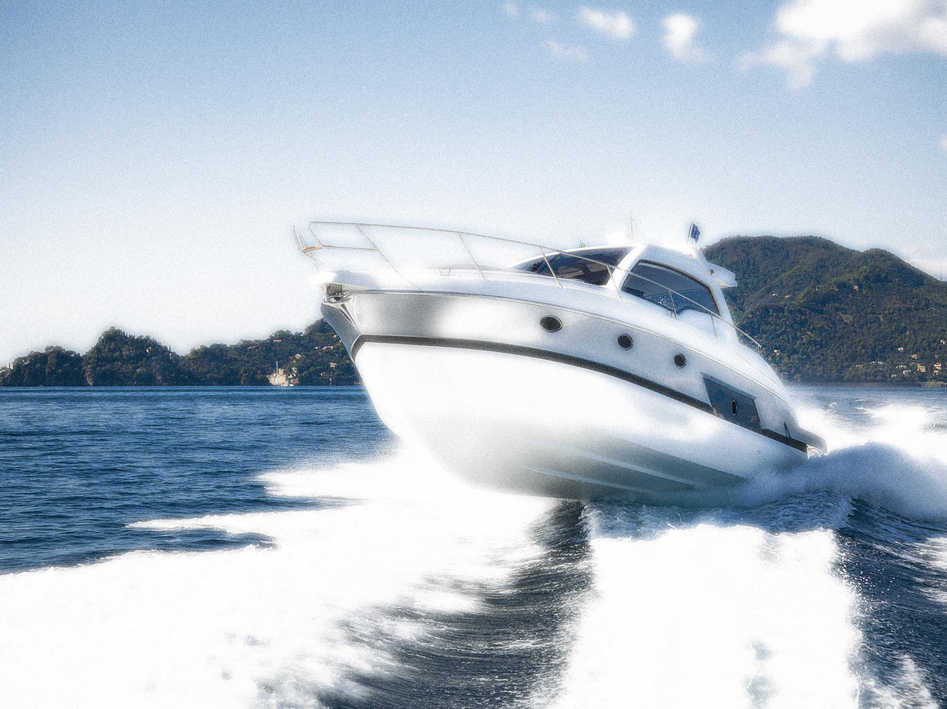
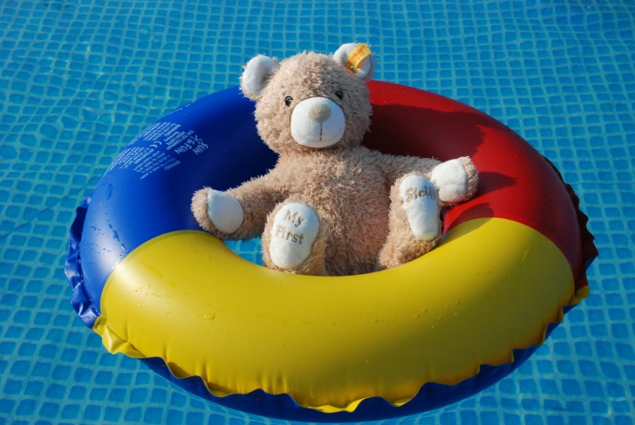
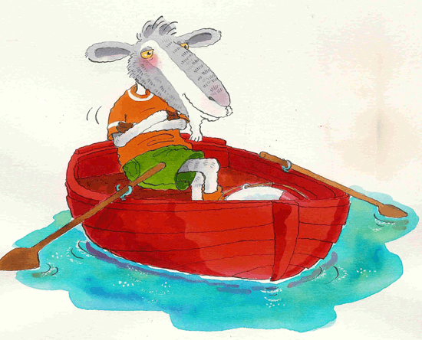
Safety in the Water
Lesson 9
The “OA” sound
Directions: This, that, these, those
Prepositions: Opposites, near, far

Slide 2
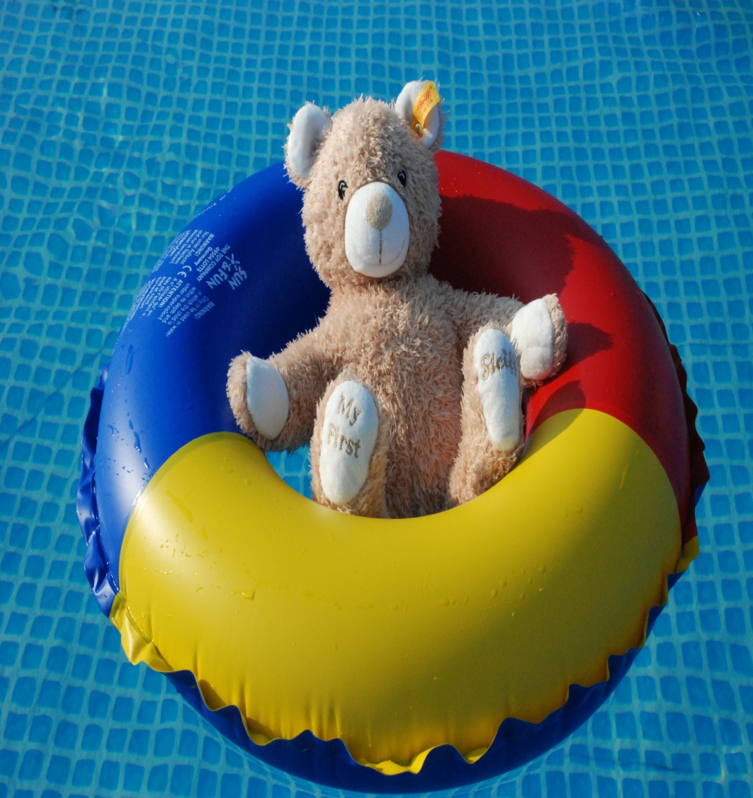
We Will be Learning
1.) The “oa” sound
2.) Directions: this, that, these, those
3.) Prepositions: opposite and near
4.) Health and safety: Water safety

Slide 3
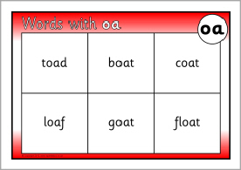
The “OA” Sound

Slide 4
“OA” Let’s Practice

Slide 5
Notes:
Have students try to make up their own “oa” jingles using the same tune and a different “oa” word. How many words can they think of?

Slide 6
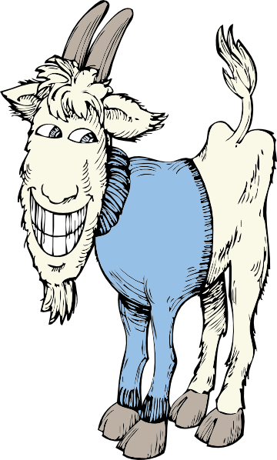
Some silly rhymes
Notes:
Have students come up with their own silly rhymes and visualize what they might look like.

Slide 7
Could you? Would you? With a goat? Could you? Would you? On a boat?

Slide 8
How might you ask for the apple?
Notes:
Ask students to gather various objects in their homes. Now have them ask each other for specific objects for example: “Can you please go get those pencils over there?”..

Slide 9
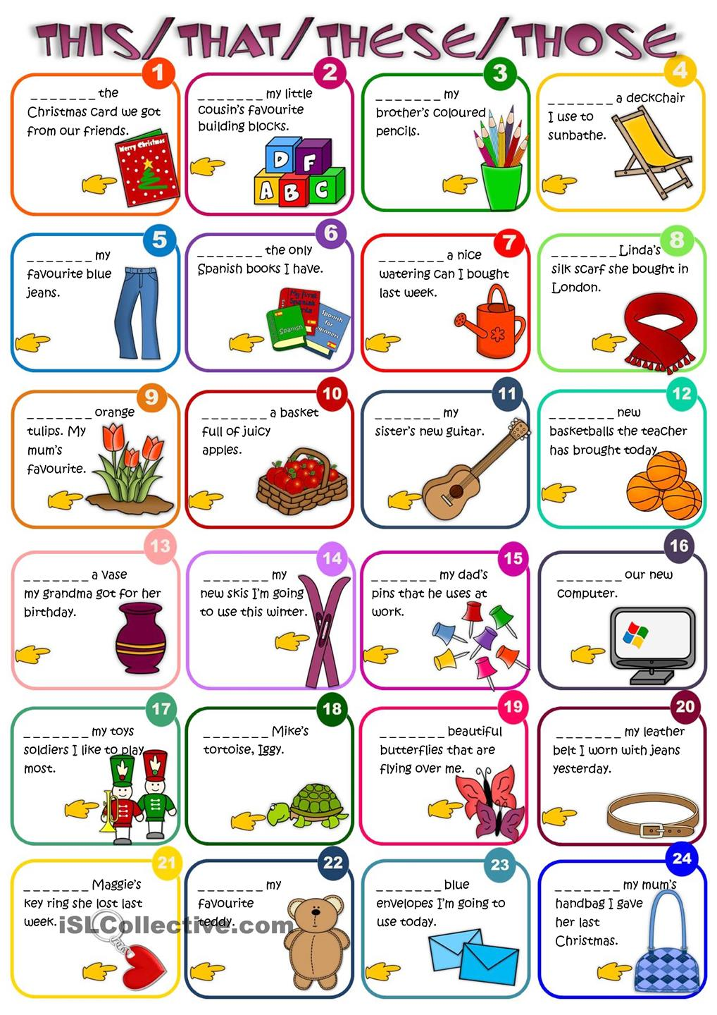
Notes:
Read the book about water safety and ask demonstrative questions to students as you read.

Slide 11
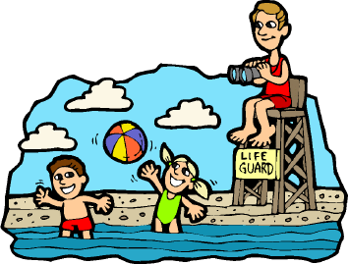
When it’s super hot outside, you cool off in the water. But let’s go over some water safety rules before you jump in!

Slide 12
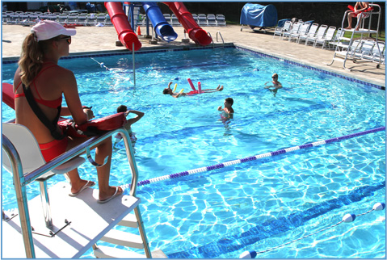
First, you should always check to be sure that there is a lifeguard on duty. Next, you need a swimming buddy. If you are in trouble, he can tell the lifeguard.

Slide 13
When you are at the pool you can only dive in water that is deep enough and you should never run.

Slide 14
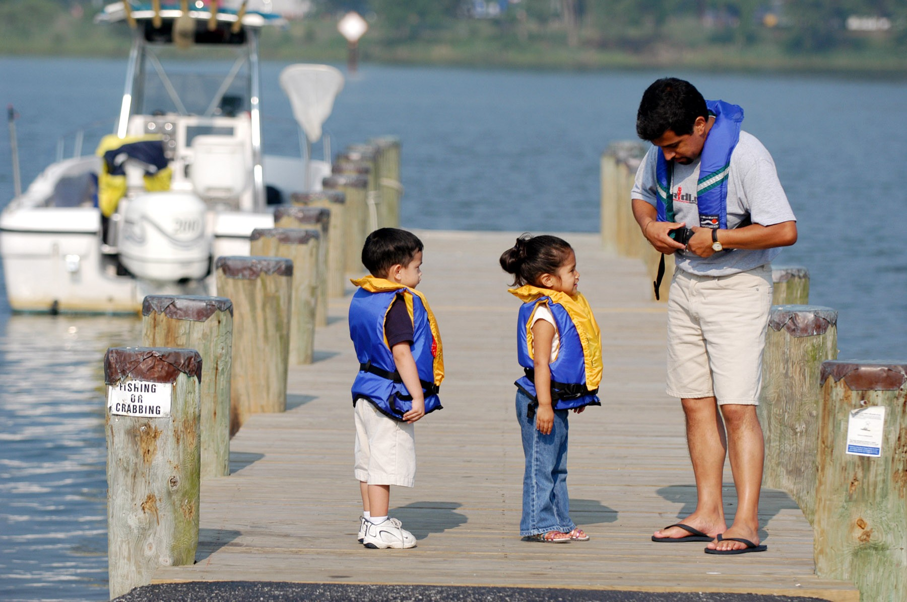
Boat safety is a little bit different. Everybody needs a life jacket and you must stay seated while the boat is moving.

Slide 15
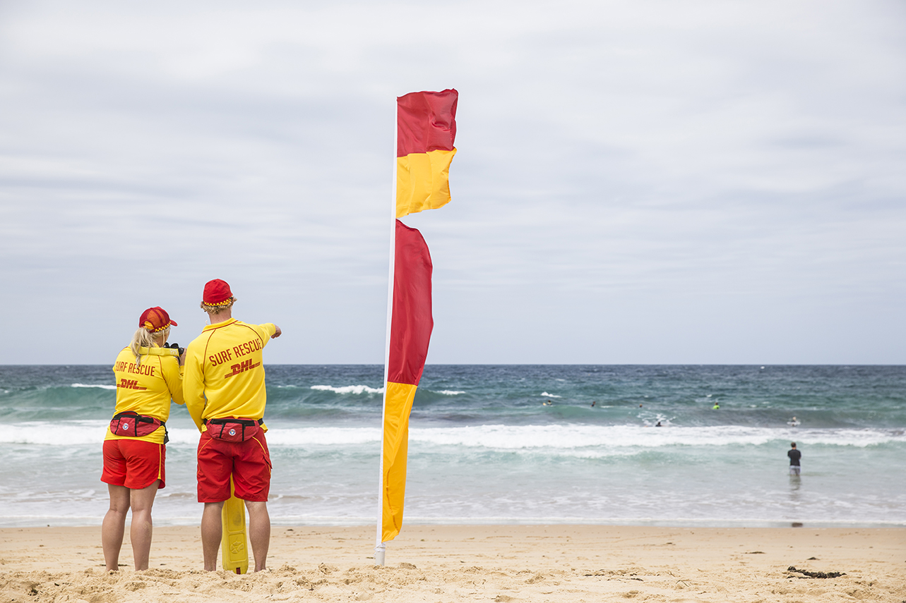
The Ocean has waves, currents, and animals. Flags show when it is unsafe to enter the water.

Slide 16
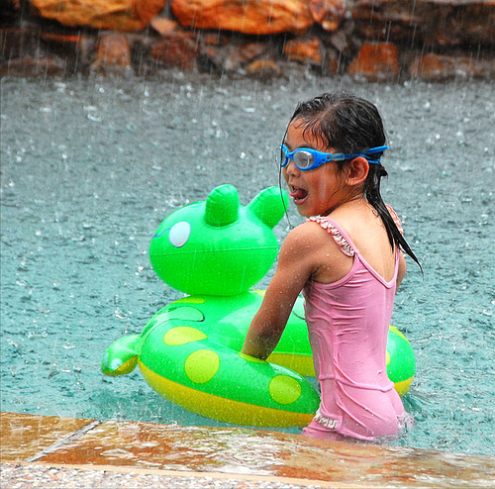
Uh-oh! A storm! Never swim when there is lightening. It is very dangerous.

Slide 17
Ah, safe and dry! Swimming is fun, just be sure to do it safely!

Slide 18
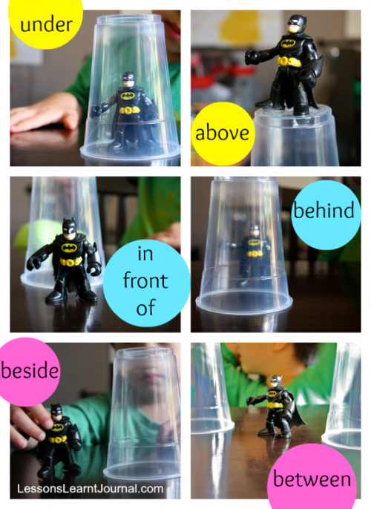
Prepositions

Slide 19
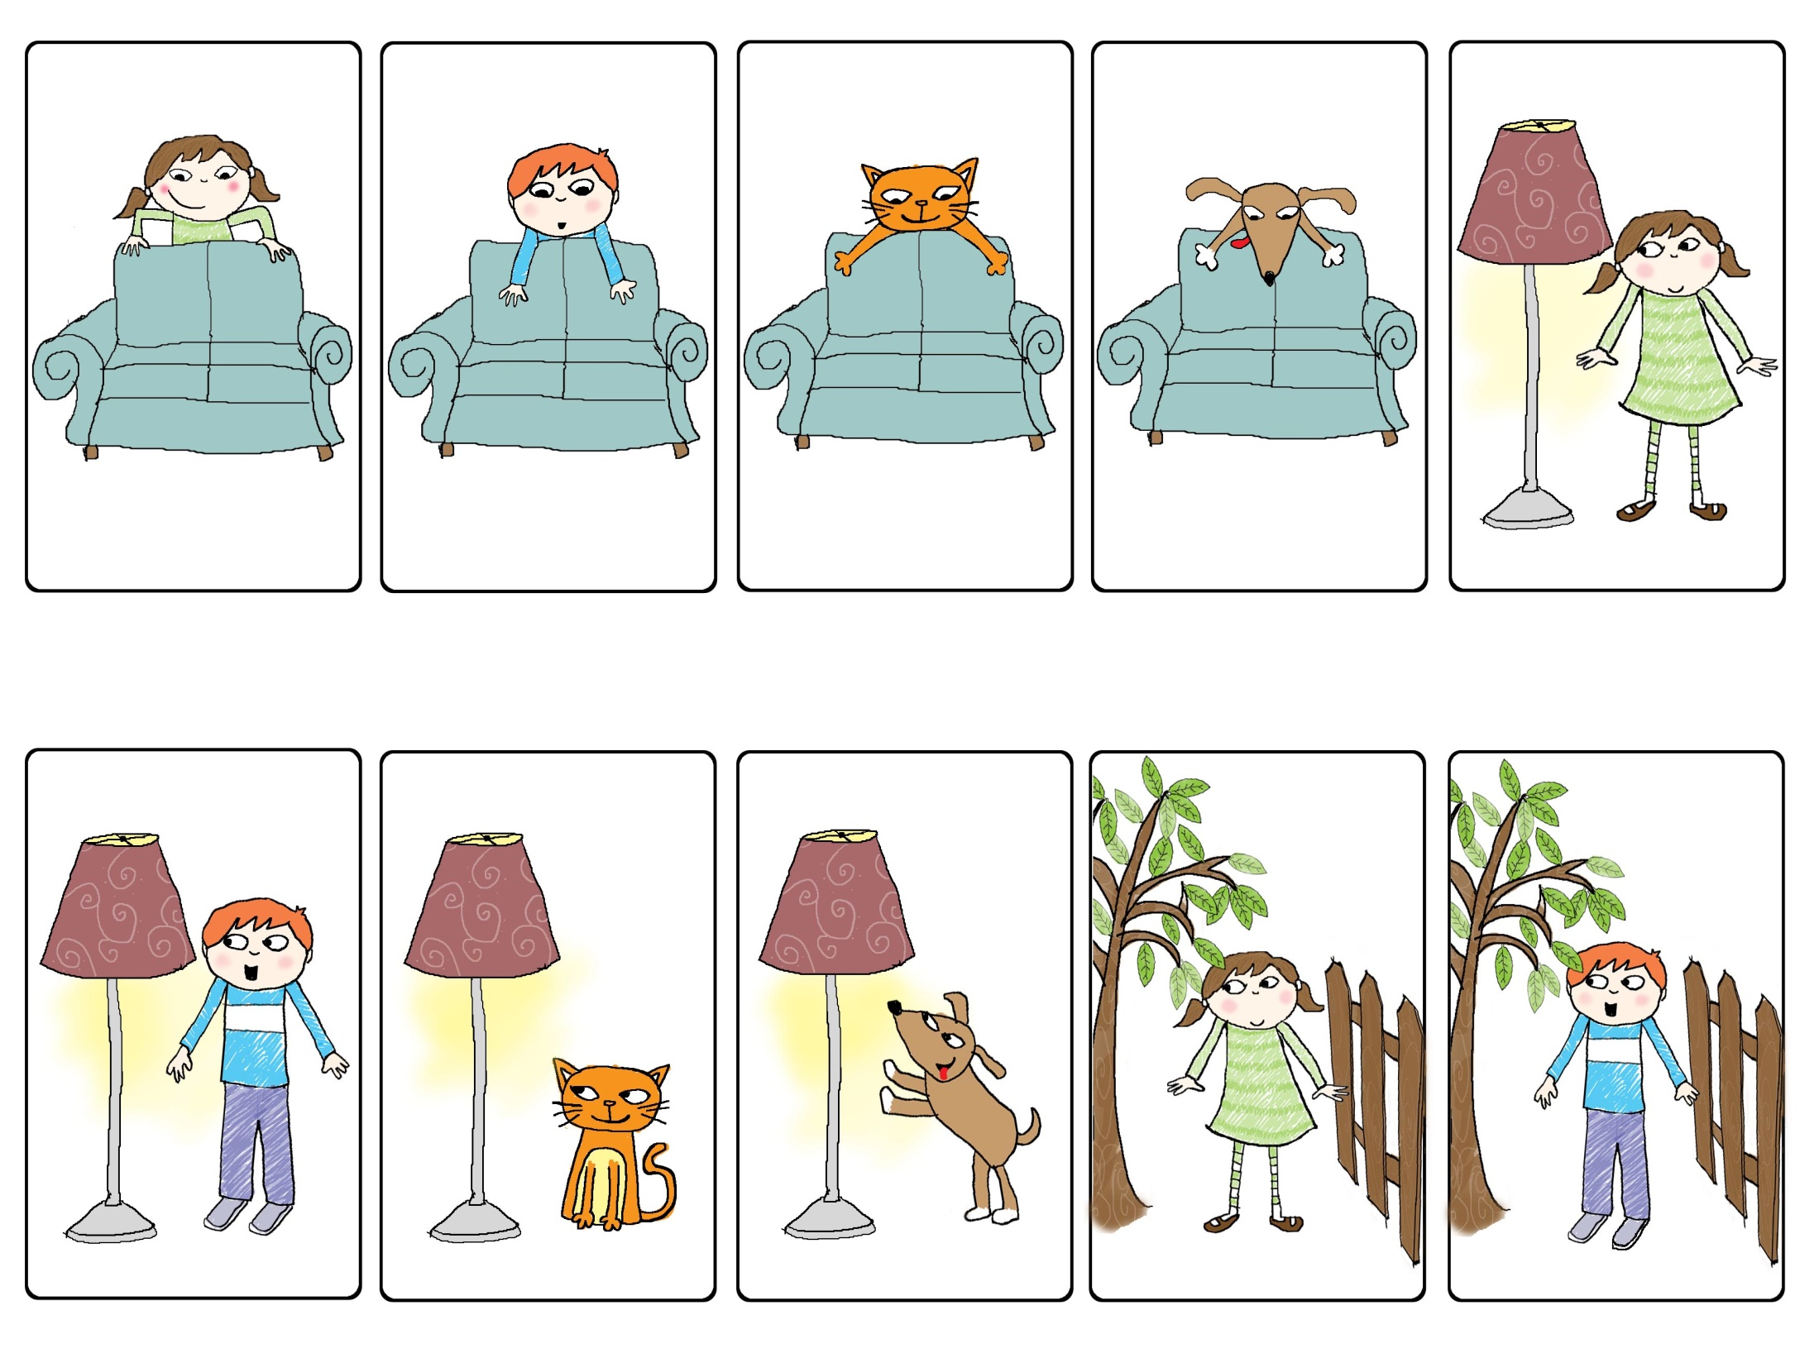
Notes:
Let’s describe the pictures. Where do you see the cat, dog, girl and boy? Review the prepositions that we’ve already learned.

Slide 21
Notes:
Let’s look at some new prepositions.

Slide 22
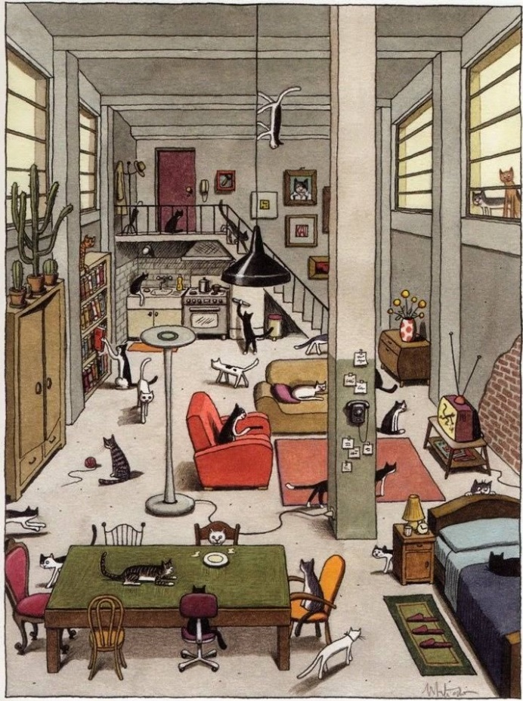
Let’s Practice

Slide 23
Let’s Review!
1.) The “oa” sound
2.) Directions: this, that, these, those
3.) Prepositions: opposite and near
4.) Health and safety: Water safety

