Slide 1



Keeping In Shape
Unit 6: Lesson 1

Slide 2


What will we be learning about?
“OY” Sounds
Predicting events – before or after a picture
Describing events using the five senses

Slide 3

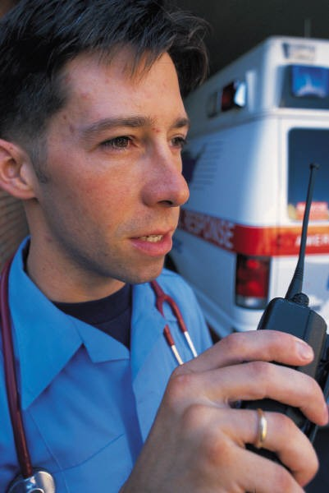
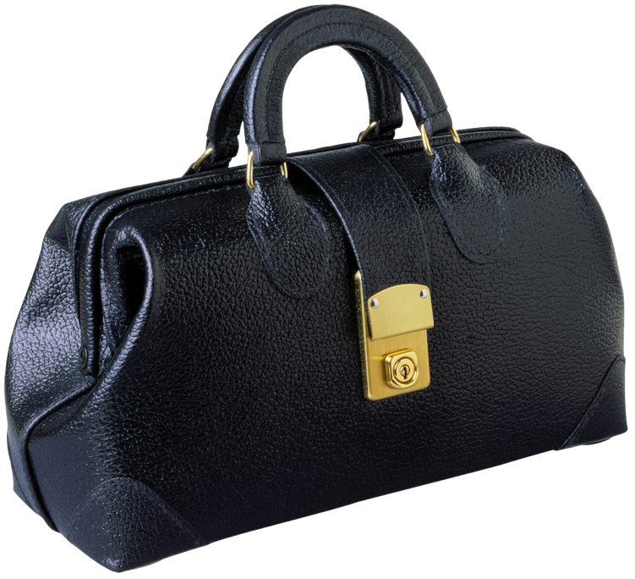

“OY” SOUNDS
“OY” Words
TOY BOY JOY LOYAL
VOYAGE
OYSTER EMPLOY

Slide 4
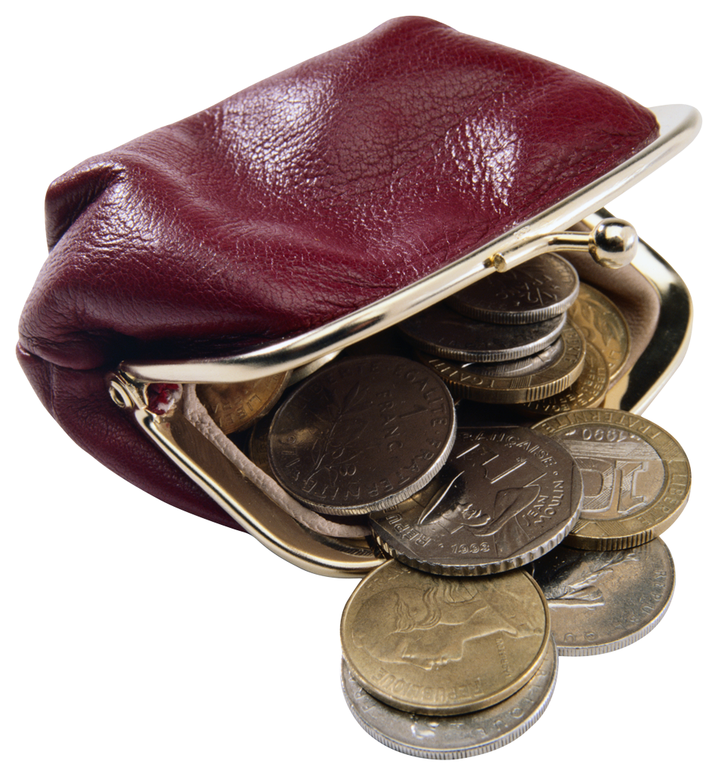
“OI” Words
COIN COIL OIL POISON POINT TOILET
What do you notice about “OY” and “OI” words?
Do they sound the same?

Slide 5

Let’s brainstorm some “OY” and “OI” words.
What can you think of? Write them in the box below.

Slide 6

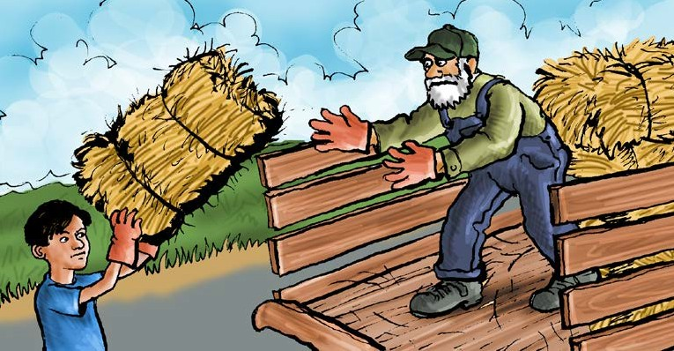



Let’s read a book! Look out for “OY” sounds!
Toys for Boys
A Reading A–Z Decodable Book • Word Count: 234
Visit www.readinga-z.com for thousands of books and materials.

Slide 7
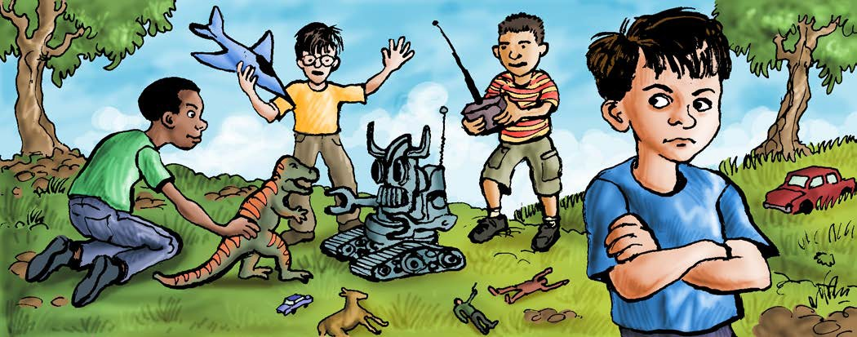
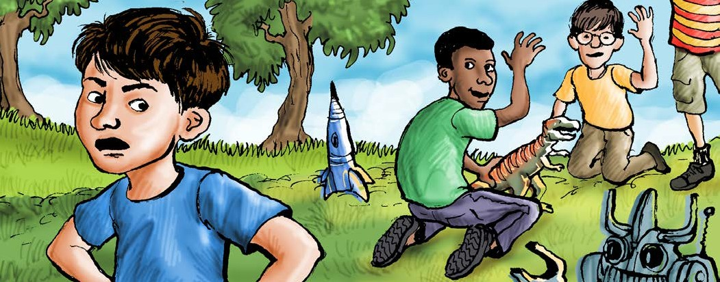
Most boys like to play with toys. But not Roy.
He was the only boy with no toys.
Toys for Boys • Dipthong /oi/
3
Roy thought toys made too much noise. He thought they cost too much.
He did not see any point in playing with toys.
4

Slide 8
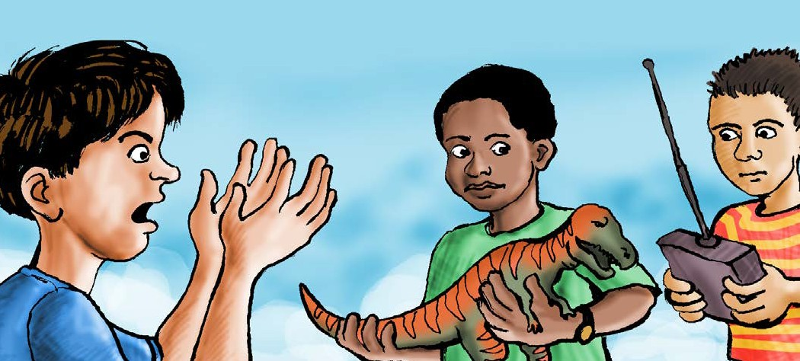
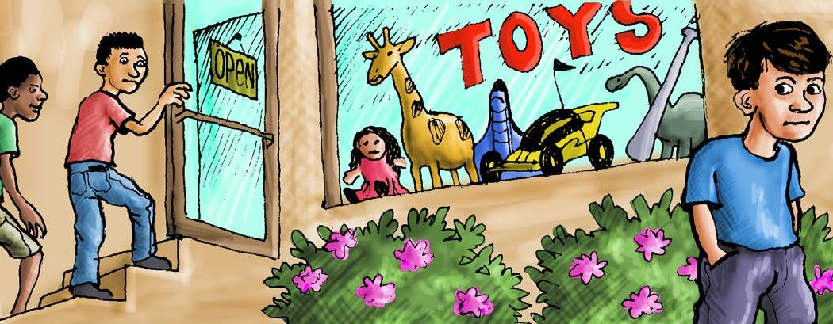
Roy saw no joy in playing with toys.
He thought only spoiled boys play with toys.
Toys for Boys • Dipthong /oi/
5
The real truth was that Roy did not have time to play with toys.
He had no time or cash to go to the toy shop.
6

Slide 9
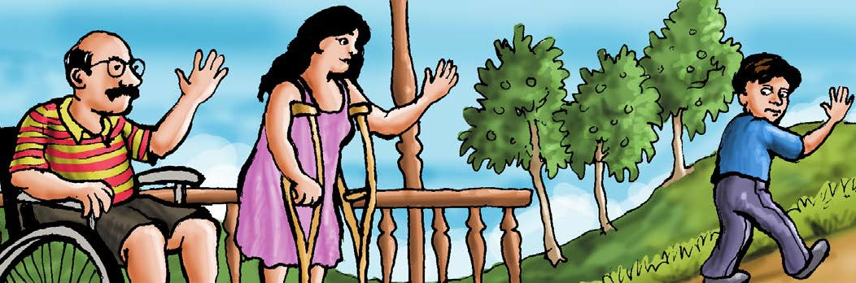
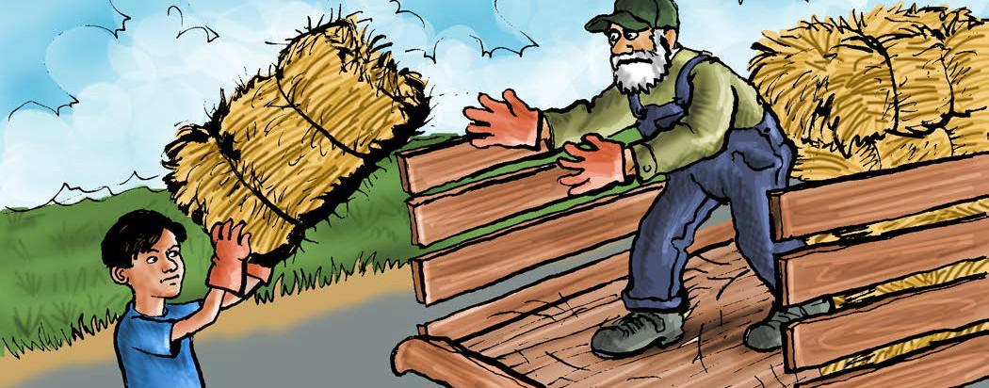
Roy had to help his mom and dad. They were not well.
They had problems with their leg joints. Roy had jobs to help pay the bills.
Toys for Boys • Dipthong /oi/
7
Roy helped hoist hay onto a truck. Roy helped dig holes in the soil.
Roy was a strong boy.
8

Slide 10
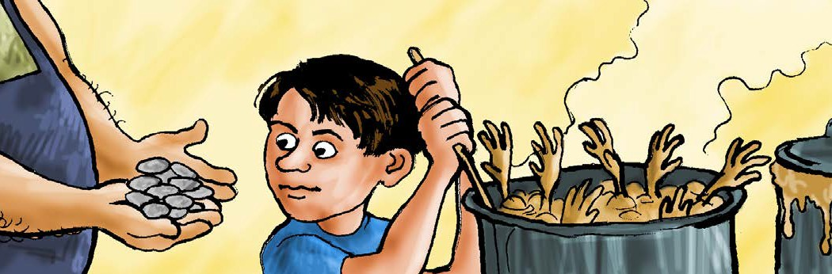
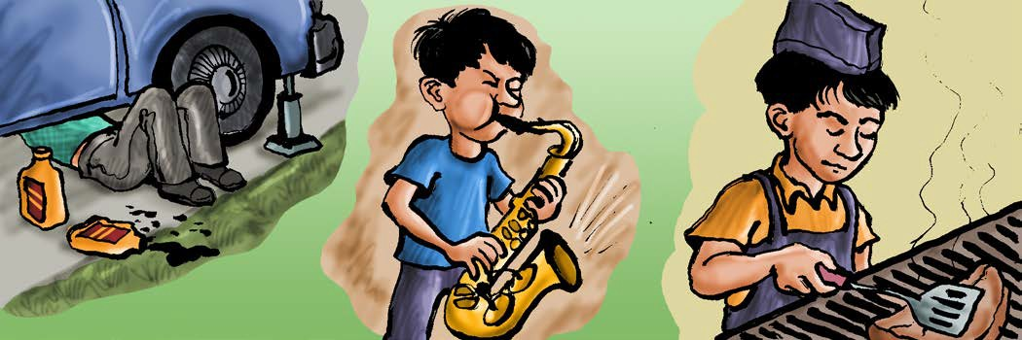
He also helped at a lunch joint.
He boiled soup and cleaned soiled dishes. They paid him with lots of coins.
Roy gave the coins to his mom and dad.
Toys for Boys • Dipthong /oi/
9
Roy also put oil in cars.
He played his sax for cash, too. Everyone loved the noise his sax made. Roy toiled all day long.
10

Slide 11
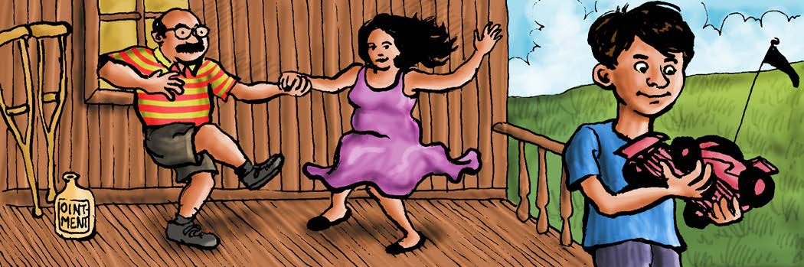
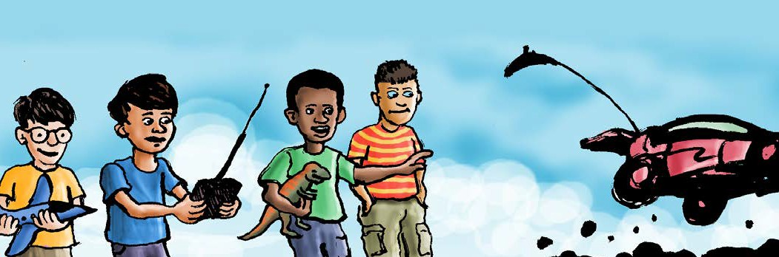
In time, Roy’s mom and dad got well. Now Roy only went to one job.
He used the coins he was paid to get new toys.
Toys for Boys • Dipthong /oi/
11
Roy and the other boys played with Roy’s new toys.
Now Roy could see the point of toys. They were not for spoiled boys.
12

Slide 12


What OY words did you see?
Do you think Roy was a good son or bad son?
Why?

Slide 13




What are some activities Roy did that would keep him in shape?
What could the boys do instead of playing with toys?
What would keep them active and in shape?
Use the photos to help you!

Slide 14
Predicting what will happen before and after
What does predicting mean?
How does this help us when we read a story?

Slide 15


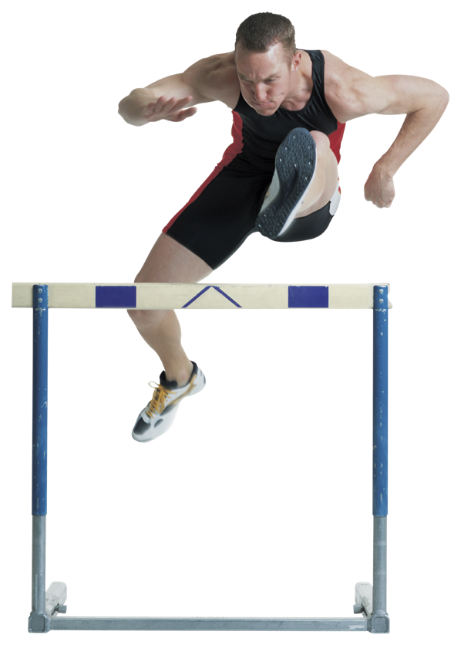
Let’s discuss!
What do you think happened before these pictures? What do you think happened after these pictures?

Slide 16
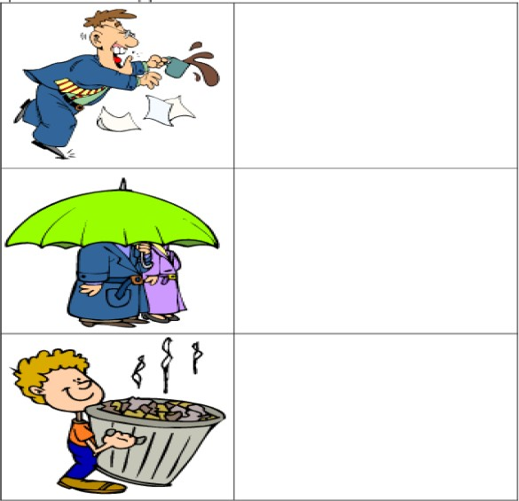
Look at the pictures. What do you think will Happen next? Draw it!

Slide 17





Slide 19



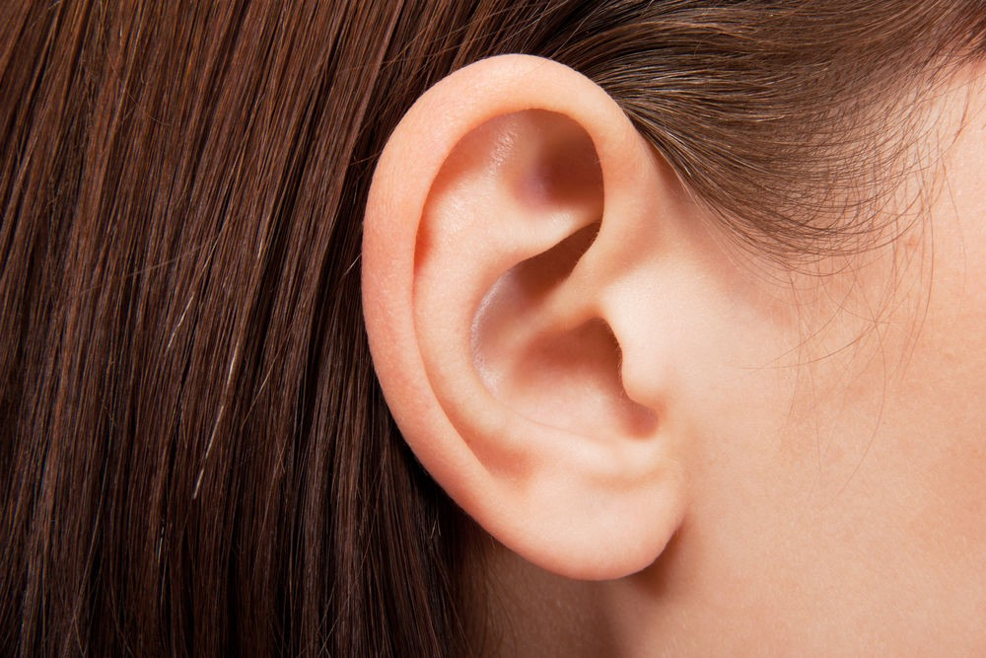

What are the five senses?

Slide 20


You are right! The five senses are:
Sight Smell Touch Taste Hear

Slide 21


Describe what you would experience with your five senses when you walk into a grocery store.
What would you smell? What would you hear? What would you feel?
Could you taste?
What would you see?

Slide 22
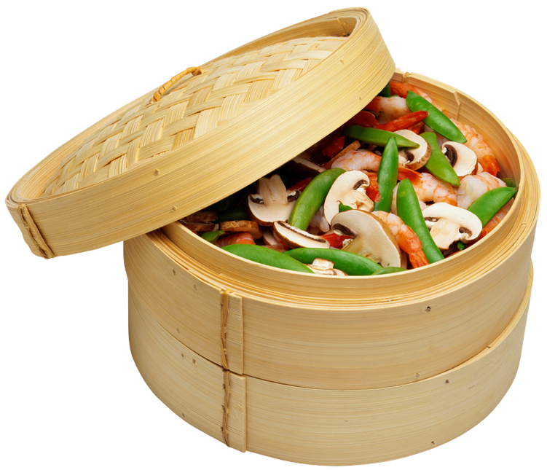
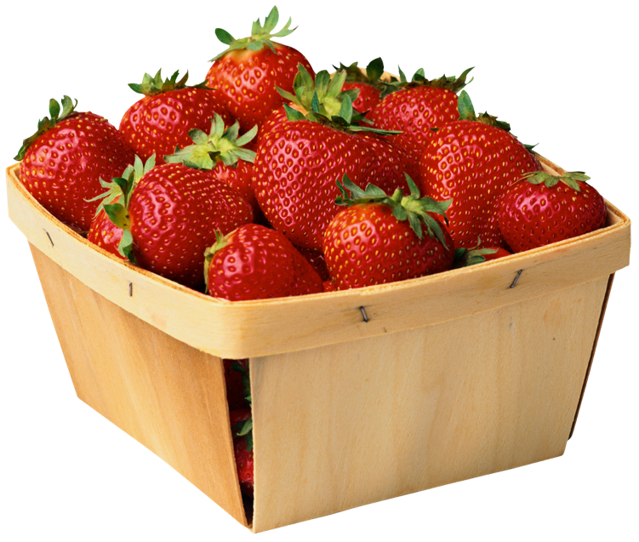
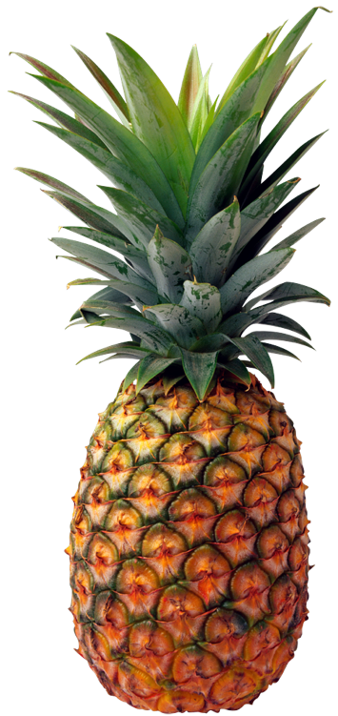
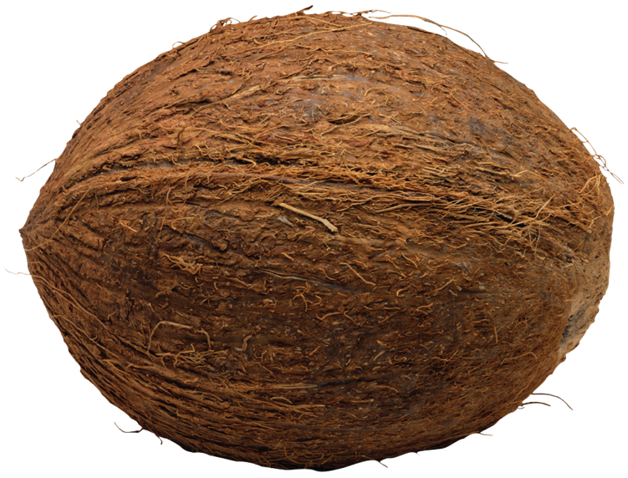
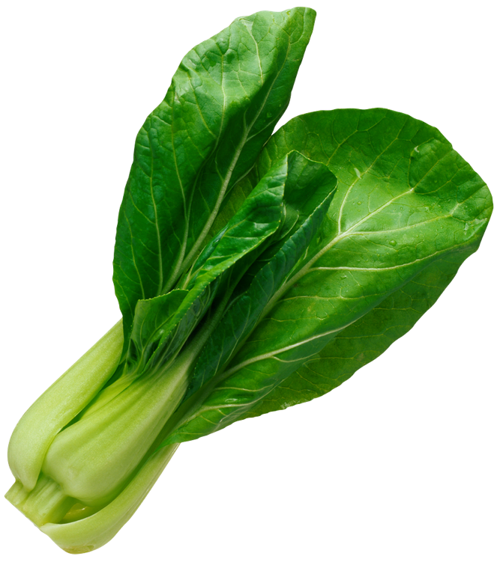
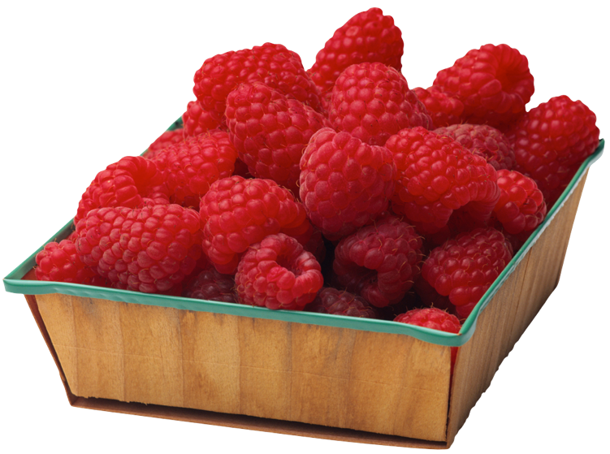

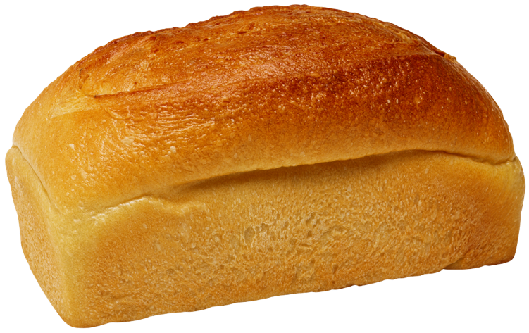
Use these photos to help you!

Slide 23




Use your five senses to tell us what would happen if you walked into a gymnasium.
Sight Smell Touch Taste Hear

Slide 24
Let’s Review!
- OY Sounds
- Predicting before and after
- Using our five senses

