Slide 1

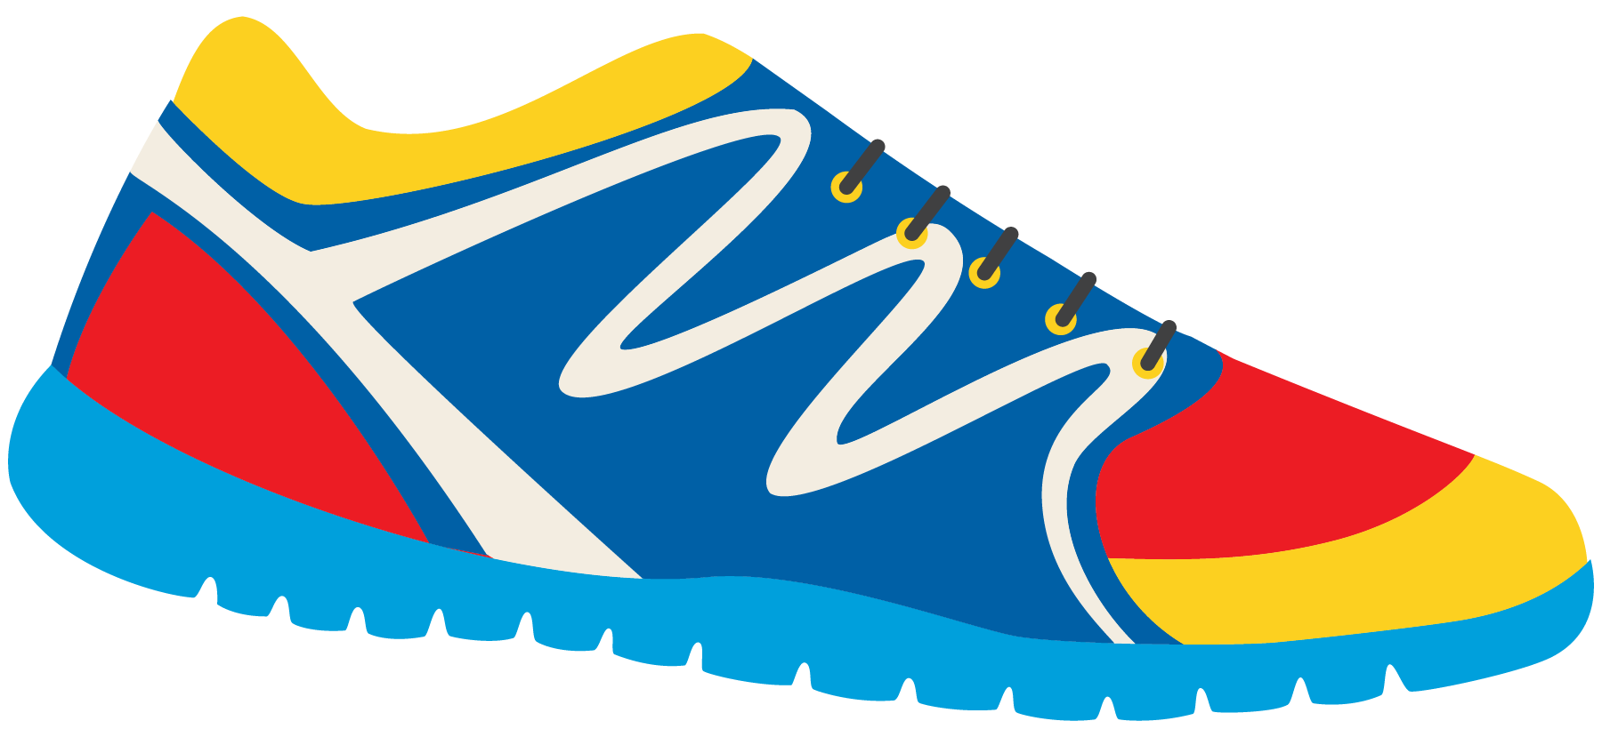

Keeping In Shape
Unit 6: Lesson 1

Slide 2

What will we be learning about?
“OY” Sounds
Predicting events – before or after a picture
Describing events using the five senses

Slide 3
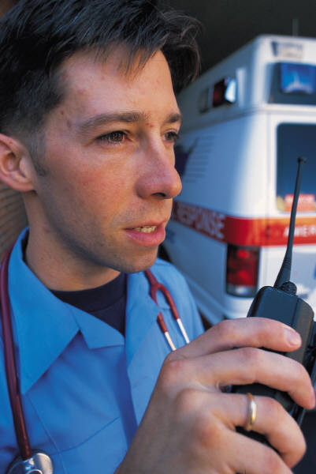
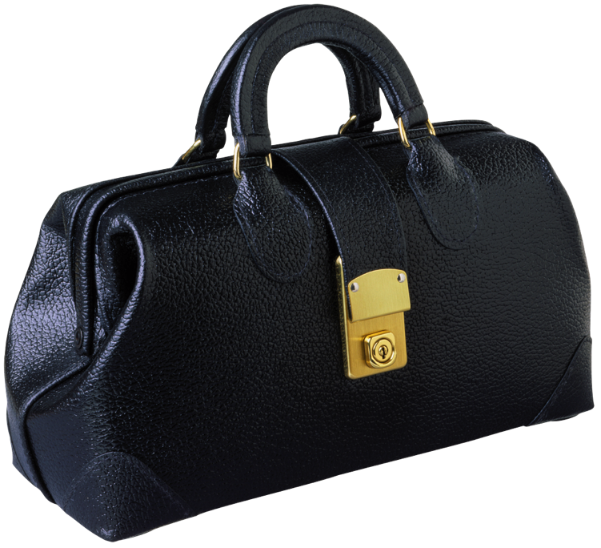

“OY” SOUNDS
“OY” Words
TOY
BOY
JOY
LOYAL
VOYAGE
OYSTER
EMPLOY

Slide 4
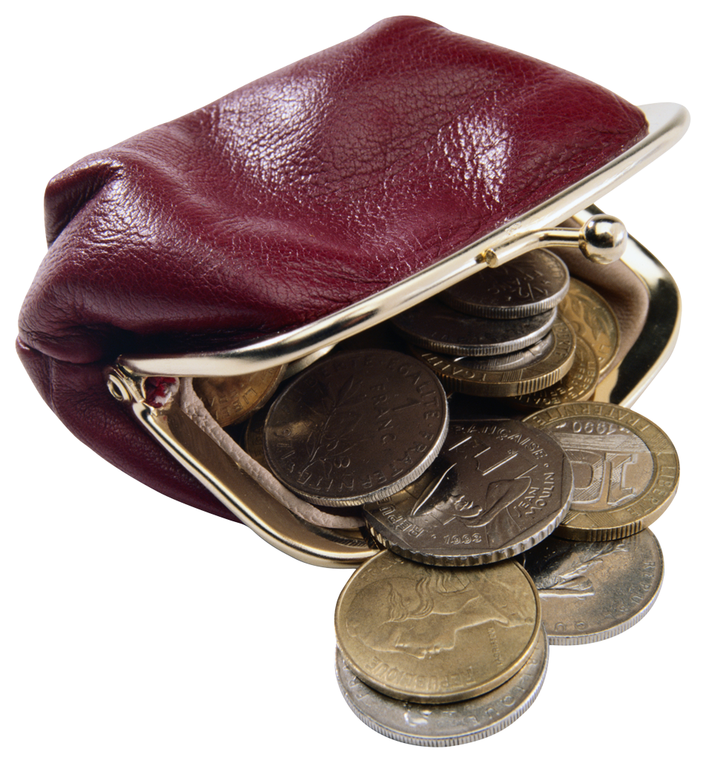
“OI” Words
COIN
COIL
OIL
POISON
POINT
TOILET
What do you notice about “OY” and “OI” words?
Do they sound the same?

Slide 5
Let’s brainstorm some “OY” and “OI” words.
What can you think of? Write them in the box below.

Slide 6
Let’s read a book! Look out for “OY” sounds!

Slide 7
Roy is outside getting fresh air!

Slide 9
Roy is working hard outside!

Slide 10
Roy is making a healthy meal!

Slide 12

What OY words did you see?
Do you think Roy was a good son or bad son?
Why?

Slide 13



What are some activities Roy did that would keep him in shape?
What could the boys do instead of playing with toys?
What would keep them active and in shape?
Use the photos to help you!

Slide 14
Predicting what will happen before and after
What does predicting mean?
How does this help us when we read a story?

Slide 15
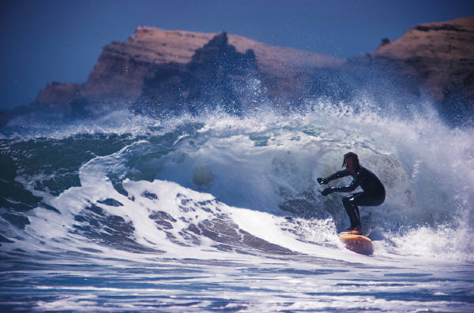
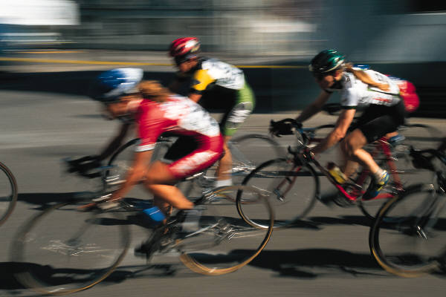
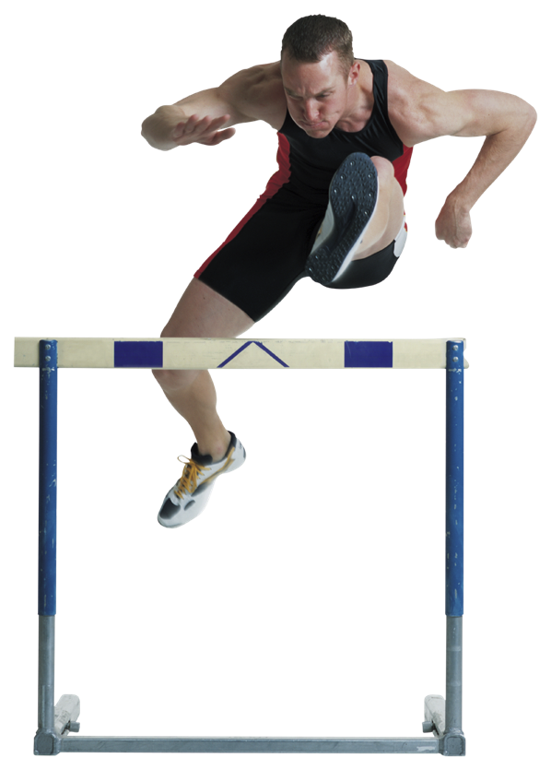
Let’s discuss!
What do you think happened before these pictures?
What do you think happened after these pictures?

Slide 16
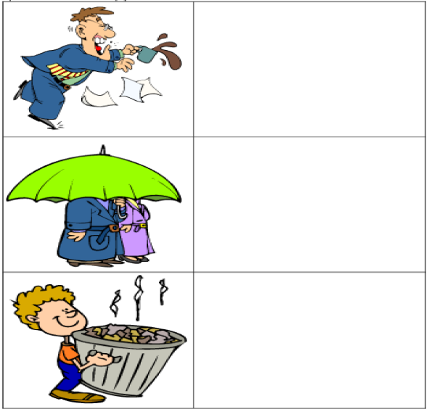
Predicting Events
Look at the pictures.
What do you think will
Happen next? Draw it!

Slide 17
One student, draw a simple photo in the first box
The second student may draw what happened after in the second box

Slide 18
Let’s do it again! Switch positions!
Before After

Slide 19
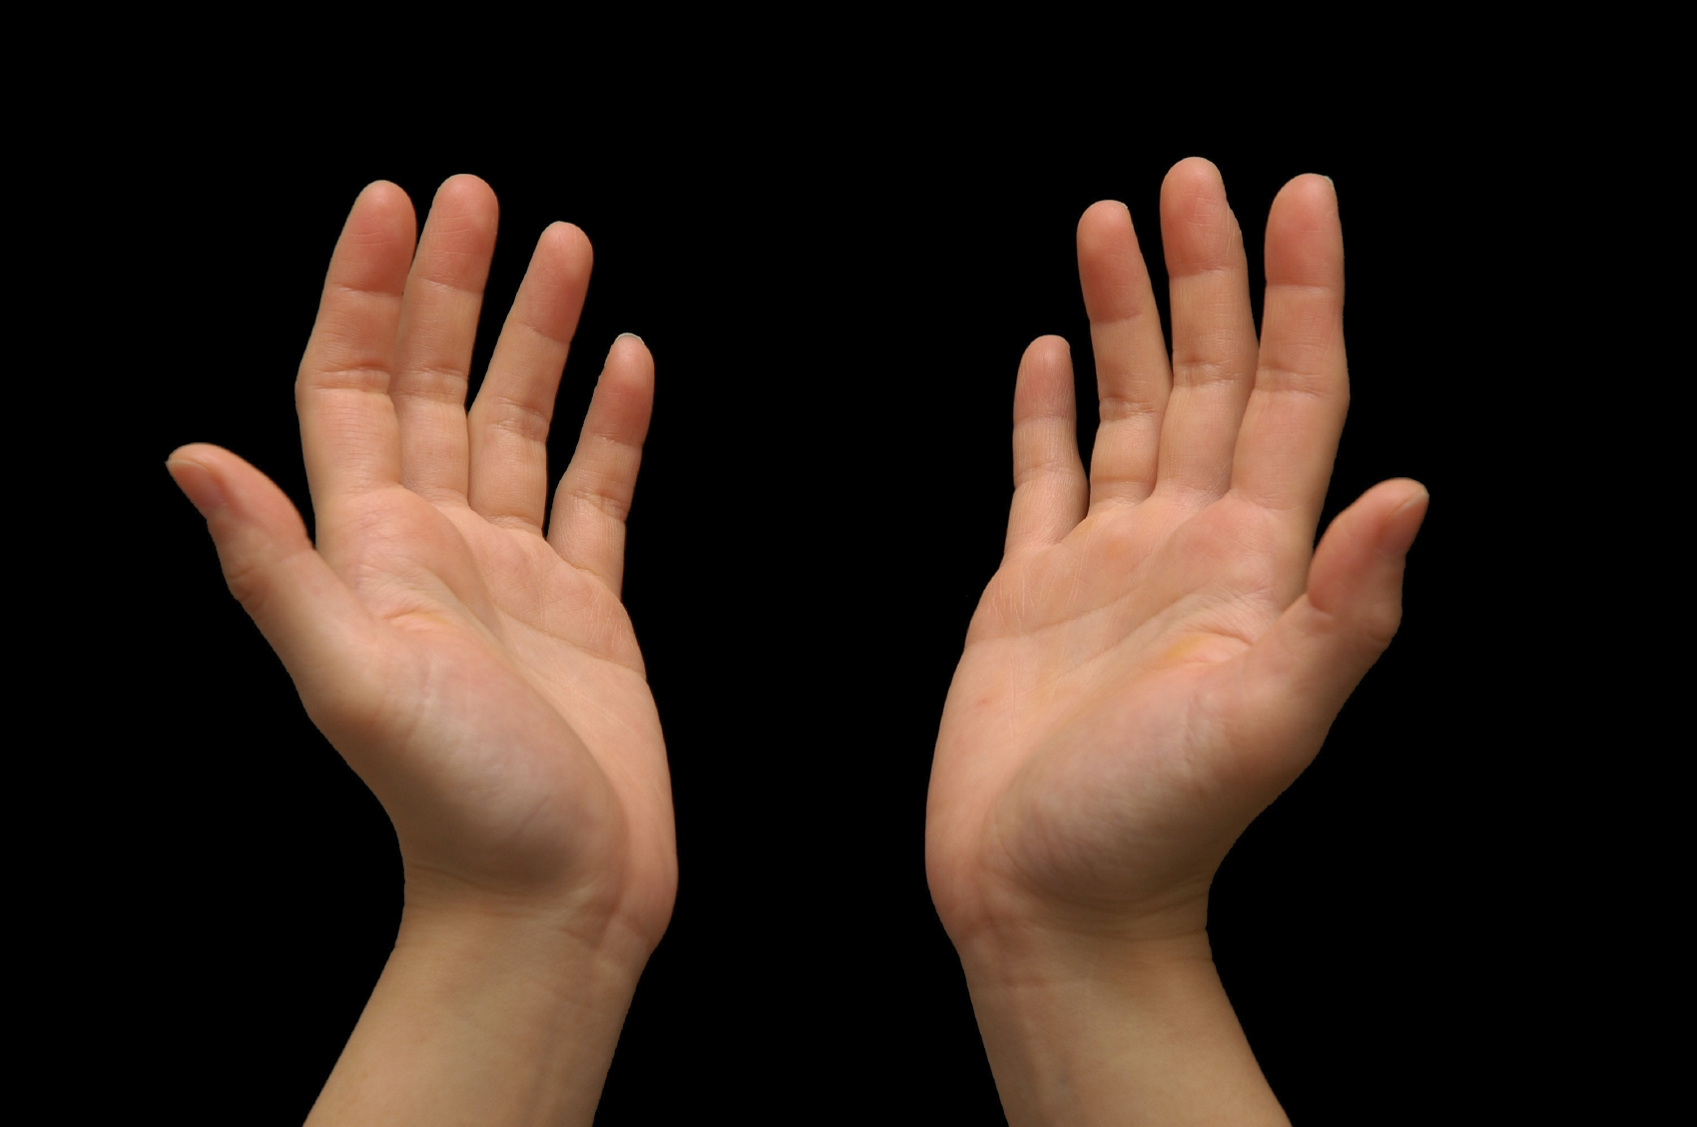

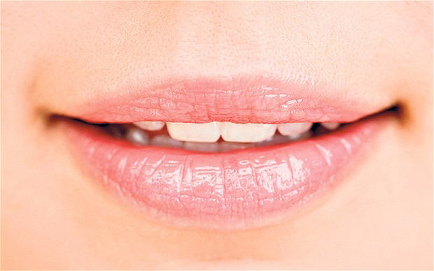
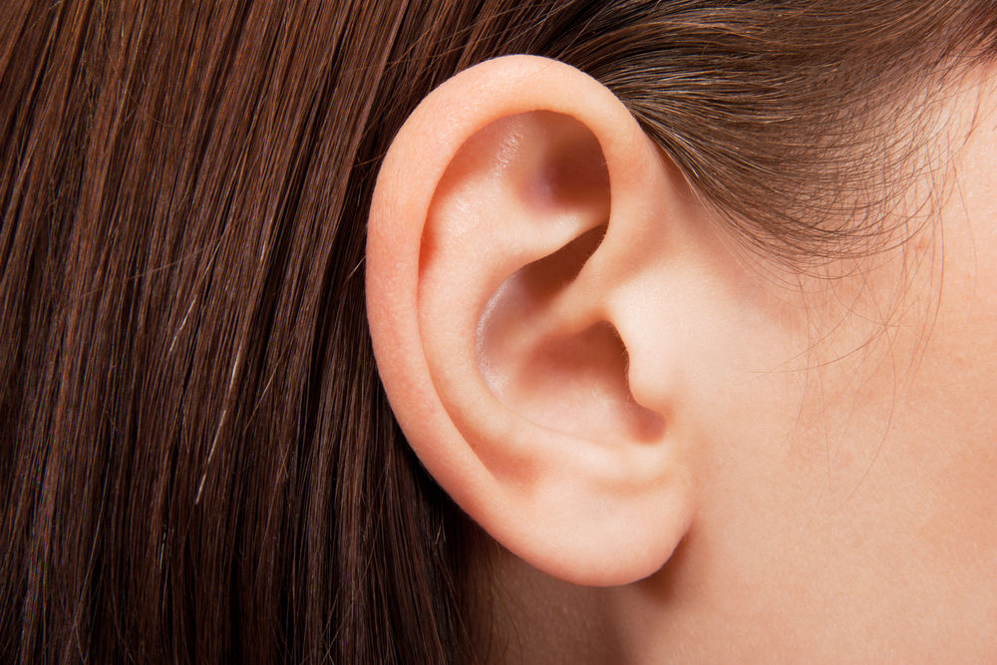
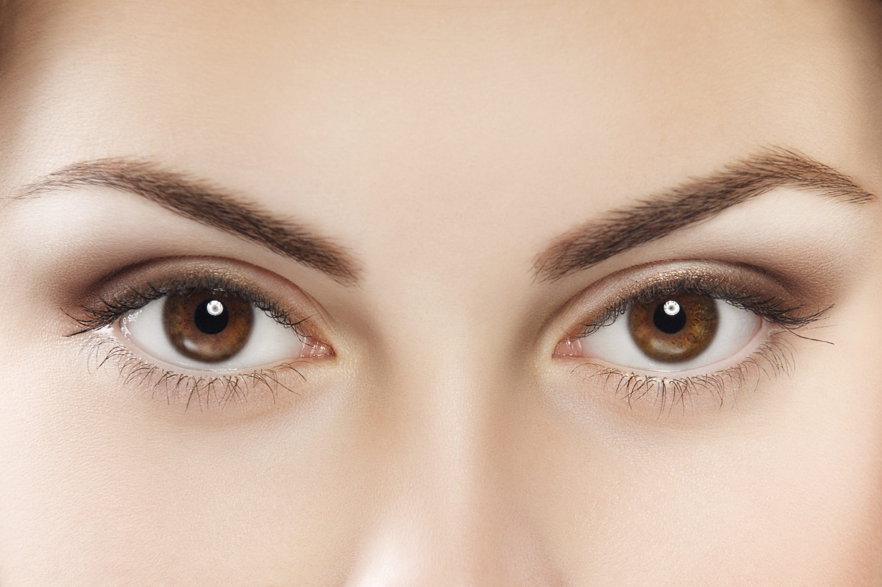
What are the five senses?

Slide 20
You are right! The five senses are:
Sight
Smell
Touch
Taste
Hear

Slide 21
What would you smell?
What would you hear?
What would you feel?
Could you taste?
What would you see?
Describe what you would experience with your five senses when you walk into a grocery store.

Slide 22
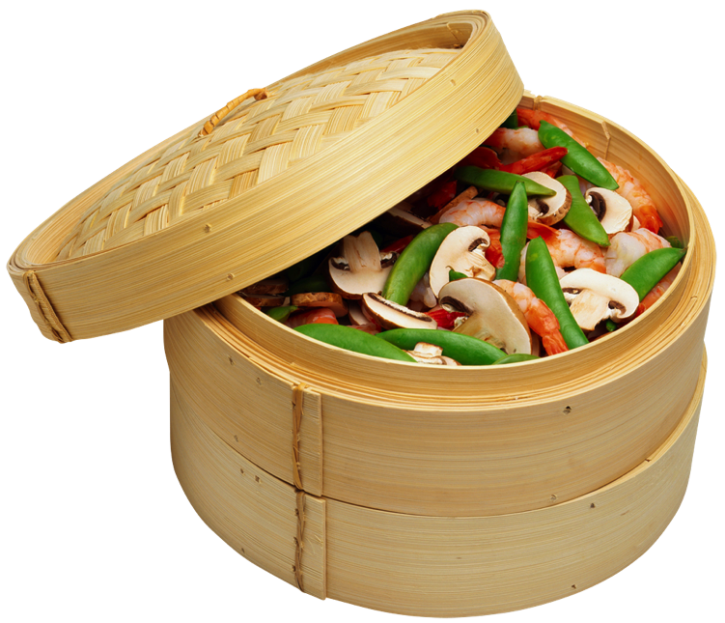
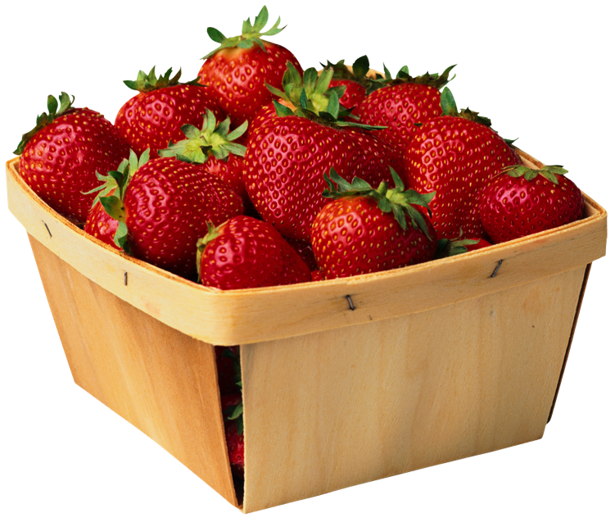
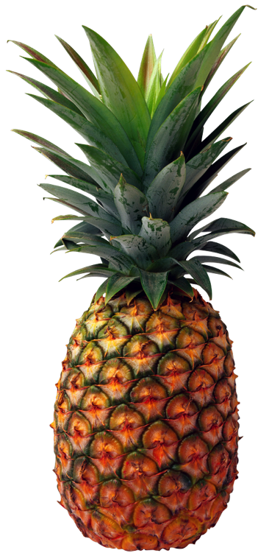
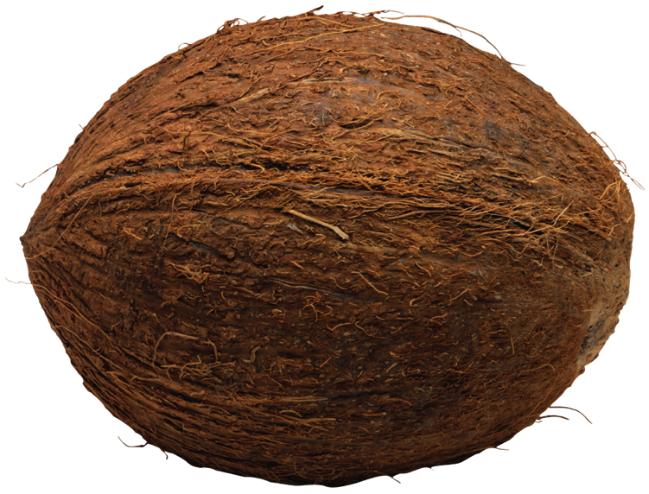
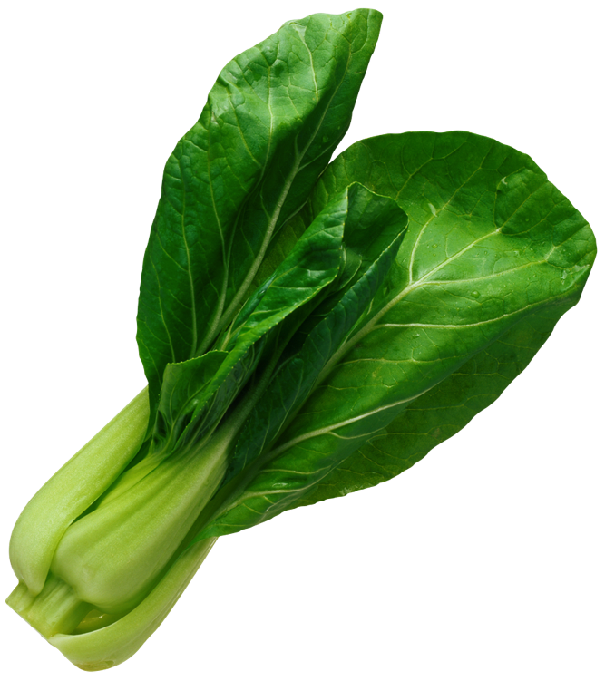
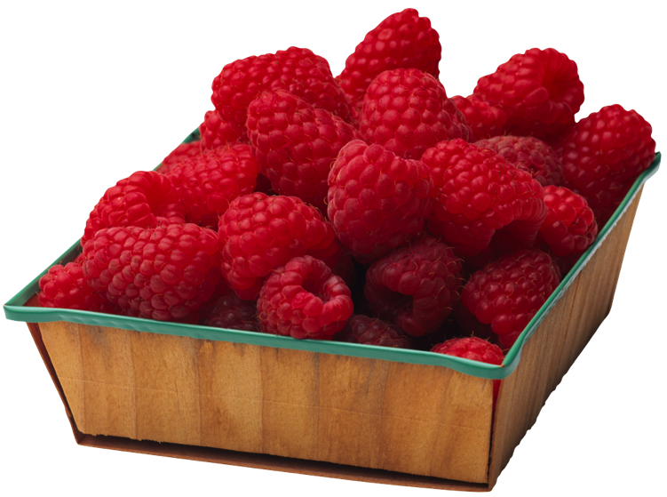
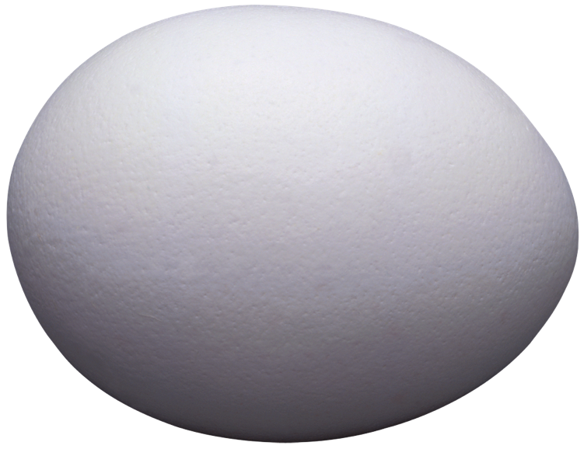
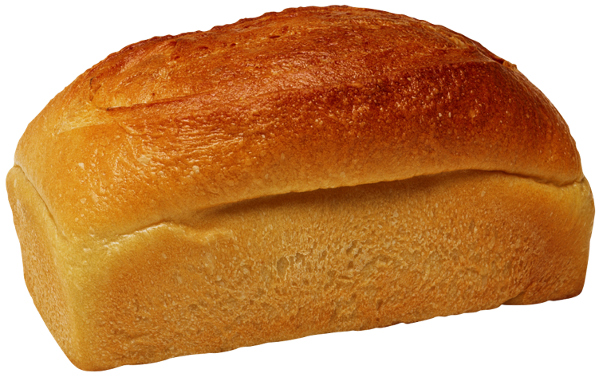
Use these photos to help you!

Slide 23



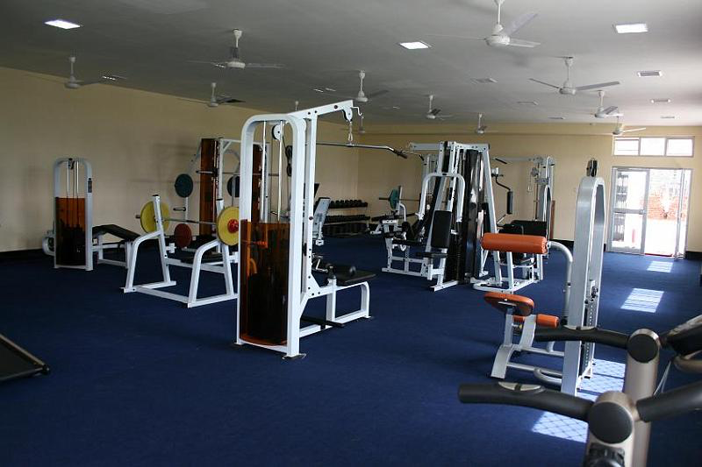
Use your five senses to tell us what would happen if you walked into a gymnasium.
Sight
Smell
Touch
Taste
Hear

Slide 24
Let’s Review!
- OY Sounds
- Predicting before and after
- Using our five senses

Slide 25
Homework
Do you have any questions?

