Slide 1

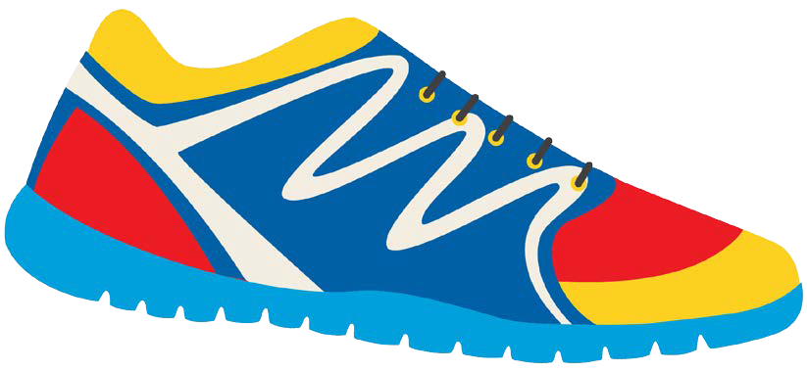

Keeping In Shape
Unit 6: Lesson 10

Slide 2


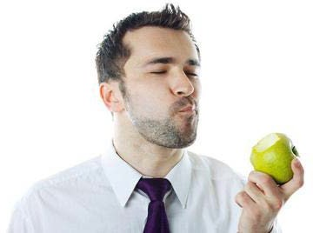
What sound do the letters “E” and “W” make when they are together?

Slide 3


You have 1 minute. Race against your classmates and write a list of as many “ew” words as you can think of.

Slide 4
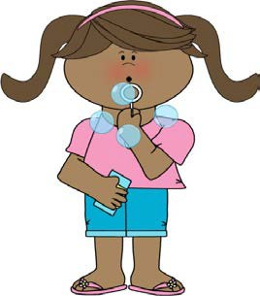
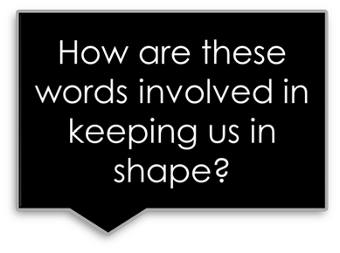
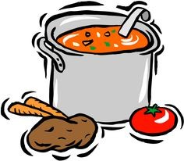
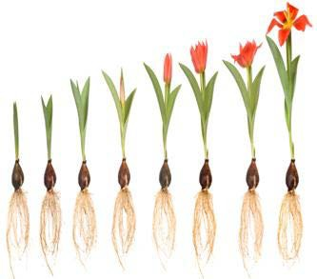
Nice job! That was a lot of words.
Now try to match the photo with the word.
Grew
Stew Blew

Slide 5
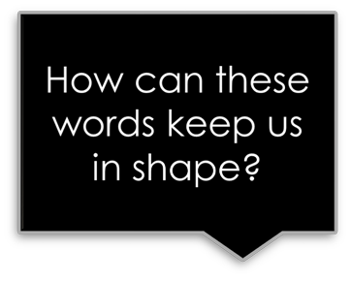


Let’s do it again. Draw a photo to match with the “ew” word.
Few
Screw
Flew

Slide 6
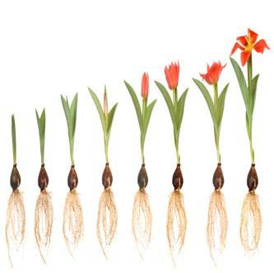
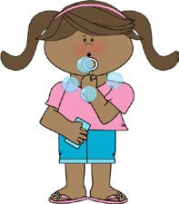
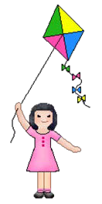
I planted a vegetable in the garden
that ______________ tall.
Tommy ____________ bubbles outside.
My mom made a healthy ___________ for dinner.
We _____________ a kite in the park last night.

Slide 7

Which of each sentence have you experienced?
Have you had stew before?

Slide 8

Let’s practice writing sentences using our “ew” words.
Remember, sentences:
Begin with a capital
End with punctuation
Involve a subject, verb, and an object.
Example:
Bill kicked the ball.

Slide 9
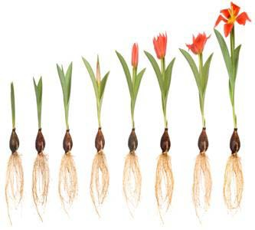
Write a sentence using the words:
Stew
Grew

Slide 10

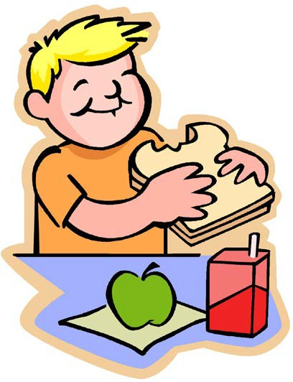
Write a sentence using the words:
Blew
Chew

Slide 11
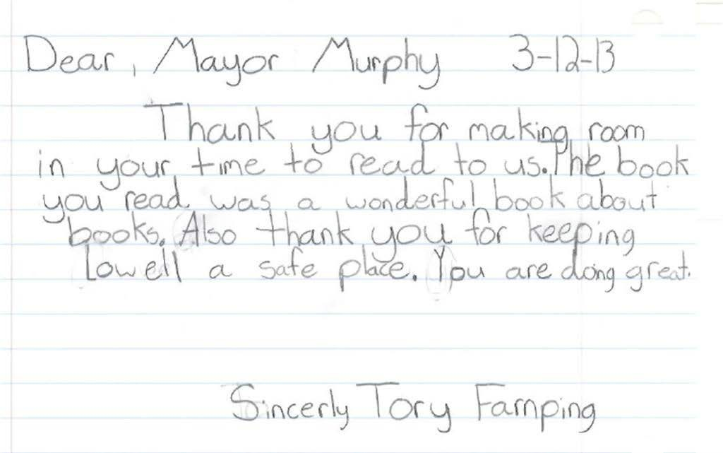
Did you notice:
Who is being thanked?

Slide 12

Dear Grandma and Papa,
Thank you for the Castle Lego. It was the number one thing on my Wish List. I love it! I play with it a lot.
Love, Billy
What similarities did you see between this letter and the last one?
Circle important lines of the letter.

Slide 13
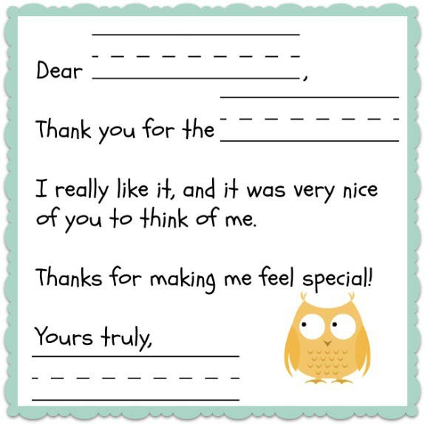
Nice job! What do you think we should include in a thank you letter?
1)
2)
3)
4)
5)

Slide 14

How can we thank people?
“Thank you so much”
“I appreciate your gift because…” “You are so kind”
“It was so nice of you to…”

Slide 15


Let’s practice writing our own thank you phrase. Pretend someone gave you a delicious and healthy meal.
How would you thank them?

Slide 16

Great work! In our next class, we will put our phrases together to create our own thank you letters.
Here are some people we might thank:
Teachers
Mother Father Grandfather Mail Carrier

