Slide 1
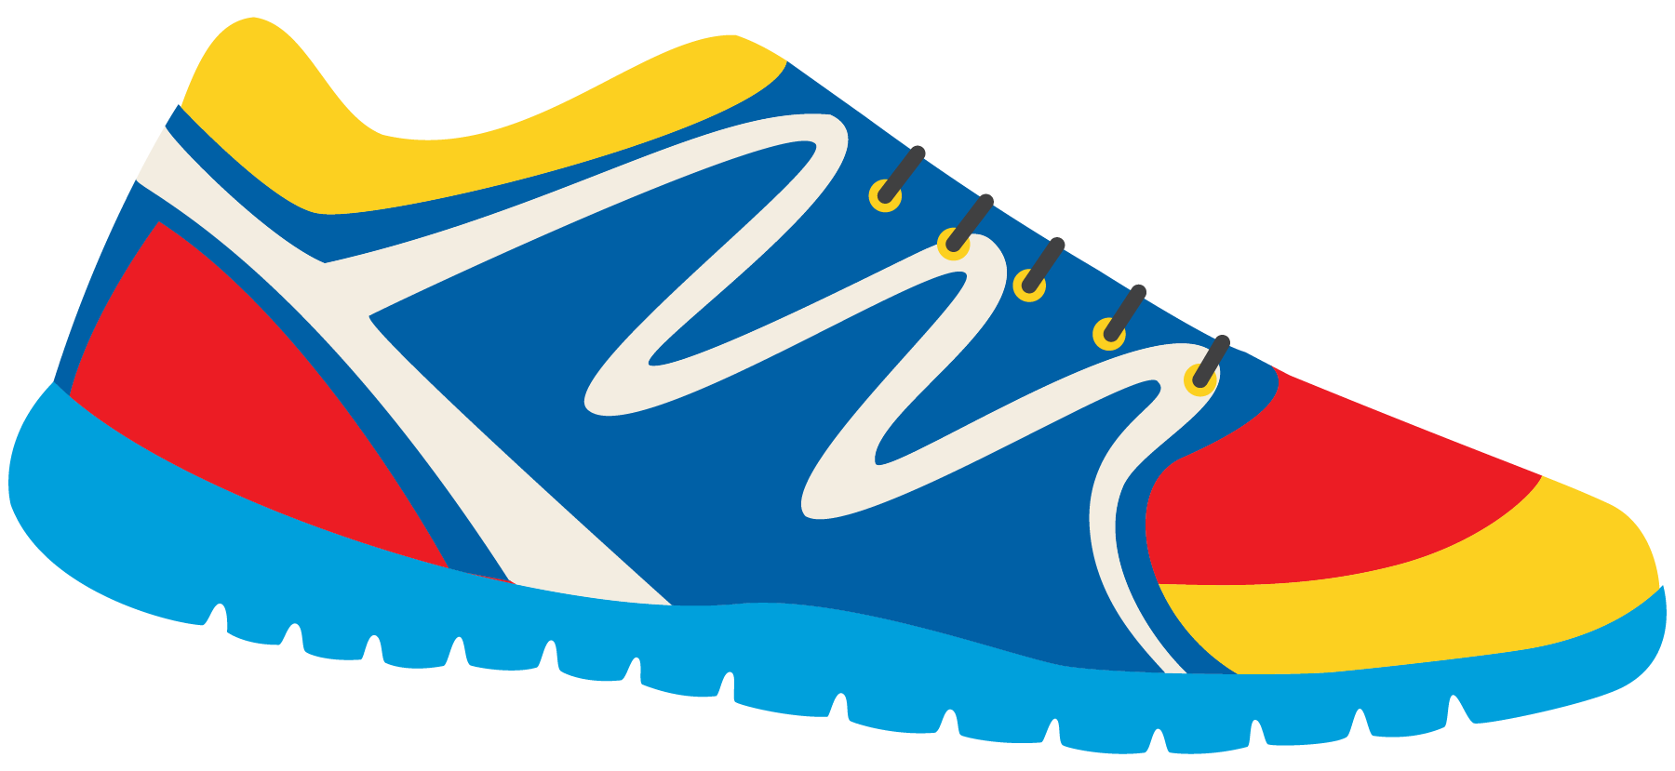
Keeping In Shape
Unit 6: Lesson 10

Slide 2
What are we learning this class?
Review “ew” sounds
Personal Note Format
Common expressions in a thank you note

Slide 3
What sound do the letters “E” and “W” make when they are together?

Slide 4
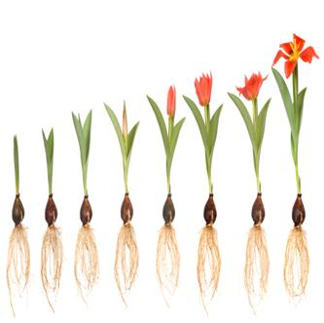
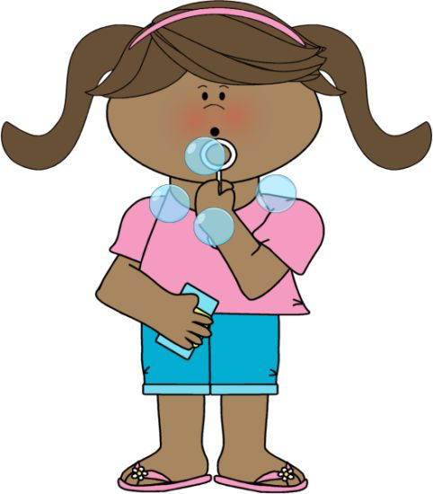
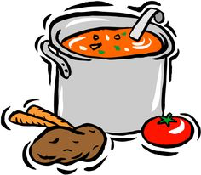
“EW” You are correct! Here are some examples of words that have “ew” in them.
Can you guess the word being depicted?

Slide 5
You have 1 minute. Race against your classmates and write a list of as many “ew” words as you can think of.

Slide 6
Nice job! That was a lot of words.
Now try to match the photo with the word.
Grew
How are these words involved in keeping us in shape?
Stew
Blew

Slide 7
Let’s do it again. Draw a photo to match with the “ew” word.
How can these words keep us in shape?
Few
Screw
Flew

Slide 8
Nice matching skills. It is important to understand what each word means.
Now we will try to fill in some blanks!
Pay attention to the details of each sentence.

Slide 9
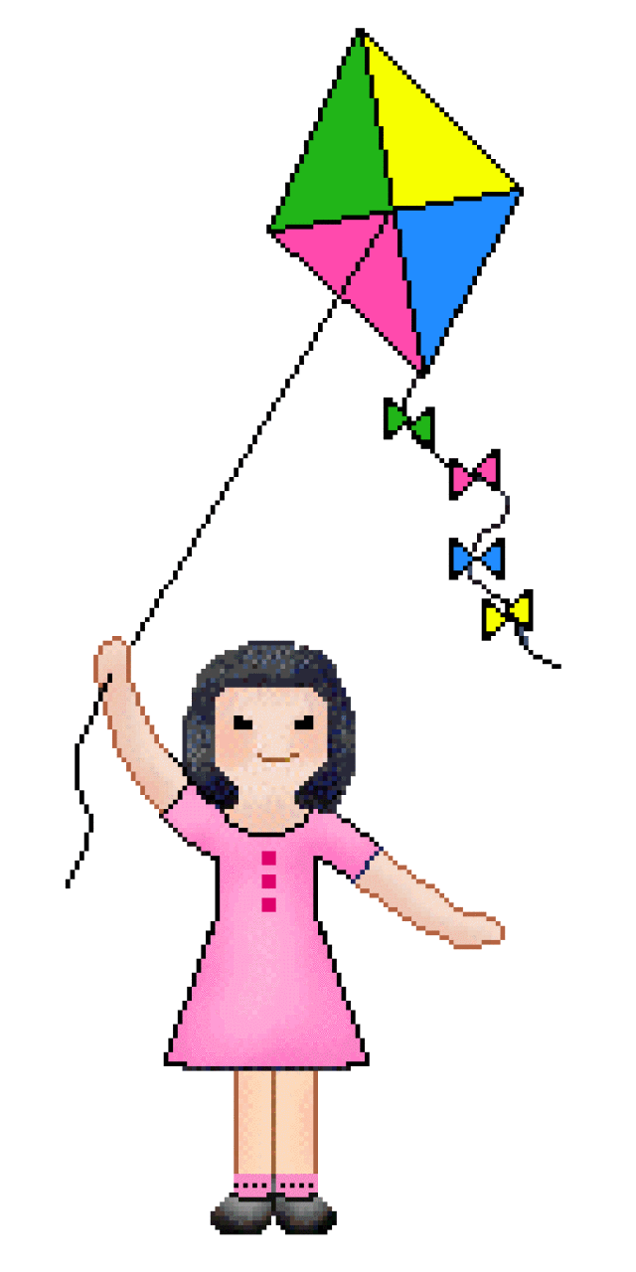
I planted a vegetable in the garden that ________________ tall.
Tommy ____________ bubbles outside.
My mom made a healthy ___________ for dinner.
We _________________ a kite in the park last night.

Slide 10
Which of each sentence have you experienced? Have you had stew before?

Slide 11
Let’s practice writing sentences using our “ew” words. Remember, sentences:
Begin with a capital
End with punctuation
Involve a subject, verb, and an object.
Example:
Bill kicked the ball.

Slide 12
Write a sentence using the words:
Stew
Grew

Slide 13
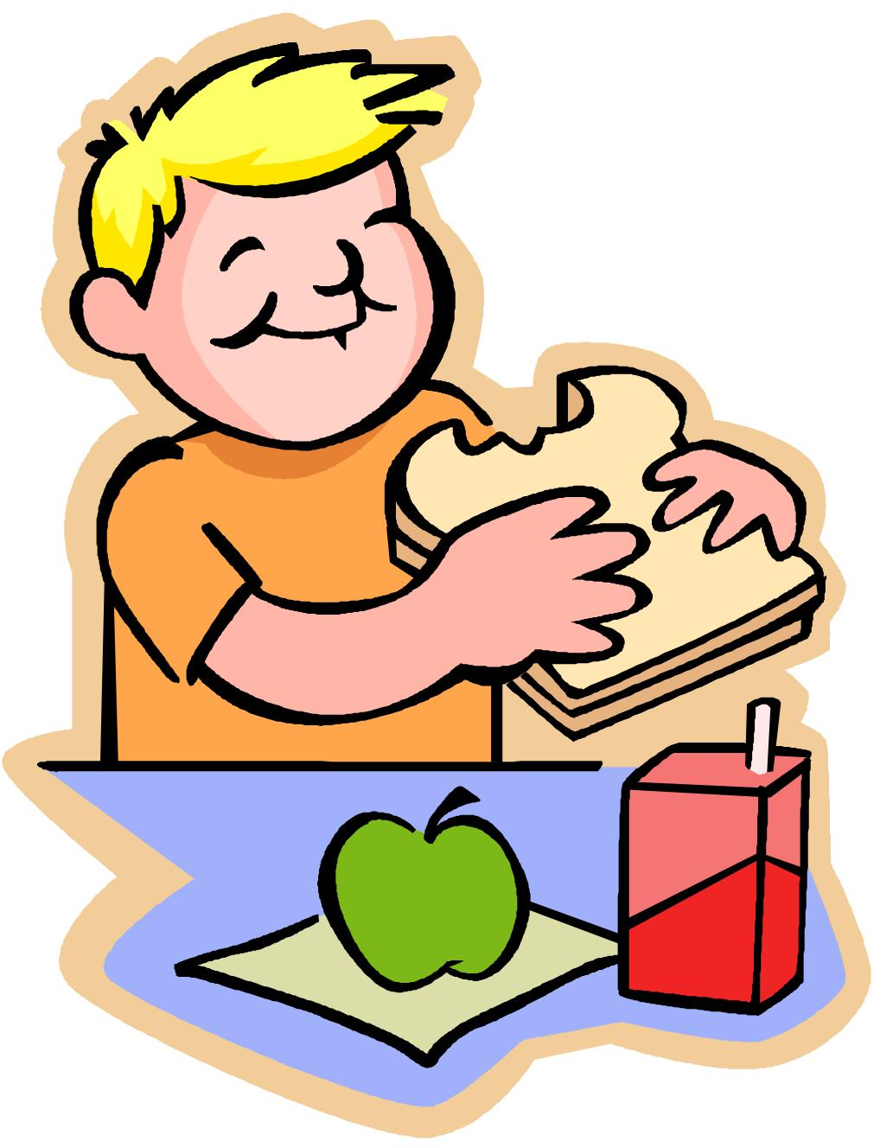
Write a sentence using the words:
Blew
Chew

Slide 14
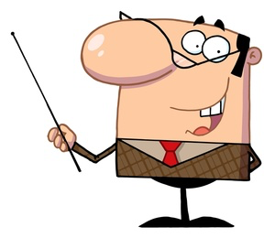
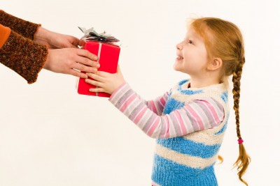
Great work!
Let’s now look at some personal notes. These are used to thank people for something that they have done for us.

Slide 15
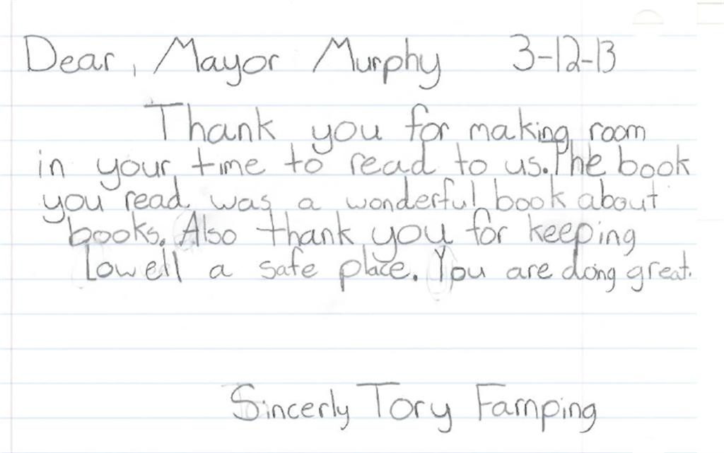
Did you notice: Who is being thanked?

Slide 16
Dear Grandma and Papa,
Thank you for the Castle Lego. It was the number one thing on my Wish List. I love it! I play with it a lot.
Love, Billy
What similarities did you see between this letter and the last one? Circle important lines of the letter.

Slide 17
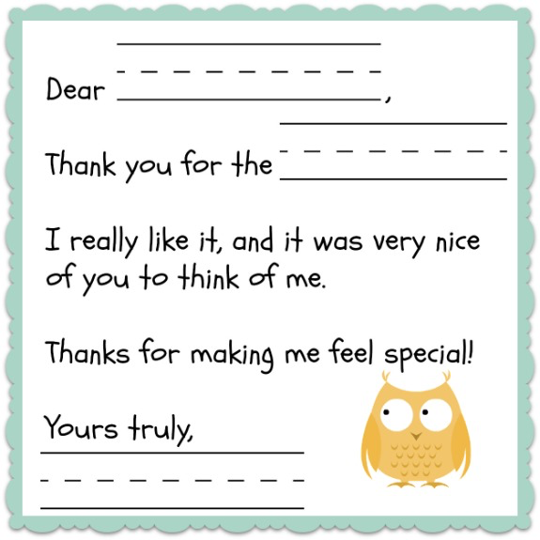
Nice job! What do you think we should include in a thank you letter?
1)
2)
3)
4)
5)

Slide 18
Great! We should include
Who we are sending the letter to
Why we are sending the letter
What we are thanking for
A kind sentence
A closing sentence

Slide 19
How can we thank people?
“Thank you so much”
“I appreciate your gift because…”
“You are so kind”
“It was so nice of you to…”

Slide 20
Let’s practice writing our own thank you phrase. Pretend someone gave you a delicious and healthy meal. How would you thank them?

Slide 21
Great work! In our next class, we will put our phrases together to create our own thank you letters.
Here are some people we might thank:
Teachers
Mother
Father
Grandfather Mail Carrier

Slide 22
Review!
“Ew” words
Personal Note Format
Phrases to use in a thank you note

Slide 23
Homework
Do you have any questions?

