Slide 1

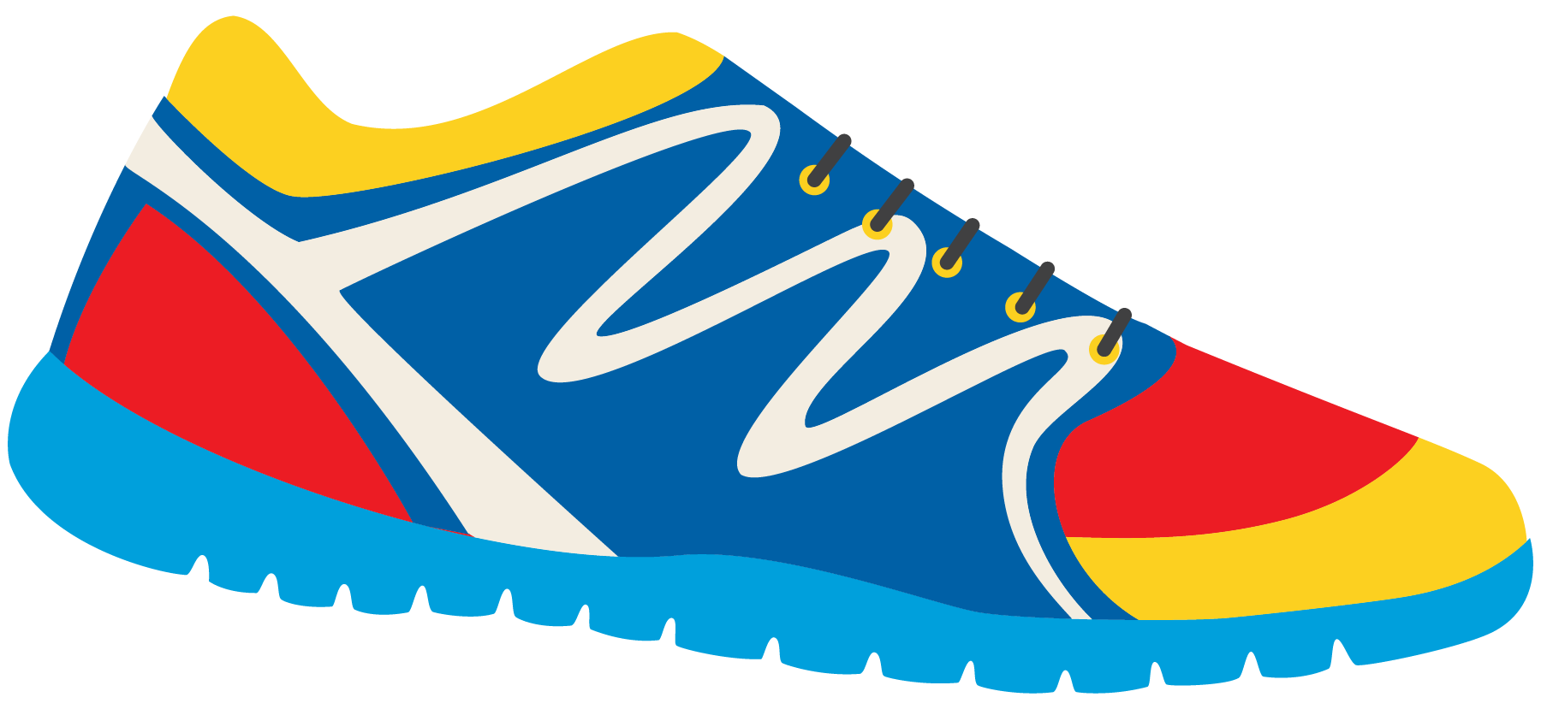

Keeping In Shape
Unit 6: Lesson 11

Slide 2



The letters “O” and “A” make different sounds. What sound does “O” make?
What sound does “A” make?

Slide 3
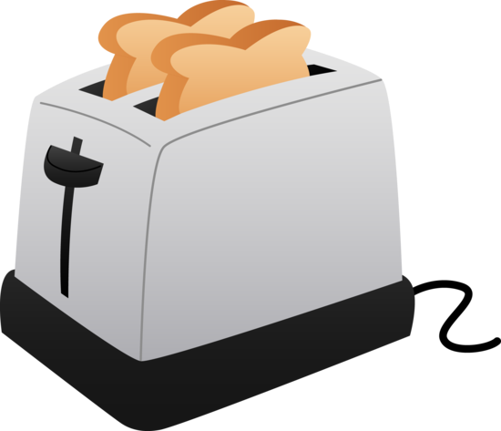
When the letters O and A are together, they make an “oa” sound, like in the word toast.
Is toast a healthy food to eat? Would it help keep us in shape?

Slide 4
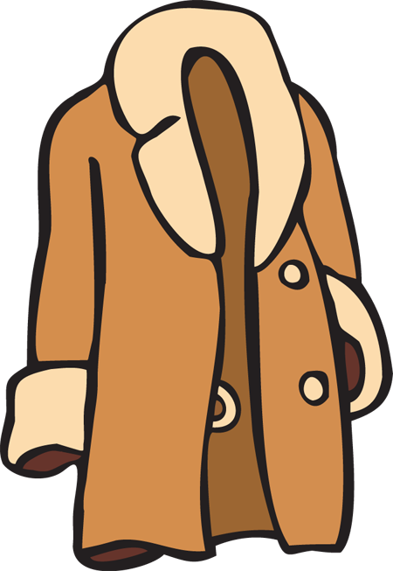

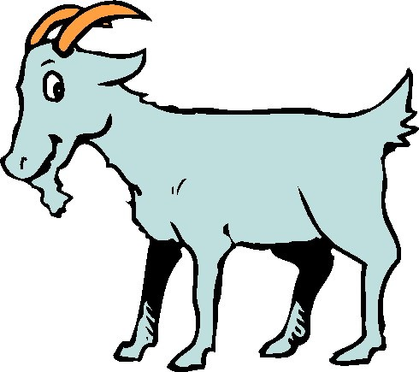
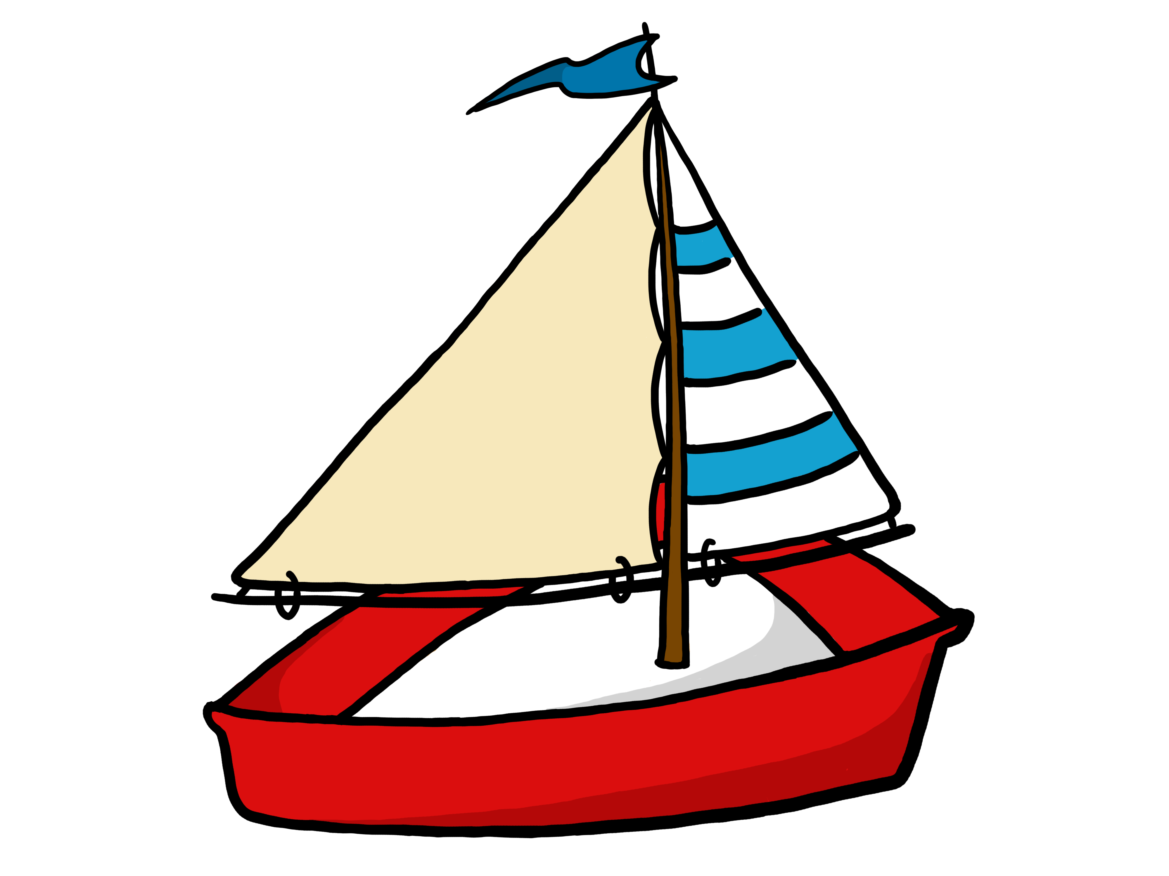
Here are some more words that have “oa” in them.
Can you guess each word?

Slide 5
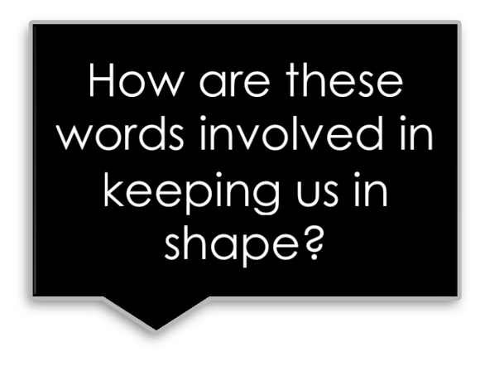
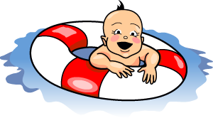

Match the photo with the word
Float
Road
Toast

Slide 6
Match the photo with the word
Coat
Toad
Boat

Slide 7

Remember one of the words we just learned. Have your classmate guess what word you are thinking of by only asking “yes” or “no” questions.
Example: Is it an animal?

Slide 8

Here is our reminder.
Remember, sentences:
Begin with a capital
End with punctuation
Involve a subject, verb, and an object.
Example:
Bill kicked the ball.

Slide 9
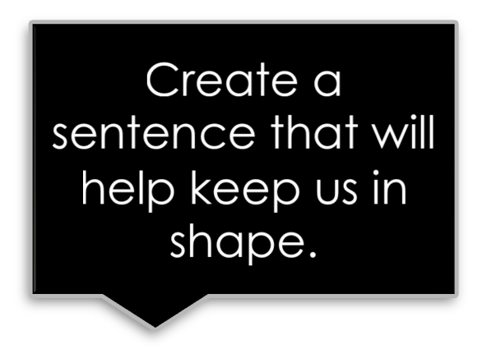
Write a sentence using the words:
Coat
Toad

Slide 10
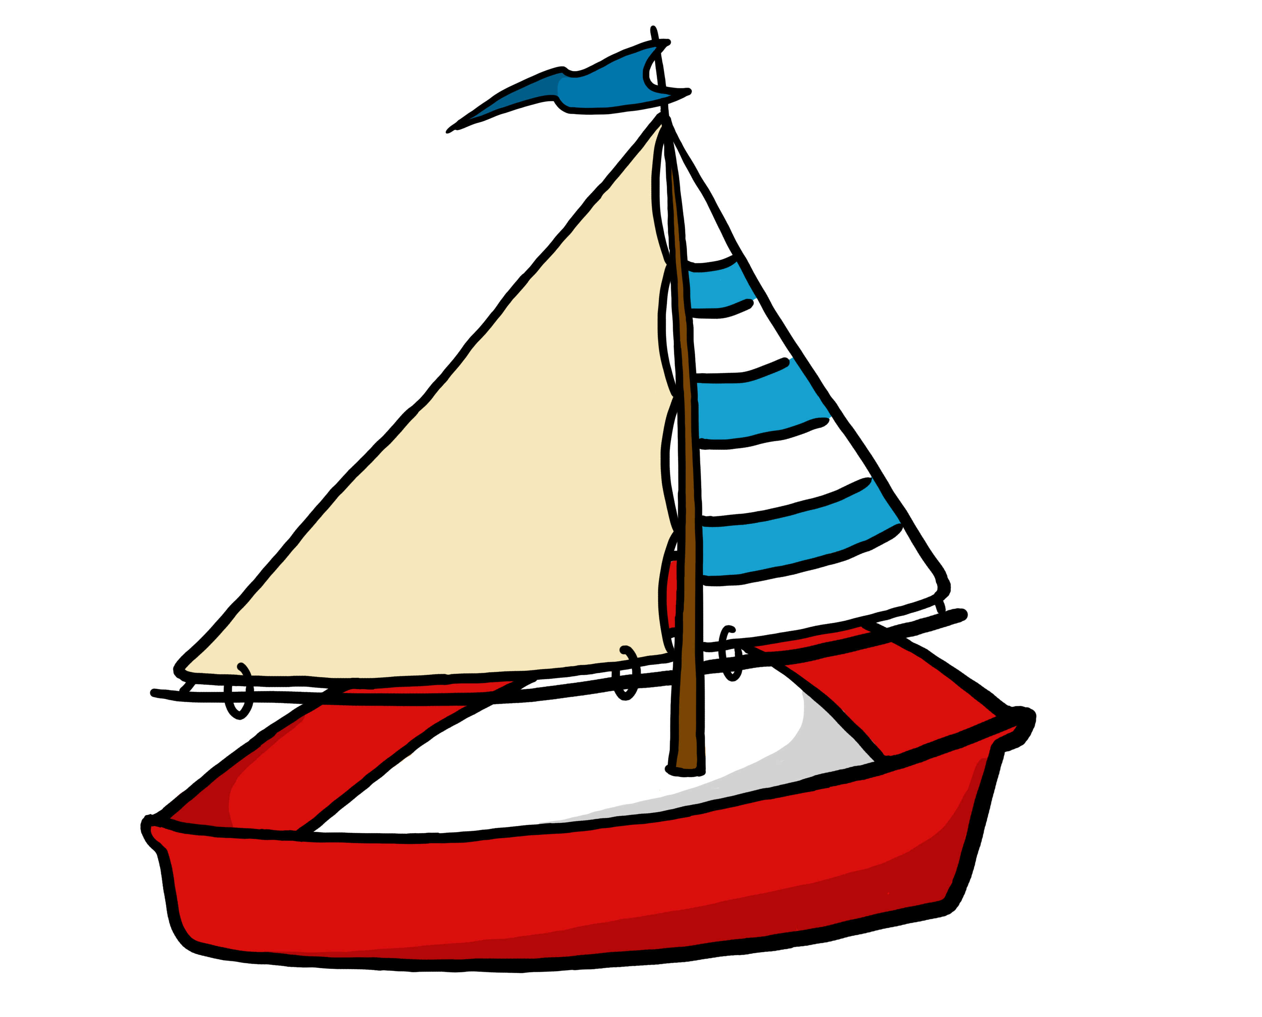
Write a sentence using the words:
Boat
Toast

Slide 11



List some phrases we could use to thank someone

Slide 12
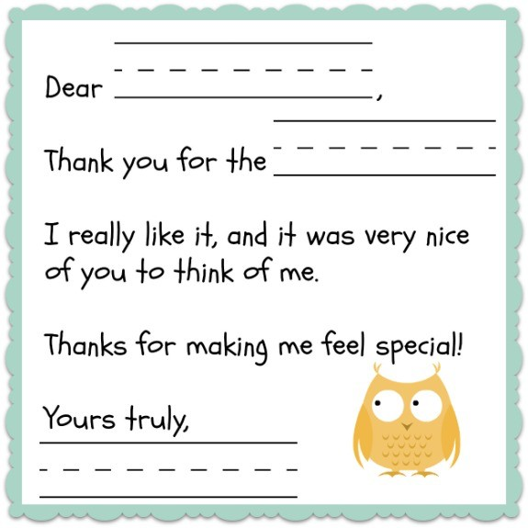
Nice work! Let’s remember to use these when we write our own thank you letter. What should we include in our letter?
Who we are sending the letter to
Why we are sending the letter
What we are thanking for
A kind sentence
A closing sentence

Slide 13
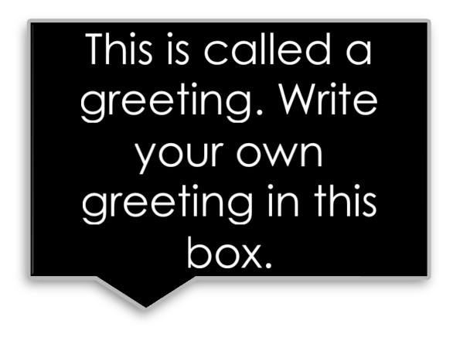

What is a kind way to begin a personal thank you letter?
“Dear…”
“Mr. or Mrs. …”

Slide 14

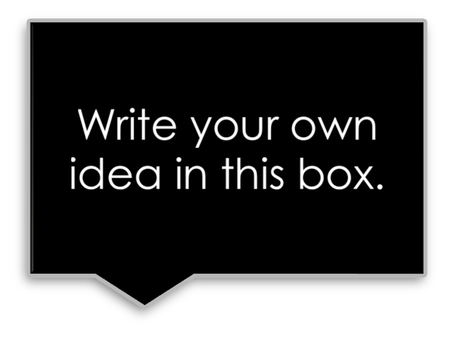

Next, we include why we are sending the letter and what we are thanking them for.
“I wanted to write you a letter to thank you for the…”
“The toy you gave me is my favourite!”

Slide 15
Great work! Now we need to include a kind sentence, and a closing sentence.
Here are some examples:
“Thanks for all your hard work…” “Thank you for thinking of me!”
“Sincerely, ____________”
“Your friend, ___________”

Slide 16

Great work! Now we will put all of this together and write our own thank you letters.
Write a thank you letter to your mom or dad to thank them for helping you to be healthy.

Slide 17
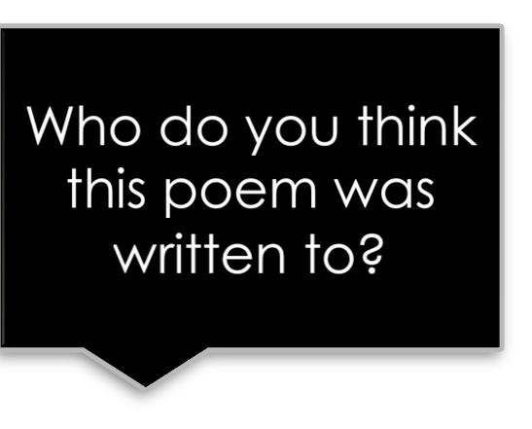
Lucky to Have Found You
I feel lucky to have found you- A friend that is so kind and true;
To lift me up when I am down, and make me smile when I frown.
It's hard to find the words to say just how much I care.
But these will have to do: Thank you
Thank you
Thank you,
(From the bottom of my heart.)

Slide 18
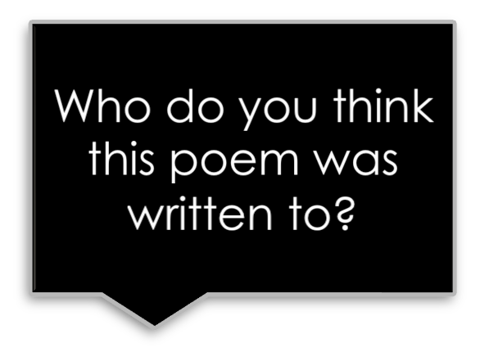
Thank You for Your Kindness
Thank you for your kindness, it meant so much to me.
You care so much about me, this is clear to see.
When I think of special, I always think of you,
And the lovely gifts you give,
and the thoughtful things you do. Your essence in my life,
is the best gift you can give, Our friendship will go on,
for as long as we both live. Thank You!

