Slide 1

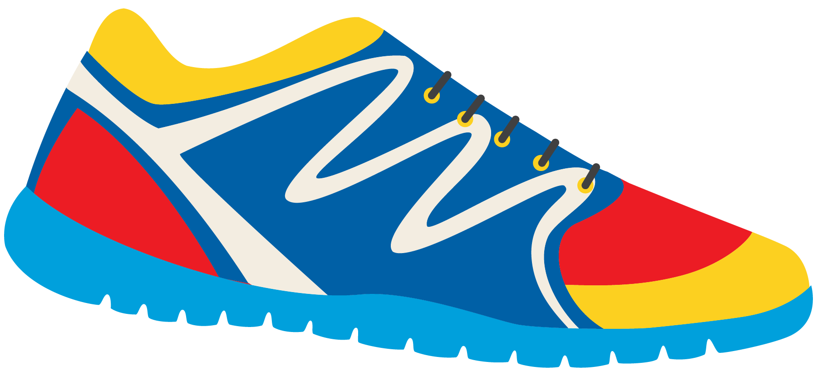

Keeping In Shape
Unit 6: Lesson 12

Slide 2

What are we learning this class?
This class will be a review of lessons 9, 10, and 11
“Ay”, “Ew” and “Ou” sounds
Sentence structure and thank you letters

Slide 3
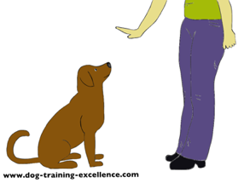

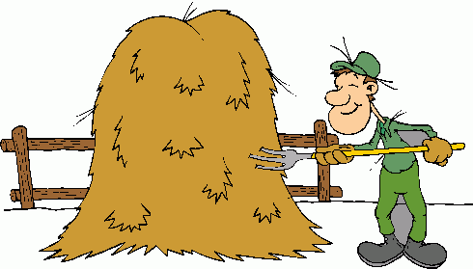

Review: What sound does “ay” make?
“ew”?
“oa”?
Which sound does each picture belong to?

Slide 4
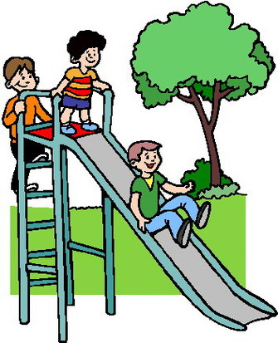
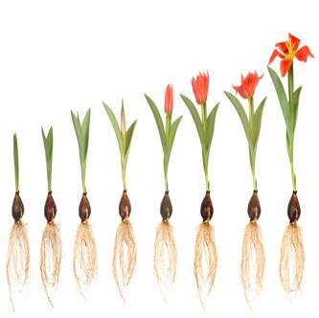
Good! Use the correct word to fill in the blank below
I planted a vegetable in the garden
that ________________ tall.
My dad says to __________ outside for at least an hour each day.
My mom made a healthy ___________
for dinner.
I used the toaster to make _________ for a healthy breakfast.

Slide 5
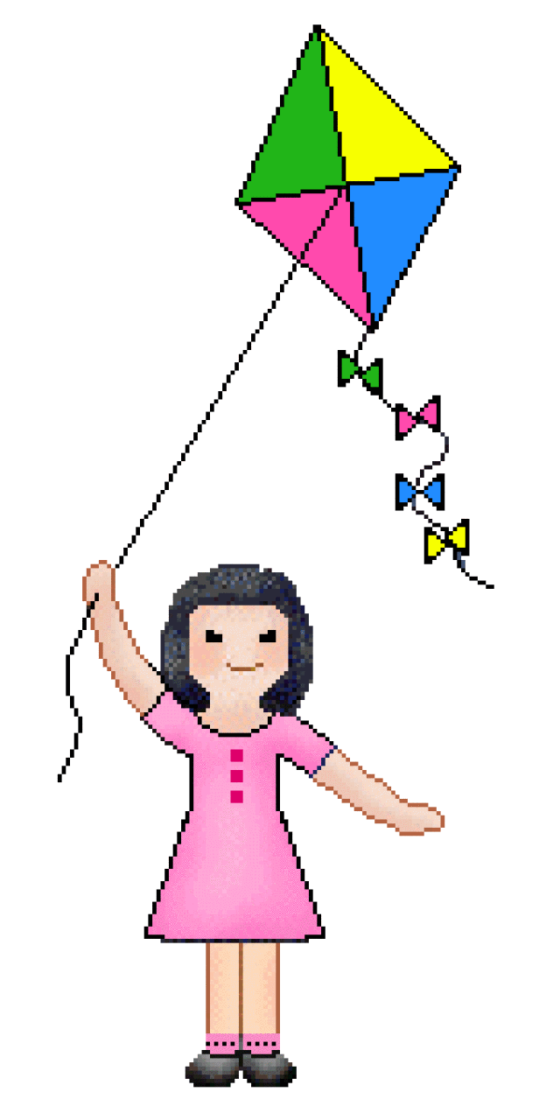
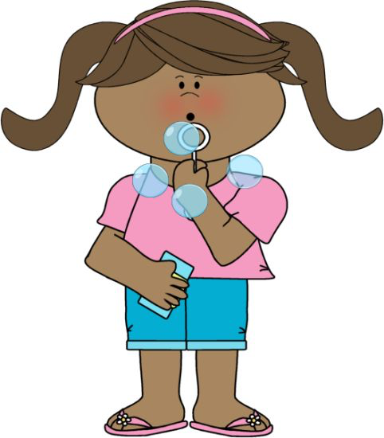
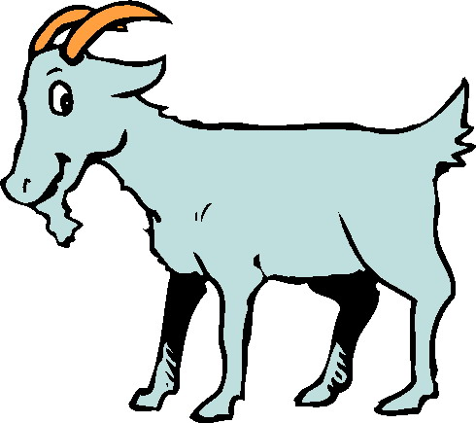
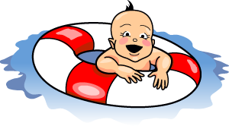


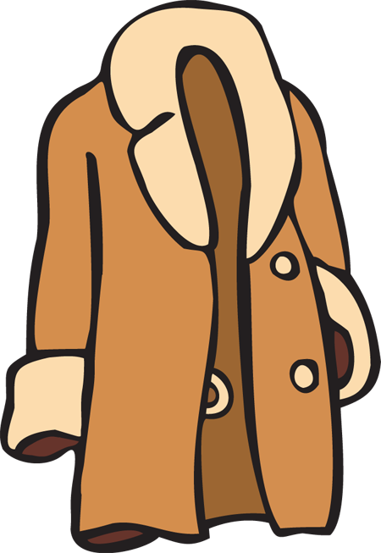
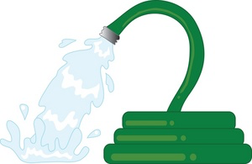

Nice work! Can you guess each word by looking at the picture?

Slide 6
Now we will play 20 Questions again.
This will test your knowledge of all three sounds!
“ay”, “ew”, “oa”

Slide 7
Have your classmate guess what word you are thinking of by only asking “yes” or “no” questions.
Example: Is it an “ew” word?

Slide 8

Nice work! Now we will put all of our knowledge together to create sentences.

Slide 9
Fill in the blanks. Sentences:
Begin with a ______________
End with ________________
Involve a subject, _________, and an object.

Slide 10
Write a sentence using the words:
Create a sentence that will help keep us in shape.
Coat
Hay

Slide 11
Write a sentence using the words:
Create a sentence that will help keep us in shape.
Play
Stew

Slide 12

Let’s now read a book. Listen for the reason why we should say thank you.

Slide 20
Why should we say thank you?

Slide 21

Correct! It is kind to say thank you. Let’s now practice writing our thank you letters.

Slide 22
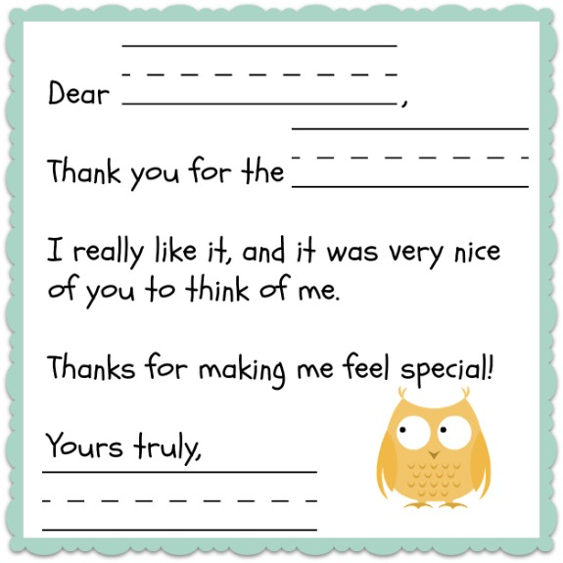
What should we include in our letter?
________ we are sending the letter to
________ we are sending the letter
________ we are thanking for
A _________ sentence
A _________ sentence

Slide 23
Great work! Now we will practice writing our own thank you letters again.
Write a thank you letter to your teacher for helping you to keep in shape!

Slide 24

Share your letters with your classmates? Did everyone include the 5 main parts of a thank you letter?

Slide 25

Review!
Three sounds
“Ay”, “Ew”, “Oa”
Writing a personal thank you note

Slide 26

Homework
Do you have any questions?

