Slide 1

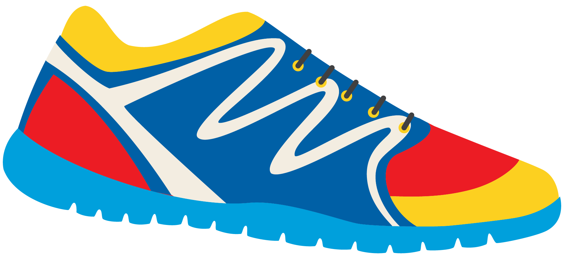

Keeping In Shape
Unit 6: Lesson 2

Slide 2


What will we be learning about?
“EA” Sounds
Simple past tense
Irregular verbs (run – ran, eat – ate, speak - spoke)
Keeping Healthy Poem

Slide 3


Last class we looked at “OY” and “OI” sounds. What are some words we came up with?

Slide 4

What sound does “E” make?
What sound does “A” make?
What do you think “EA” sounds like together?

Slide 5

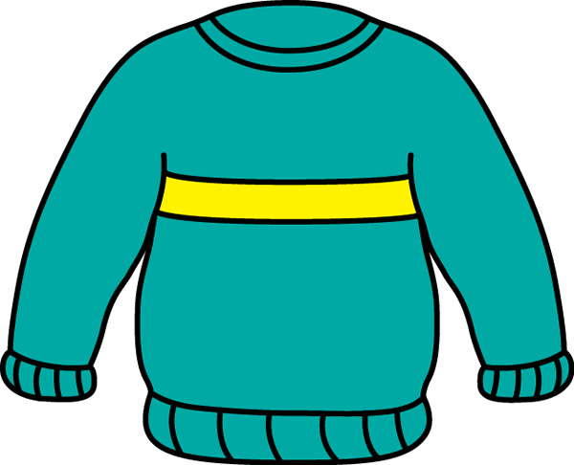

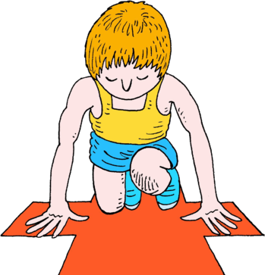
“EA” can make two different sounds
Let’s read these words together
Bread Ready Weather Sweater

Slide 6

Use these words in a sentence!
1. I like to use on my healthy sandwich.
2. When it is cold outside, I wear my favourite .
3. The
is cold and rainy today.
4. My coach told me to get
for the race.

Slide 7

We just looked at “EA” words that make the short E sound.
Bread
Beach
Do these words sound different? How?

Slide 8



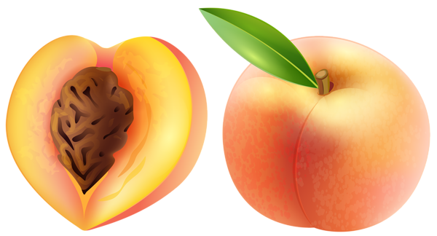

Try to think of some healthy foods that use the letters “EA”

Slide 9

Eating healthy helps to keep us in shape. Write a sentence about a healthy “EA” food you like to eat!

Slide 10




What other words have “EA” in them? Write one, then draw a picture for it.

Slide 11


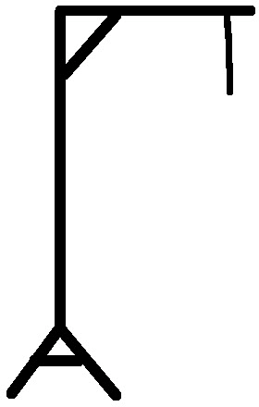
Let’s play hangman! Use an “EA” word.
Give us a hint – does it use a long “E” sound or short “E” sound?

Slide 12
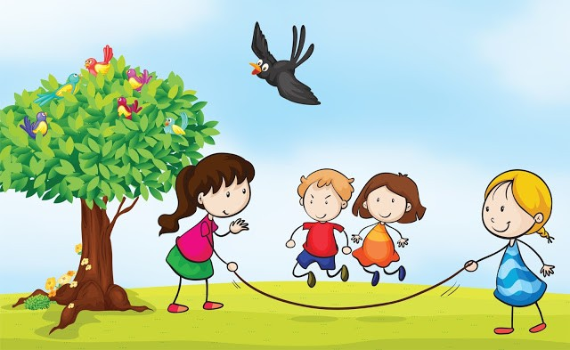
When using a regular verb in the past tense, what do we add to it?
I played with my friends outside all night long.

Slide 13

Simple Past Tense
Regular Verbs:
Play
Walk
Wash
Use these in a sentence!
I (play) outside with my friends last night.
My mom (walk) with me to school.
I (wash) my hands after I ate a sticky peach.

Slide 14
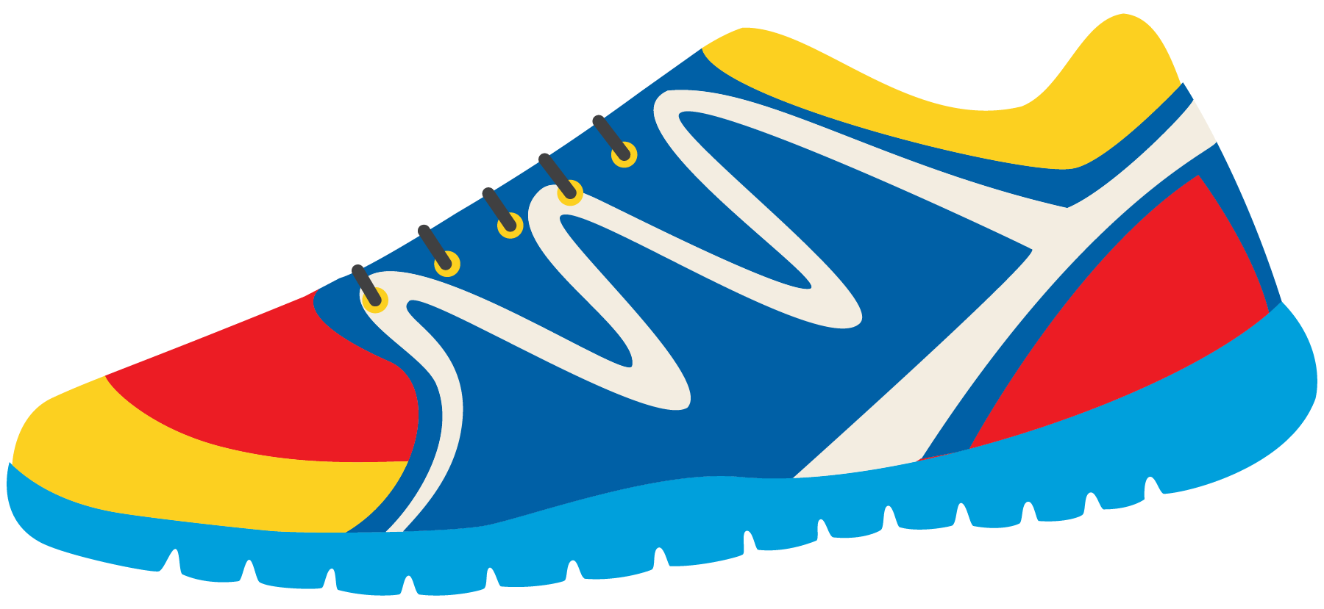
Past Tense: Irregular Verbs
What about these verbs? How would we use them in the past tense form?
Eat
Run
Speak
Swim
I runned?
I speaked?

Slide 15

Try to use them in a sentence.
I (eat) a healthy dinner yesterday.
I (swim) from one side of the pool to the other.
I (run) all the way to school this morning.
I (speak) with my swim coach yesterday.

Slide 16


Think of more verbs (action words) that keep us active!
Are they regular or irregular?
Can we just add “ED” on the end of the word?
Try it yourself – does it sound correct?

Slide 17


Write your own sentence using an irregular verb.
Tell me about a healthy activity you did in the past.

Slide 18
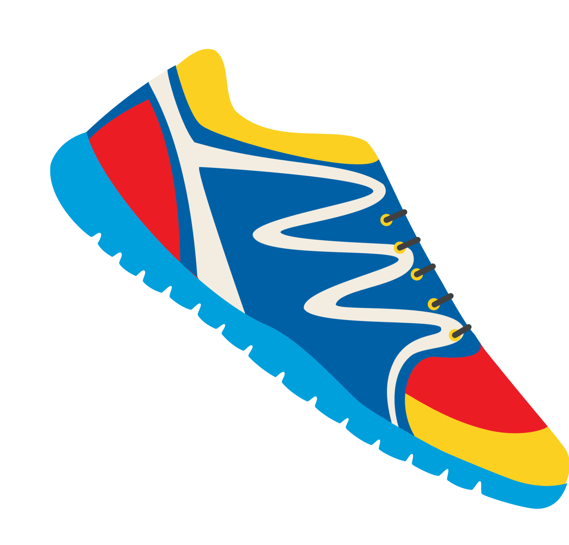

Let’s read a poem about keeping active and healthy!
Most of us, try to stay fit! And staying away, from the food we like, get's us in a snit! How is it possible, not to eat, what you like and not, have it show? Your mind, is telling you one thing, but it's awfully, hard to say no!
We're aware,
what is good for us, but how, can you turn away? There's so many tempting foods to eat, so how can you keep them at bay?
I guess, you have to go, with blinders on and not, admit you looked!
For if you do, you're in a whole lot of trouble. And it's then, your goose, is cooked!

Slide 19

Let’s Review!
- EA Words
- Simple Past Tense
- Irregular Verbs

Slide 20

Homework

