Slide 1
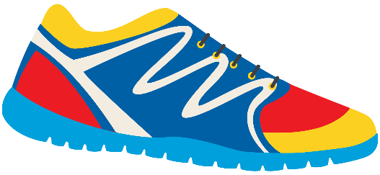
Keeping In Shape
Unit 6: Lesson 2

Slide 2
What will we be learning about?
“EA” Sounds
Simple past tense
Irregular verbs (run – ran, eat – ate, speak - spoke)
Keeping Healthy Poem

Slide 3
Last class we looked at “OY” and “OI” sounds. What are some words we came up with?
_______________ _______________ _______________ _______________ _______________ _______________ _______________ _______________

Slide 4
What sound does “E” make? What sound does “A” make? What do you think “EA” sounds like together?

Slide 5
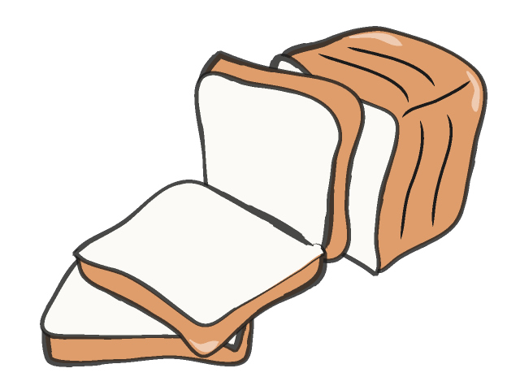
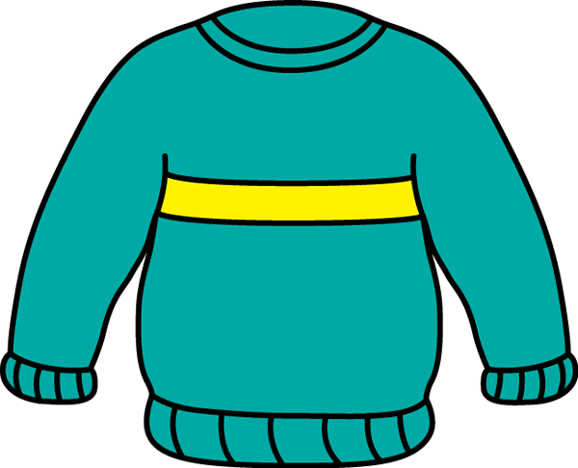
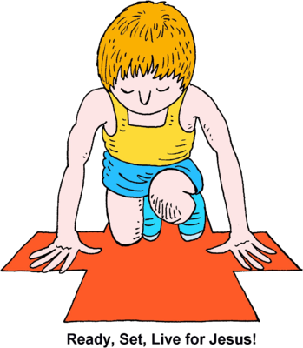
“EA” can make two different sounds
Let’s read these words together
Bread
Ready
Weather
Sweater

Slide 6
Use these words in a sentence!
I like to use ____________________ on my healthy sandwich.
When it is cold outside, I wear my favourite _____________________.
The _____________________ is cold and rainy today.
My coach told me to get _____________________ for the race.

Slide 7
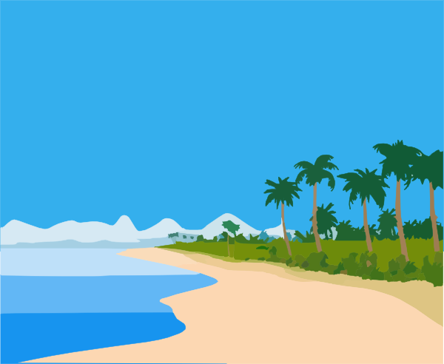
We just looked at “EA” words that make the short E sound.
Bread Beach
Do these words sound different? How?

Slide 8
You’re right! Beach makes a long “E” sound!

Slide 9
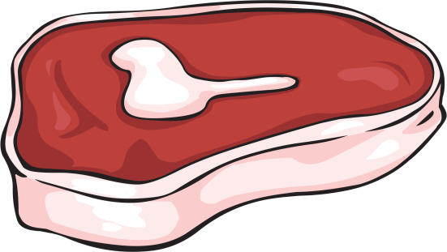
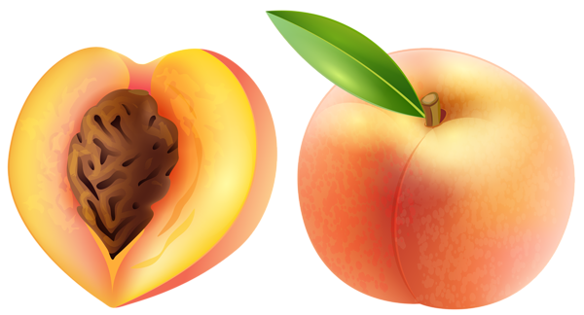
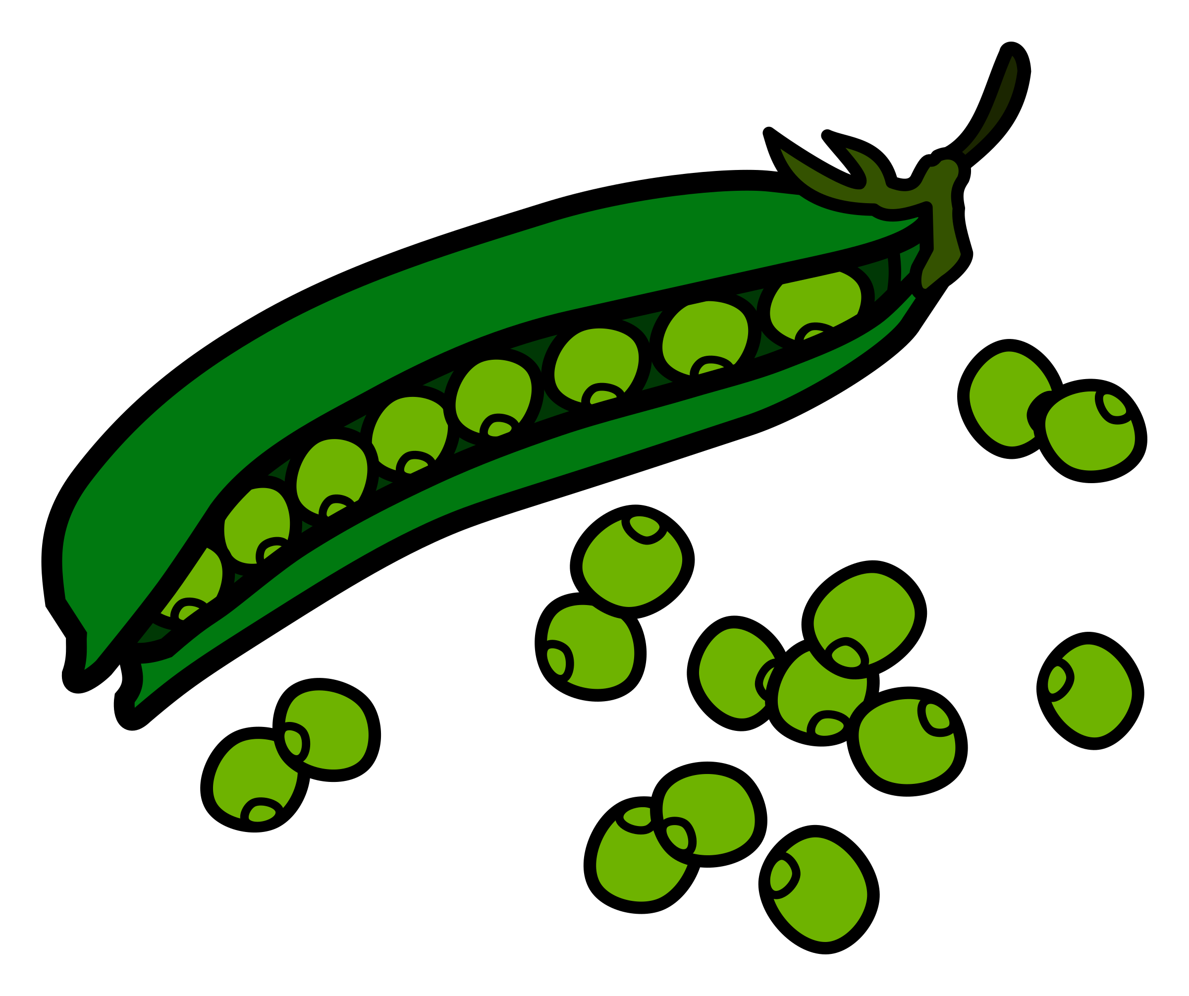
Try to think of some healthy foods that use the letters “EA”

Slide 10
Eating healthy helps to keep us in shape. Write a sentence about a healthy “EA” food you like to eat!
_____________________________________________________________
_____________________________________________________________
_____________________________________________________________
_____________________________________________________________
_____________________________________________________________

Slide 11
What other words have “EA” in them? Write one, then draw a picture for it.
_____________________________________
_____________________________________

Slide 12
Let’s play hangman! Use an “EA” word. Give us a hint – does it use a long “E” sound or short “E” sound?
_________________________________

Slide 13
Verbs! Review: What is a verb? What is a regular verb?

Slide 14
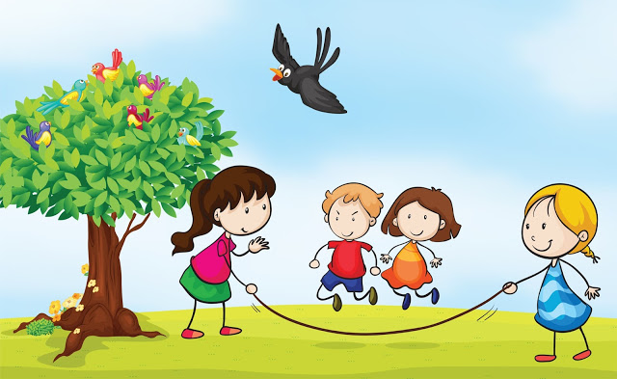
When using a regular verb in the past tense, what do we add to it?
I played with my friends outside all night long.

Slide 15
Simple Past Tense
Regular Verbs:
Play
Walk
Wash
Use these in a sentence!
I (play) _______________ outside with my friends last night. My mom (walk) ____________ with me to school. I (wash) __________________ my hands after I ate a sticky peach.

Slide 16
Past Tense: Irregular Verbs
What about these verbs? How would we use them in the past tense form?
Eat
Run
Speak
Swim
I swimmed?
I eated?
I runned?
I speaked?

Slide 17
No, we cannot just add “ED” to the end of every verb!
These are called irregular verbs.
Eat - Ate
Run - Ran
Speak - Spoke
Swim - Swam

Slide 18
Try to use them in a sentence.
I (eat) ____________________ a healthy dinner yesterday.
I (swim) ___________________ from one side of the pool to the other.
I (run) _____________________ all the way to school this morning.
I (speak) __________________ with my swim coach yesterday.

Slide 19
Think of more verbs (action words) that keep us active!
Are they regular or irregular? Can we just add “ED” on the end of the word?
Try it yourself – does it sound correct?
_______________ _______________ _______________ _______________ _______________ _______________ _______________ _______________

Slide 20
Write your own sentence using an irregular verb.
Tell me about a healthy activity you did in the past.
___________________________________
___________________________________
___________________________________

Slide 21
Let’s read a poem about keeping active and healthy!
Most of us, try to stay fit!
And staying away, from the food we like, get's us in a snit!
How is it possible, not to eat,
what you like and not, have it show?
Your mind, is telling you one thing, but
it's awfully, hard to say no!
We're aware, what is good for us,
but how, can you turn away?
There's so many tempting foods to eat,
so how can you keep them at bay? I guess, you have to go, with
blinders on and not, admit you looked!
For if you do, you're in a whole lot of
trouble. And it's then, your goose, is
cooked!

Slide 22
Let’s Review! - EA Words - Simple Past Tense
- Irregular Verbs

Slide 23
Homework

