Slide 1

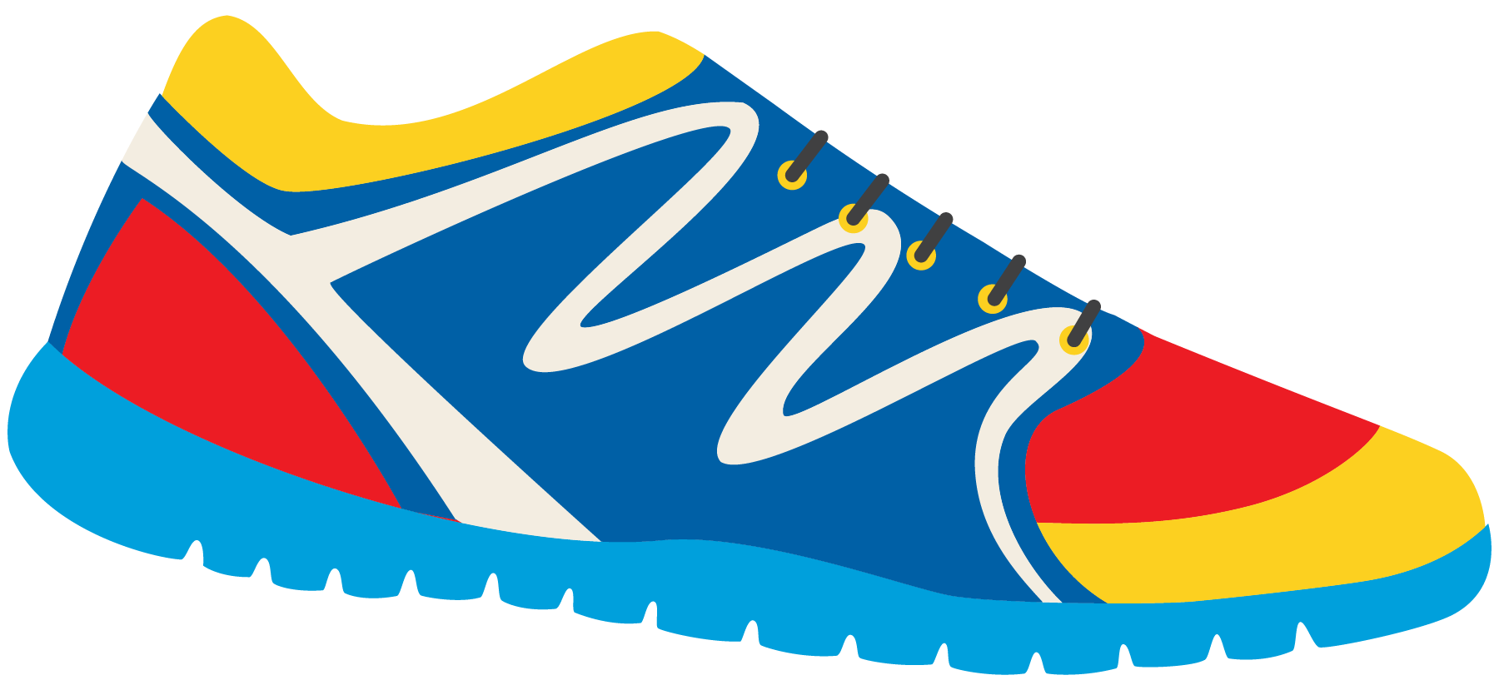

Keeping In Shape
Unit 6: Lesson 3

Slide 2


What will we be learning about?
“IE” Sounds
More simple past tense irregular verbs (go – went, feel – felt, give – gave, is – was)

Slide 3


In our class last week, we looked at “EA” words. What were some words you came up with?
Do they have a long E sound? Or a short E sound?

Slide 4

Today we are looking at “IE” words.
What are some that you can think of?

Slide 5


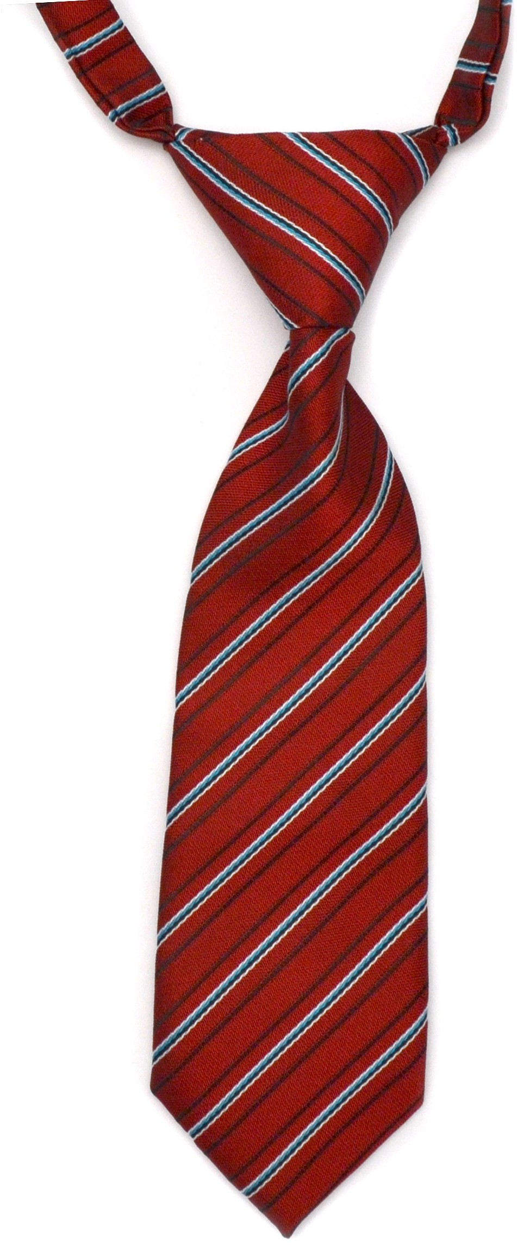
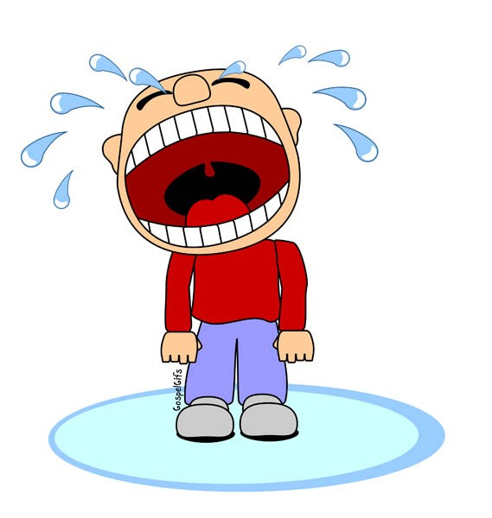
Use these pictures to help you think of more words!

Slide 6


Are these foods healthy?
What sorts of foods would help keep you in shape?

Slide 7
What have you noticed about IE words?
Do they make different sounds?
Pie
Cookie
How do they sound different? What letter do they sound like?

Slide 8
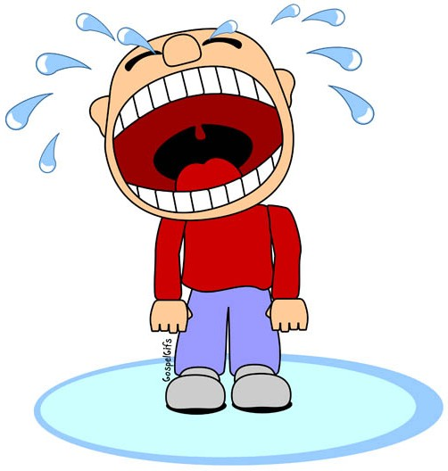
Let’s use some “IE” words in a sentence!
I like to eat
The baby every day!
My dad wears a

Slide 9
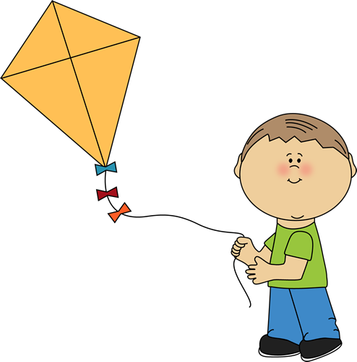
Billy likes to fly a kite to keep active. Write a sentence about Billy.
Start it like this: Billy flies…

Slide 10
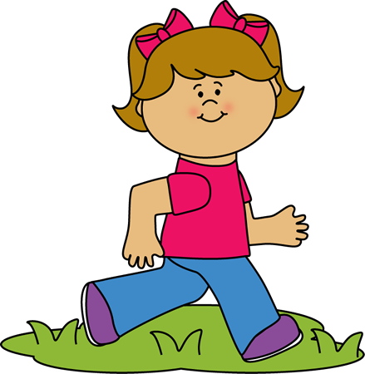
Try it again. We are going to write about Lucy. She ties her shoes before she goes for a run.

Slide 11



Let’s play hangman! Use an “IE” word.
Give us a hint – does it use a long “I” sound or a “Y” sound?

Slide 12
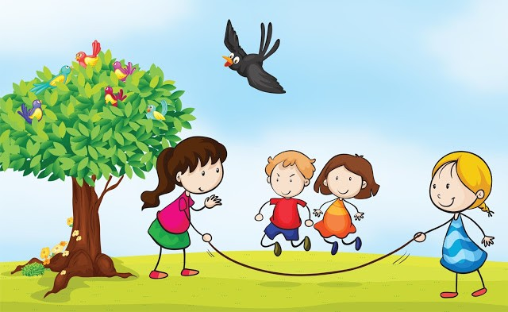
Review: When using a regular verb in the past tense, what do we add to it?
I played with my friends outside all night long.

Slide 13
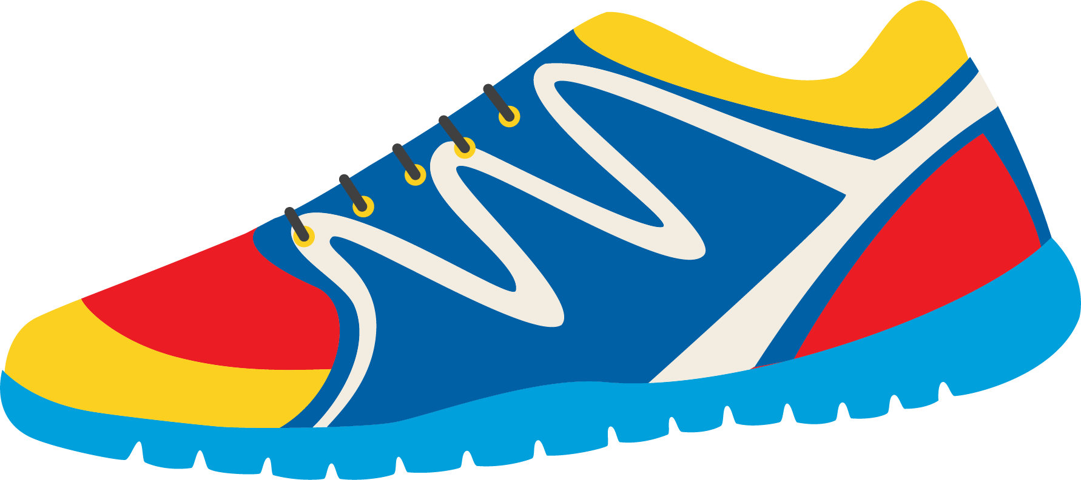
Past Tense: Irregular Verbs
What about these verbs? How would we use them in the past tense form?
Go
Feel
Give
Is
I feeled?
I is?

Slide 14

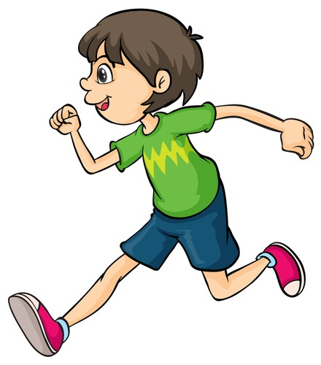

There are no rules for these words, we simply must remember how to use them in the past tense.
Let’s read these sentences together. Which makes more sense? What sounds better?
I go to the store last night.
I went to the store last night.
I feel tired after my race today. I felt tired after my race today.

Slide 15

Try to use them in a sentence.
I (go) to the gymnasium last night.
I (feel) hungry after my soccer game.
I (give) my sister an apple to eat yesterday.
I (is) ahead of all of the runners in the race yesterday.

Slide 16


Write your own sentence using an irregular verb.
Tell me about a healthy activity you did in the past.

Slide 17
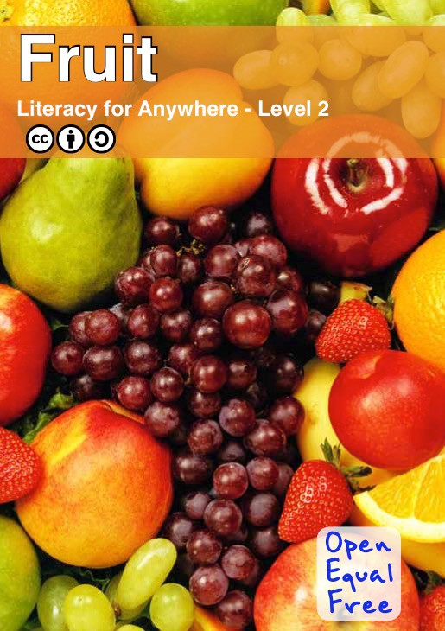

Slide 18
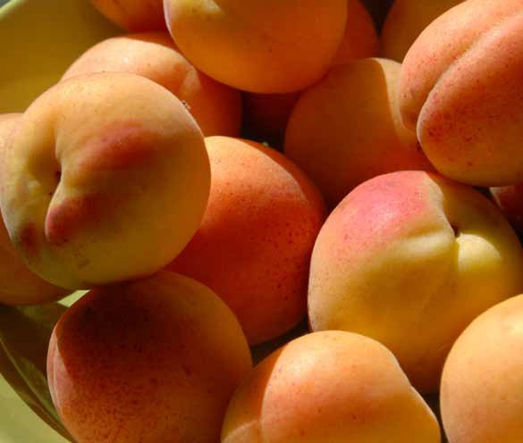
Fruit grows on plants all over the world. Different fruits come from different countries. These are apricots from Armenia.
Fruit
Level 2
iii
1

Slide 19
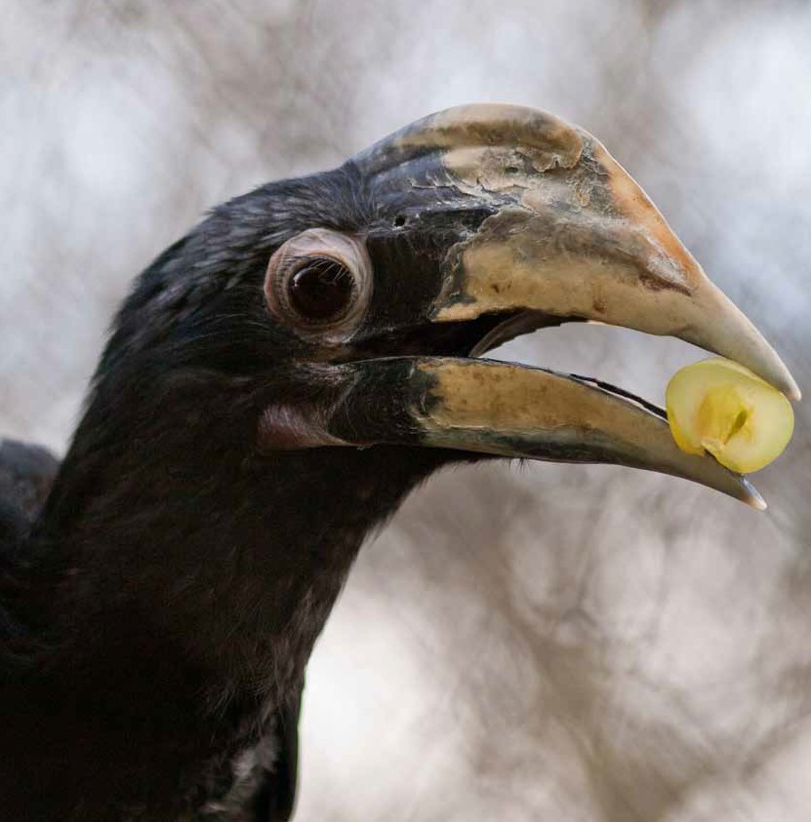
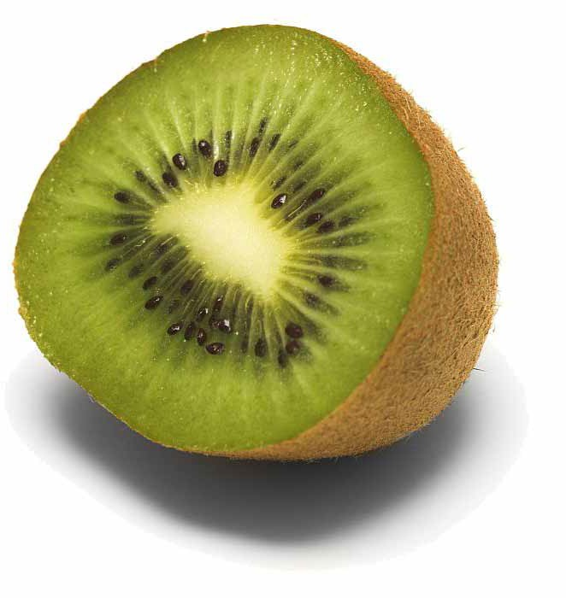
Fruits and vegetables are different. Fruits have seeds but vegetables don’t. Some seeds are very big, like in a peach. Some seeds are tiny, like in a kiwi.
Fruits have seeds to make new plants. When animals eat fruit they carry the seeds far away. This lets plants grow in new places.
2
3

Slide 20
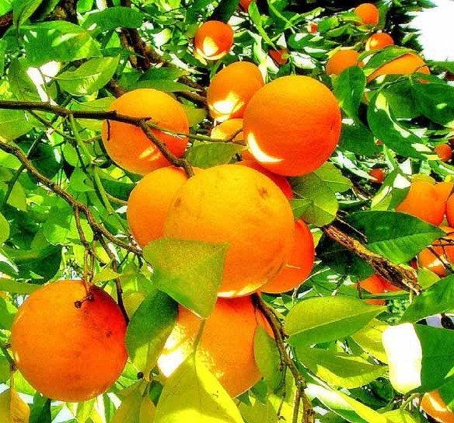
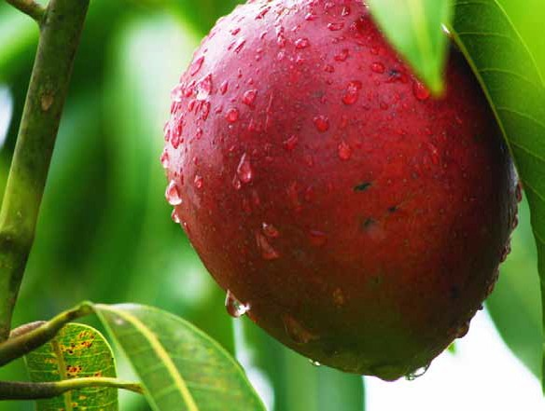
Some countries can grow more fruit than
others. Countries that are warm can grow many fruits. Mangoes grow well in warm countries.
Fruit is good to eat. It is good for our bodies. Fruits have vitamins that make us healthy. These are Oranges. They have a lot of vitamin C.
10
11

Slide 21
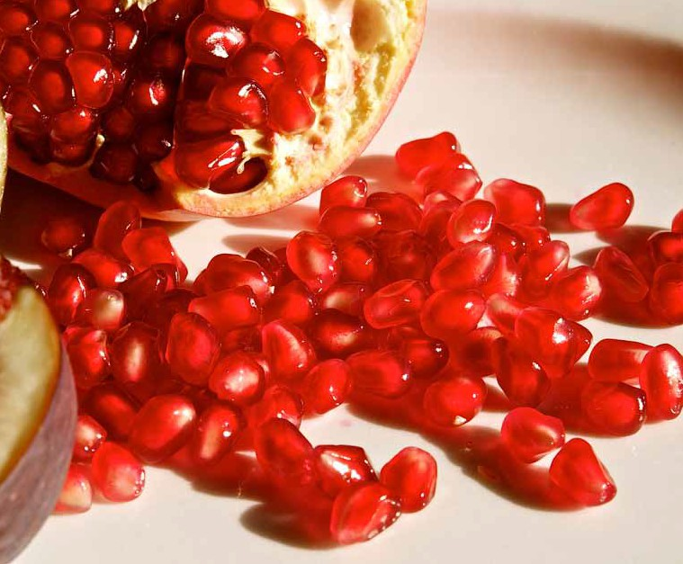
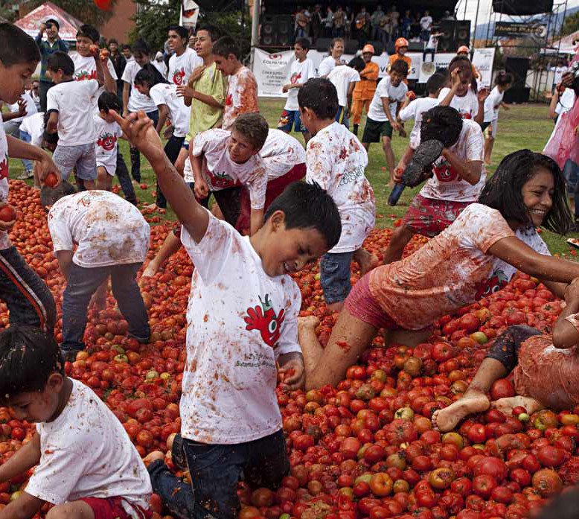
Sometimes fruit can make a mess. In some countries there is a special party where people throw tomatoes at each other. It is called Tomatina.
Fruit is an important part of the world. Fruit allows plants to make new plants. Fruit gives us food to eat. It is an important way that animals and plants work together.
20
21

