Slide 1

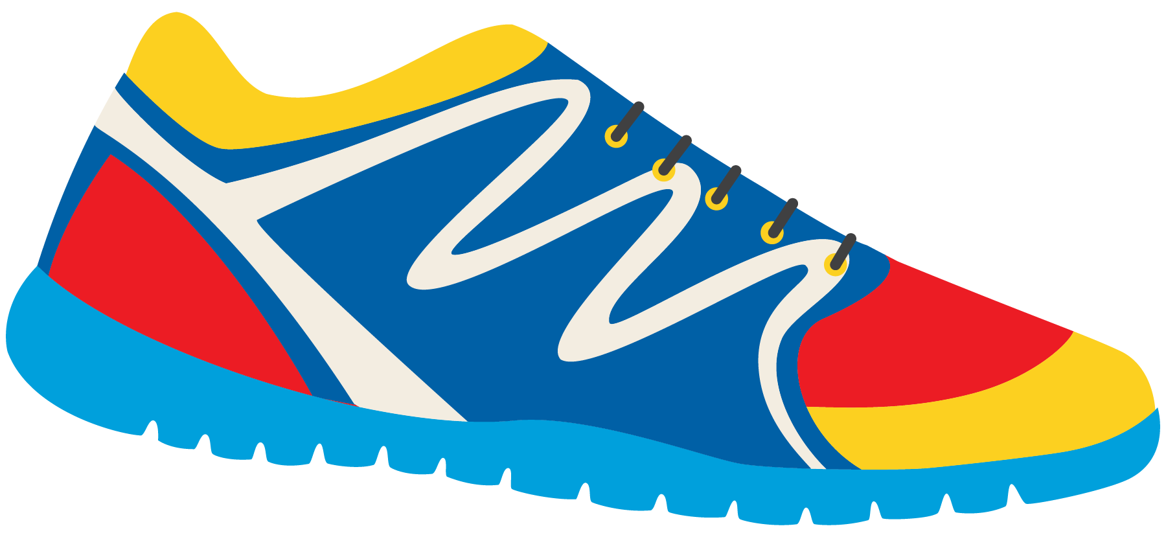

Keeping In Shape
Unit 6: Lesson 3

Slide 2

What will we be learning about?
“IE” Sounds
More simple past tense irregular verbs (go – went, feel – felt, give – gave, is – was)

Slide 3

In our class last week, we looked at “EA” words. What were some words you came up with? Do they have a long E sound? Or a short E sound?
_______________ _______________ _______________ _______________ _______________ _______________ _______________ _______________

Slide 4
Today we are looking at “IE” words.
What are some that you can think of? What sound does “IE” make?

Slide 5
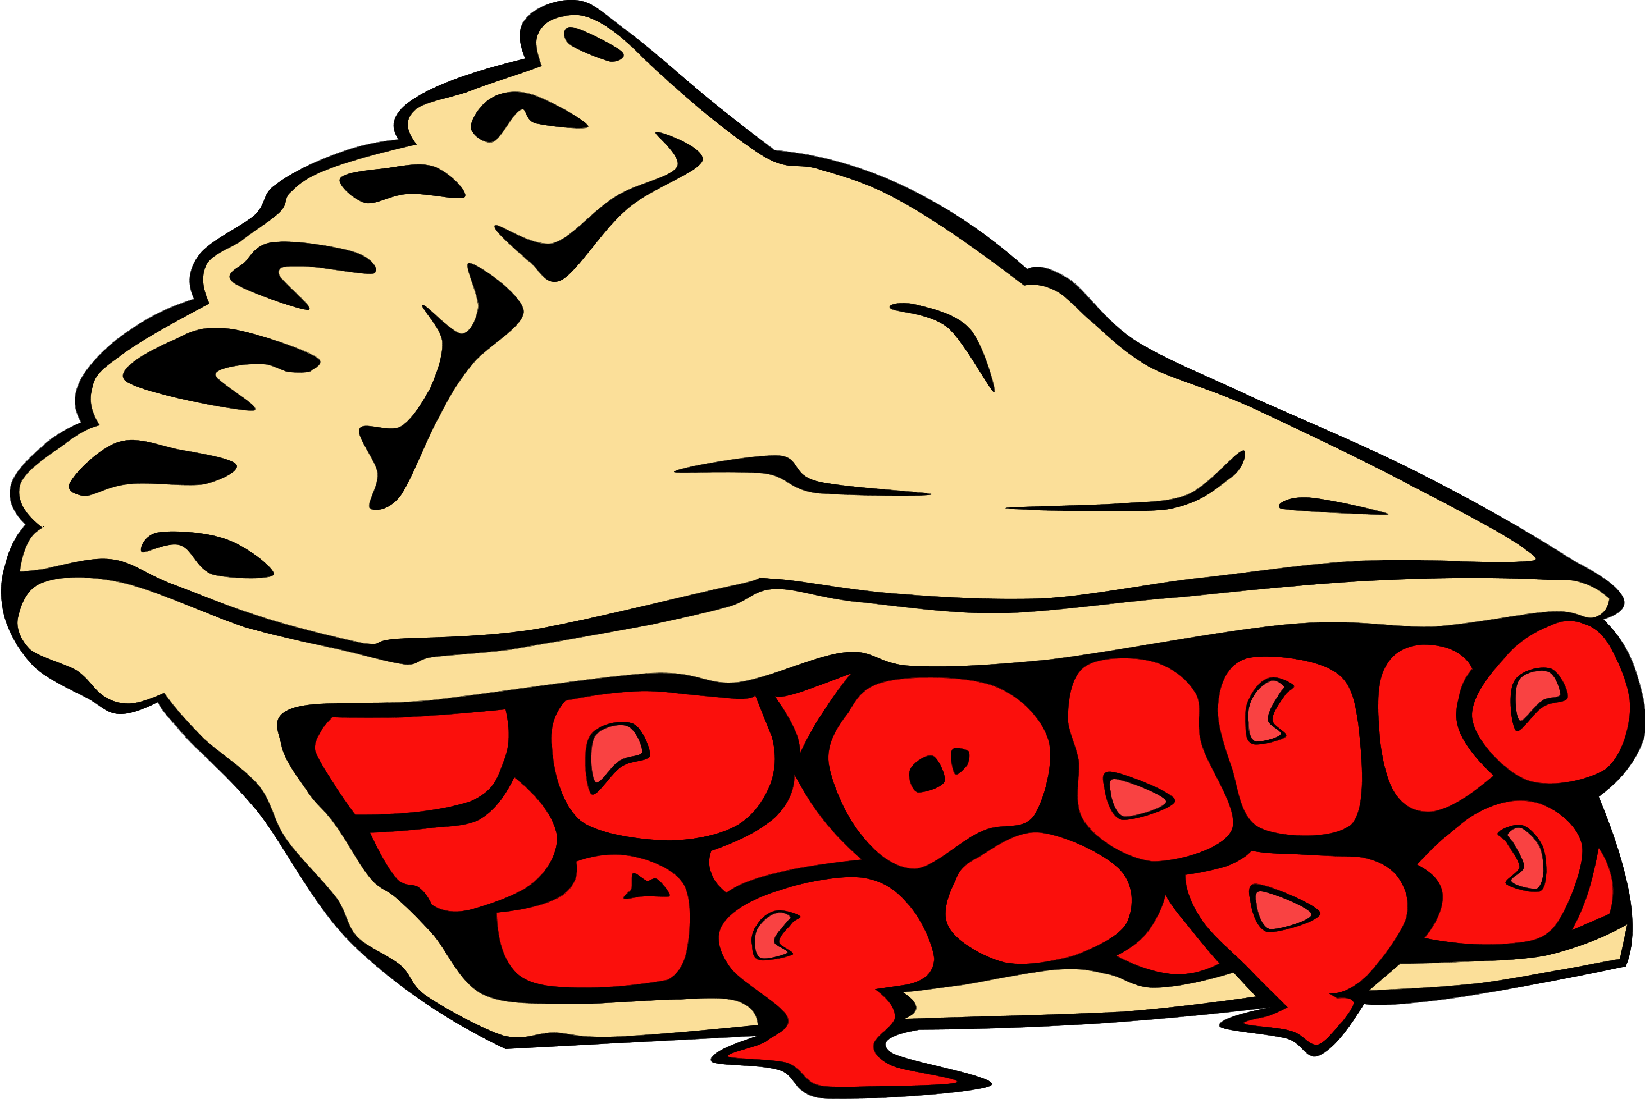

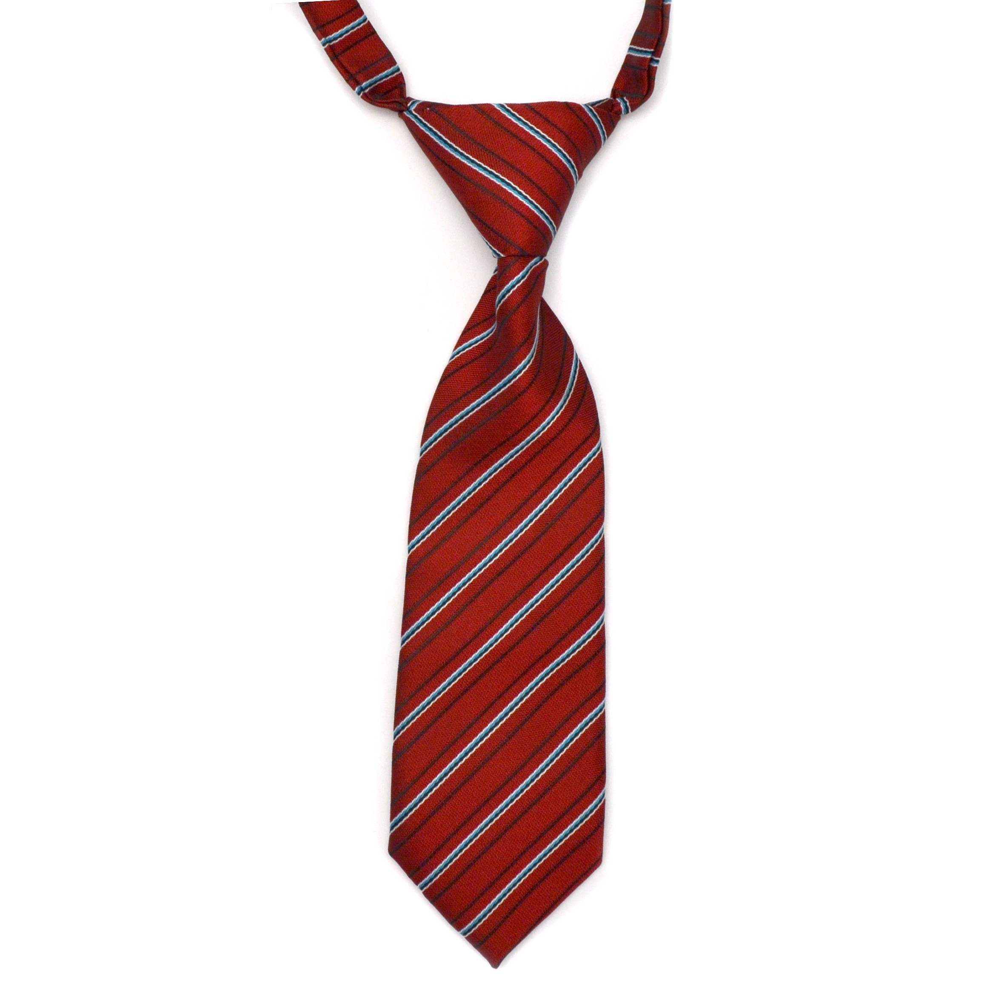
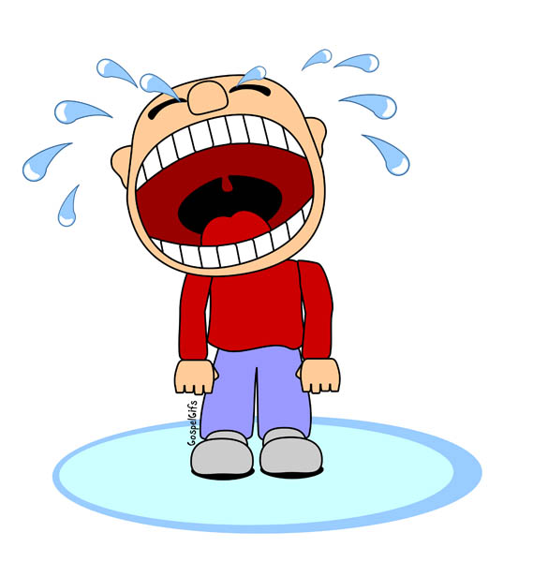
Use these pictures to help you think of more words!

Slide 6

Are these foods healthy?
What sorts of foods would help keep you in shape?

Slide 7
What have you noticed about IE words? Do they make different sounds?
Pie Cookie
How do they sound different? What letters do they sound like?

Slide 8

You’re right! They make a long I and a Y sound!

Slide 9
Let’s use some “IE” words in a sentence!
I like to eat _______________________________
The baby ___________________ every day!
My dad wears a ______________________________

Slide 10
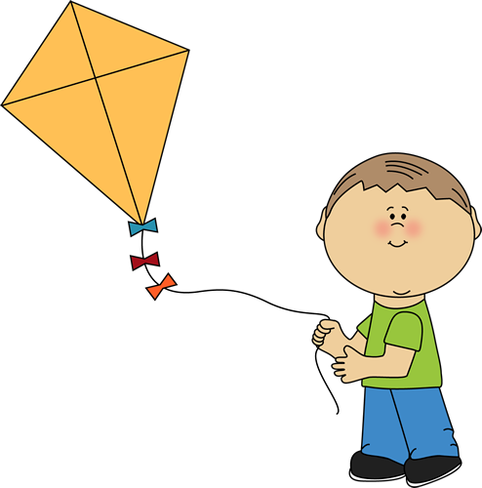
Billy likes to fly a kite to keep active. Write a sentence about Billy. Start it like this: Billy flies…
_____________________________________________________________
_____________________________________________________________
_____________________________________________________________
_____________________________________________________________
_____________________________________________________________

Slide 11
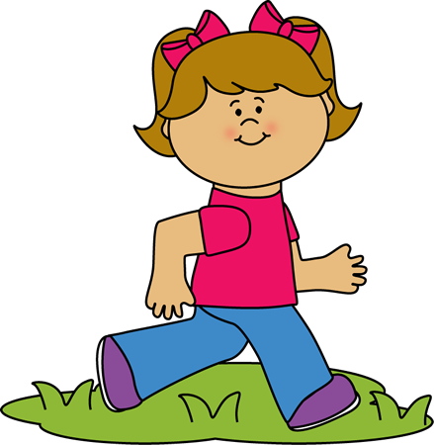
Try it again. We are going to write about Lucy. She ties her shoes before she goes for a run.
_____________________________________________________________
_____________________________________________________________
_____________________________________________________________
_____________________________________________________________
_____________________________________________________________

Slide 12


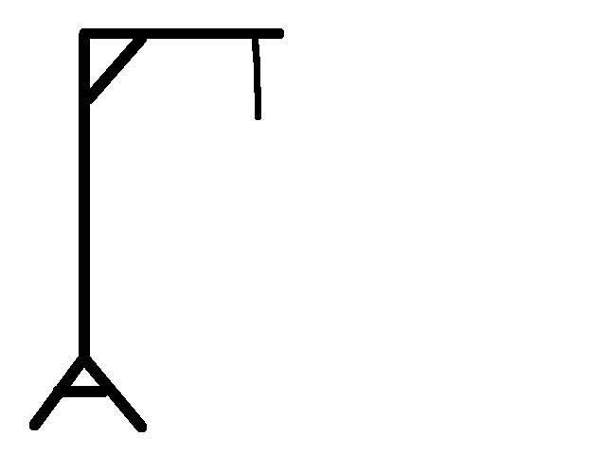
Let’s play hangman! Use an “IE” word. Give us a hint – does it use a long “I” sound or a “Y” sound?
_________________________________

Slide 13
More Irregular Verbs! Review: What is an irregular verb? What is a past verb? Do you know any examples?

Slide 14
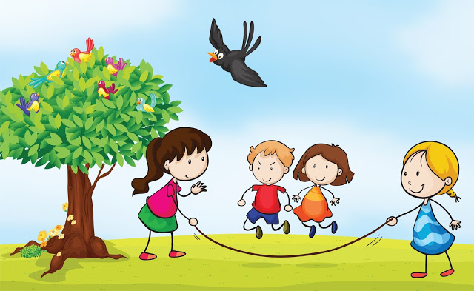
Review: When using a regular verb in the past tense, what do we add to it?
I played with my friends outside all night long.

Slide 15
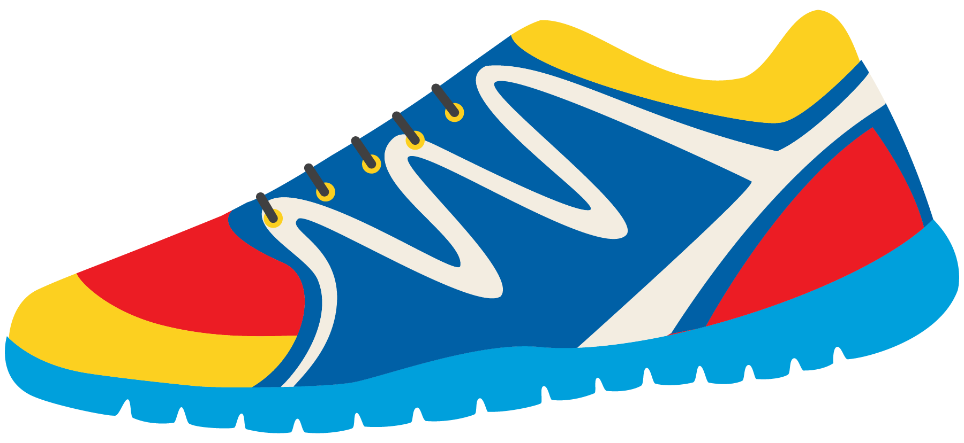
Past Tense: Irregular Verbs
What about these verbs? How would we use them in the past tense form?
Go
Feel
Give
Is
I gived?
I goed?
I feeled?
I is?

Slide 16
No, we cannot just add “ED” to the end of every verb!
These are called irregular verbs.
Go – Went
Feel – Felt
Give – Gave
Is - Was

Slide 17
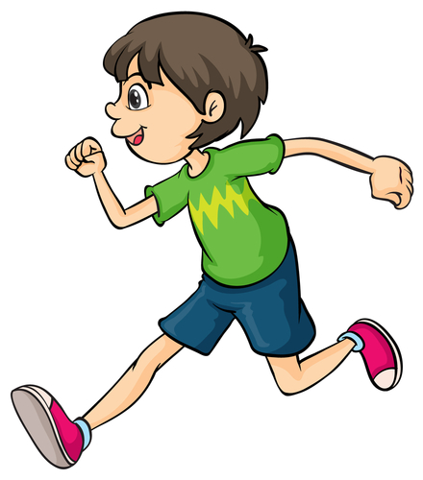
There are no rules for these words, we simply must remember how to use them in the past tense.
Let’s read these sentences together. Which makes more sense? What sounds better?
I go to the store last night.
I went to the store last night.
I feel tired after my race today.
I felt tired after my race today.

Slide 18
Try to use them in a sentence.
I (go) ____________________ to the gymnasium last night.
I (feel) ___________________ hungry after my soccer game.
I (give) _____________________ my sister an apple to eat yesterday.
I (is) __________________ ahead of all of the runners in the race yesterday.

Slide 19
Write your own sentence using an irregular verb.
Tell me about a healthy activity you did in the past.
___________________________________
___________________________________
___________________________________

Slide 20
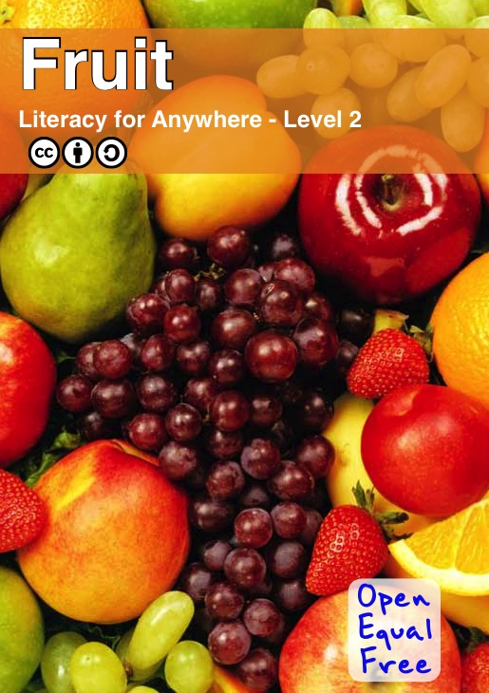

Slide 25
Review How is fruit good for us? What does fruit do to our bodies? How is it good for the Earth?

Slide 26
Let’s Review! - IE Words - Past Tense Irregular Verbs
Writing Sentences
Fruit Book

Slide 27
Homework
Do you have any questions?

