Slide 1

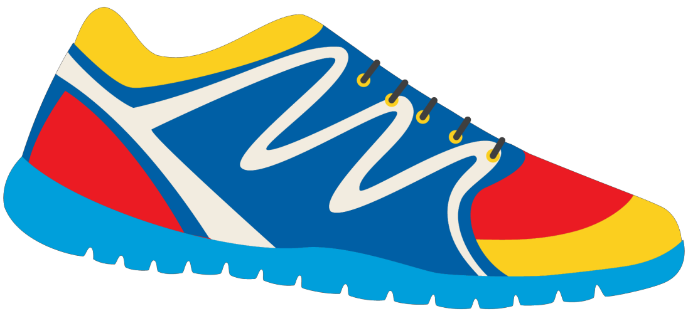

Keeping In Shape
Unit 6: Lesson 4

Slide 2


This class is a review!
“OY”, “EA”, and “IE” sounds
Simple past tense irregular
verbs
Using our senses
Healthy activities and foods!

Slide 3


We learned about the OY, EA, and IE sounds.
Let’s list a few words from each sound!
“OY” Words “EA” Words “IE” Words

Slide 4



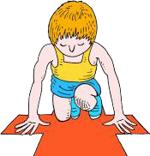

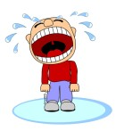
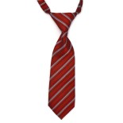

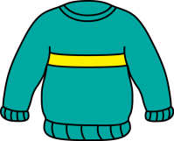



Write the sound next to the picture!
“EA”, “OY”, or “IE”?

Slide 5
Complete the sentences
I like to use ____________________ on my healthy sandwich.
When it is cold outside, I wear my favourite _____________________.
When it is cold outside, I dream of going to a sandy ________________.
My favourite dessert is ______________. I like apple, cherry, and blueberry!
My dad wears a ______________ when he goes to work.

Slide 6


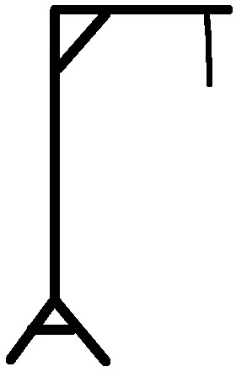
Let’s play hangman! Use an “OY”, “EA”, or “IE” word.
Give us a hint – what sound do the letters make?

Slide 7

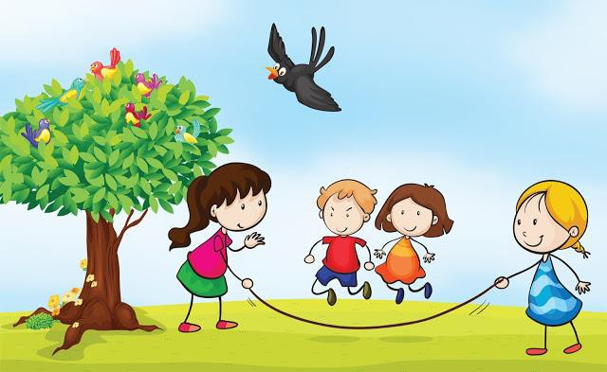
Imagine you are playing outside with your friends. What do you see? What do you smell? Hear? Touch? Taste?

Slide 8
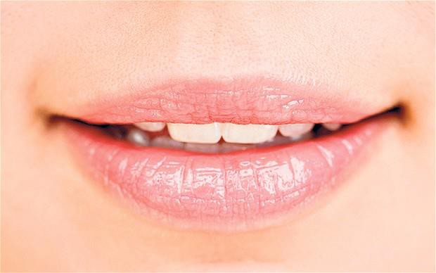
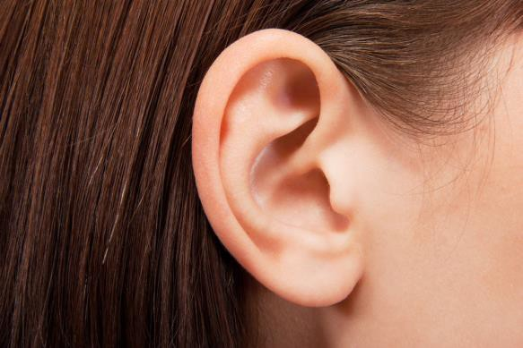
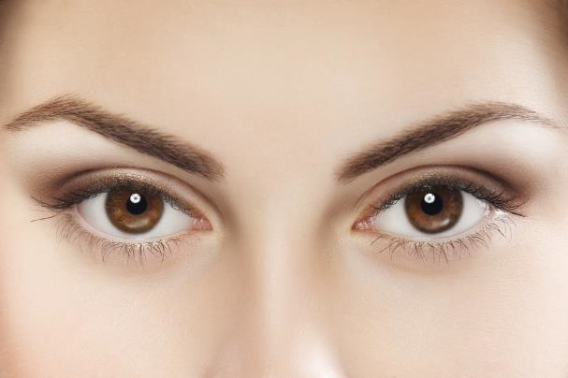
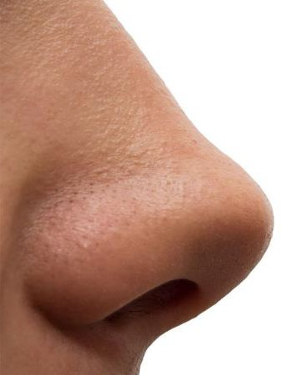
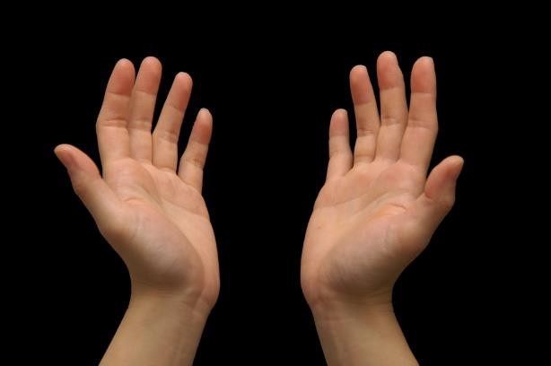
Use these photos to help you think of what you would see, smell, touch, taste and hear outside. Write one sentence for each sense.

Slide 9

Take some time to think about this scene. What healthy snacks would you bring with
you?

Slide 10
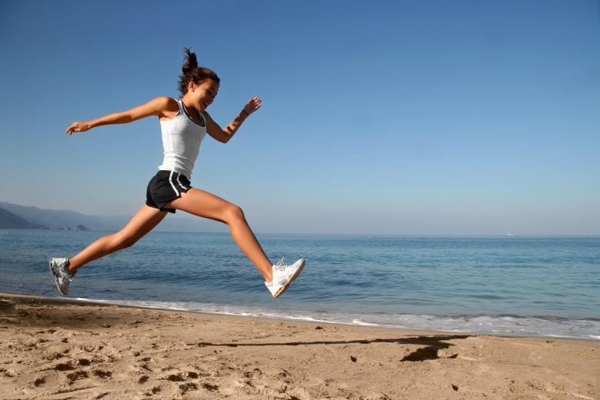
Predicting Events
What do you think will happen next in this photo? Write one sentence and share what you think with us.

Slide 11

Now let’s look at
past tense
irregular verbs
Do you remember some irregular verbs we talked about?
Type them below.

Slide 12

Let’s Practice!
I (eat) a healthy dinner yesterday.
I (swim) from one side of the pool to
the other.
I (run) all the way to school this
morning.
I (speak) with my swim coach yesterday.

Slide 13
More Practice!
I (go) to the gymnasium last night.
I (feel) hungry after my soccer game. I (give) my sister an apple to eat
yesterday.
I (is) ahead of all of the runners in the race yesterday.

Slide 14
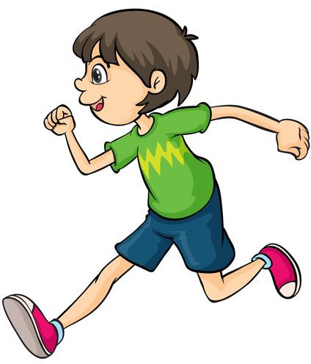

Review of
Irregular Verbs
Let’s make sure we all
understand irregular verbs!
Pick one verb we practiced and write a sentence using your verb!

Slide 15
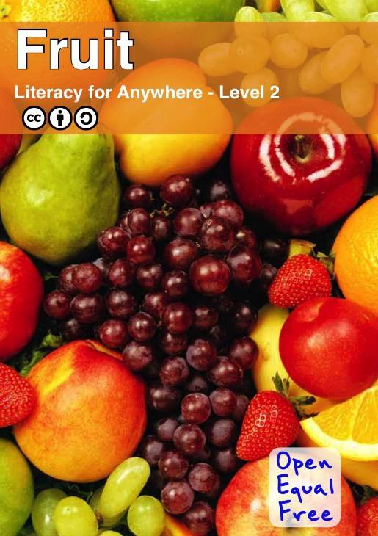
Last week, we read a book about fruit!
List 5 facts about fruit.
Use these questions to help
you.
How do they benefit us? What are they good for?
What kinds of fruits are
there?
Where does fruit grow well?

Slide 16

Draw a picture of a new fruit you learned
about.
Write the name of the fruit
beside the picture. Would you like to taste the fruit
one day?

Slide 17

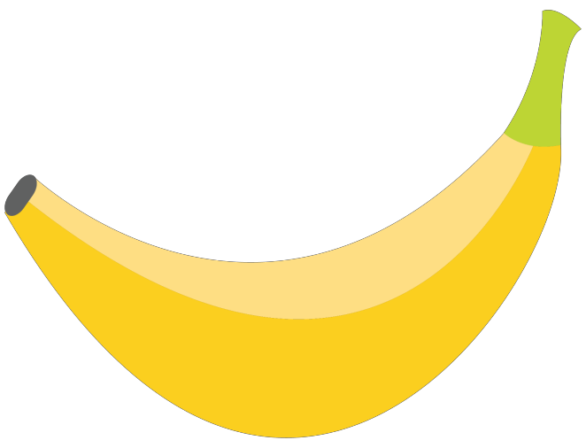
Review
“OY”, “EA”, and “IE” words Using our senses Irregular Verbs
Fruit

Slide 18
Homework
Do you have any questions?

