Slide 1
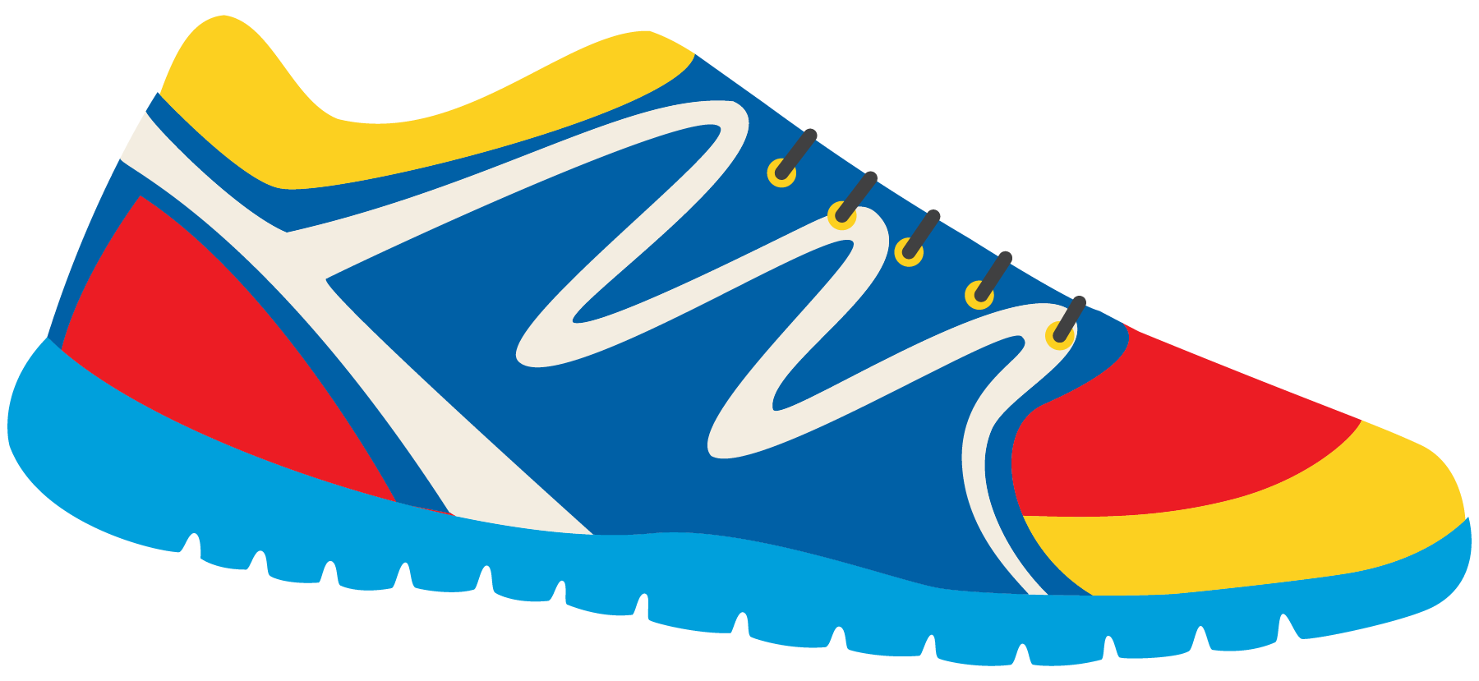
Keeping In Shape
Unit 6: Lesson 4

Slide 2
This class is a review!
“OY”, “EA”, and “IE” sounds
Simple past tense irregular verbs
Using our senses
Healthy activities and foods!

Slide 3
We learned about the OY, EA, and IE sounds. Let’s list a few words from each sound!
“OY” Words
“EA” Words
“IE” Words

Slide 4
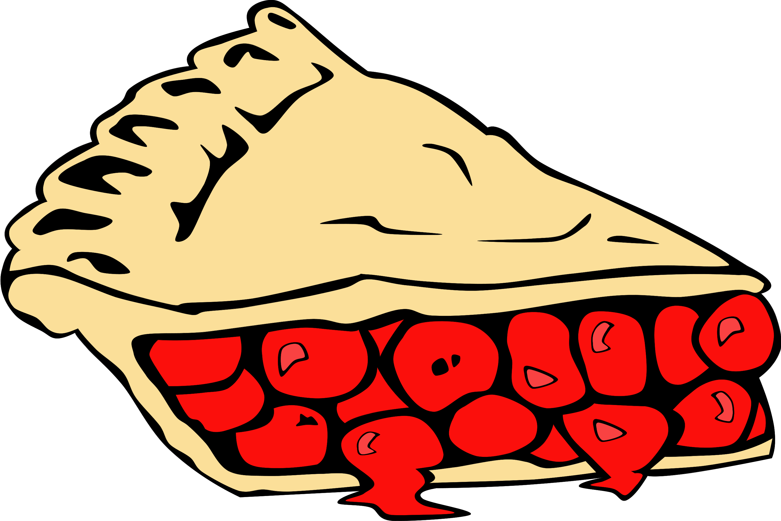
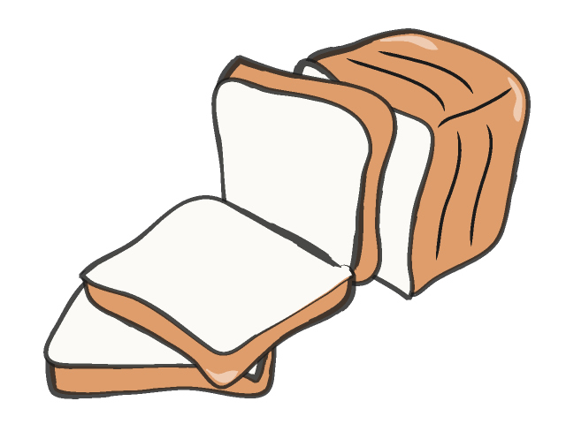
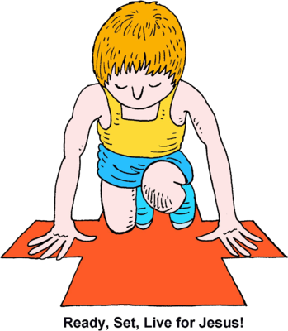
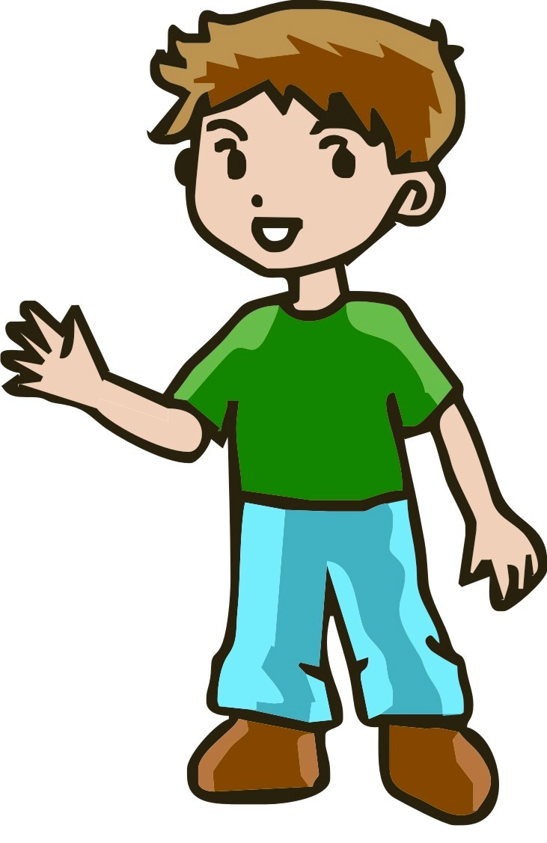
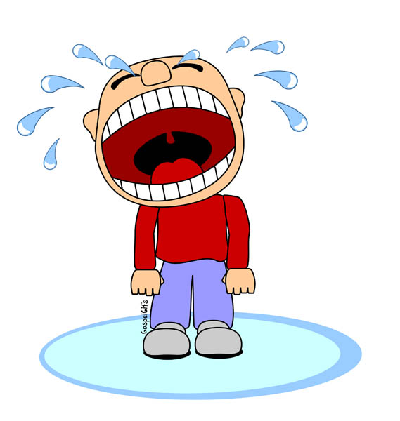
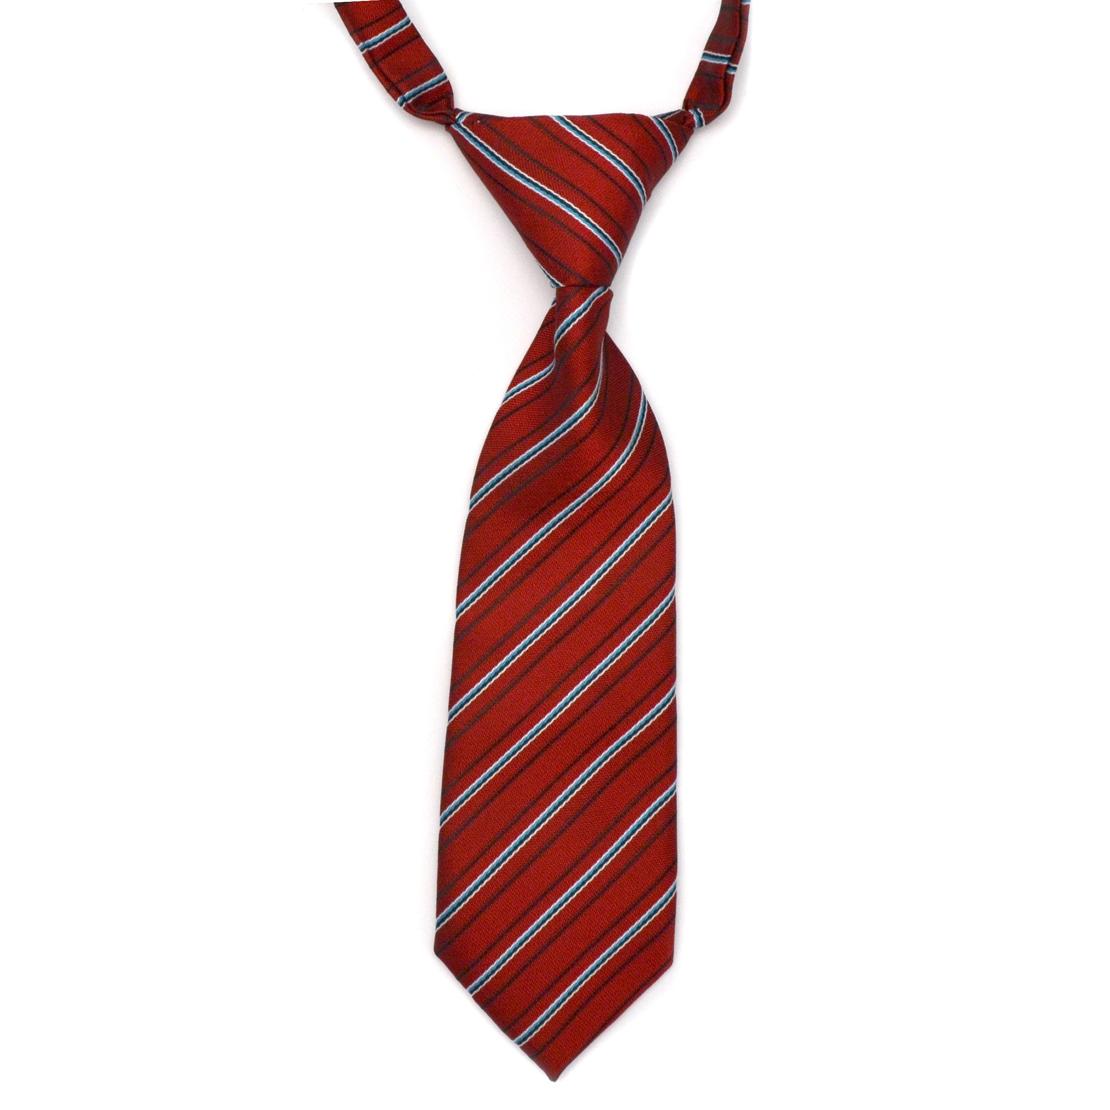
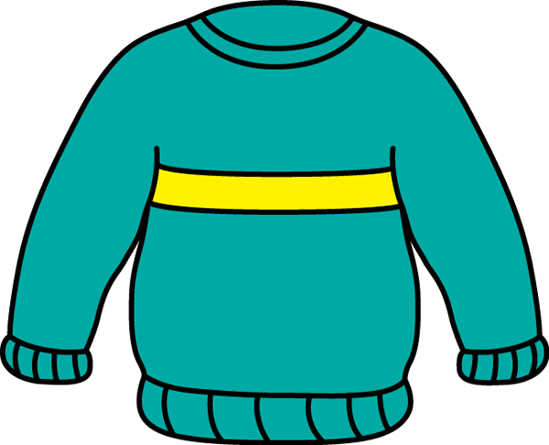
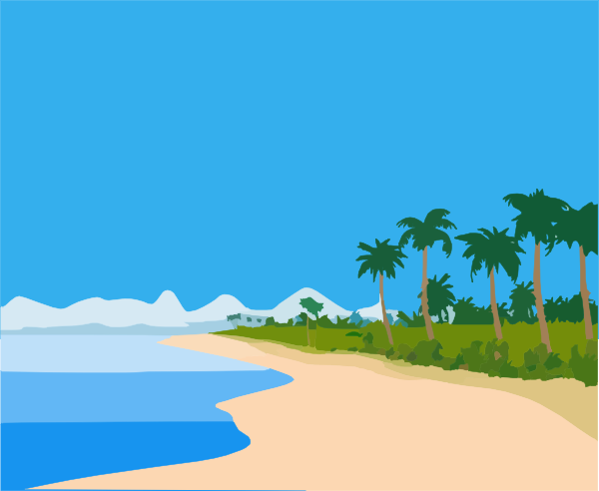
Write the sound next to the picture!
“EA”, “OY”, or “IE”?

Slide 5
Complete the sentences
I like to use ____________________ on my healthy sandwich.
When it is cold outside, I wear my favourite _____________________.
When it is cold outside, I dream of going to a sandy ________________.
My favourite dessert is ______________. I like apple, cherry, and blueberry!
My dad wears a ______________ when he goes to work.

Slide 6
Let’s play hangman! Use an “OY”, “EA”, or “IE” word. Give us a hint – what sound do the letters make?
_________________________________

Slide 7
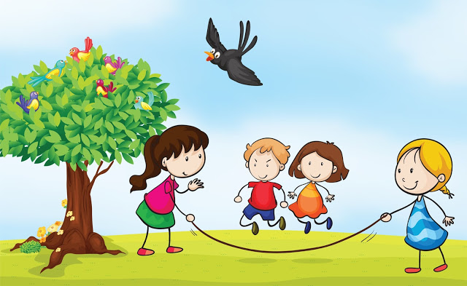
Imagine you are playing outside with your friends. What do you see? What do you smell? Hear? Touch? Taste?

Slide 8
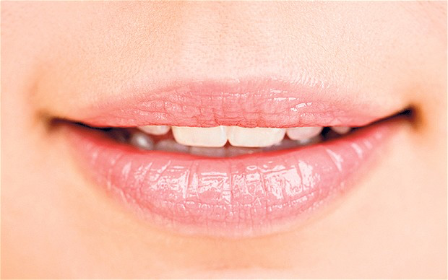
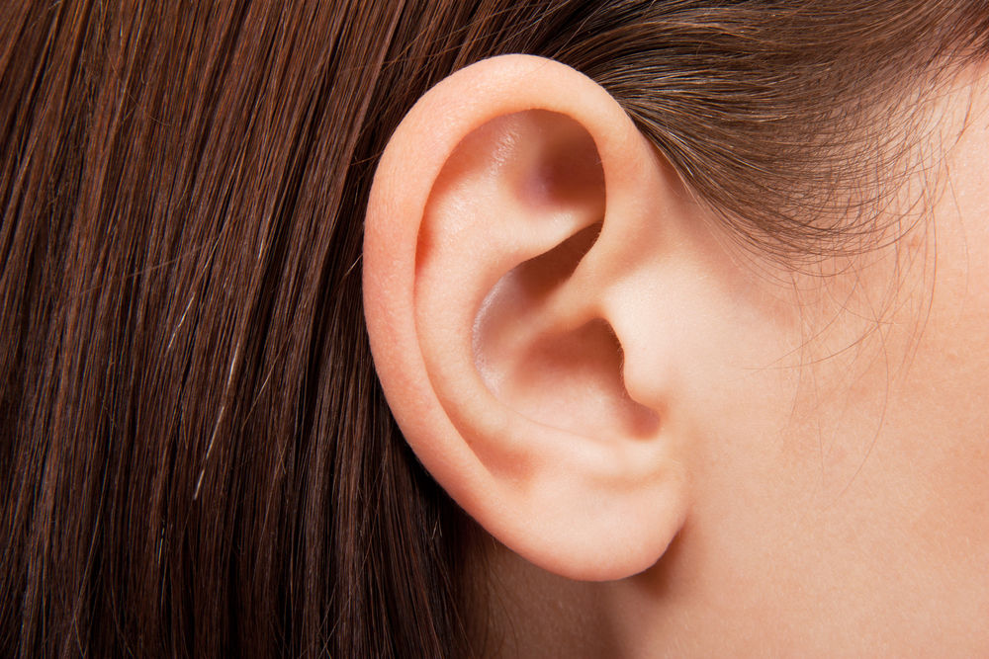
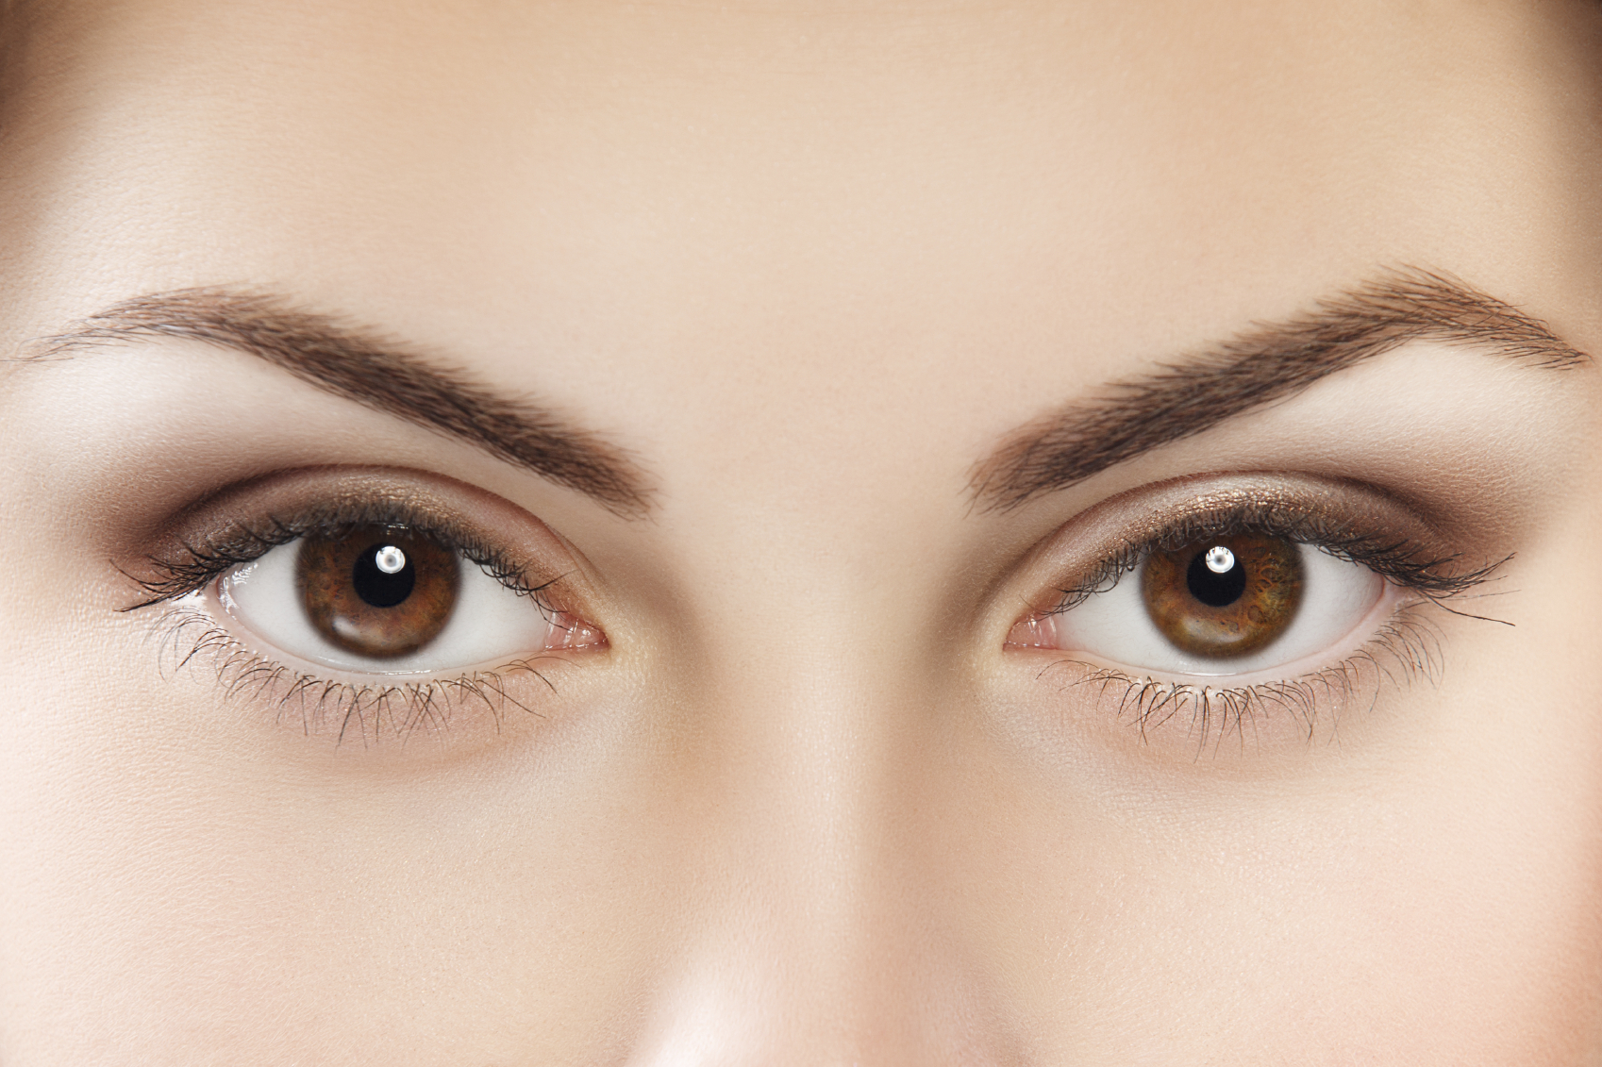
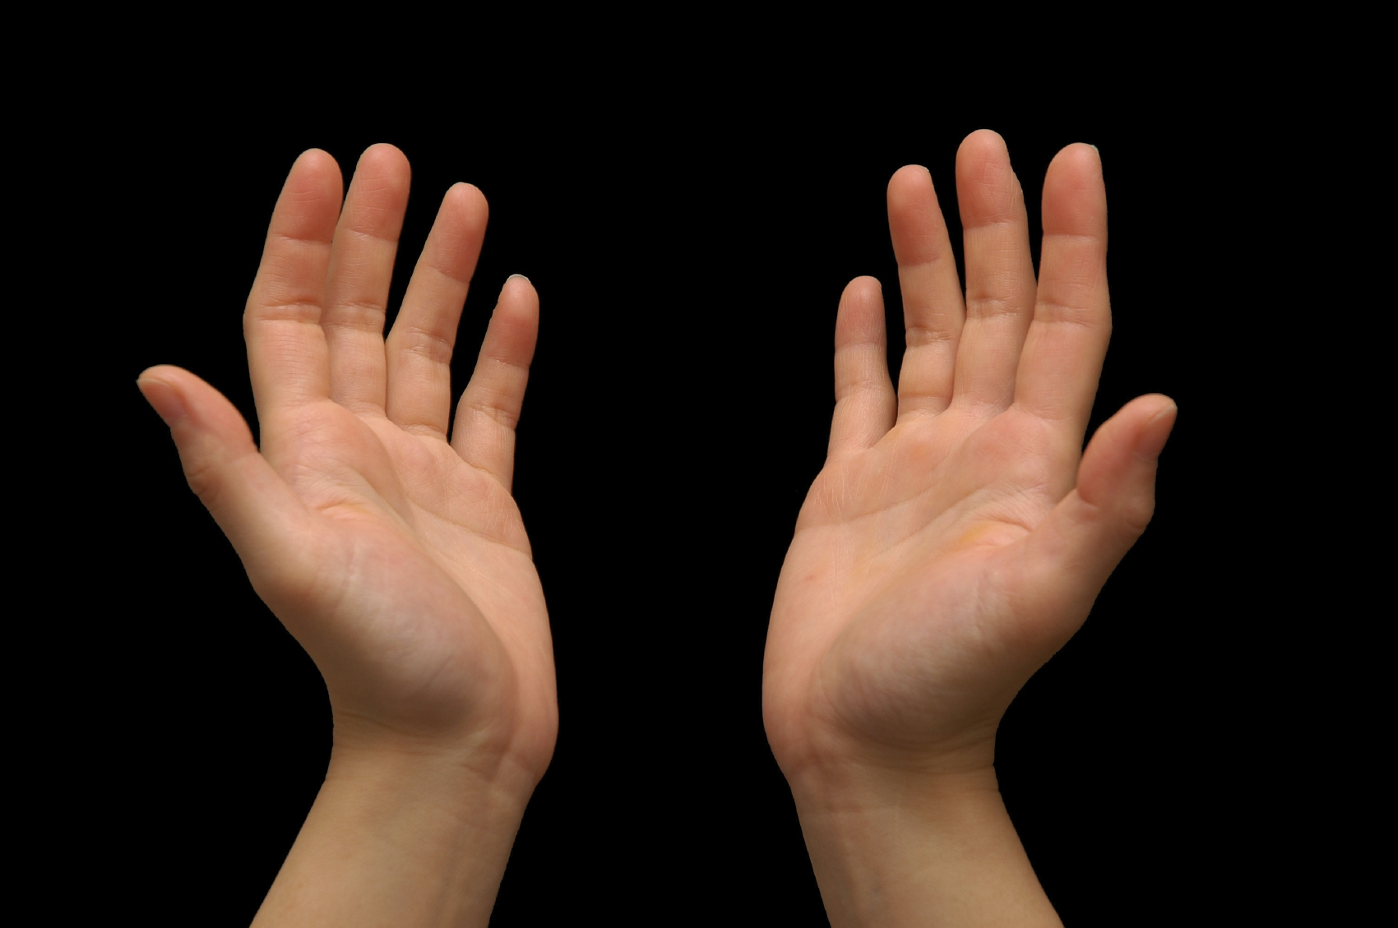
Use these photos to help you think of what you would see, smell, touch, taste and hear outside. Write one sentence for each sense.

Slide 9
Take some time to think about this scene. What healthy snacks would you bring with you?

Slide 10
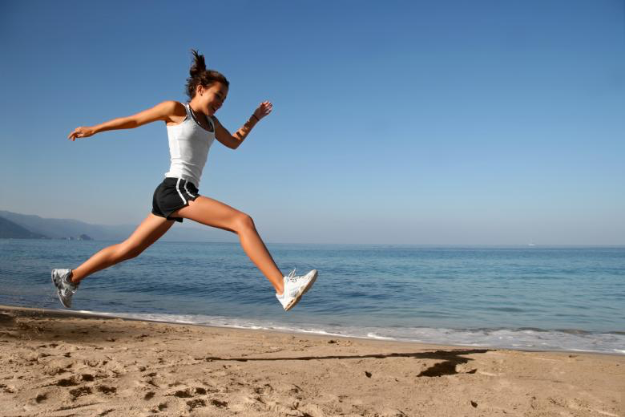
Predicting Events
What do you think will happen next in this photo? Write one sentence and share what you think with us.

Slide 11
Now let’s look at past tense irregular verbs
Do you remember some irregular verbs we talked about? Type them below.

Slide 12
Let’s Practice!
I (eat) ____________________ a healthy dinner yesterday.
I (swim) ___________________ from one side of the pool to the other.
I (run) _____________________ all the way to school this morning.
I (speak) __________________ with my swim coach yesterday.

Slide 13
More Practice!
I (go) ____________________ to the gymnasium last night.
I (feel) ___________________ hungry after my soccer game.
I (give) _____________________ my sister an apple to eat yesterday.
I (is) __________________ ahead of all of the runners in the race yesterday.

Slide 14
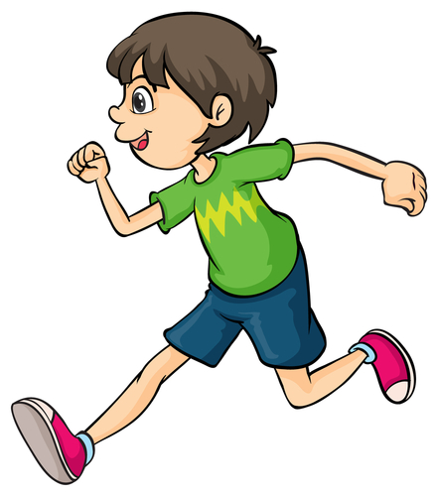
Review of Irregular Verbs
Let’s make sure we all understand irregular verbs!
Pick one verb we practiced and write a sentence using your verb!

Slide 15
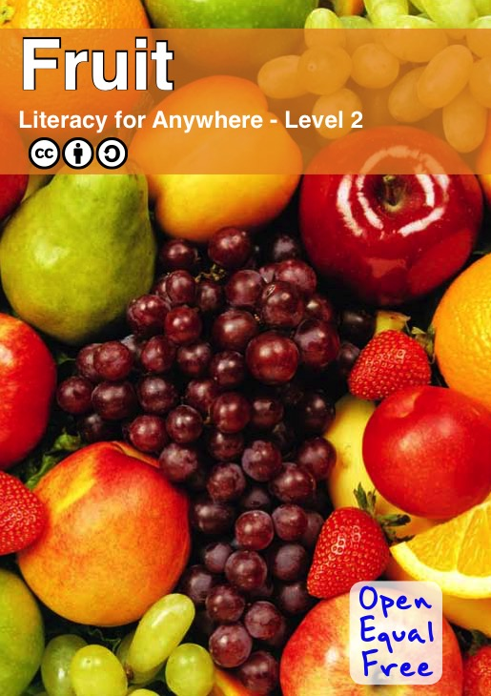
Last week, we read a book about fruit!
List 5 facts about fruit.
Use these questions to help you.
How do they benefit us? What are they good for? What kinds of fruits are there?
Where does fruit grow well?

Slide 16
Draw a picture of a new fruit you learned about.
Write the name of the fruit beside the picture. Would you like to taste the fruit one day?

Slide 17
Review
“OY”, “EA”, and “IE” words
Using our senses
Irregular Verbs
Fruit

Slide 18
Homework
Do you have any questions?

