Slide 1

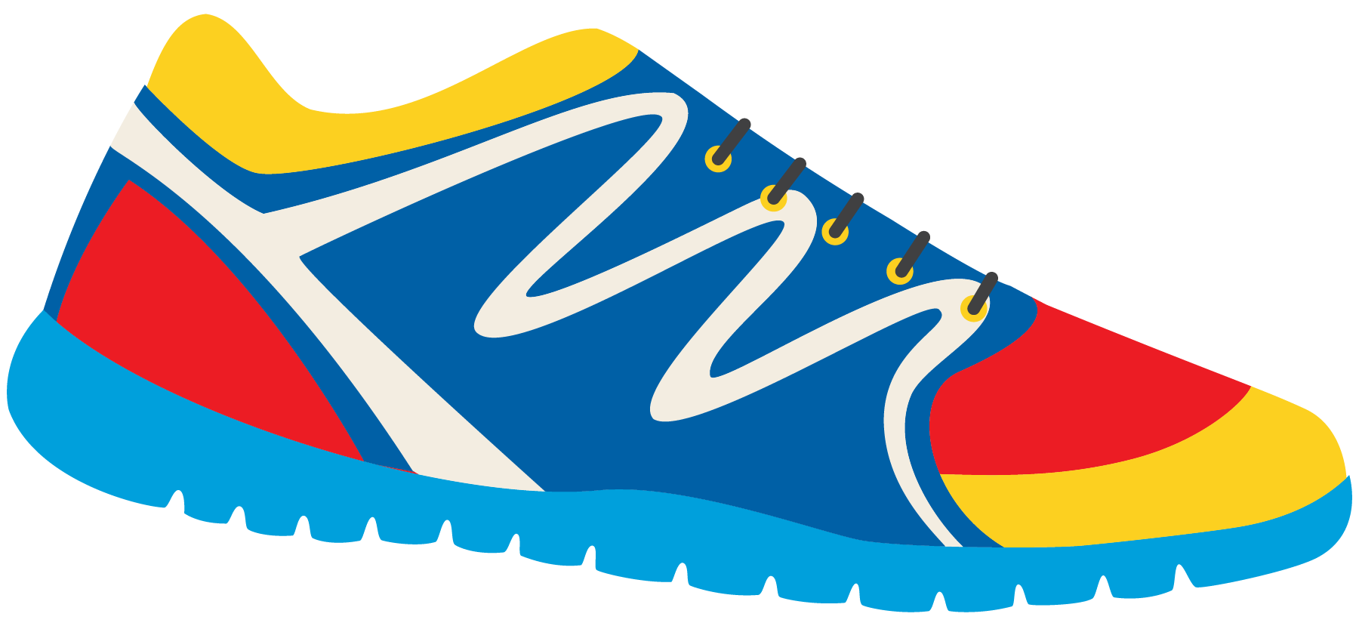

Keeping In Shape
Unit 6: Lesson 5

Slide 2

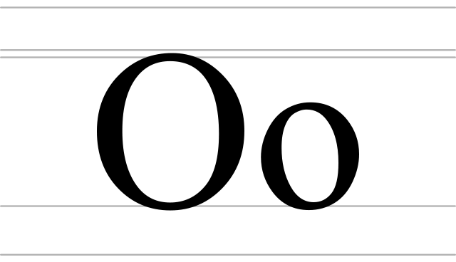
What sound does the letter “O” make?
What does it sound like when two letter O’s are together in a word?

Slide 3

Let’s look at words that have “Oo” in them.
Do you know any words that have “Oo” in them?
List them below.

Slide 4
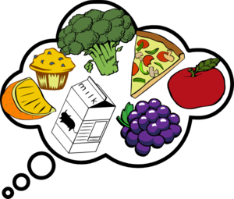
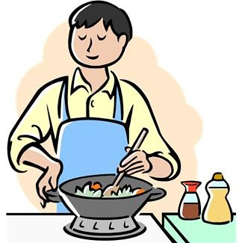
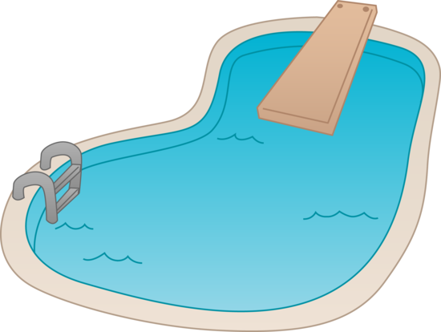
Fill in the blanks of these words!
d
F
Sm
thie
P
l
C
k

Slide 5




Fill in more
blanks!
R t
Sp n T th
W d

Slide 6

None of these words have two “O’s” in them. How do we pronounce these words?
Do
Two
To
Blue
Shoe
Threw

Slide 7

Let’s think about keeping in shape. Fill in the sentence with the appropriate word.
I use a to eat my soup.
I love to go swimming in the .
I help my dad chop the in the yard.
I drink a fruit every morning to get proper vitamins
After I eat a snack, I brush each in my mouth.

Slide 8



Try to write your own sentence now. Use one word that has two “O” letters in it.

Slide 9


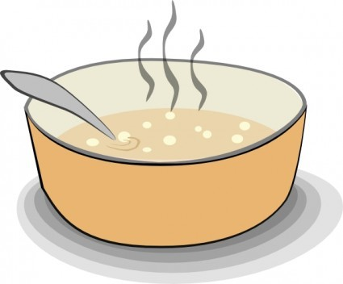
Great! Now try to write another sentence. Use one word that has the “Oo” sound in it.
This means that the word may not have two O’s in it.

Slide 10
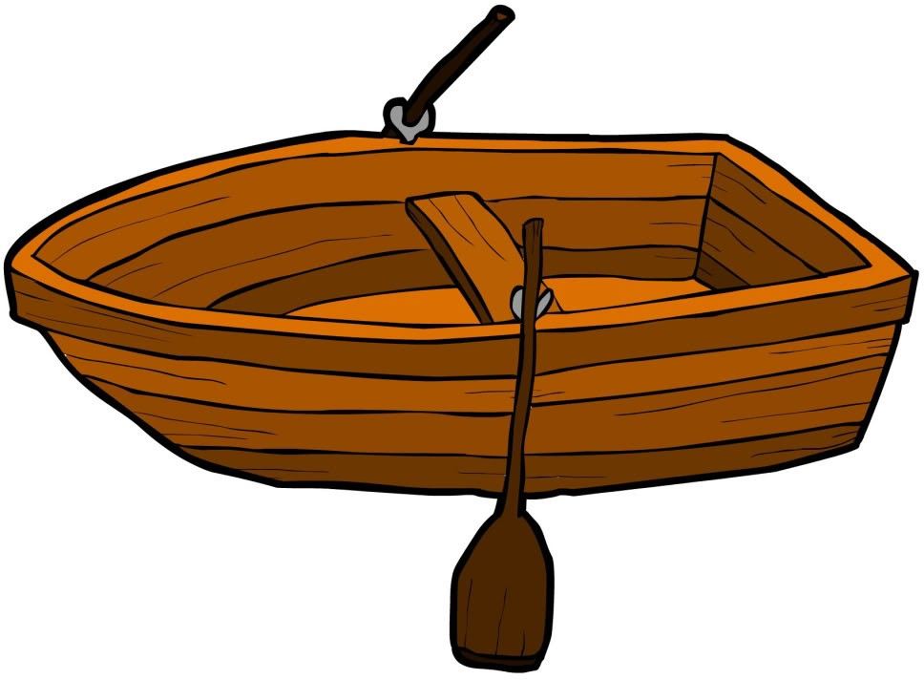
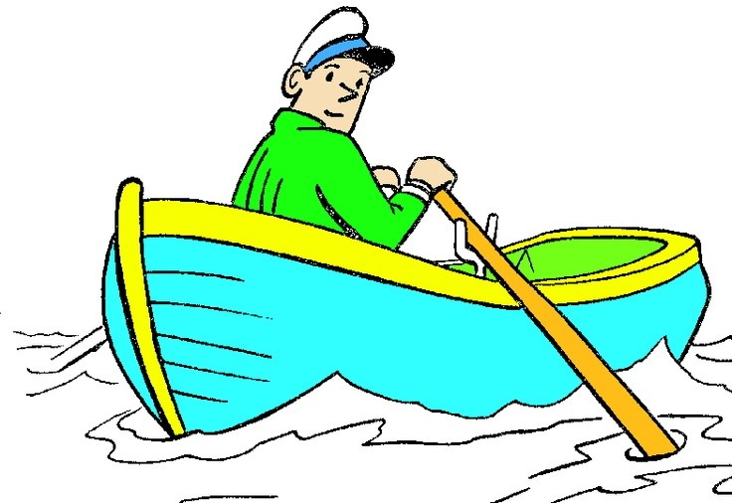
Writing the end of a song
Let’s sing this song together, then – write the end of it in the blank below.
Row, row, row your boat Gently down the stream, Merrily, merrily, merrily, merrily

Slide 11

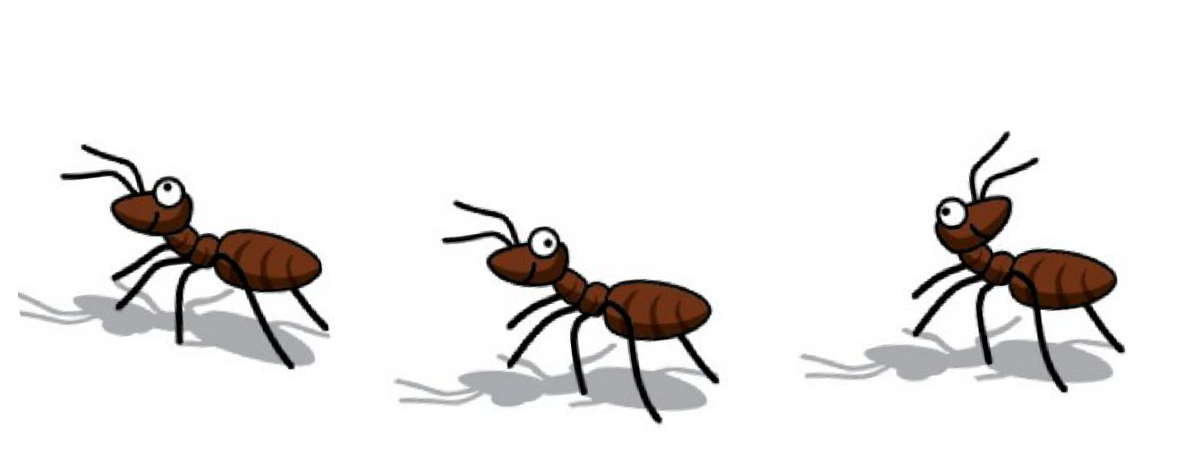
Let’s try it again!
The ants go marching!
The ants go marching one by one Horrah! Horrah!
The ants go marching one by one Horrah! Horrah!
The ants go marching one by one

Slide 12
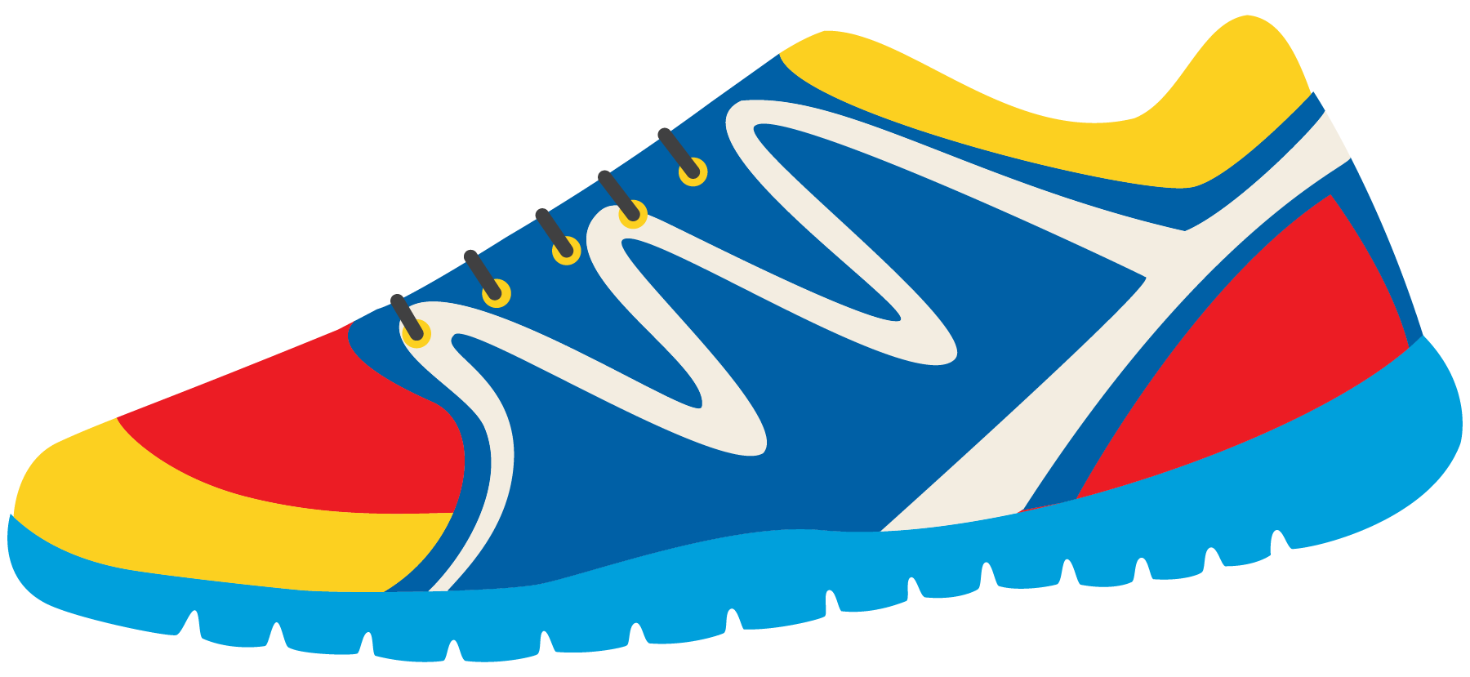


One more time! This time you sing a song and your classmate will finish it. Write the name of your song in the box below.
What is the song you are singing about? Is it an activity that can keep you active like rowing or marching?

Slide 13

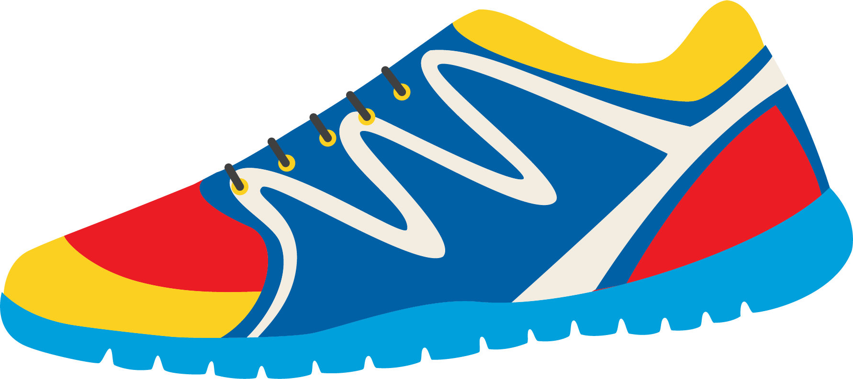
Past Tense: Irregular Verbs
Let’s look at more irregular verbs. How would you create the past tense?
Drink
Say
Swim
Wake
I sayed?
I waked?

Slide 14
Read these sentences out loud.
Do they sound better?
I drank 8 glasses of water today!
“She got the goal!” I said to my coach. I swam a lap in the pool in two minutes!
I woke up very early for practice this morning.

Slide 15


Now, practice these verbs
I (drink) all of my smoothie
this morning!
“I (say) I am very tired.”
I (swim) to the boat in the middle of the lake.
I (wake) up my mom so she could drive me to practice.

Slide 16


Great! Write a sentence using one of these verbs!
Drink Swim Say Wake

Slide 17
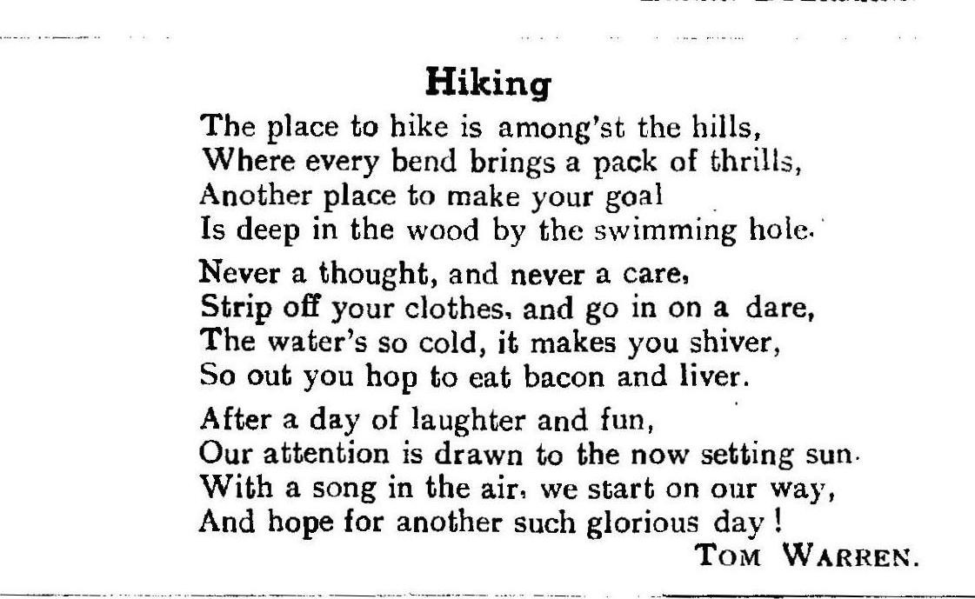
Let’s read this poem together!

Slide 18
Homework!
Do you have any questions?

