Slide 1

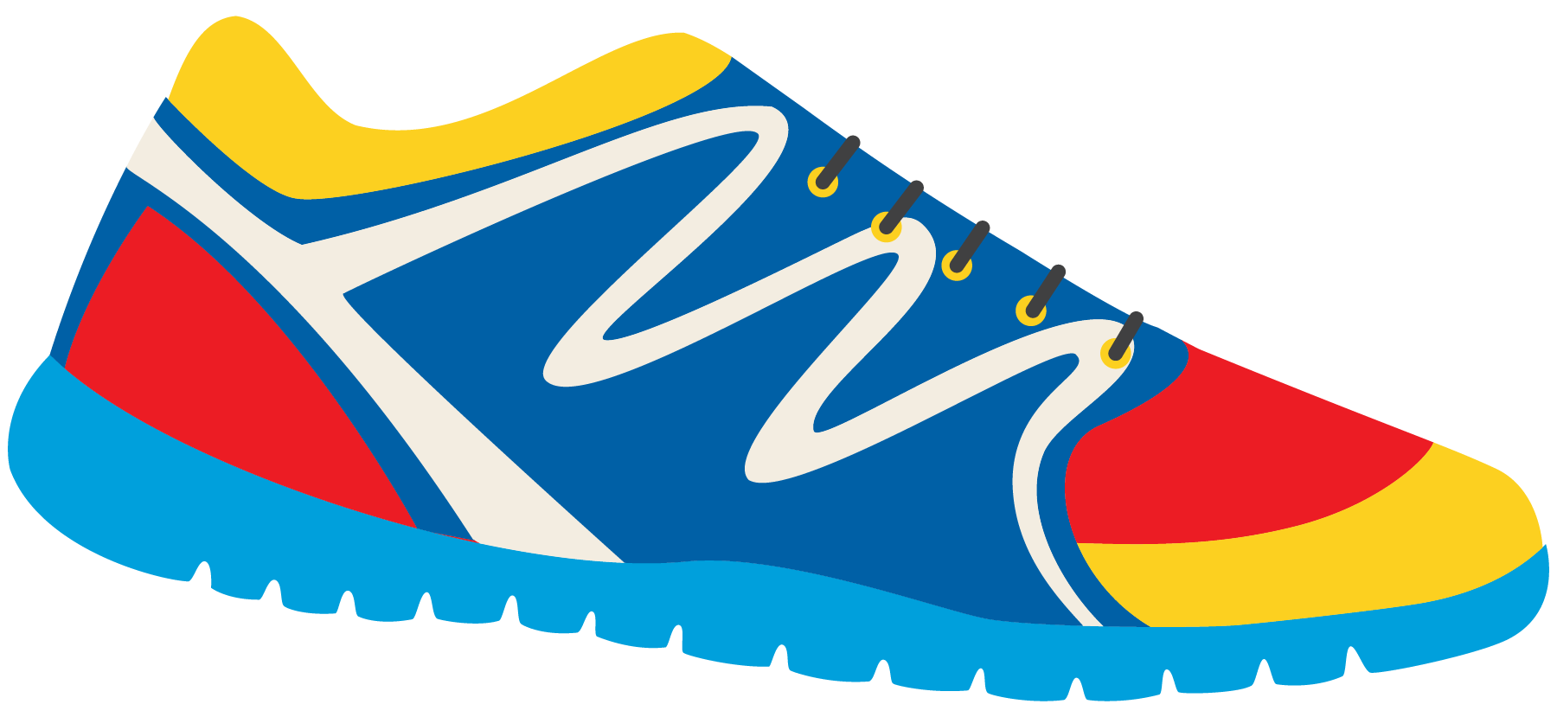

Keeping In Shape
Unit 6: Lesson 6

Slide 2


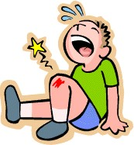
Today , we will be looking a words with the “Ow” sound.
t
What sound does O and W make together?
This photo might help you!

Slide 3
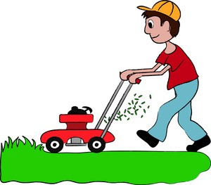
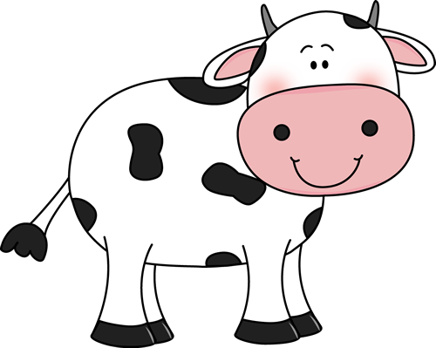

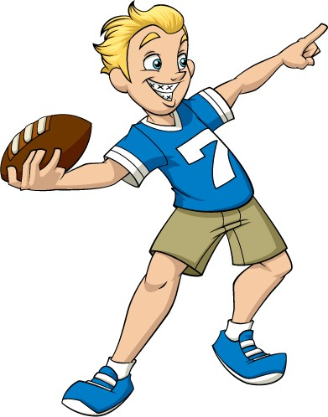

What words have “OW” in them?

Slide 4

Try to think of some more “Ow” words. What can you come up with?

Slide 5
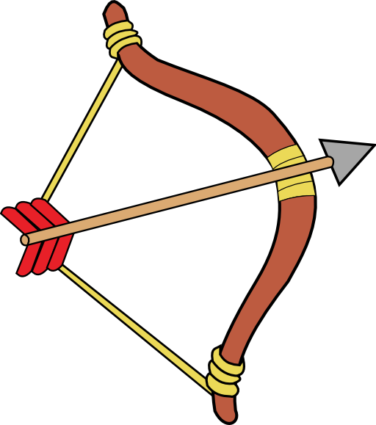
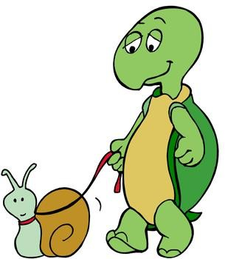
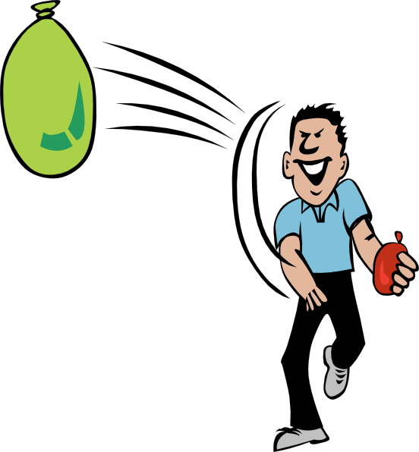

Fill in the blanks!
B __ ___ and A r r ___ ___
S l ___ ___
T h r ___ ___ S n ___ ____

Slide 6

Mow is a word with the “Ow” sound. What can we mow?
How does this keep us active and in shape?

Slide 7
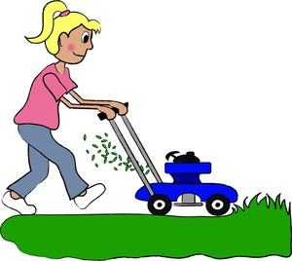

Let’s think about keeping in shape. Fill in the sentence with the appropriate word.
I _____________ the lawn for my mom and dad.
I _____________ the football around every night after school.
I like to play in the cold, white ____________.
My mom digs holes to plant ___________ in the garden.
Grandpa took me in the boat and asked me to ____________ because I am strong!

Slide 8



Great! Write your own sentence. How do you keep in shape?
Include an “Ow” word.

Slide 9

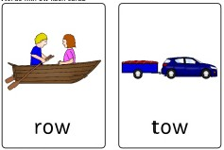
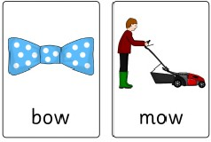
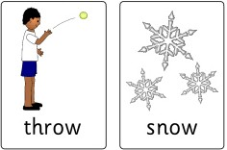
Let’s play a game!
Act out an “Ow” word, and we will guess the word. Use these pictures to help you.

Slide 10
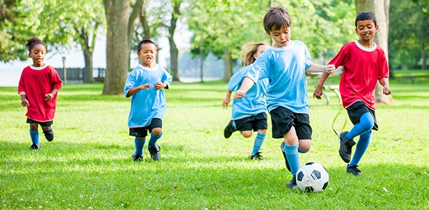
What is happening in
the photo?
The children are playing soccer.
This is called present continuous tense.

Slide 11
Am/Is/Are
I am playing soccer.
He is playing soccer. They are playing soccer.
Tell me what the girl in blue is doing. Tell me what the children are doing.
Tell me what you are doing right now.

Slide 12

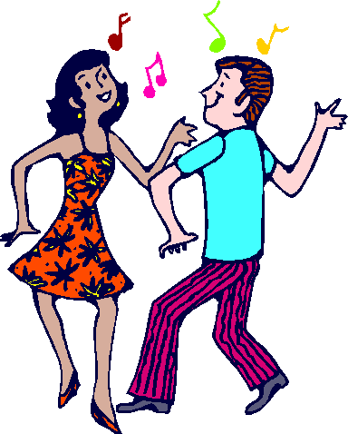
Let’s try to fill in the sentences.
Am, Is or Are?
We ____________ swimming in the ocean.
He ___________ throwing the ball to me. She ____________ dancing in the field.
They ____________ eating a salad.
I ____________ playing outside right now.

Slide 13
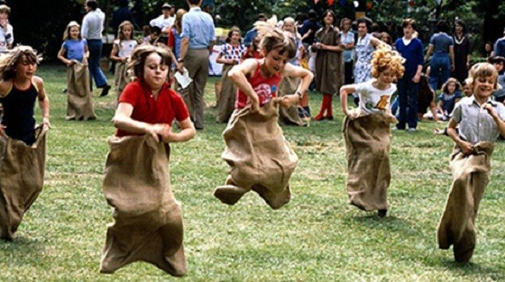
What is happening in this photo?

Slide 14
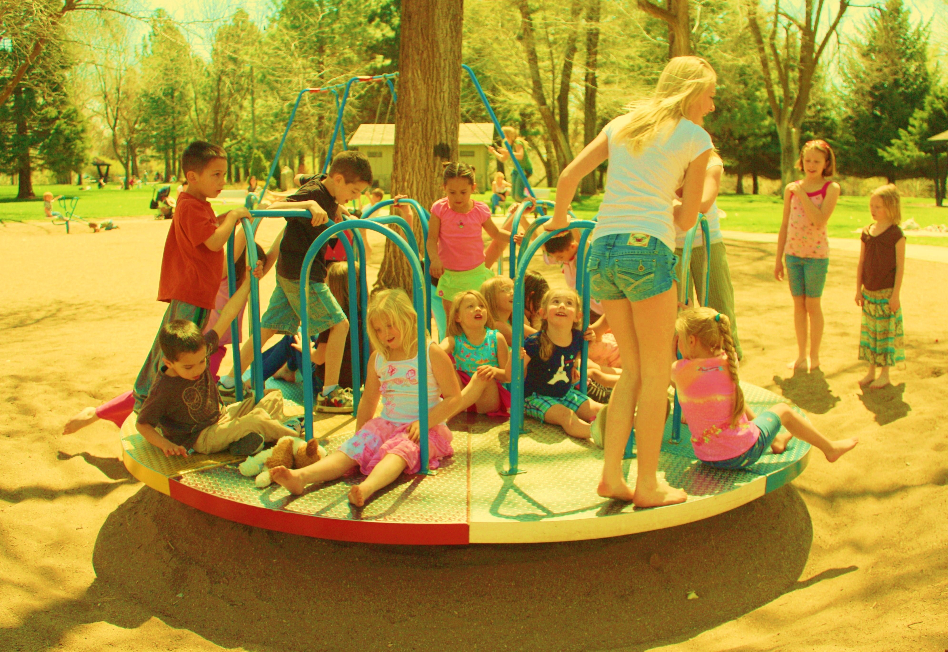
One more time, what is happening in this photo?

Slide 15
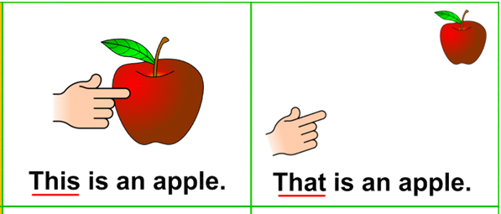
This and That Pronouns
When do we use the words “this” and “that”?
Close to us.
Far away from us.

Slide 16
Tell me about something that is in the same room as you. Use “this” or “that”.
Use “this” if the item is close to you.
Use “that” if the item is far away from you.
“This is my computer chair”
“That is my bookshelf” “This is my pencil” “That is my mother”

Slide 17
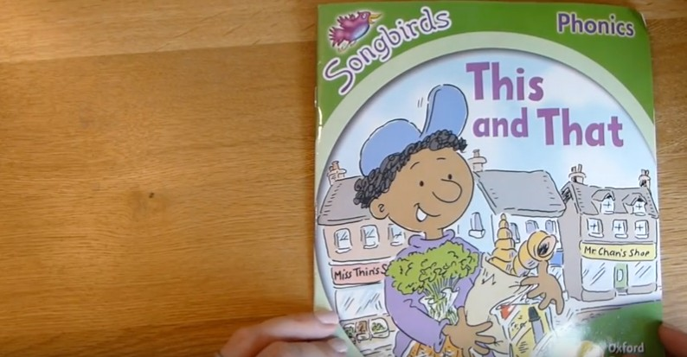
Let’s read a book.
Listen for “this” and “that”

Slide 18

Tim kept active by walking to the stores!
He also bought healthy food items to eat.
Did you like this book?

Slide 19
Homework

