Slide 1
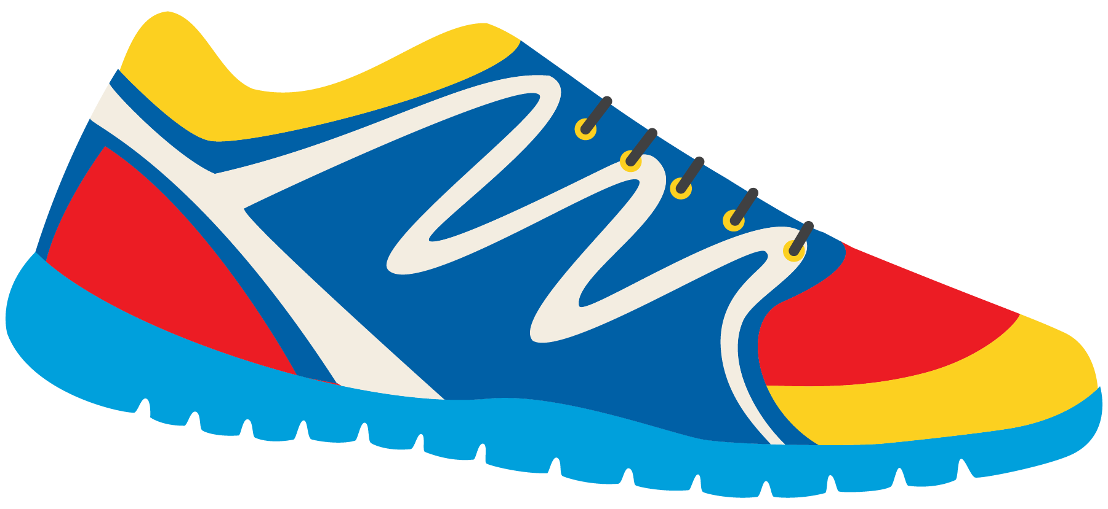
Keeping In Shape
Unit 6: Lesson 6

Slide 2
What are we learning this class?
Review the “Ow” sound
Describe a picture – present continuous tense
Pronouns (This, that)
Read “This and That”

Slide 3
Today , we will be looking at words with the “Ow” sound.
What sound does O and W make together?
This photo might help you!

Slide 4
“OW”! Just like when we get hurt. You are right!

Slide 5
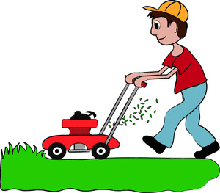
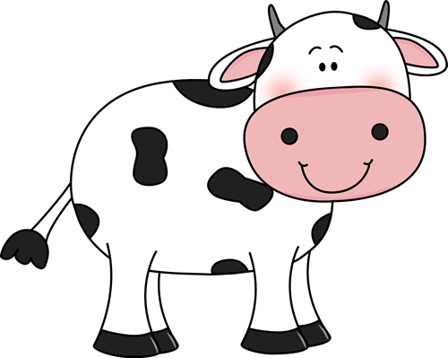
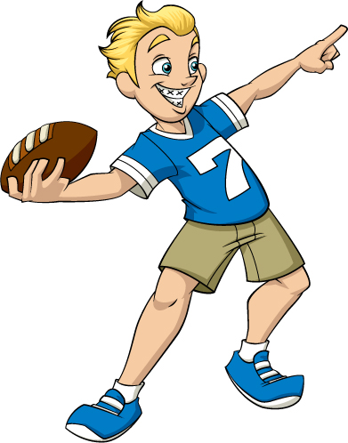
What words have “OW” in them?

Slide 6
Try to think of some more “Ow” words. What can you come up with?

Slide 7
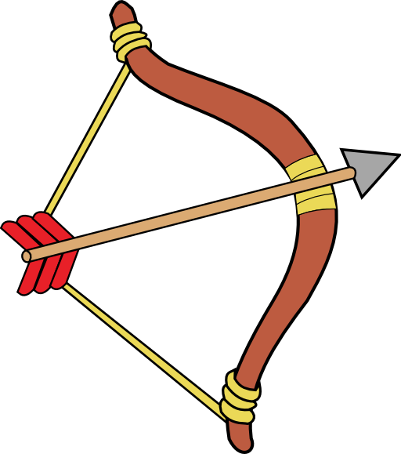
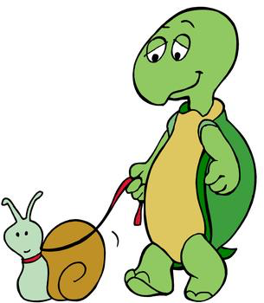
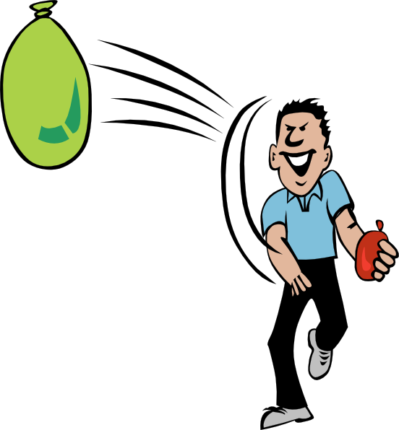
Fill in the blanks!
B ___ ___ and A r r ___ ___
S l ___ ___
T h r ___ ___
S n ___ ___

Slide 8
Mow is a word with the “Ow” sound. What can we mow? How does this keep us active and in shape?

Slide 9
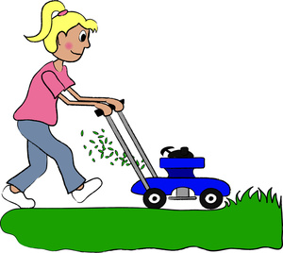
Let’s think about keeping in shape. Fill in the sentence with the appropriate word.
I _____________ the lawn for my mom and dad.
I _____________ the football around every night after school.
I like to play in the cold, white ______________.
My mom digs holes to plant _______________ in the garden.
Grandpa took me in the boat and asked me to ____________ because I am strong!

Slide 10
Great! Write your own sentence. How do you keep in shape? Include an “Ow” word.

Slide 11
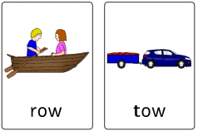
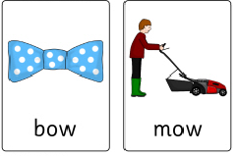
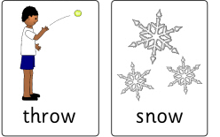
Let’s play a game!
Act out an “Ow” word, and we will guess the word. Use these pictures to help you.

Slide 12
What is happening in the photo?
The children are playing soccer.
This is called present continuous tense.

Slide 13
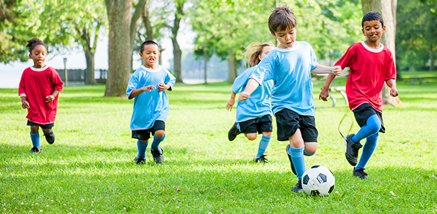
Am/Is/Are
I am playing soccer.
He is playing soccer.
They are playing soccer.
Tell me what the girl in blue is doing. Tell me what the children are doing. Tell me what you are doing right now.

Slide 14
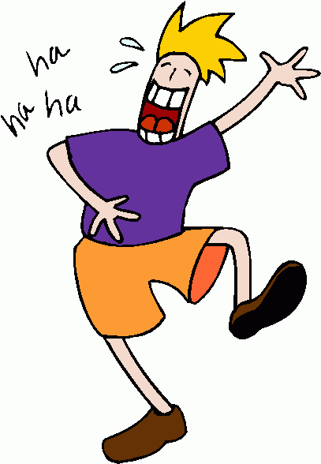
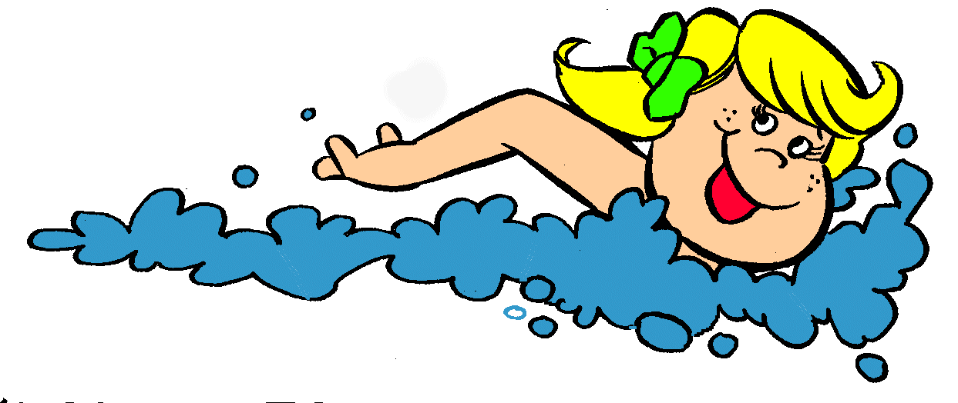
Here is a chart to help us remember.
I | Am | Playing Swimming Listening Laughing Kicking Throwing Dancing Reading Eating
He She It | Is
You We They | Are
Create a sentence from the chart.

Slide 15
Let’s try to fill in the sentences. Am, Is or Are?
We _____________ swimming in the ocean.
He ______________ throwing the ball to me.
She _____________ dancing in the field. They ____________ eating a salad.
I _______________ playing outside right now.

Slide 16
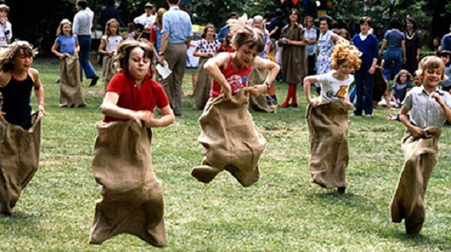
What is happening in this photo?

Slide 17
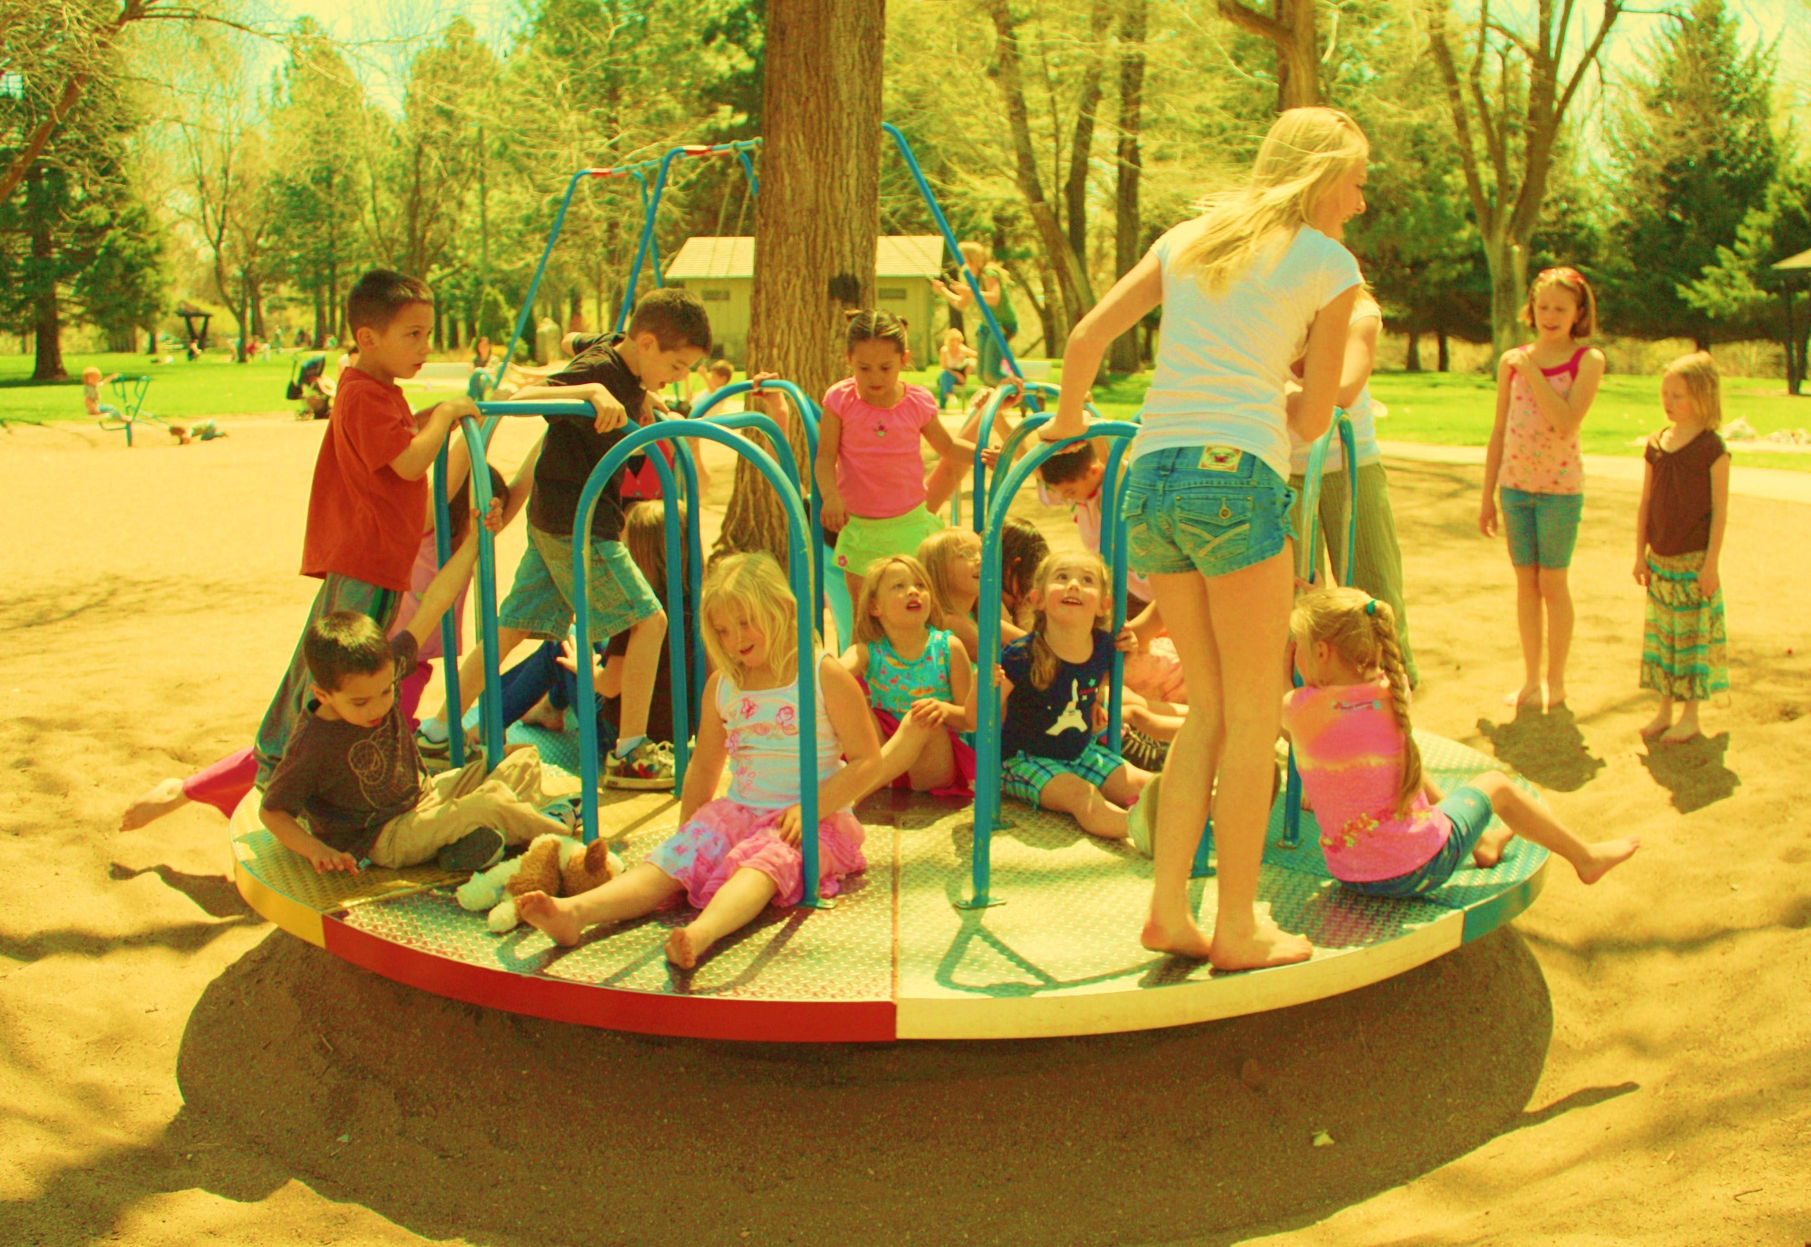
One more time, what is happening in this photo?

Slide 18
This and That Pronouns
When do we use the words “this” and “that”?
Close to us.
Far away from us.

Slide 19
Tell me about something that is in the same room as you. Use “this” or “that”.
Use “this” if the item is close to you.
Use “that” if the item is far away from you.
“This is my computer chair”
“That is my bookshelf” “This is my pencil” “That is my mother”

Slide 20
Let’s read a book. Listen for “this” and “that”

Slide 29
Tim kept active by walking to the stores! He also bought healthy food items to eat.
Did you like this book?

Slide 30
Review!
“Ow” sound
Describing pictures – present continuous tense
Pronouns (This, that)

Slide 31
Homework

