Slide 1

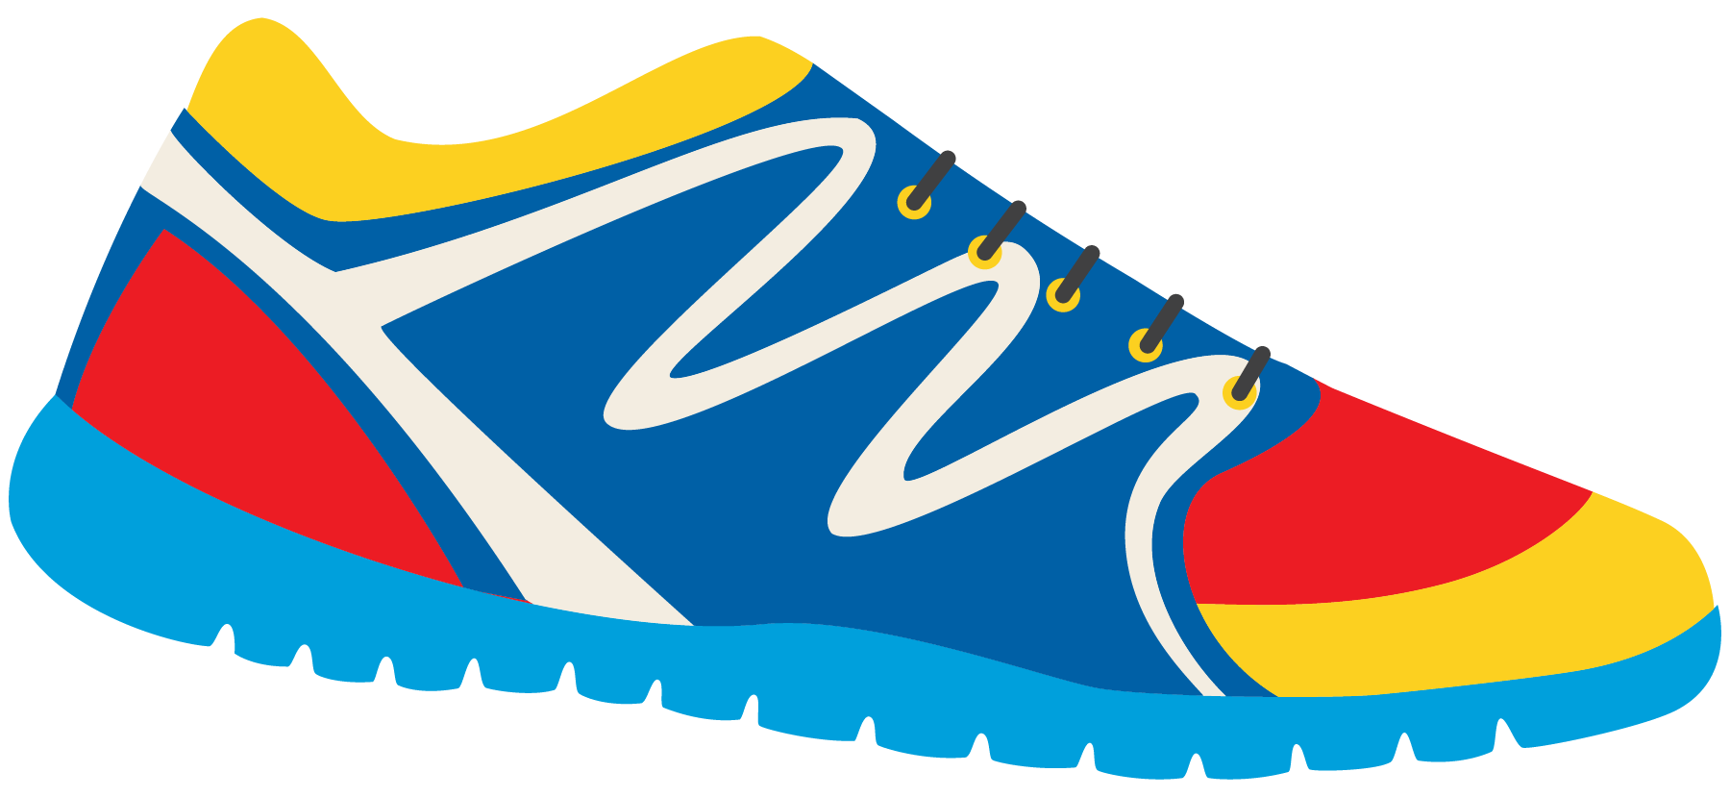

Keeping In Shape
Unit 6: Lesson 7

Slide 2

Today , we will be looking a words with the “Ou” sound.
t
What do you think the letters “O” and “U” sound like together?
Say it out loud. Practice with your class!

Slide 3



What words have “OU” in them?

Slide 4


How do we spell these words?
Practice spelling each word.

Slide 5



Try to think of other words that use “Ou” in them!

Slide 6
Fill in the sentence with the appropriate word.
I climbed the tall ______________ with my father.
My mom says to only put healthy food in my ______________.
It is good to spend time outside of the ____________ so we can get active.
I love to play outside and watch the ___________ in the sky.

Slide 7

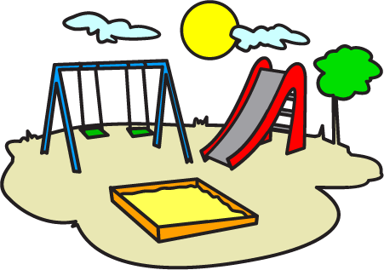
Tell me how you can keep in shape using an “OU” word.

Slide 8

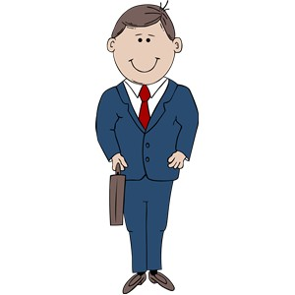
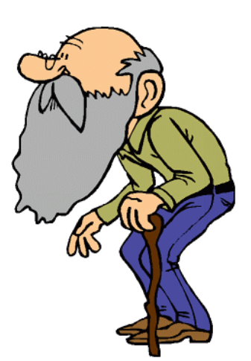
Look at this photo. Who is taller? Who do you think is older?
Taller and Older Comparative

Slide 9
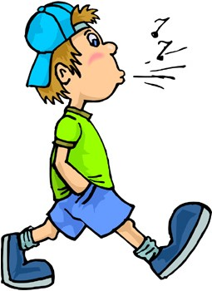
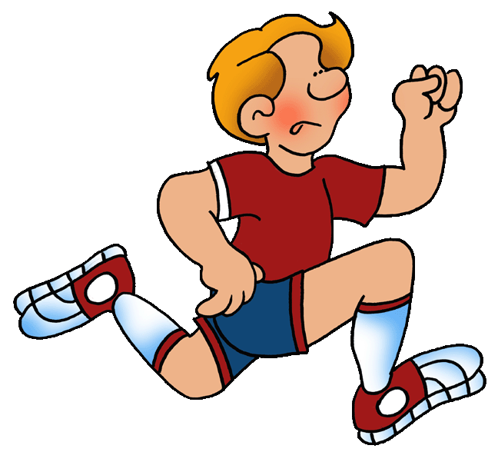
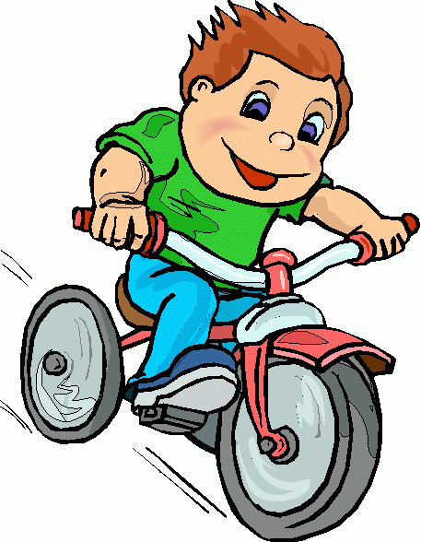
Who is going fast?
Who is going faster?
Who is going the fastest?
The Fastest - Superlative

Slide 10
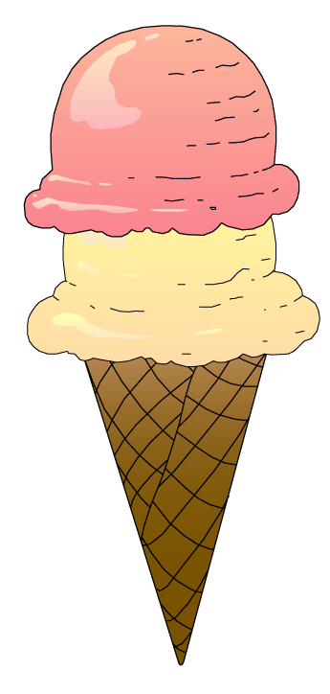


Let’s try one more time. Describe these using the word “sweet”
Sweet? Sweeter? Sweetest?
Which of these foods would keep us in shape?
Why?

Slide 11
Let’s review comparative and superlative!
This boy is going fast.
But this boy is faster.
Comparative
However, this boy is the fastest.
Superlative

Slide 12
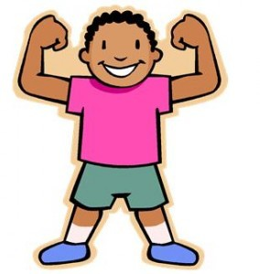
Write your own sentence.
Use the word strong.
Strong. Stronger. Strongest.

Slide 13


“Shall we” and “how about” can both be used when you are making a suggestion.
Shall we play basketball tonight?
How about you come over for dinner tonight?

Slide 14


We will practice together. Fill in the blanks.
_________ ________ play volleyball or hockey?
_________ ________ hockey?

Slide 15

Write your own sentence.
Begin with “Shall we” or “How about”

Slide 16

Great work! Let’s read this poem together now!
We are the grouches, We don’t want a mouse! We only want grouches Around in our house!
We are the grouches, And we like to pout.
WE like to grumble And grouse all about.
We are the grouches, And we loudly shout, Get out, little mouse! Get out, out, OUT!
How many “Ou” words can you spot?

Slide 17
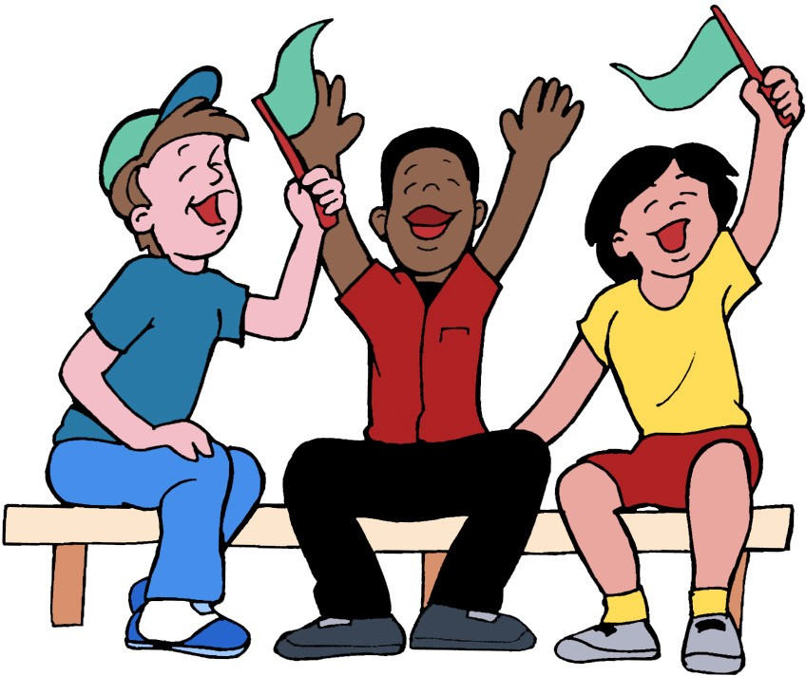
Keeping Active
Sometimes sports teams create a chant like the one we read to say to an opposing team.
Can you create a chant?

