Slide 1
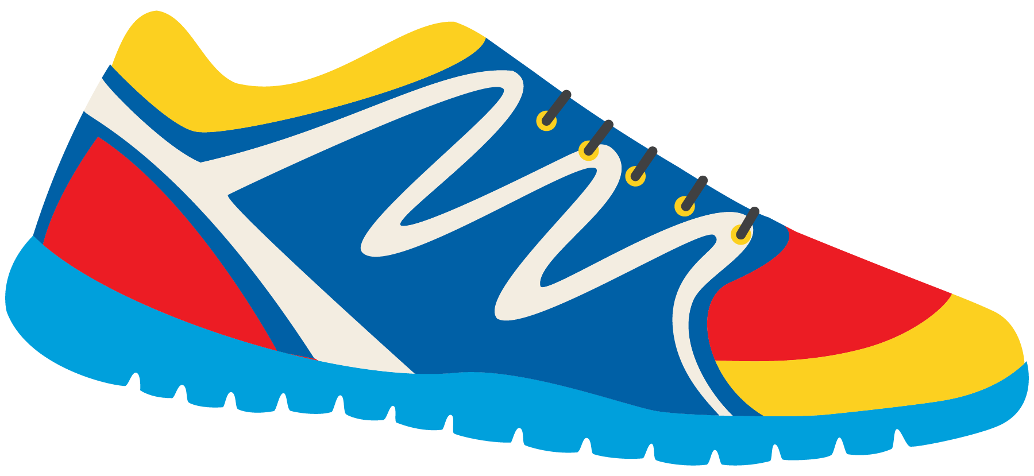
Keeping In Shape
Unit 6: Lesson 7

Slide 2
What are we learning this class?
Review the “Ou” sound
Comparative and Superlative
Using new phrases

Slide 3
Today , we will be looking at words with the “Ou” sound.
What do you think the letters “O” and “U” sound like together?
Say it out loud. Practice with your class!

Slide 4
The letters “OU” most commonly make the “Ow” sound!

Slide 5
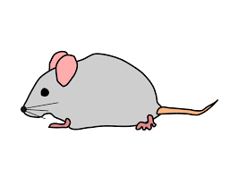
What words have “OU” in them?

Slide 6
How do we spell these words? Practice spelling each word.

Slide 7
Try to think of other words that use “Ou” in them!

Slide 8
Fill in the sentence with the appropriate word.
I climbed the tall _________________ with my father.
My mom says to only put healthy food in my _______________.
It is good to spend time outside of the ___________ so we can get active.
I love to play outside and watch the ____________ in the sky.

Slide 9
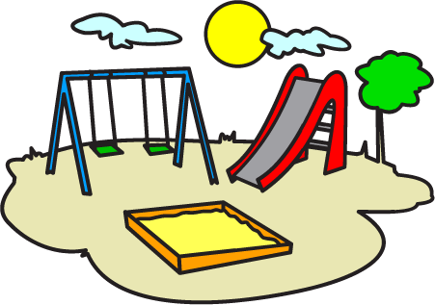
Tell me how you can keep in shape using an “OU” word.

Slide 10
Great work!
Now we will be looking at comparative and superlative words!

Slide 11
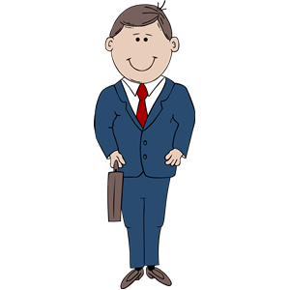
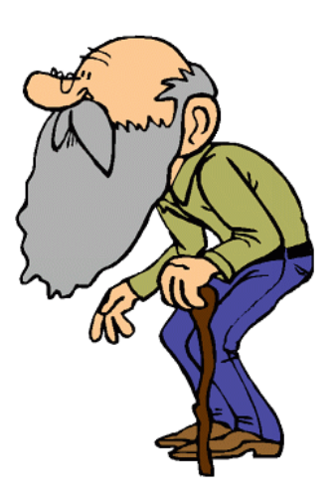
Look at this photo. Who is taller? Who do you think is older?
Taller and Older
Comparative

Slide 12
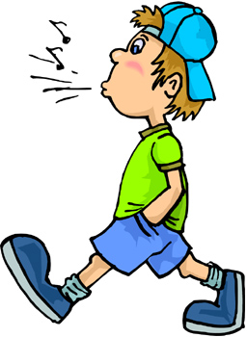
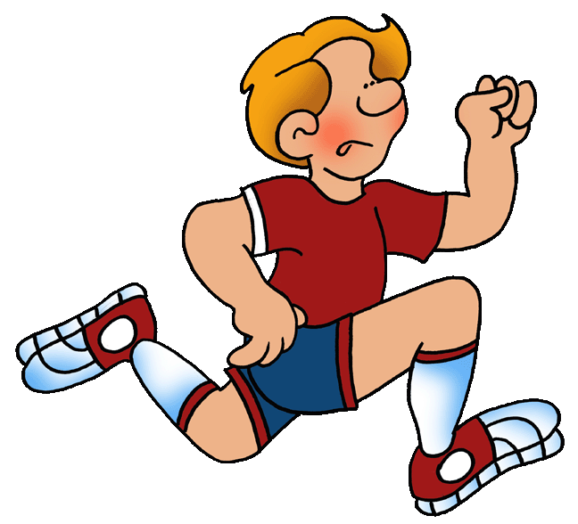
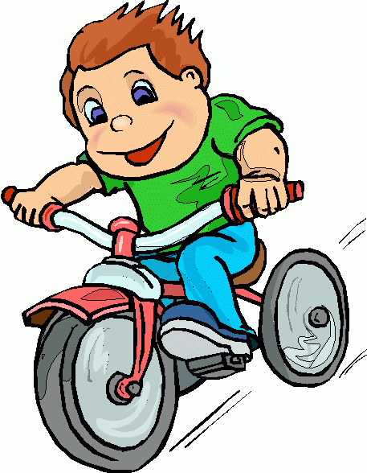
Who is going fast? Who is going faster? Who is going the fastest?
The Fastest - Superlative

Slide 13
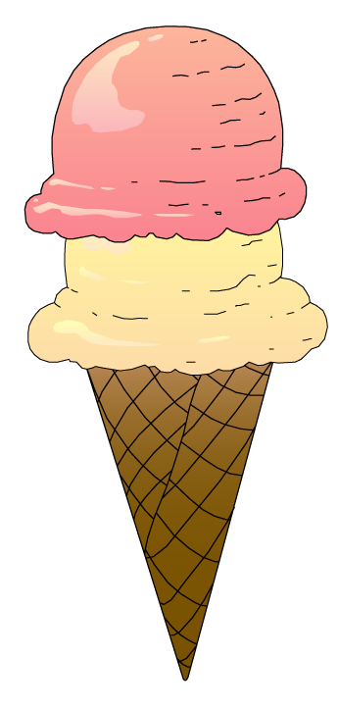
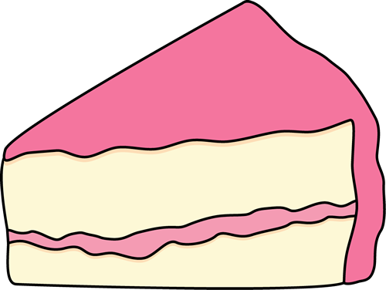
Let’s try one more time. Describe these using the word “sweet”
Sweet? Sweeter? Sweetest?
Which of these foods would keep us in shape? Why?

Slide 14
Let’s review comparative and superlative!
This boy is going fast.
But this boy is faster.
Comparative
However, this boy is the fastest.
Superlative

Slide 15
Write your own sentence. Use the word strong.
Strong. Stronger. Strongest.

Slide 16
Awesome job! Now we will practice using the phrases “Shall we…” and “How about...”

Slide 17
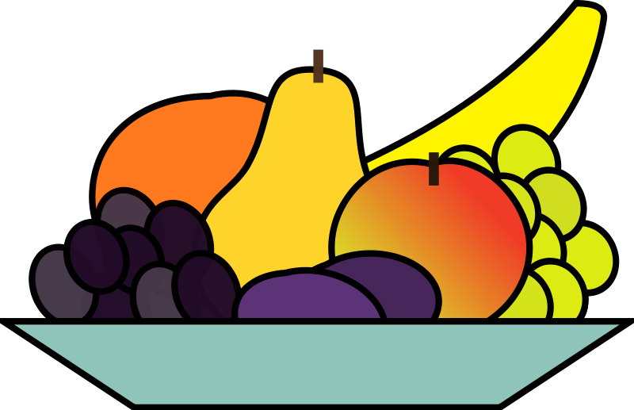
“Shall we” and “how about” can both be used when you are making a suggestion.
Shall we play basketball tonight?
How about you come over for dinner tonight?

Slide 18
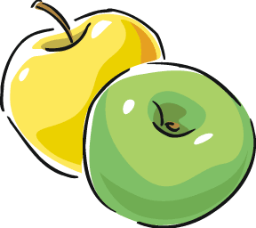
Shall We and How About…
“Shall we…” is used with a verb.
Shall we eat an apple or a banana? Shall we play soccer with the boys? Shall we dance to this song?
“How about…” is used with a noun.
How about tomorrow?
How about this soccer ball? How about grandma?

Slide 19
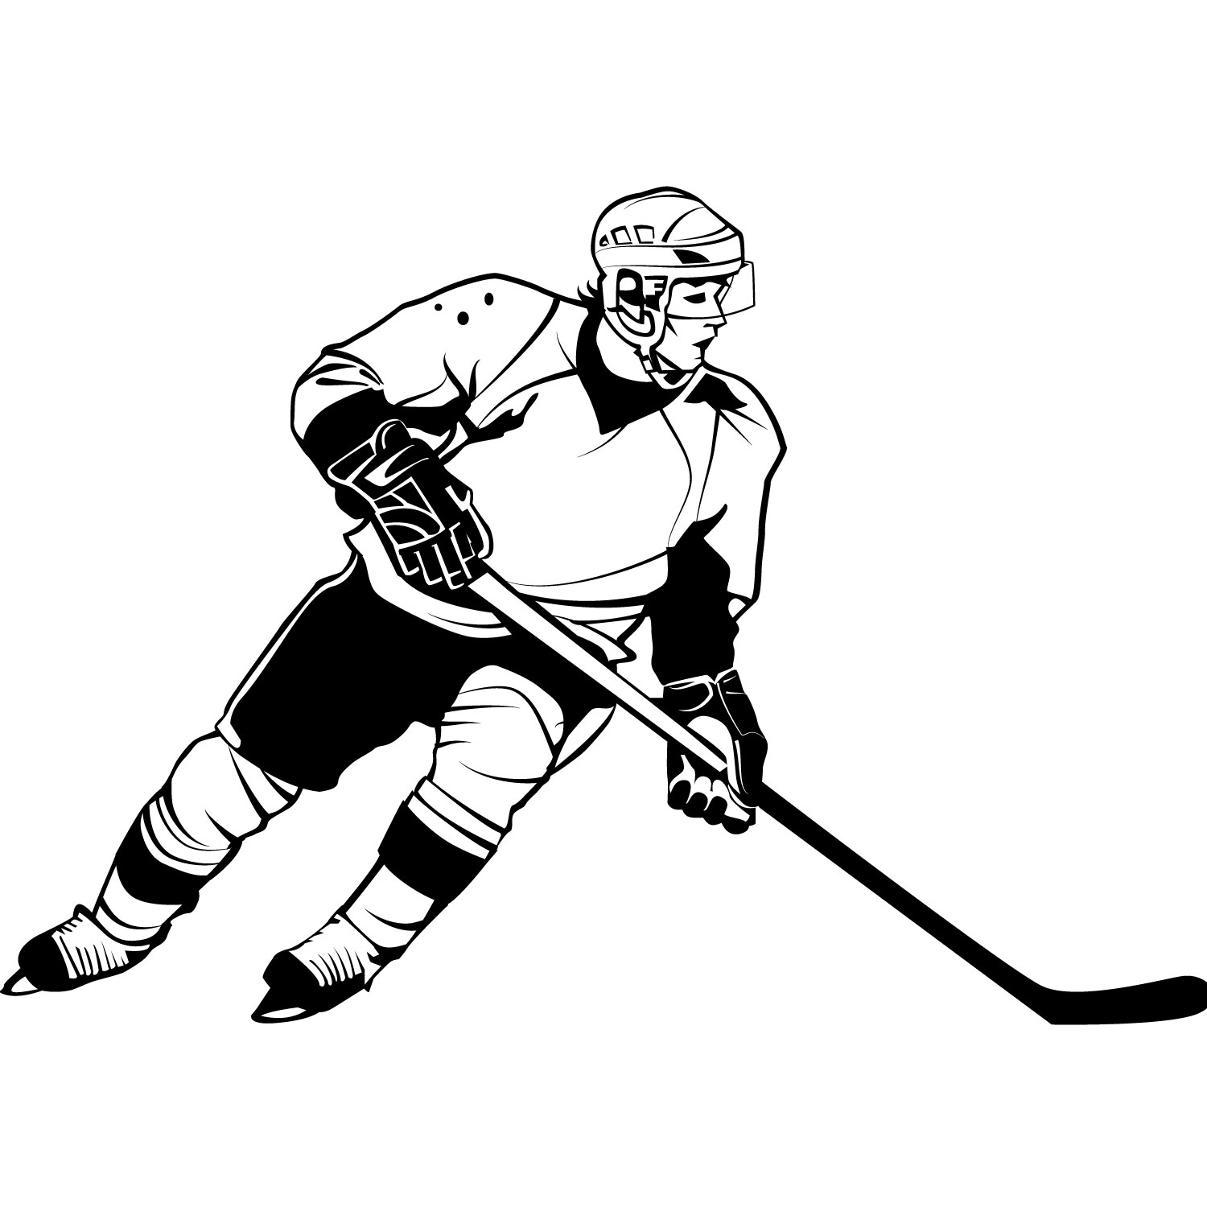
We will practice together. Fill in the blanks.
__________ _________ play volleyball or hockey?
___________ __________ hockey?

Slide 20
Write your own sentence. Begin with “Shall we” or “How about”

Slide 21
Great work! Let’s read this poem together now!
We are the grouches,
We don’t want a mouse! We only want grouches
Around in our house! We are the grouches,
And we like to pout.
WE like to grumble
And grouse all about.
We are the grouches,
And we loudly shout,
Get out, little mouse! Get out, out, OUT!
How many “Ou” words can you spot?

Slide 22
Review!
“Ou” sound
Comparative and Superlative
Shall we, and how about…

Slide 23
Homework

Slide 24
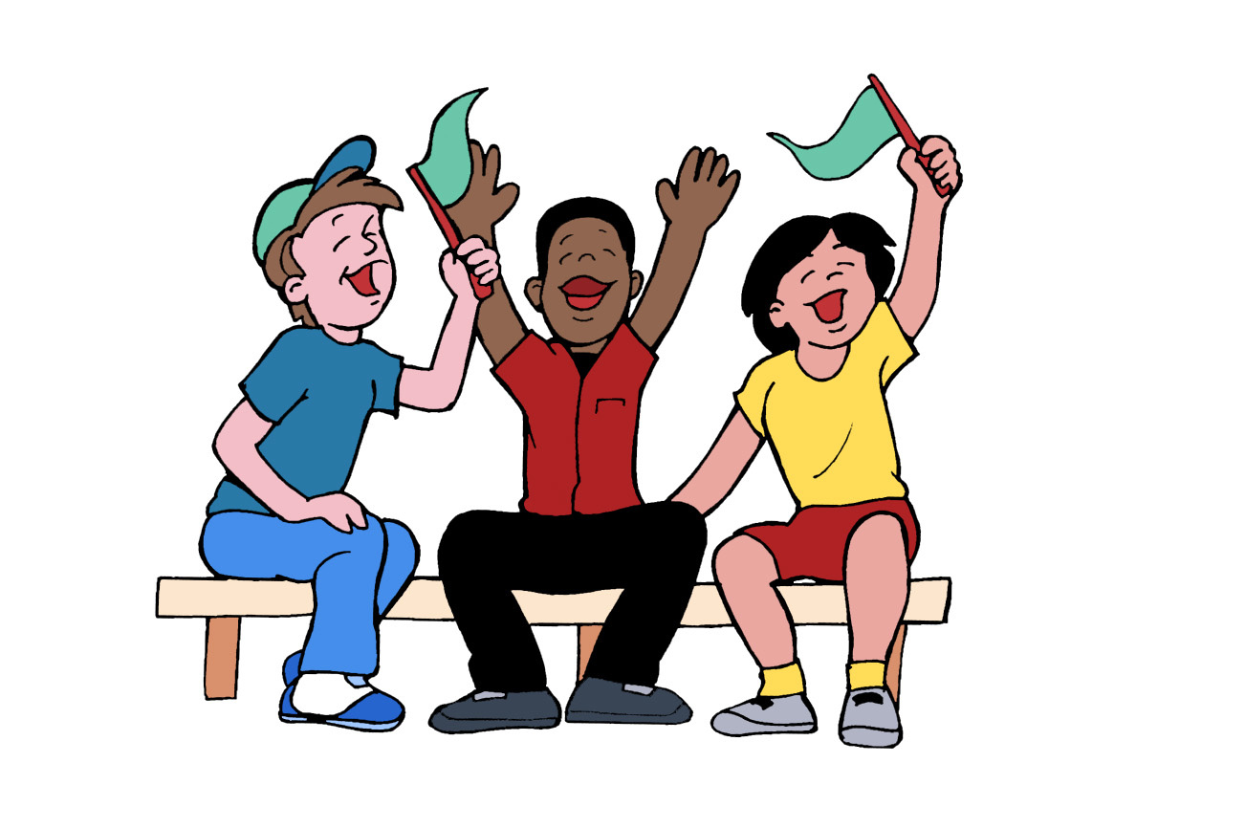
Keeping Active
Sometimes sports teams create a
chant like the one we read to say to an opposing team.
Can you create a chant?

