Slide 1

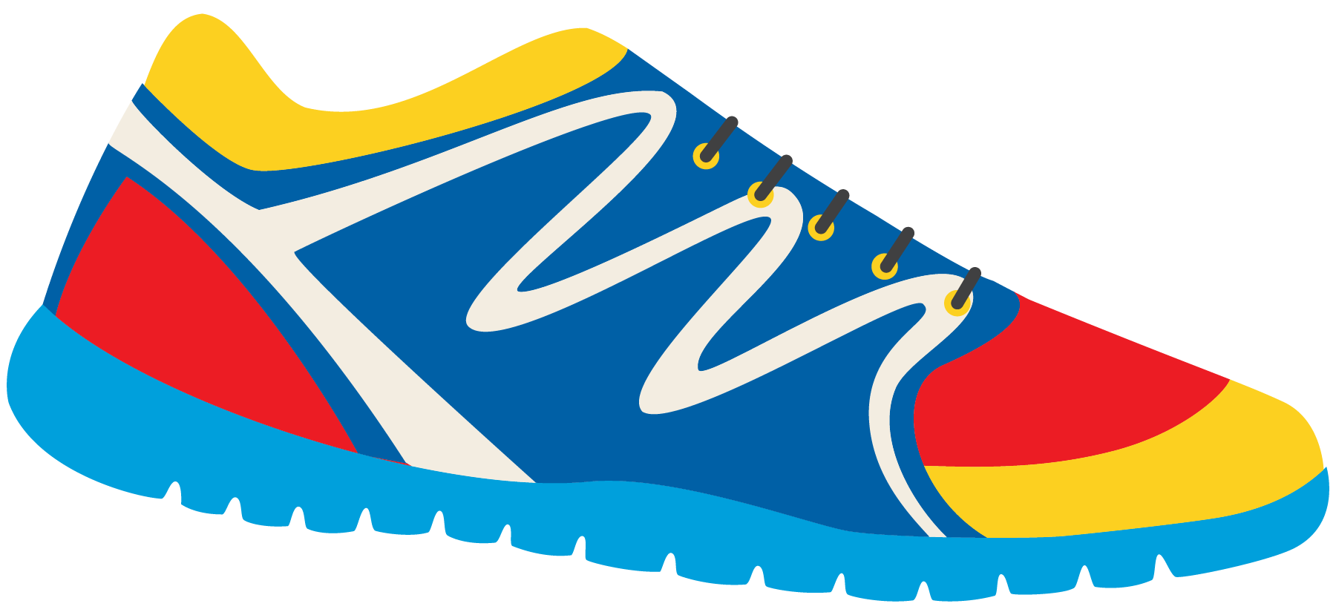

Keeping In Shape
Unit 6: Lesson 8

Slide 2



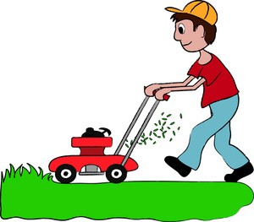

We learned about the sounds “Oo”, “Ow”, and
“Ou”.
What does each pairing sound like?
List an example word of each sound.
“Oo”
“Ow”
“Ou”

Slide 3

Great work! Let’s play a guessing game!
What word am I thinking of?
This is something I do to the grass on my lawn when it is getting long.

Slide 4
Let’s do it again!
What word am I thinking of?
This is something large, white and fluffy in the sky. I watch these when I play outside.

Slide 5
One more time!
What word am I thinking of?
This is something on the earth that is tall. You can climb it, and the higher you climb the colder it gets. It is hard work to climb.

Slide 6



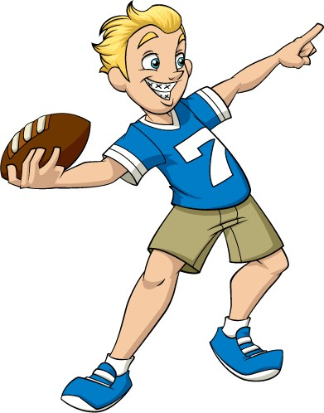
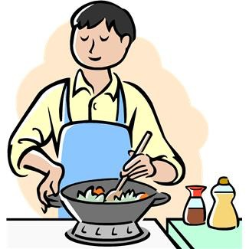
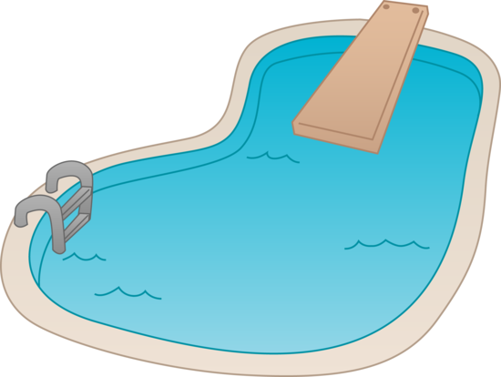

Nice Job! Now it is your turn.
Pick a photo and describe the item or activity that would keep us in shape. We will guess the “Ow”, “Oo”, or “Ou” word.

Slide 7


Great work. You know your “Oo”, “Ow”, and
“Ou” words!
Now write your own sentence using an “Oo”, “Ow” or “Ou” word of your choice!

Slide 8
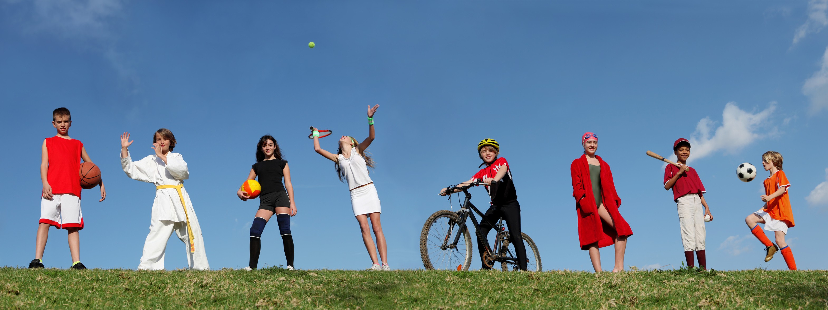
Let’s now review present continuous tense.
Am/Is/Are
What are the children in the picture doing? Describe using the words am, is and are.

Slide 9
Fill in the blanks to create a correct sentence.
She _____ playing tennis.
They ______ playing outside.
He _______ riding a bike.

Slide 10



Write a sentence about what you are doing right now.
Should you use am, is, or are?

Slide 11
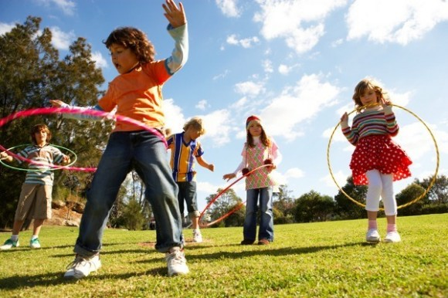
Let’s do it again. What is happening in this photo?

Slide 12

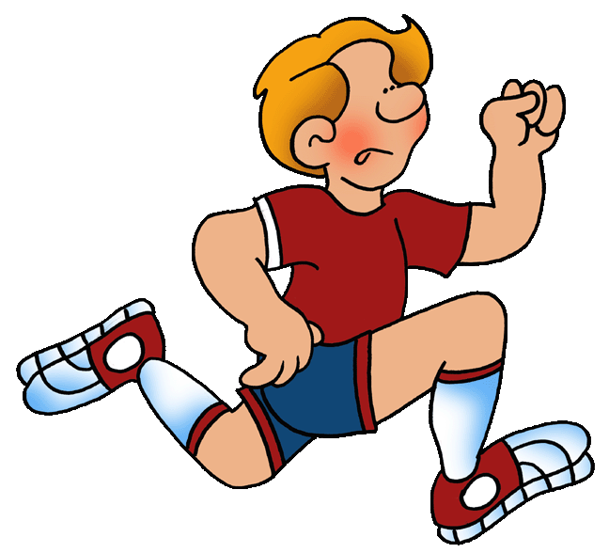

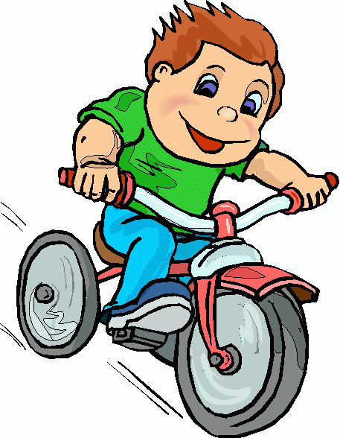
Review: Use the adjective “fast” to describe these boys.
Who is going faster? The fastest?

Slide 13
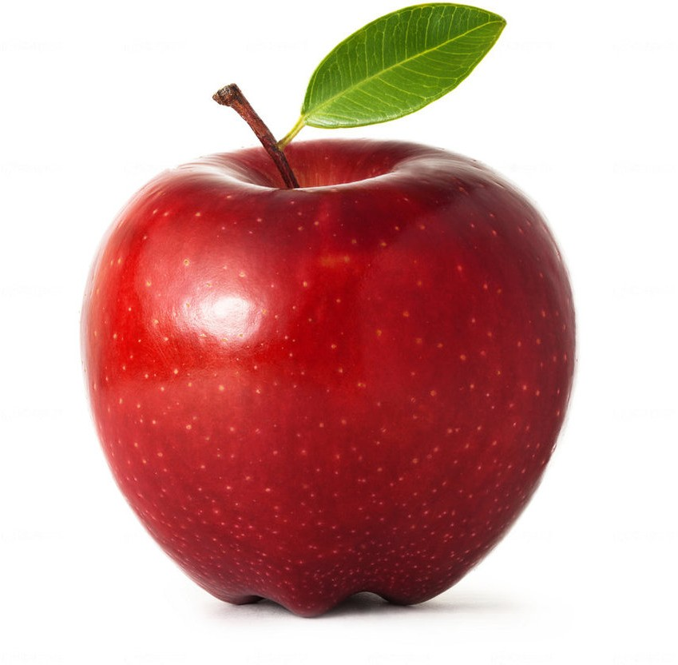
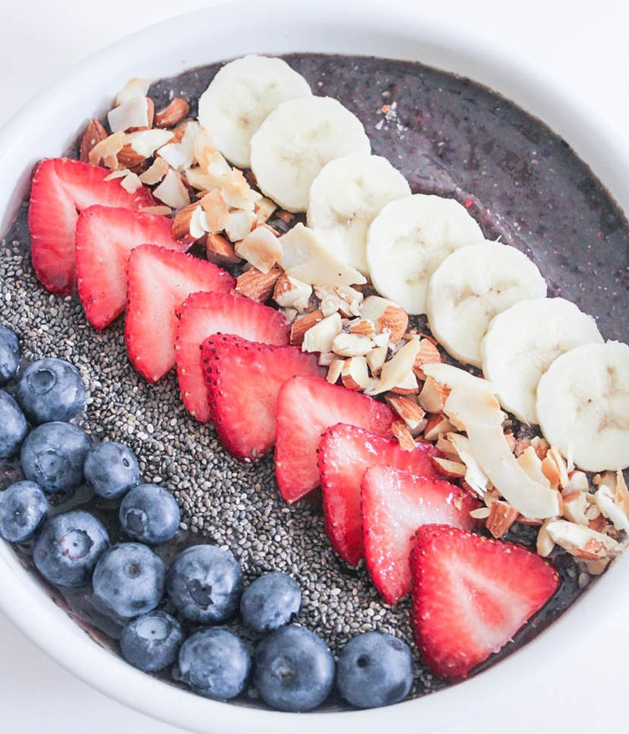
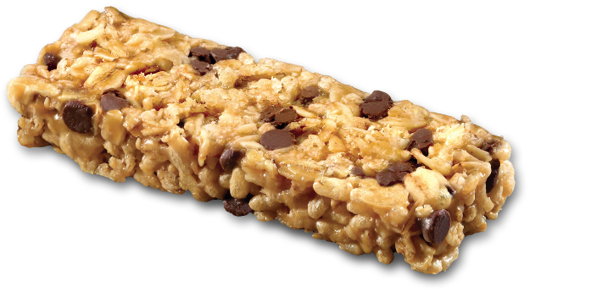
Let’s try one more time. Describe these using the word “healthy”
Healthy? Healthier? Healthiest?
Why would these foods would keep us in shape?

Slide 14


Try it yourself using the word “tall”.
Draw and label a “tall”, “taller” and “tallest” person.

Slide 15


Write your own sentence.
Use the word strong.
Strong. Stronger. Strongest.

Slide 16


“Shall we” and “how about” can both be used when you are making a suggestion.
Shall we play basketball tonight?
How about you come over for dinner tonight?

Slide 17


Write your own sentence using “shall we”.
Here is an example.
Shall we play volleyball or hockey tonight?

Slide 18
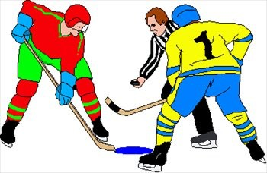

Great! Now, answer the question you just asked using “how about…”
Here is an example. How about hockey?

Slide 19


Slide 20
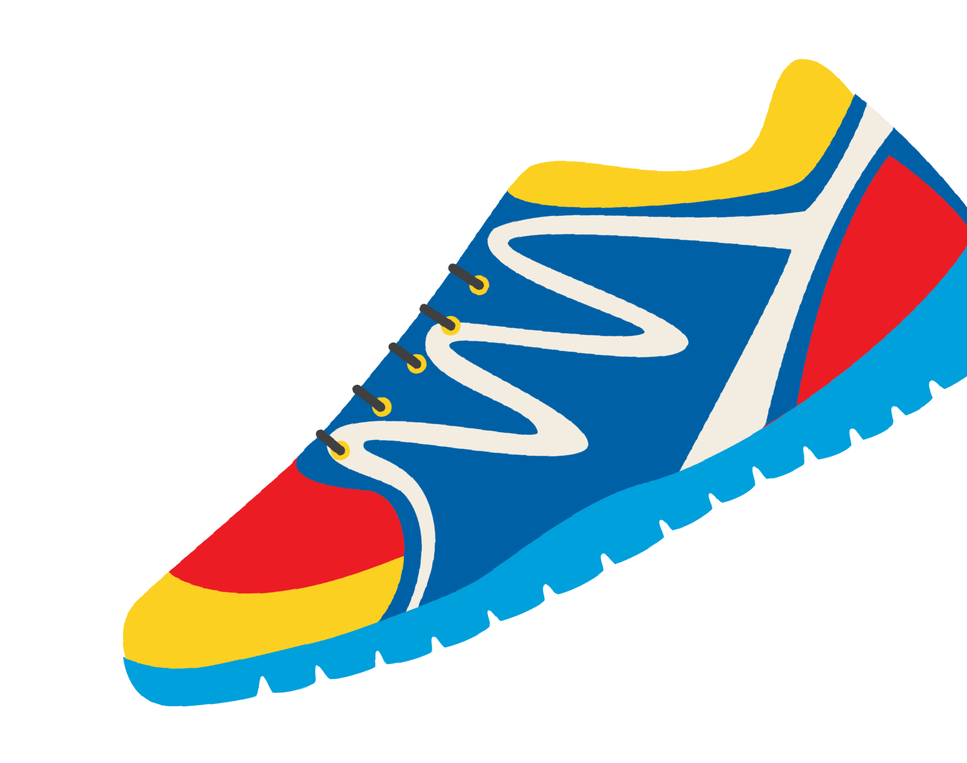

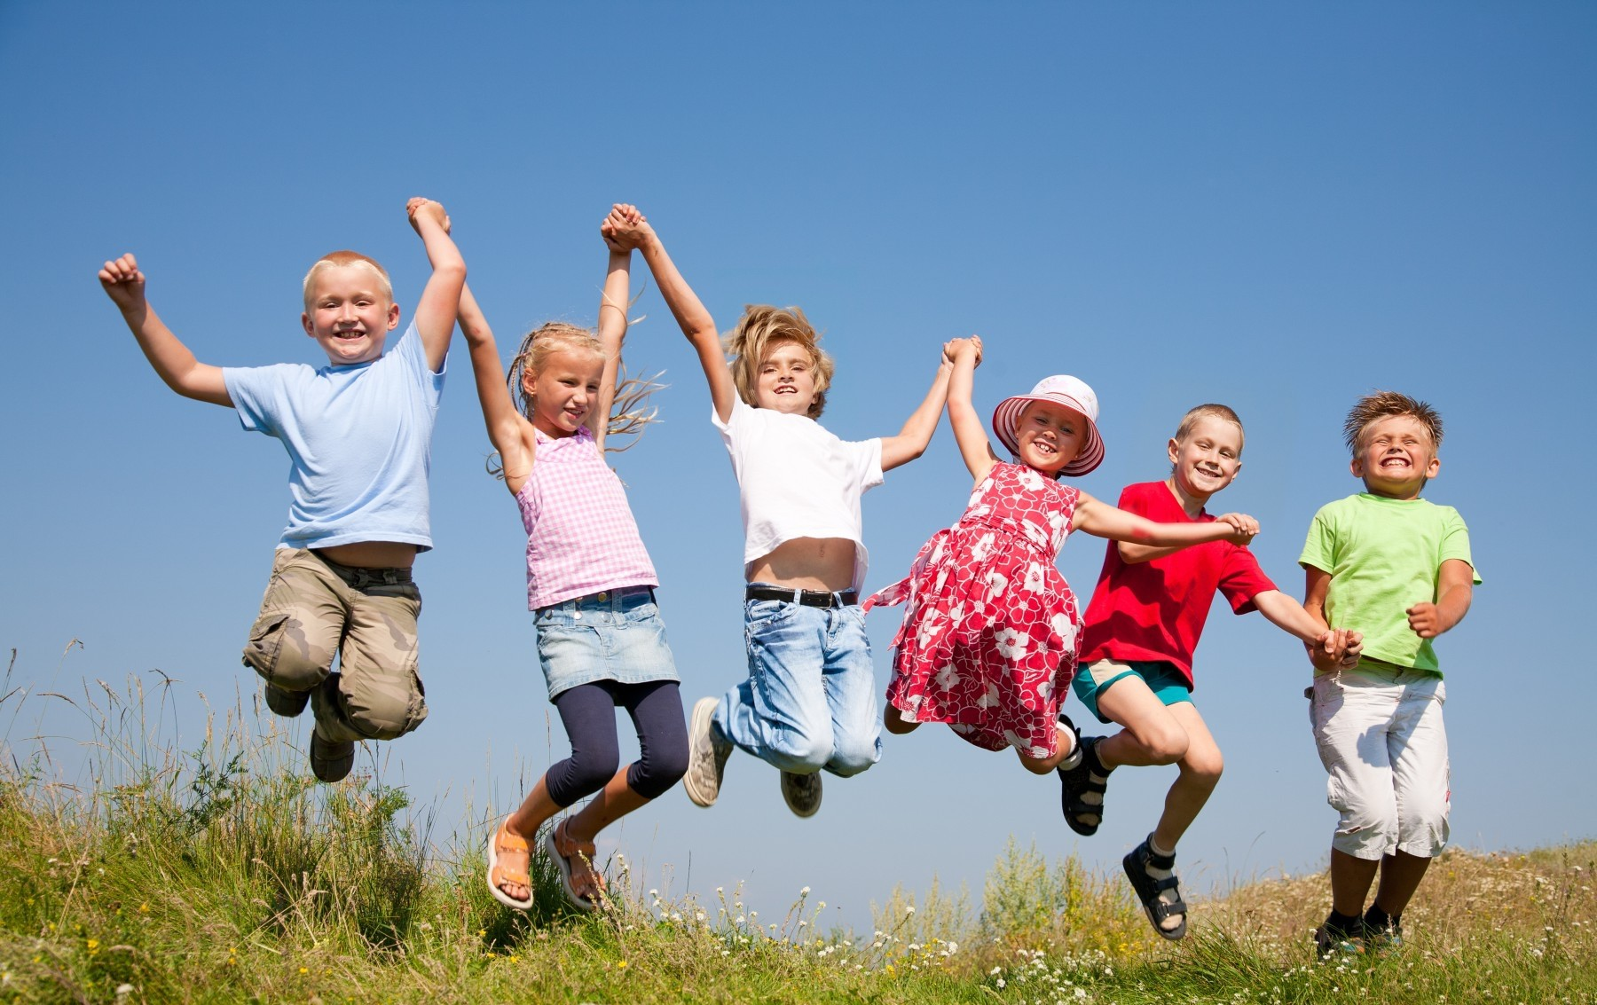
Review!
“Ow”, “Oo”, and “Ou” words
Describing a photo
Comparative and Superlative
Shall we, and how about…

