Slide 1
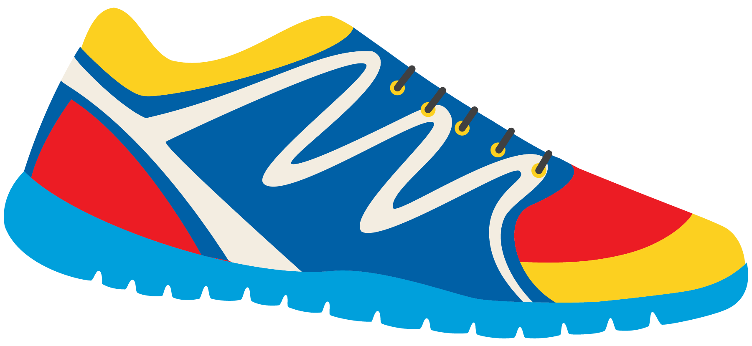
Keeping In Shape
Unit 6: Lesson 8

Slide 2
What are we learning this class?
A review of the lessons 5-7
Oo, Ow, and Ou sounds
Describing a photo
Comparative and Superlative
“Shall we” and “How about”

Slide 3
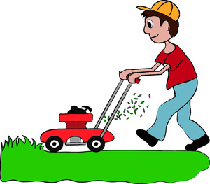
We learned about the sounds “Oo”, “Ow”, and “Ou”.
What does each pairing sound like?
List an example word of each sound.
“Oo”
“Ow”
“Ou”

Slide 4
Great work! Let’s play a guessing game!
What word am I thinking of?
This is something I do to the grass on my lawn when it is getting long.

Slide 5
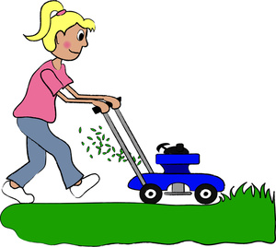
You are right! It is mow.
How does this activity keep us in shape?

Slide 6
Let’s do it again!
What word am I thinking of?
This is something large, white and fluffy in the sky. I watch these when I play outside.

Slide 7
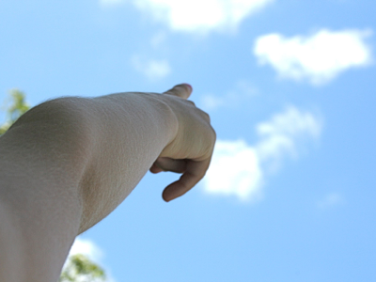
Correct! The word is cloud.
Do you like to watch the clouds when you are outside?

Slide 8
One more time!
What word am I thinking of?
This is something on the earth that is tall. You can climb it, and the higher you climb the colder it gets. It is hard work to climb.

Slide 9
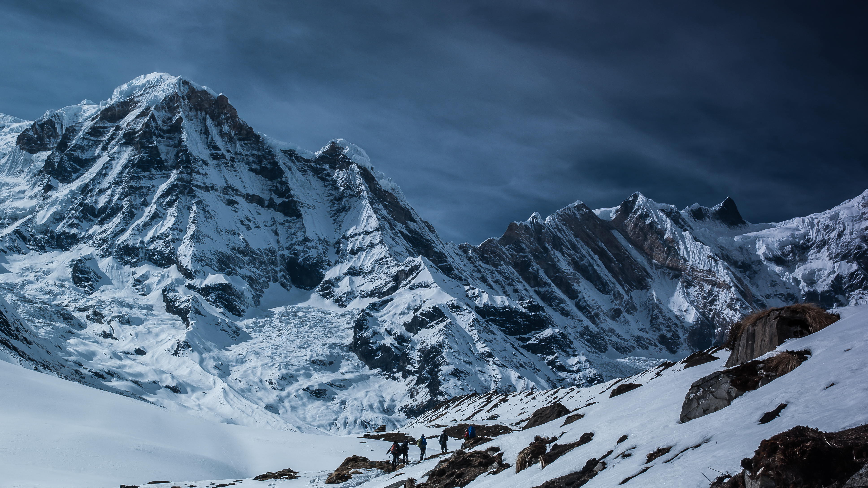
Right! The word is mountain.
Have you seen a mountain before? Would you like to climb one?

Slide 10
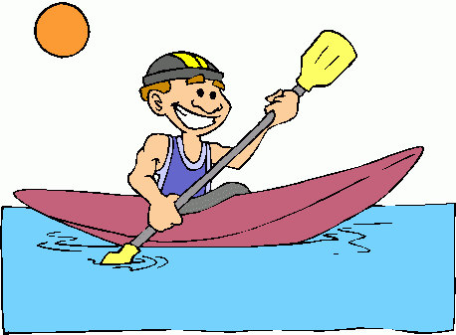
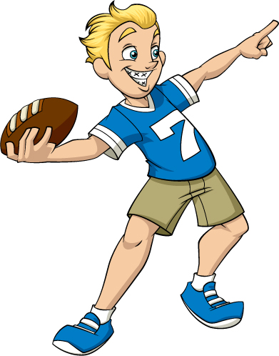
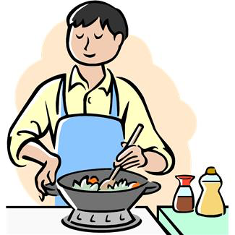
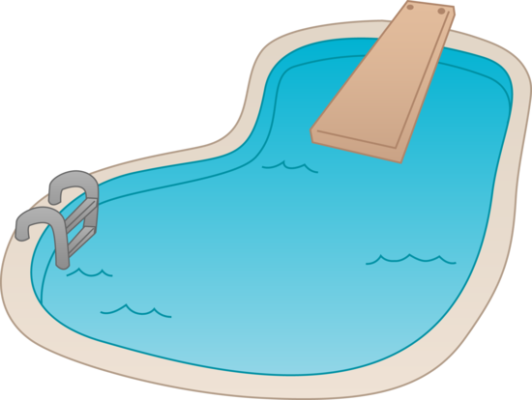
Nice Job! Now it is your turn.
Pick a photo and describe the item or activity that would keep us in shape. We will guess the “Ow”, “Oo”, or “Ou” word.

Slide 11
Great work. You know your “Oo”, “Ow”, and “Ou” words!
Now write your own sentence using an “Oo”, “Ow” or “Ou” word of your choice!

Slide 12
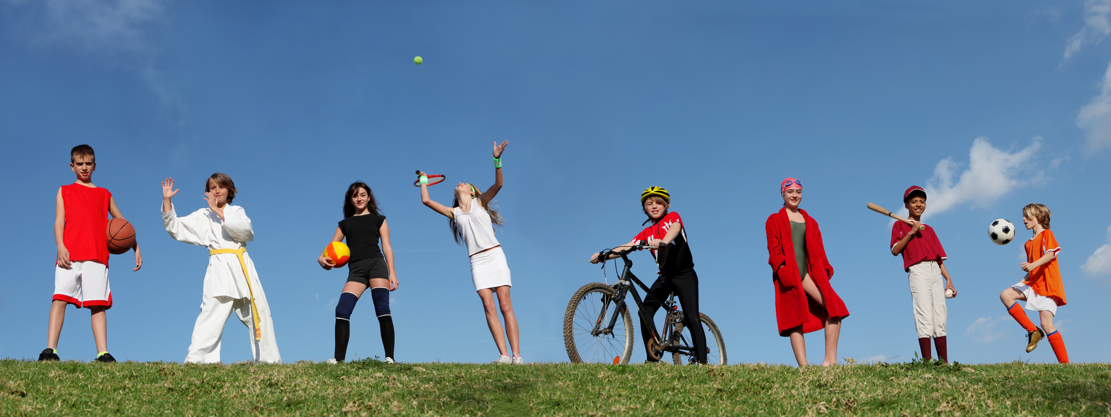
Let’s now review present continuous tense.
Am/Is/Are
What are the children in the picture doing? Describe using the words am, is and are.

Slide 13
Fill in the blanks to create a correct sentence.
She _____ playing tennis. They ______ playing outside. He _______ riding a bike.

Slide 14
Write a sentence about what you are doing right now. Should you use am, is, or are?

Slide 15
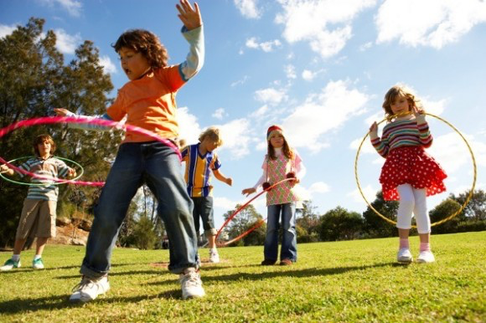
Let’s do it again. What is happening in this photo?

Slide 16
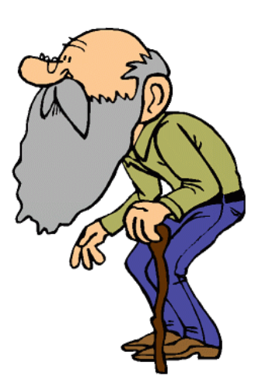
Nice work!
You learned how to use Am/Is/Are appropriately!
Now we will be reviewing comparative and superlative words!

Slide 17
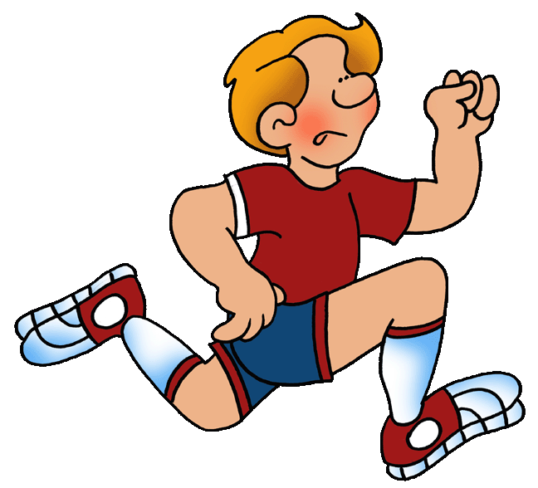
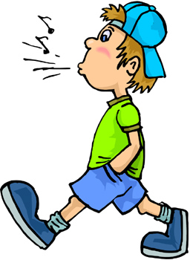
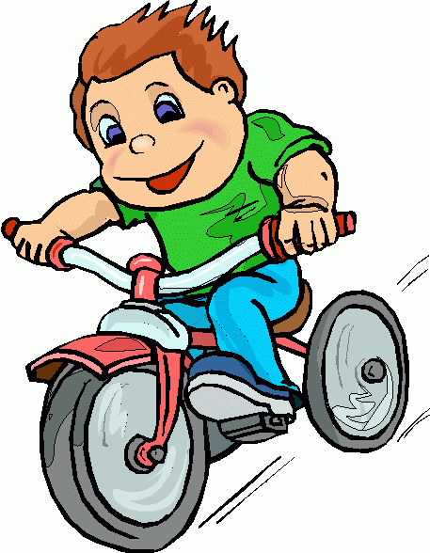
Review: Use the adjective “fast” to describe these boys.
Who is going faster? The fastest?

Slide 18
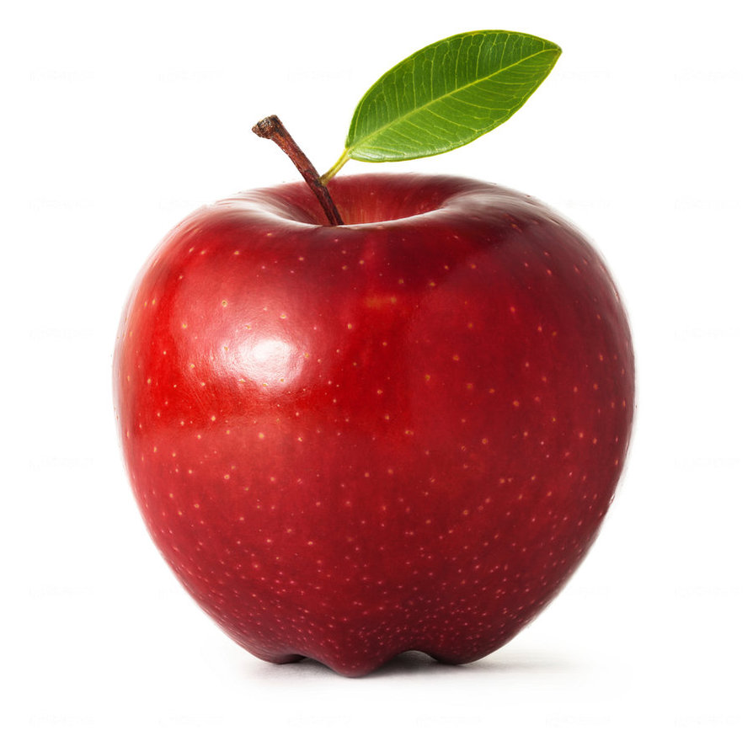
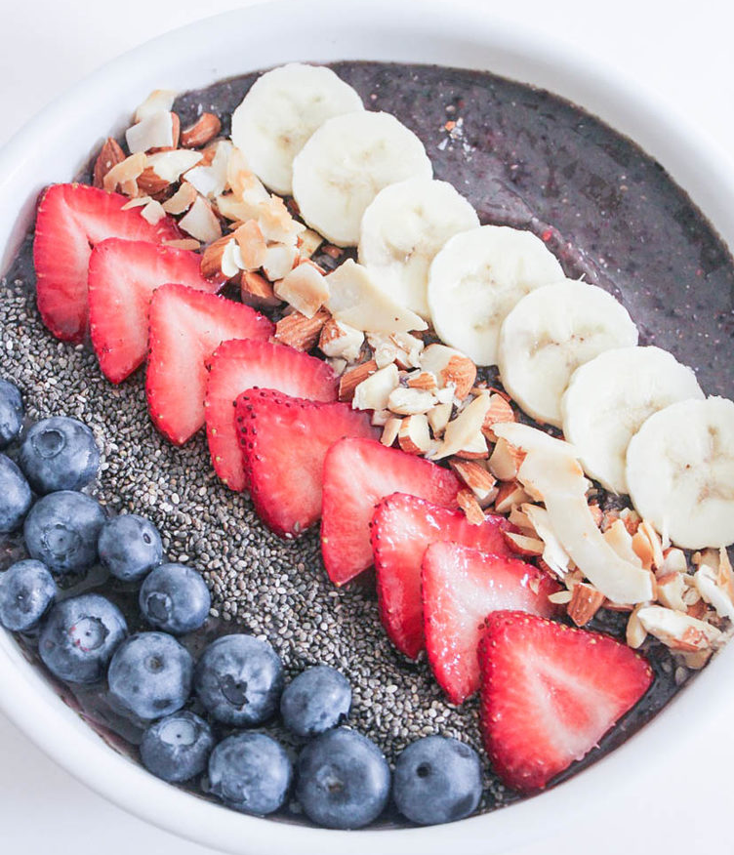
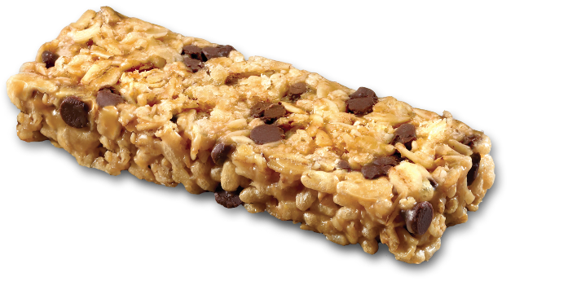
Let’s try one more time. Describe these using the word “healthy”
Healthy? Healthier? Healthiest?
Why would these foods would keep us in shape?

Slide 19
Try it yourself using the word “tall”.
Draw and label a “tall”, “taller” and “tallest” person.

Slide 20
Write your own sentence. Use the word strong.
Strong. Stronger. Strongest.

Slide 21
Awesome job! Now let’s review the phrases “Shall we…” and “How about...”

Slide 22
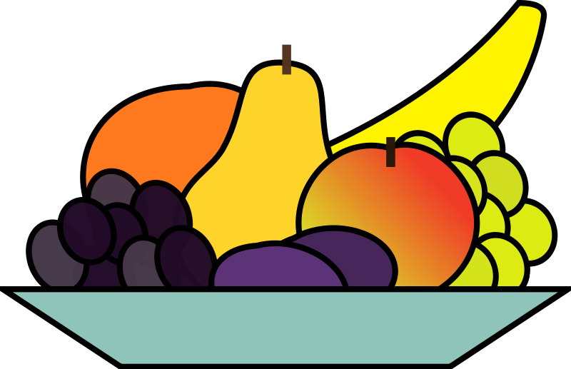
“Shall we” and “how about” can both be used when you are making a suggestion.
Shall we play basketball tonight?
How about you come over for dinner tonight?

Slide 23
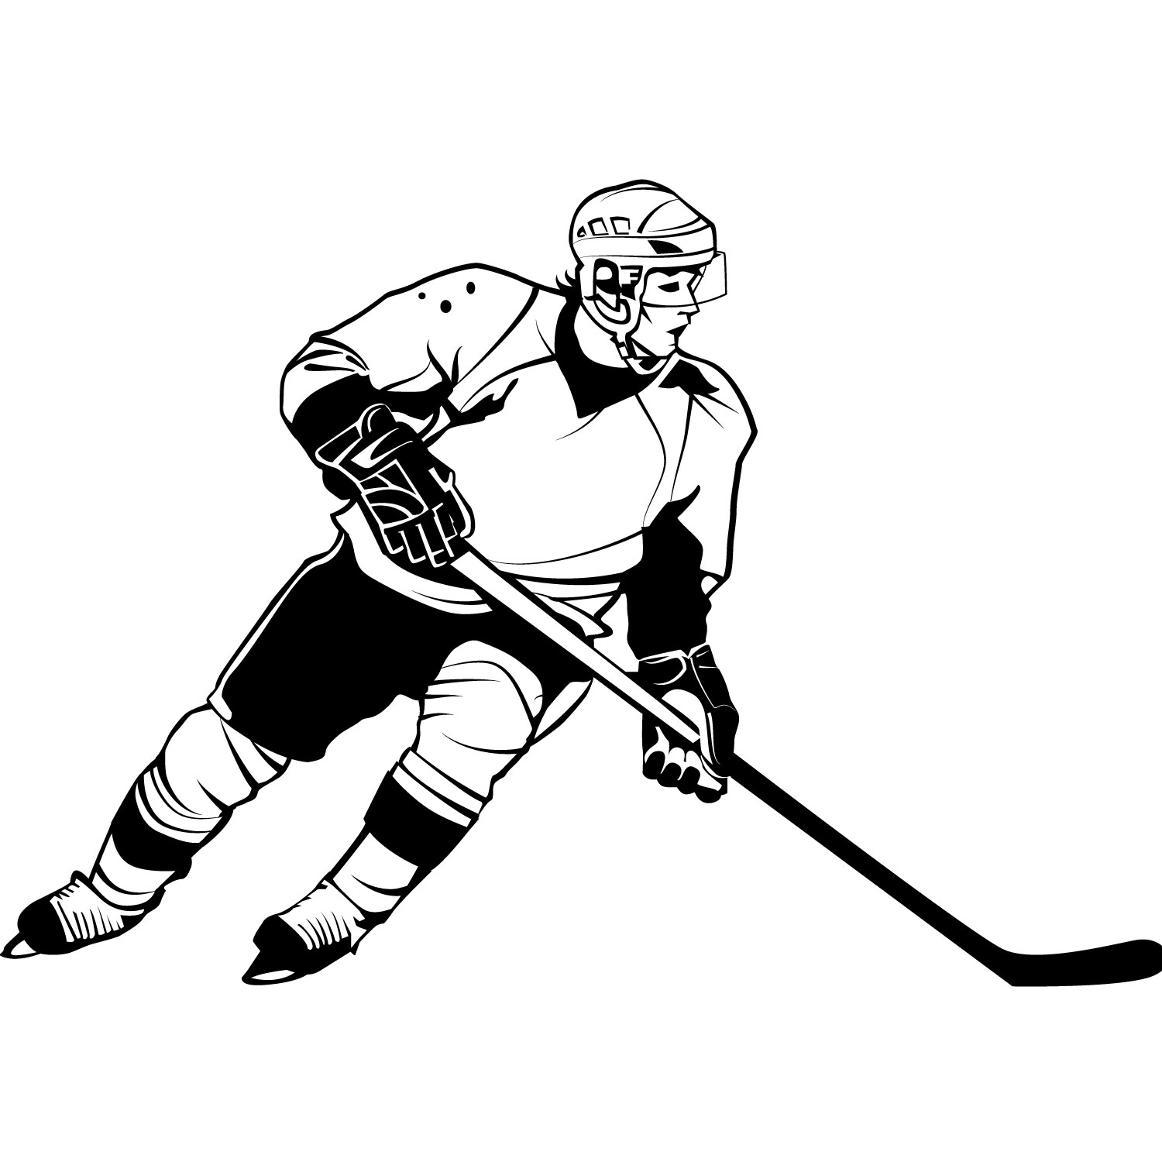
Write your own sentence using “shall we”.
Here is an example. Shall we play volleyball or hockey tonight?

Slide 24
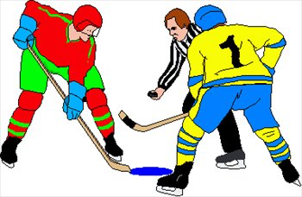
Great! Now, answer the question you just asked using “how about…”
Here is an example. How about hockey?

Slide 25
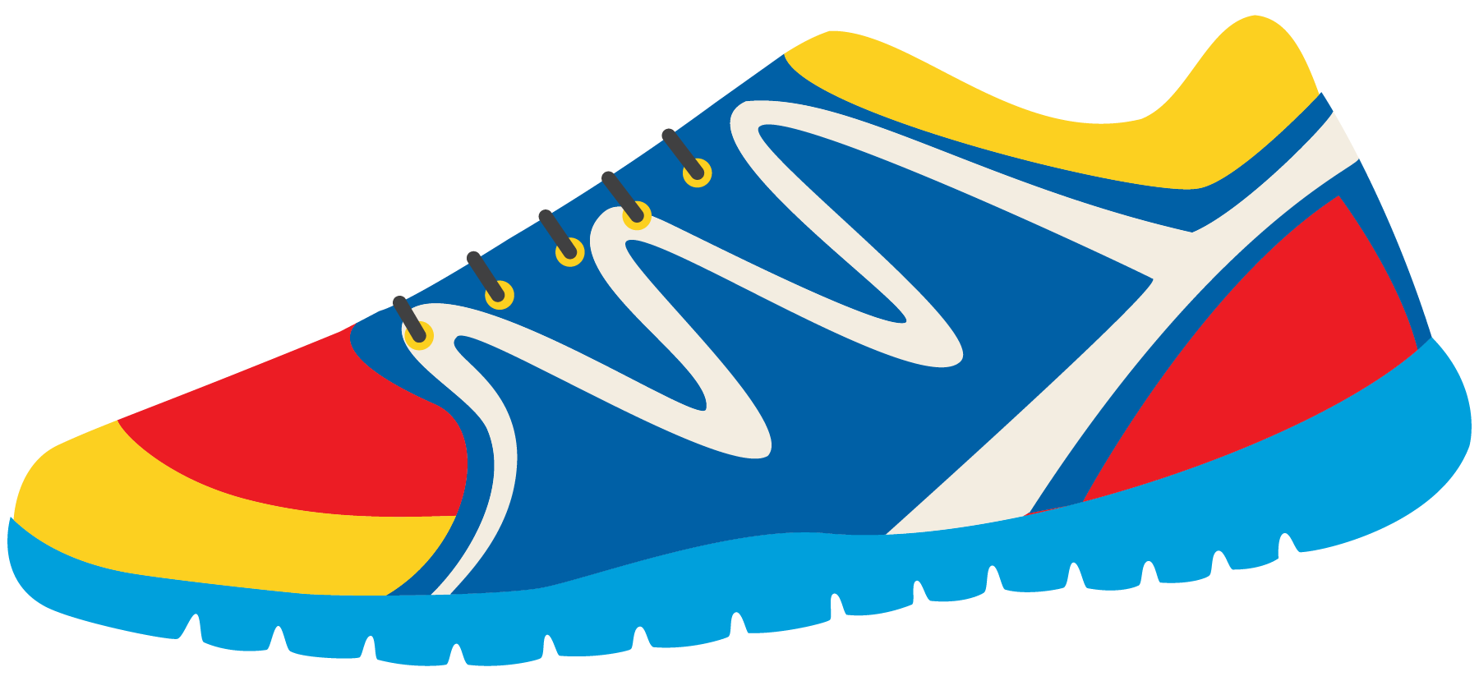
Great work! Playing sports and being outside helps to keep us in shape. Let’s read a poem about keeping in shape!

Slide 27
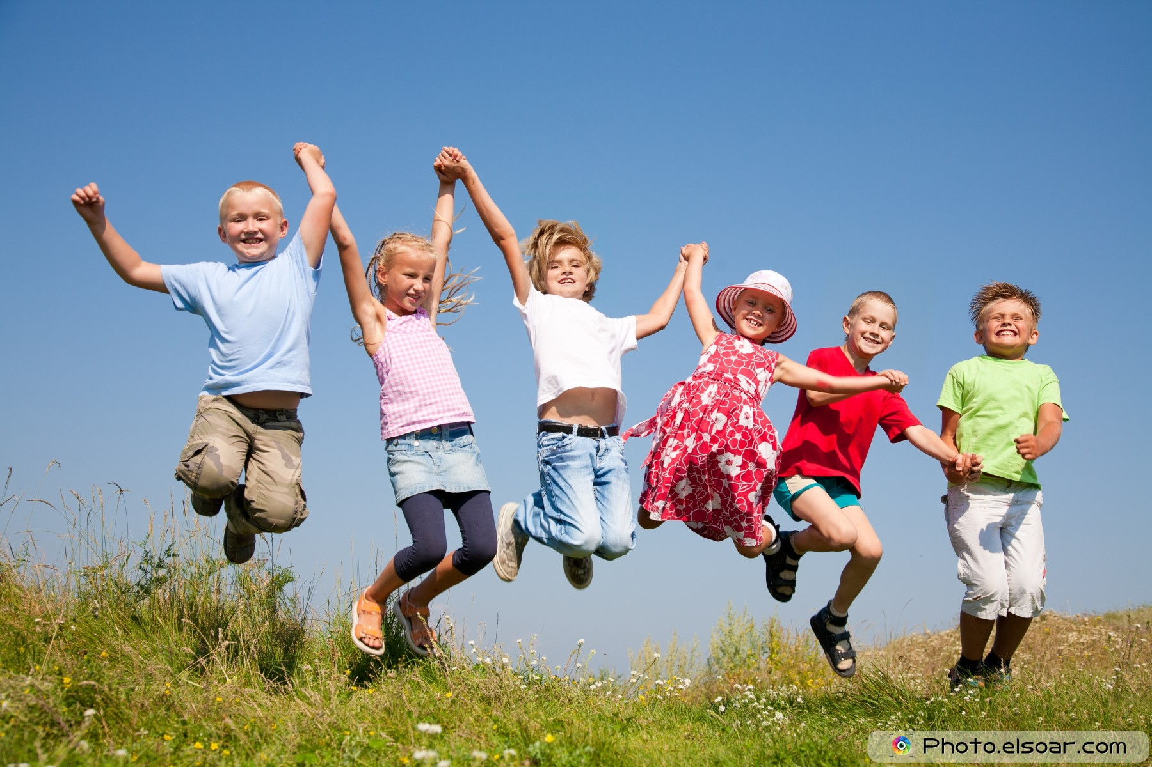
Review!
“Ow”, “Oo”, and “Ou” words
Describing a photo
Comparative and Superlative
Shall we, and how about…

Slide 28
Homework
Do you have any questions?

Slide 29
What do you think she should do?
What activities would keep her in shape?
What would you like to do?

