Slide 1

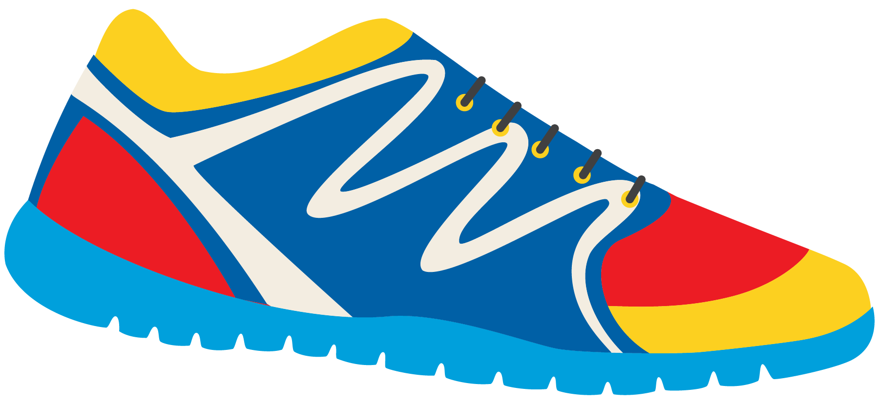

Keeping In Shape
Unit 6: Lesson 9

Slide 2


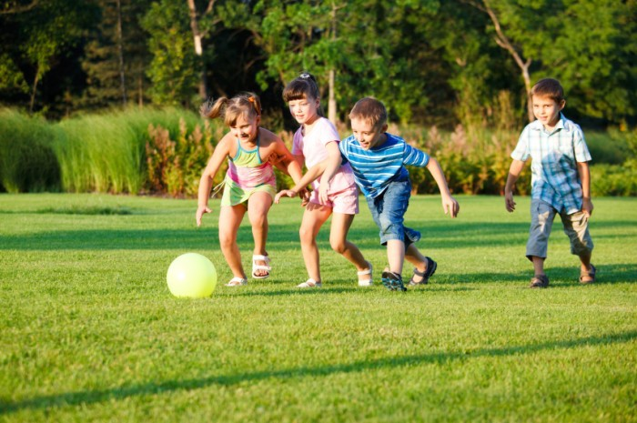
What sound do the letters “A” and “Y” make when they are together?

Slide 3


You have 1 minute. Race against your classmates and write a list of as many “ay” words as you can think of.

Slide 4


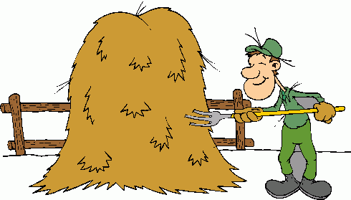
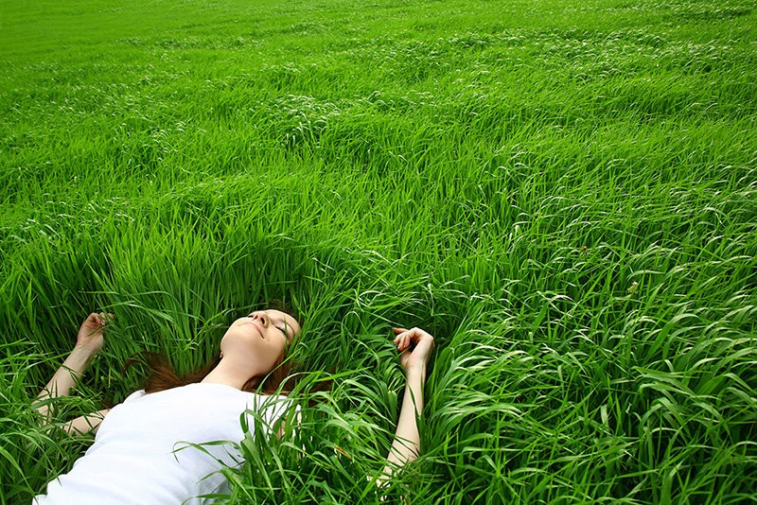
Nice job! That was a lot of words.
Now try to match the photo
with the word.
Lay
Day Hay

Slide 5

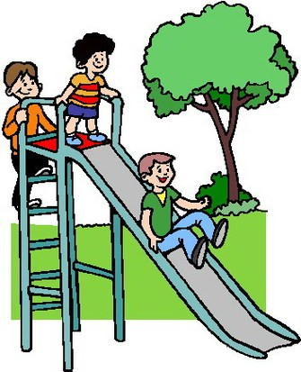
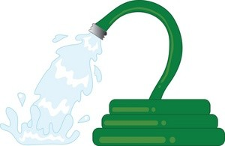
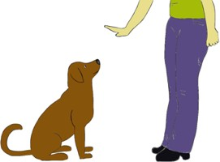
Let’s do it again. Match the photo with the word.
Spray
Stay Play

Slide 6

I love to __________ outside with friends.
My mom will _________ the garden hose to water our healthy vegetables.
We only play outside during the ______.
My dad says to __________ outside for at least an hour each day.

Slide 7

What are some things you noticed about each sentence?

Slide 8
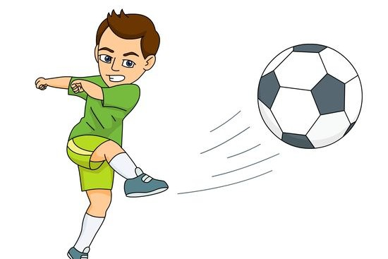
There are 5 important parts to a basic sentence.
Bill kicked the ball.
Subject
Object
Capital letter
Verb
Punctuation

Slide 9

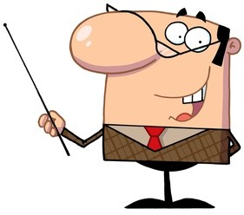
Steve laid down on the grass.
Identify the 5 important parts of this basic sentence.
Capital?
Punctuation?
Subject?
Verb?
Object?

Slide 10

Try your own sentence! Include the 5 parts of a basic sentence
that we learned about.

Slide 11
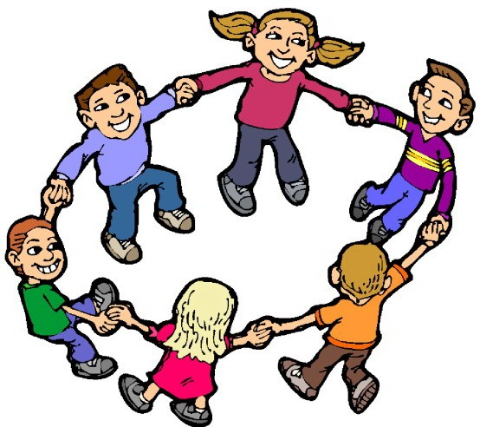
Nice work! Now let’s try to add our “ay” words into the sentence. Write a sentence using one “ay” word.

Slide 12


Great job!
How can the sentence you wrote keep us in shape?

Slide 13

Now we will look at adjectives and adverbs.
What is an adjective?
What is an adverb?
Adjective – a describing word Adverb – tells us more about a verb

Slide 14



Let’s list some examples of adverbs and adjectives that we already know
Adverbs Adjectives

Slide 15


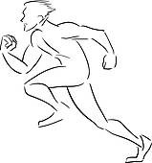
Great list! Here are some adverbs
you may not have heard before. Try to use one in a sentence.
Gracefully Loudly Rapidly Quietly Carelessly
Example: Julie carelessly shot the ball into the basket.

Slide 16

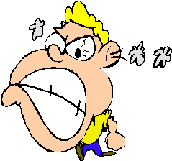
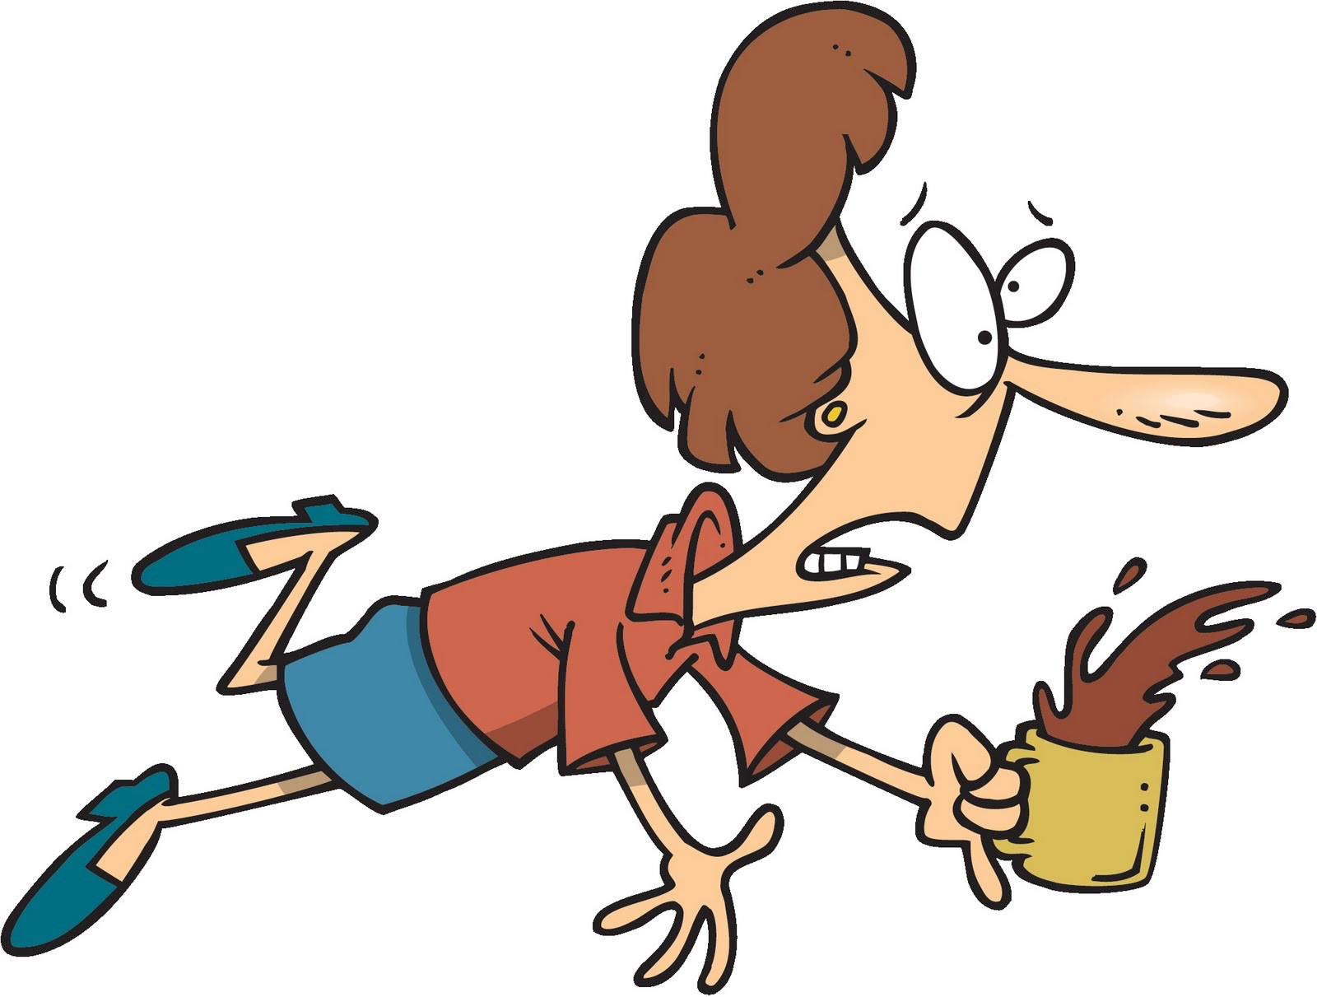

Here are some new adjectives. Try to use one of these in a sentence.
Clumsy Aggressive Brave Round Gigantic Rough
Example: Kevin is a clumsy athlete.

Slide 17

Write a sentence describing something that would keep us in shape using an adjective.

Slide 18

Great work! Being outside is a great way to stay active and in shape?
Pop Question:
At least how long should we play outside each day?

Slide 19
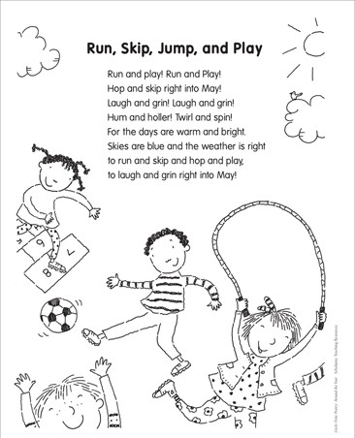

Slide 20


