Slide 1
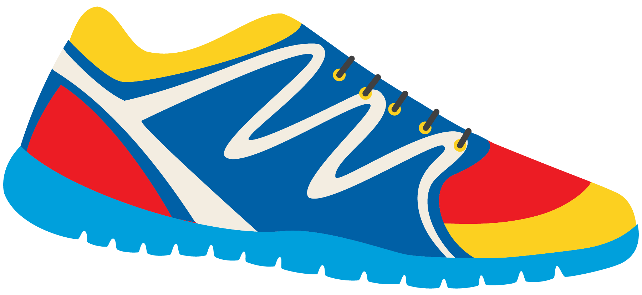
Keeping In Shape
Unit 6: Lesson 9

Slide 2
What are we learning this class?
“Ay” sound
Writing short sentences
Adjectives and Adverbs

Slide 3
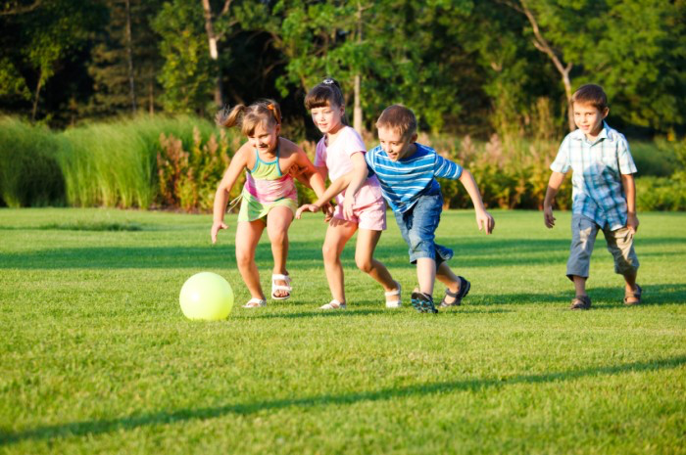
What sound do the letters “A” and “Y” make when they are together?

Slide 4
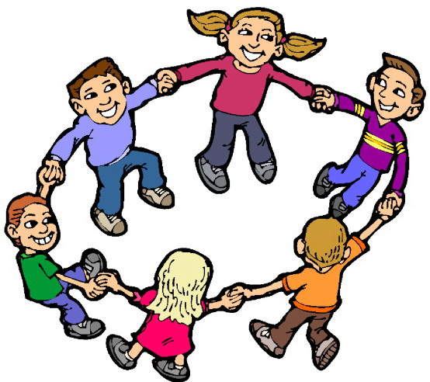
“Ay” You are correct! Here are some examples of words that have “ay” in them.
Can you guess the word being depicted?

Slide 5
You have 1 minute. Race against your classmates and write a list of as many “ay” words as you can think of.

Slide 6
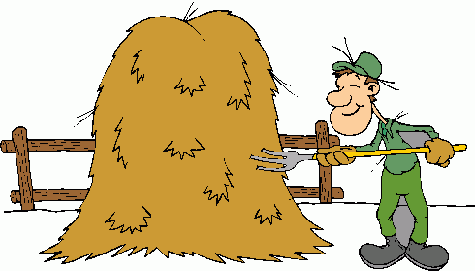
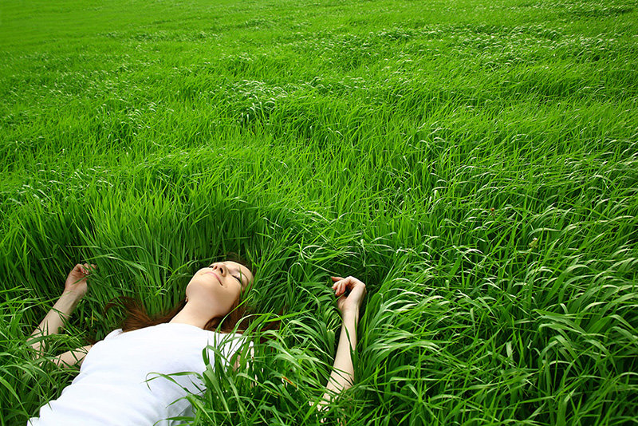
Nice job! That was a lot of words.
Now try to match the photo with the word.
Lay
How are these words involved in keeping us in shape?
Day
Hay

Slide 7
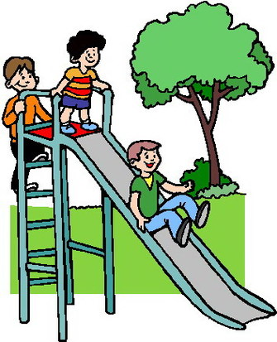
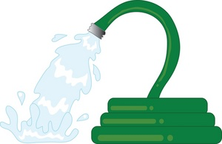
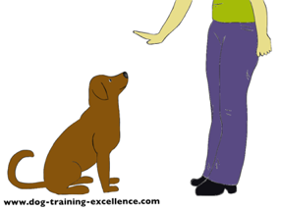
Let’s do it again. Match the photo with the word.
How can these words keep us in shape?
Spray
Stay
Play

Slide 8
Nice matching skills. It is important to understand what each word means.
Now we will try to fill in some blanks!
Pay attention to the details of each sentence.

Slide 9
I love to __________ outside with friends.
My mom will _________ the garden hose to water our healthy vegetables.
We only play outside during the ______.
My dad says to __________ outside for at least an hour each day.

Slide 10
What are some things you noticed about each sentence?

Slide 11
Correct! Here are some important parts of a sentence.
Begin with a capital
End with punctuation
Involve a subject, verb, and an object.
Example:
Bill kicked the ball.

Slide 12
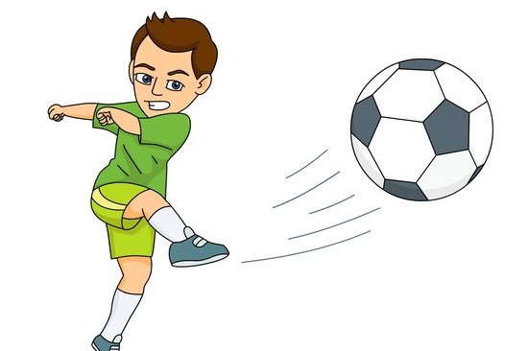
Bill kicked the ball.
There are 5 important parts to a basic sentence.
Subject
Object
Capital letter
Verb
Punctuation

Slide 13
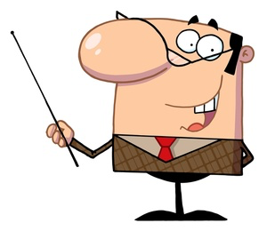
Steve laid down on the grass.
Identify the 5 important parts of this basic sentence.
Capital? Punctuation? Subject? Verb?
Object?

Slide 14
Try your own sentence! Include the 5 parts of a basic sentence that we learned about.

Slide 15
Nice work! Now let’s try to add our “ay” words into the sentence. Write a sentence using one “ay” word.

Slide 16
Great job! How can the sentence you wrote keep us in shape?

Slide 17
Now we will look at adjectives and adverbs. What is an adjective? What is an adverb?
Adjective – a describing word
Adverb – tells us more about a verb

Slide 18
Let’s list some examples of adverbs and adjectives that we already know
Adverbs
Adjectives

Slide 19
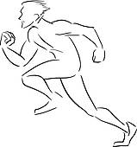
Great list! Here are some adverbs you may not have heard before. Try to use one in a sentence.
Gracefully
Loudly
Rapidly
Quietly
Carelessly
Example: Julie carelessly shot the ball into the basket.

Slide 20
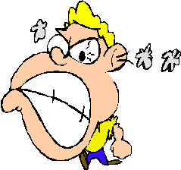
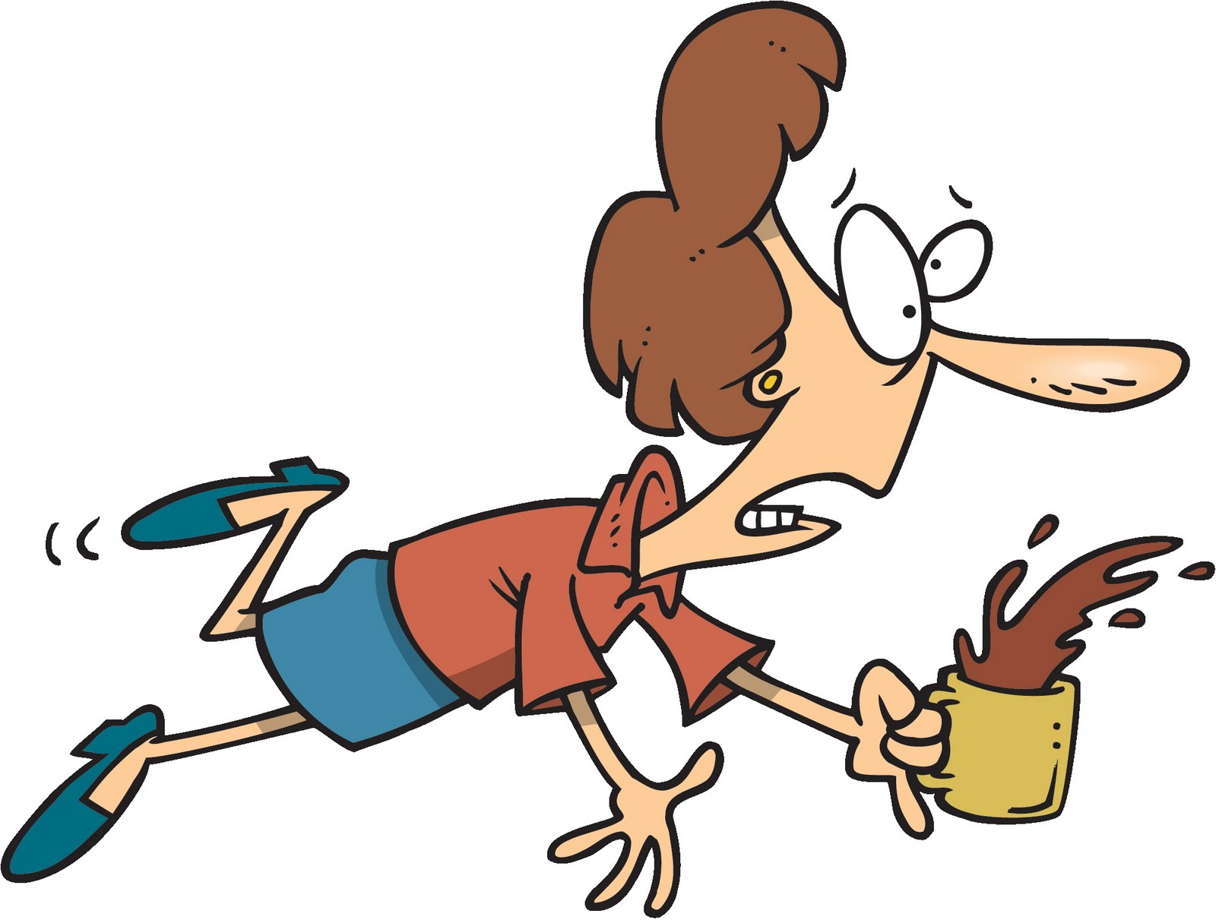
Here are some new adjectives. Try to use one of these in a sentence.
Clumsy
Aggressive
Brave
Round
Gigantic Rough
Example: Kevin is a clumsy athlete.

Slide 21
Write a sentence describing something that would keep us in shape using an adjective.

Slide 22
Great work! Being outside is a great way to stay active and in shape. Pop Question: At least how long should we play outside each day?

Slide 23
Answer: At least 60 minutes each day!

Slide 24
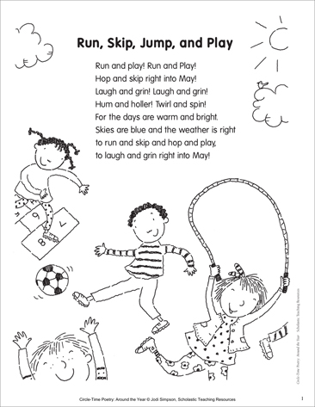

Slide 26
Review!
“Ay” words
Writing our own sentences
Adverbs and Adjectives

Slide 27
Homework
Do you have any questions?

