Slide 1


SPORTS
Unit 7: Lesson 1

Slide 2



Think of the “er” sound. What do you think it sounds like?
Can you think of a sport that has the “er” sound in it?

Slide 3

Let’s list some other words that have “er” in them.

Slide 4
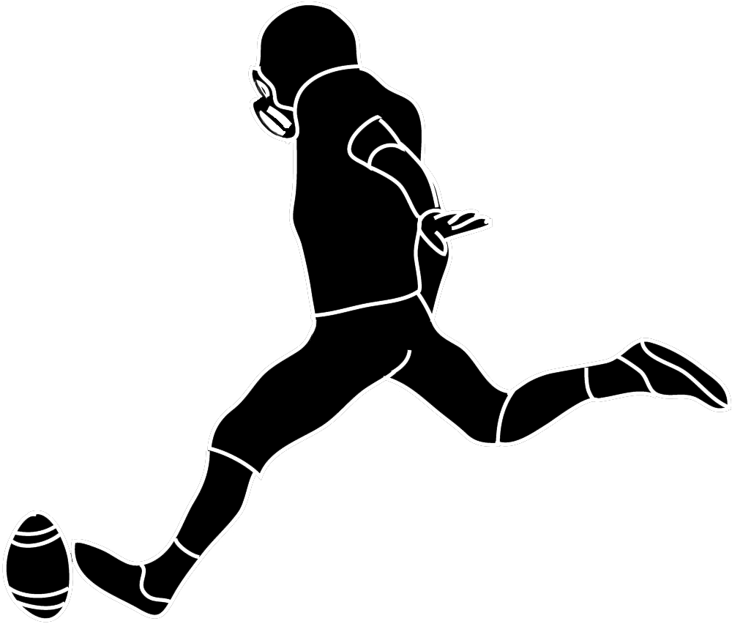



Look at the pictures. What “er” word is being shown?

Slide 5
Nice work! Let’s work together to fill in the appropriate “er” word in each sentence.
We like to play basketball ___________________.
My jersey _____________________ is 7.
I __________________ the volleyball over the net.
I threw the football to the ______________ of the field.

Slide 6



Circle the “er” words you find.
I like to play soccer. My team is called the Timbercreek Tigers. My favourite position is a defender. The number on my jersey is 7, and my teammates say I am a fast runner. I am good at keeping the ball within the field borders and I am the best kicker.

Slide 7

Practice writing a sentence using your own “er” word.

Slide 8
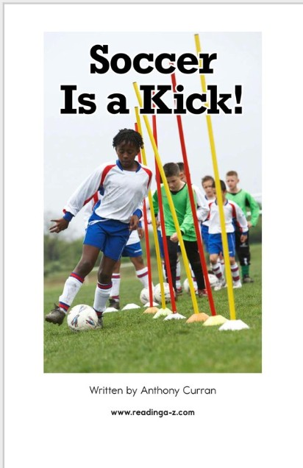

Slide 9
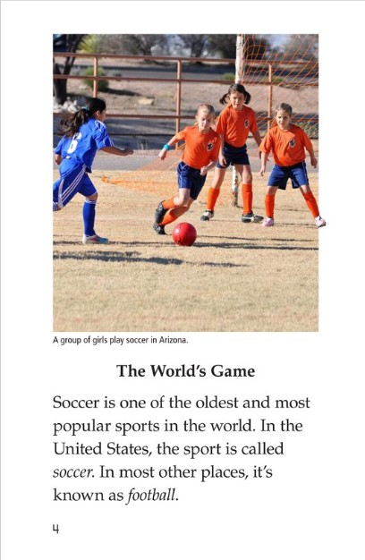

Slide 10
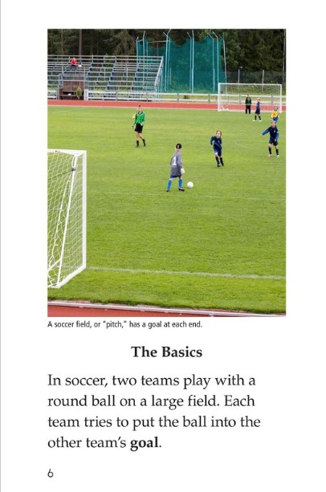

Slide 11
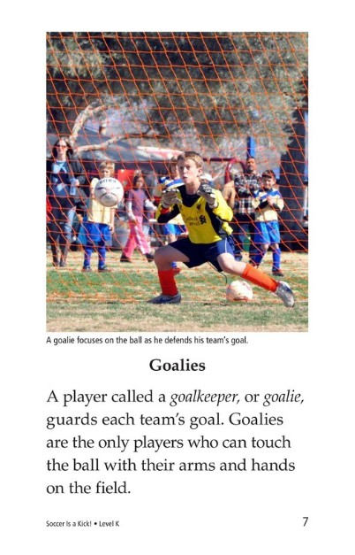

Slide 12
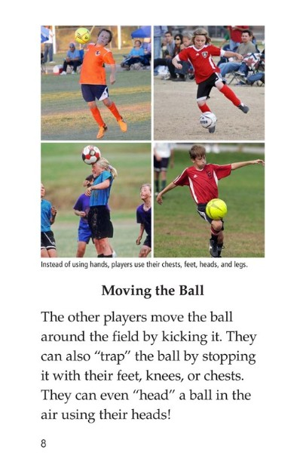

Slide 13
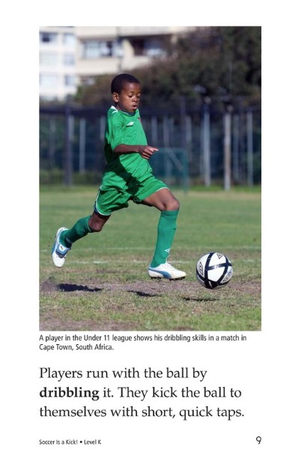

Slide 14
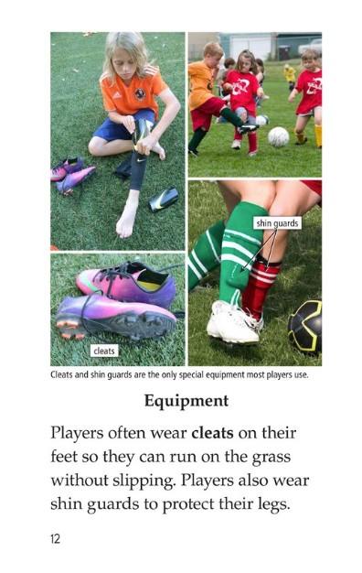

Slide 15
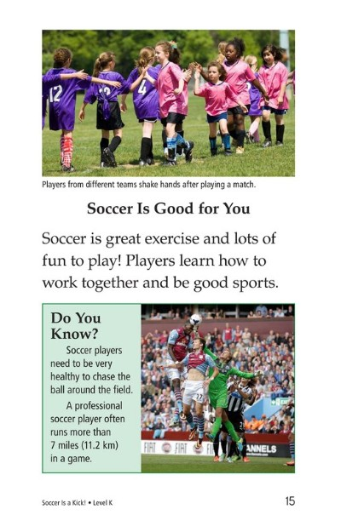

Slide 16

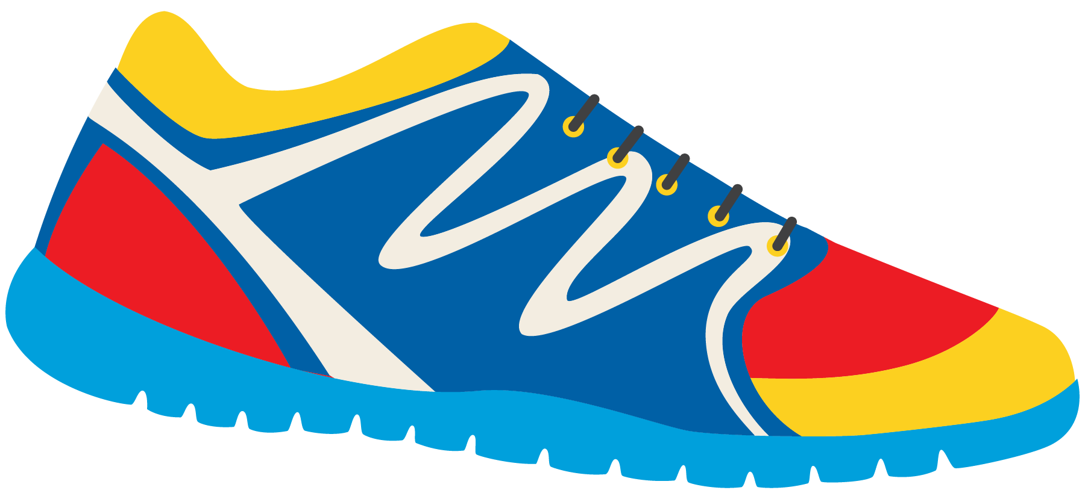
What did you learn about soccer?

Slide 17
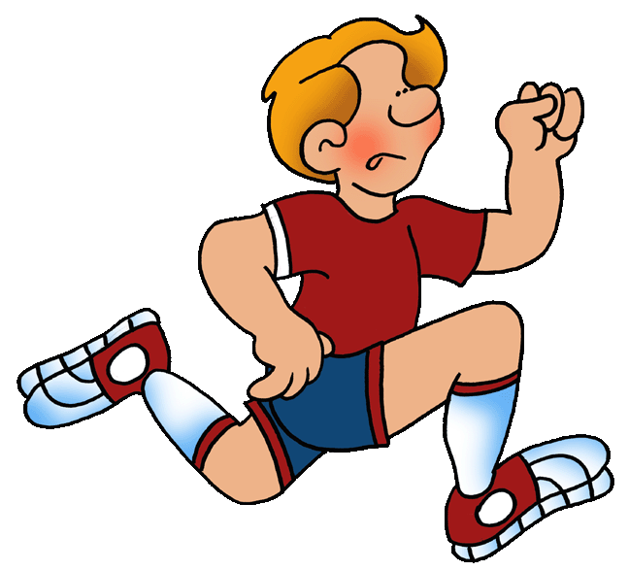
Tom is a fast runner.
Circle the adjective

Slide 18
Here are some more adjectives we can use
Speedy
Cheerful
Excellent
Quick
Impressive
Rough
Wonderful
Tall
Intense
Strong

Slide 19

Jane is a cheerful goalie.
Speedy
Cheerful
Excellent
Quick
Impressive
Rough
Wonderful
Tall
Intense
Strong

Slide 20
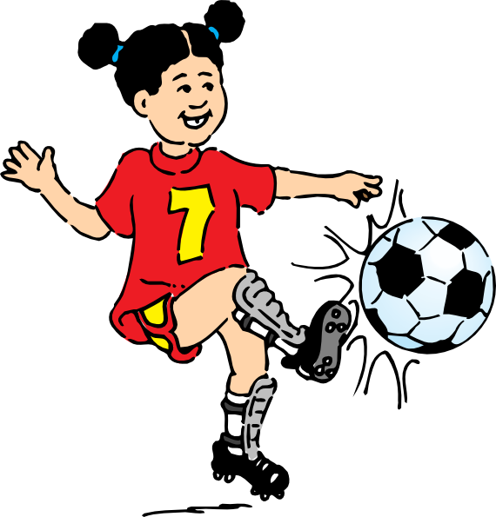
My mom says I am a rough player.
Speedy
Cheerful
Excellent
Quick
Impressive
Rough
Wonderful
Tall
Intense
Strong

Slide 21
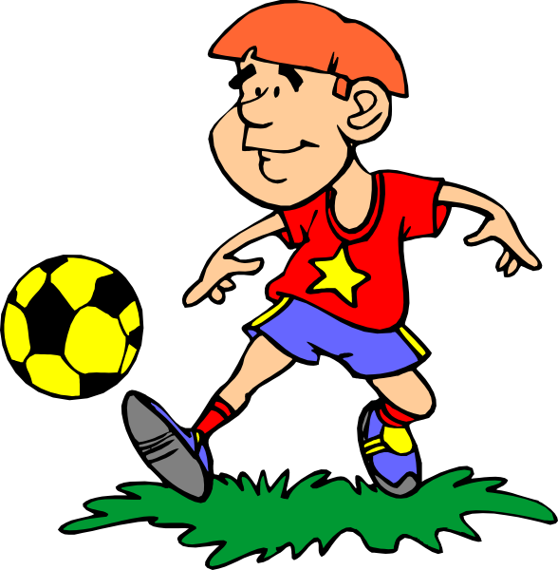
Josie is an excellent player.
Speedy
Cheerful
Excellent
Quick
Impressive
Rough
Wonderful
Tall
Intense
Strong

Slide 22
Write your own sentence using an adjective
Speedy
Excellent
Quick
Cheerful
Rough
Wonderful
Tall
Intense
Strong
Impressive

