Slide 1
SPORTS
Unit 7: Lesson 1

Slide 2
What are we learning this class?
“Er” words
Complex and descriptive adjectives
Reading a book about Soccer!

Slide 3
Think of the “er” sound. What do you think it sounds like?
Can you think of a sport that has the “er” sound in it?

Slide 4
Correct! Soccer!

Slide 5
Let’s list some other words that have “er” in them.

Slide 6
Look at the pictures. What “er” word is being shown?

Slide 7
Nice work! Let’s work together to fill in the appropriate “er” word in each sentence.
We like to play basketball ________________________.
My jersey ____________________ is 7.
I _____________________ the volleyball over the net. I threw the football to the ______________ of the field.

Slide 8
Circle the “er” words you find.
I like to play soccer. My team is called the Timbercreek Tigers. My favourite position is a defender. The number on my jersey is 7, and my teammates say I am a fast runner. I am good at keeping the ball within the field borders and I am the best kicker.

Slide 9
Practice writing a sentence using your own “er” word.

Slide 10
Now let’s read a book about soccer.
Have you played soccer before? Do you like it?

Slide 19
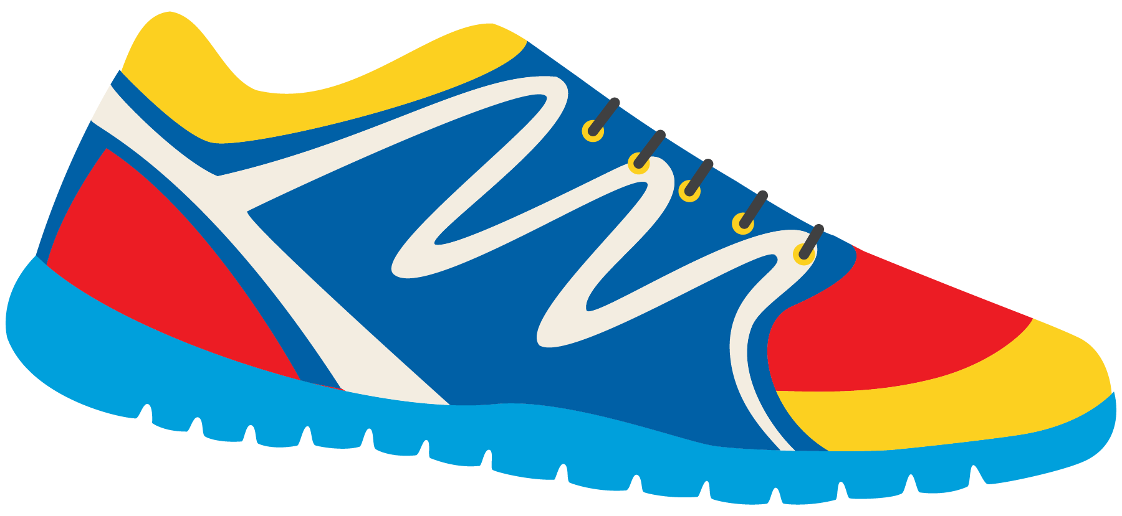
What did you learn about soccer?

Slide 20
Great! Now we will look at adjectives.
Do you remember what an adjective is?

Slide 21
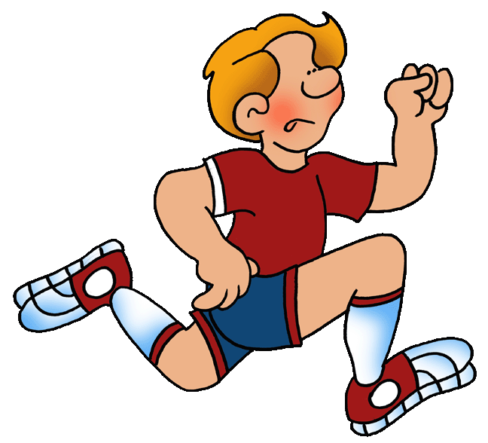
Tom is a fast runner.
Circle the adjective

Slide 22
Here are some more adjectives we can use
Speedy
Cheerful
Excellent
Quick
Impressive
Rough
Wonderful
Tall
Intense
Strong

Slide 23
Jane is a cheerful goalie.
Speedy
Cheerful
Excellent
Quick
Impressive
Rough
Wonderful
Tall
Intense
Strong

Slide 24
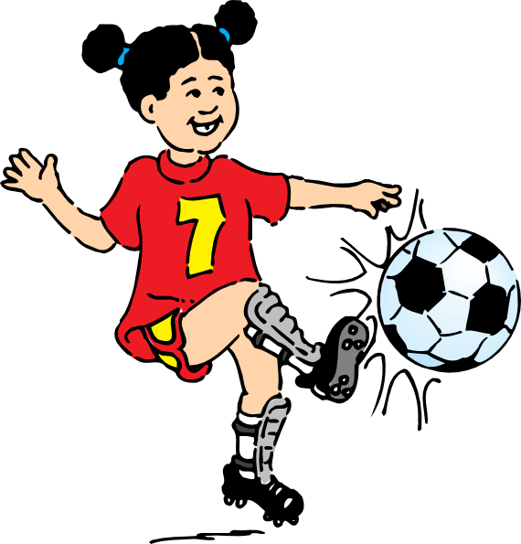
My mom says I am a rough player.
Speedy
Cheerful
Excellent
Quick
Impressive
Rough
Wonderful
Tall
Intense
Strong

Slide 25
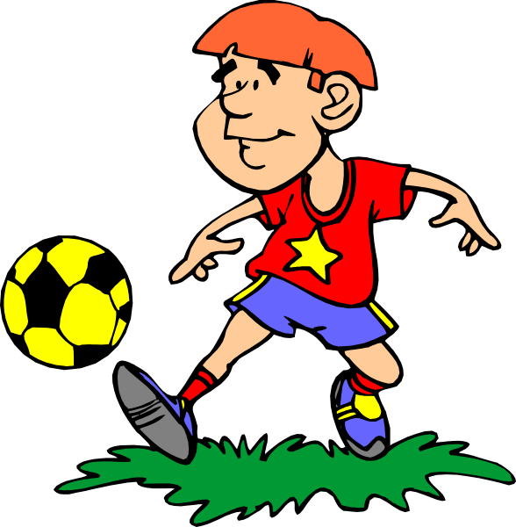
Josie is an excellent player.
Speedy
Cheerful
Excellent
Quick
Impressive
Rough
Wonderful
Tall
Intense
Strong

Slide 26
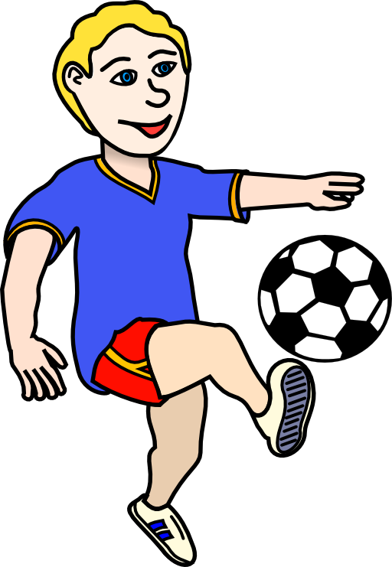
Write your own sentence using an adjective
Speedy
Excellent
Quick
Cheerful
Wonderful
Rough
Tall
Intense
Strong
Impressive

Slide 27
Try again. This time, write a sentence using two adjectives.
Speedy
Excellent
Quick
Cheerful
Wonderful
Rough
Tall
Intense
Strong
Impressive

Slide 28
What did we learn today?
“Er” words
Complex and descriptive adjectives
Reading a book about Soccer!

Slide 29
Nice work! Let’s look at the homework now

Slide 30
Do you have any questions?

