Slide 1


SPORTS
Unit 7: Lesson 10

Slide 2





What are we learning this class?
“A review of comparative and superlative words
Reading about the Summer Olympics

Slide 3
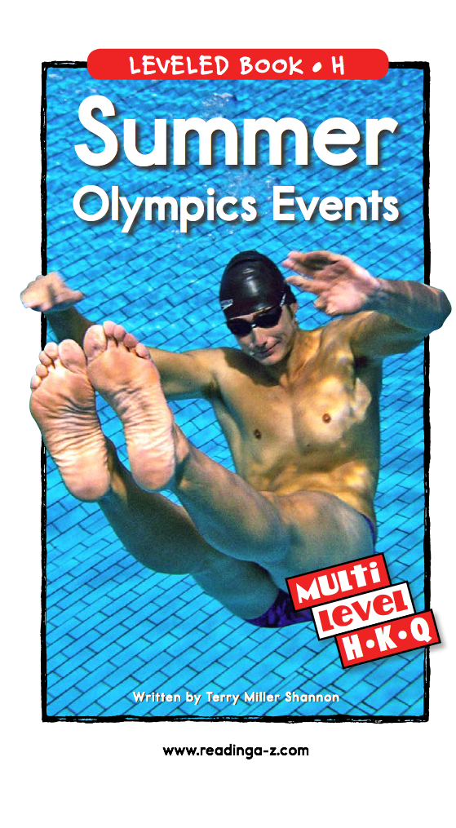
Have you heard of the Olympics before?

Slide 4
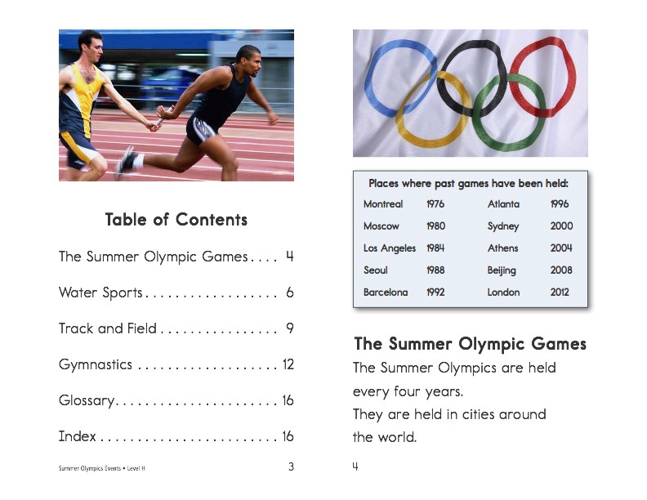

Slide 5
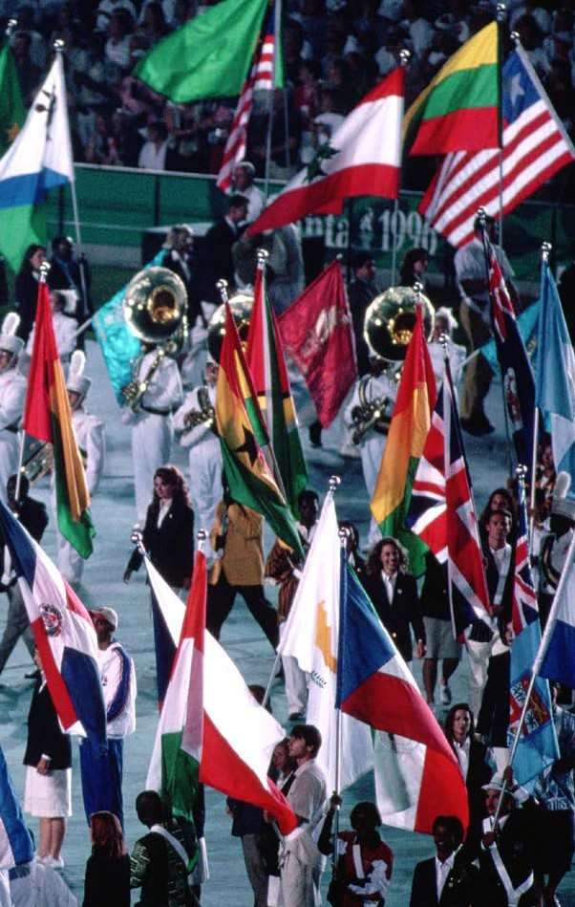
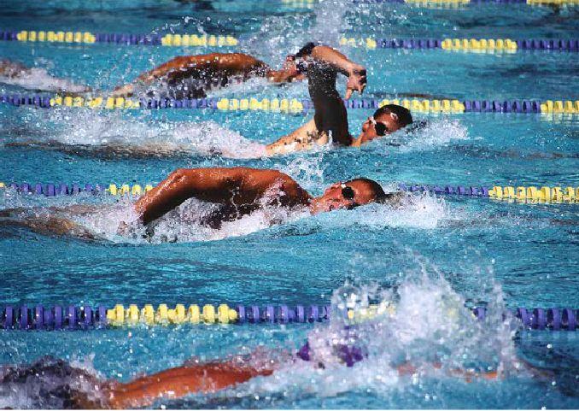
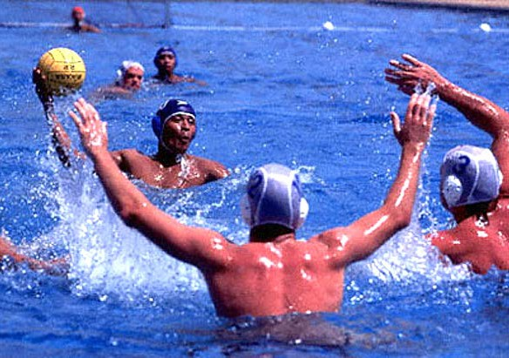
swimming
water polo
Water Sports There are many water sports. One water sport is swimming.
Athletes walk in a parade at the start of the Games.
Let’s look at some of the games.
Summer Olympics Events • Level H
5
6

Slide 6
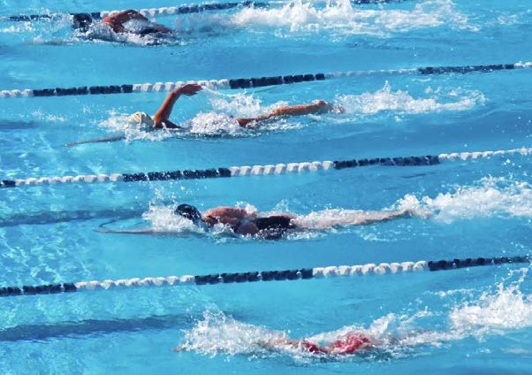
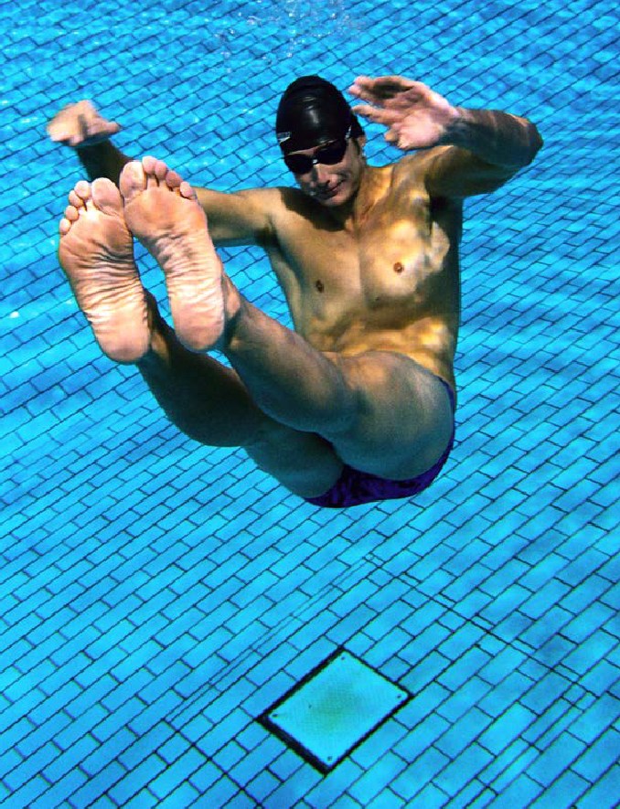
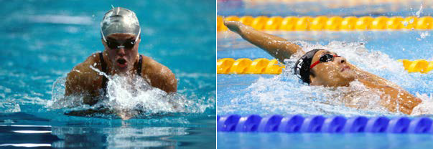
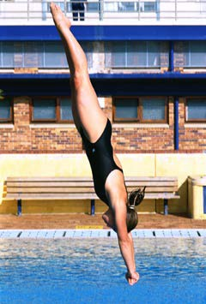
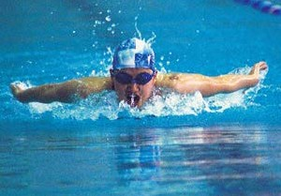
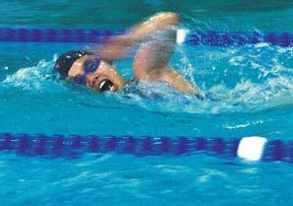
relay race
diving
breaststroke
backstroke
Divers twist and flip before hitting the water.
butterfly stroke
freestyle
Some swimming races use only one kind of stroke.
Other races use many strokes.
Another water sport is diving. Divers jump from high above the water.
Summer Olympics Events • Level H
7
8

Slide 7
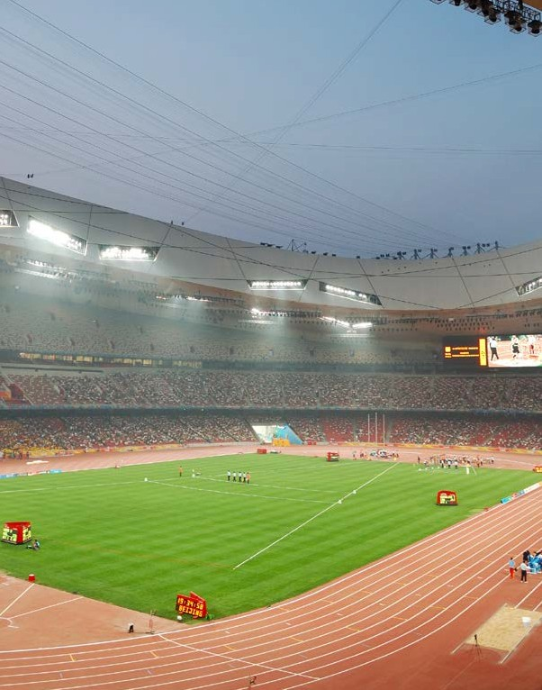
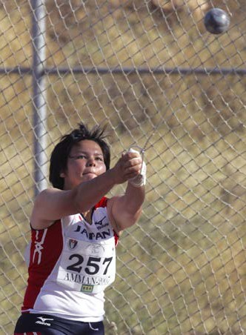
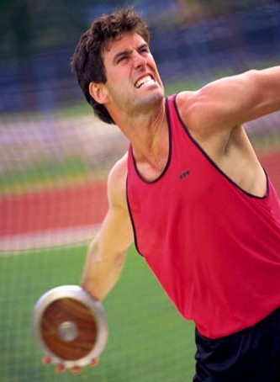
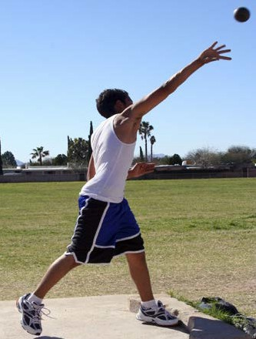
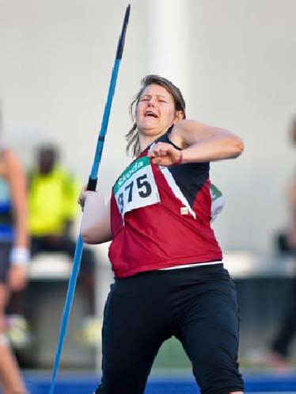
hammer throw
discus
shot put
javelin
Many Olympic events take place on the track and field.
Track and Field
Track and field events are games of running, throwing, and jumping. Races can be short or long.
In throwing games, people win by throwing objects the farthest.
Summer Olympics Events • Level H
9
10

Slide 8
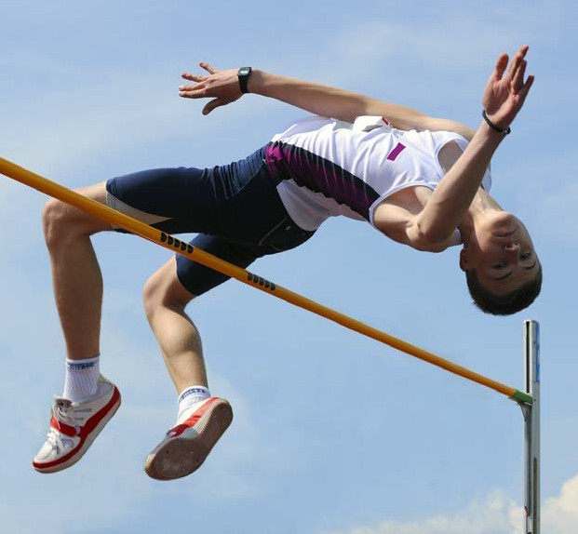
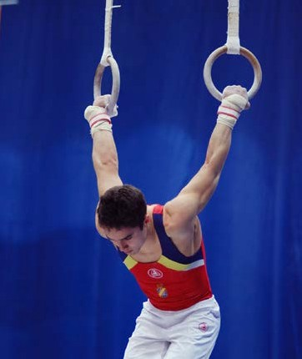
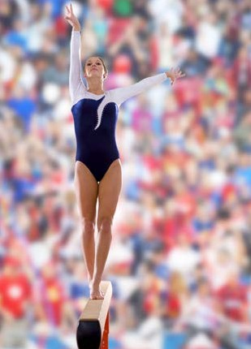
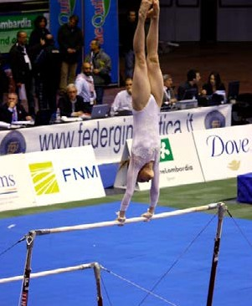
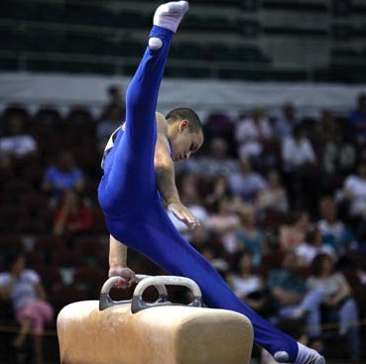
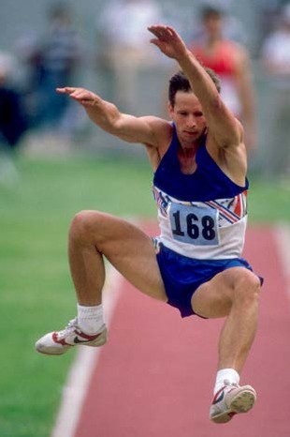
high jump
men’s rings
women’s balance beam
men’s pommel horse
In the high jump, people leap over a bar.
In the long jump, people leap as far as they can.
women’s uneven bars
Gymnastics Gymnasts leap, flip, and twirl. They need strength, skill, and good timing.
long jump
Summer Olympics Events • Level H
11
12

Slide 9
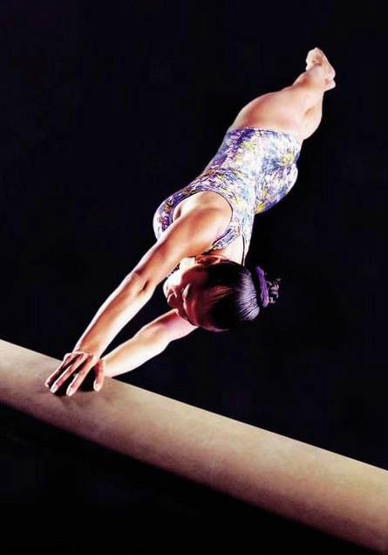
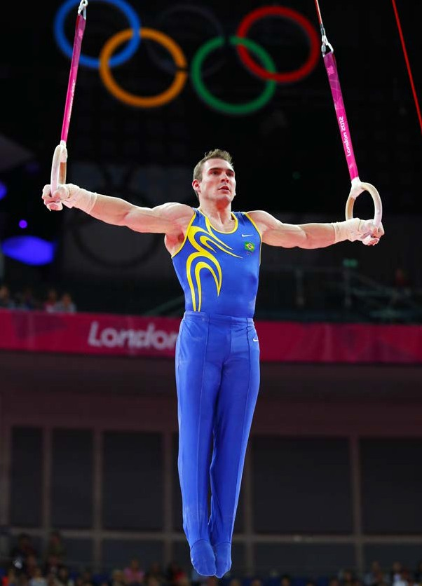
balance beam
rings
A gymnast’s arms and shoulders need to be strong to do the rings.
Only women compete on the balance beam. They must balance on the beam while they turn and flip.
Only men compete on the rings. They hold onto the rings and flip their bodies in circles.
Summer Olympics Events • Level H
13
14

Slide 10

Let’s now review comparative and superlative
Do you remember
?
What is a comparative word?

Slide 11
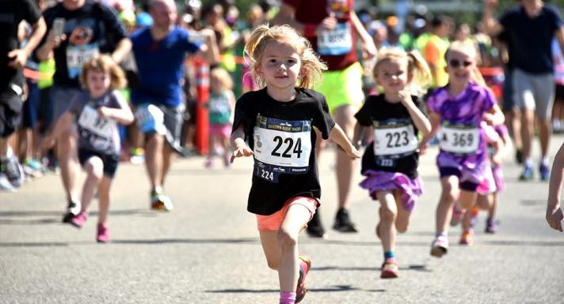
Nice work! Use the comparative and superlative to describe this picture

Slide 12
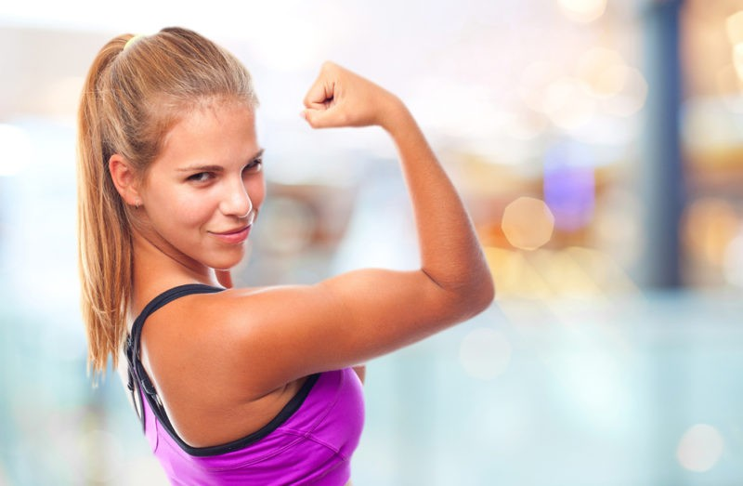
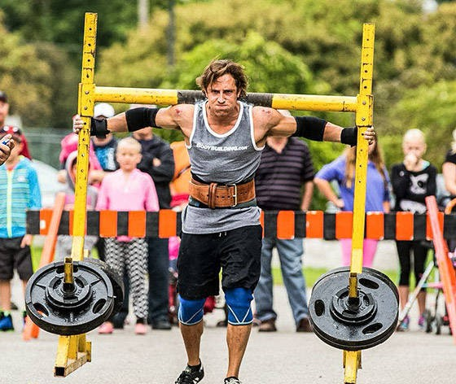
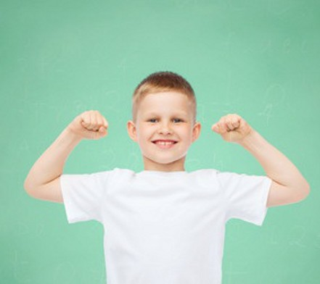
Use these words to describe the people in the photos
Strong Stronger Strongest

Slide 13

Here are some more examples
COMPARATIVE SUPERLATIVE
Quick | Quicker | Quickest
Smart | Smarter | Smartest
Great | Greater | Greatest
Good | Better | The Best
Tall | Taller | Tallest
Hot | Hotter | Hottest
Fat | Fatter | Fattest

Slide 14
Great work!
Describe something that is in the same room as you using the comparative and superlative
Example: “This pen is large. This pen is larger. This pen is largest”

Slide 15
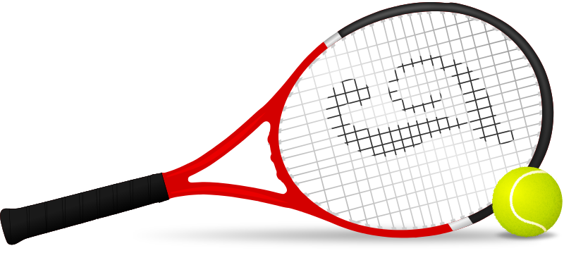
Tell us about a time you played a sport. Describe the players using comparative

Slide 16
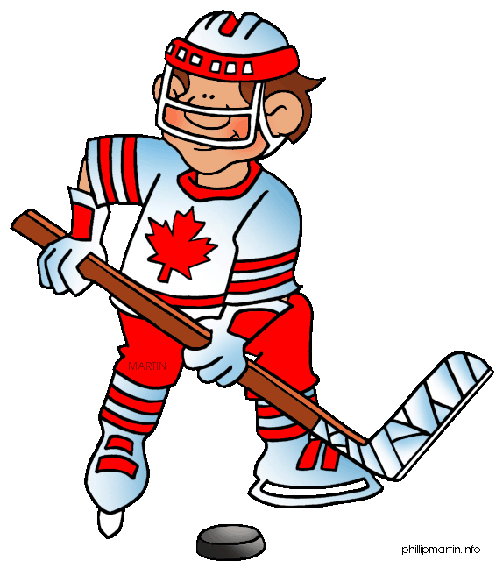
Great work!

