Slide 1
SPORTS
Unit 7: Lesson 10

Slide 2
What are we learning this class?
“A review of comparative and superlative words
Reading about the Summer Olympics

Slide 3
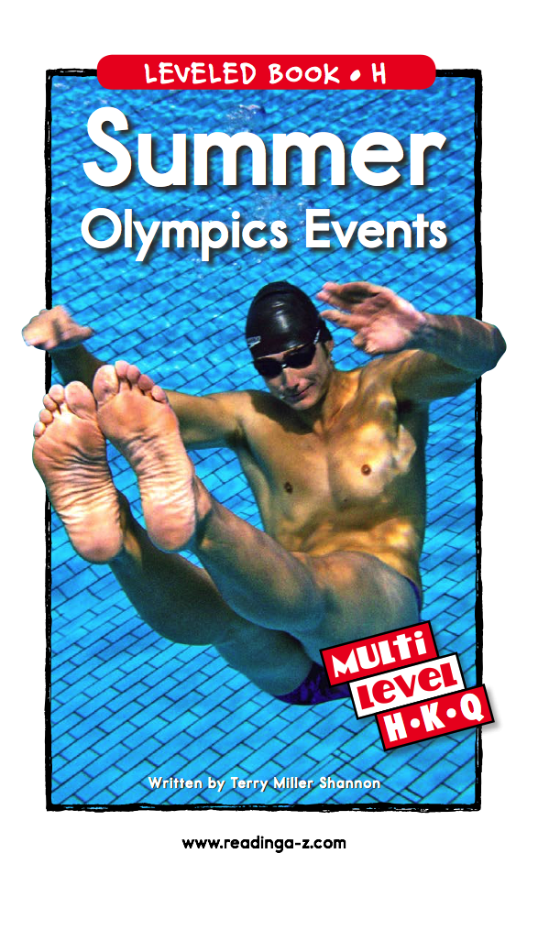
Have you heard of the Olympics before?

Slide 4
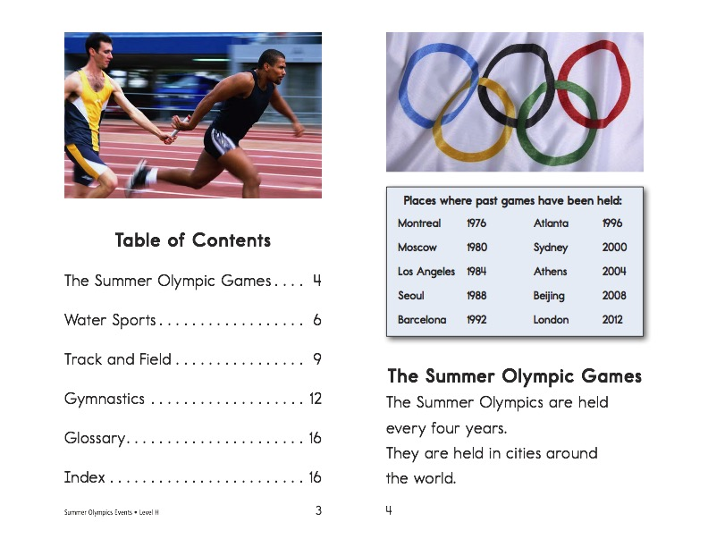

Slide 10

Great! What is your favourite summer Olympic sport?

Slide 11

Let’s now review comparative and superlative
Do you remember?
What is a comparative word?

Slide 12

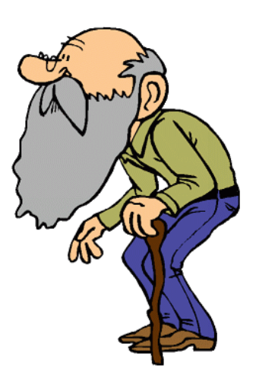
Comparative
The man in the green shirt is older

Slide 13
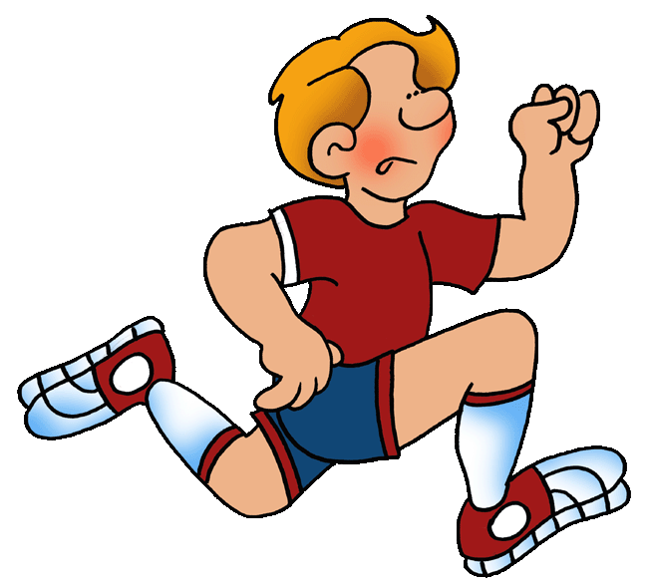

Comparative
Describe the photos using the words “fast” and “faster”

Slide 14
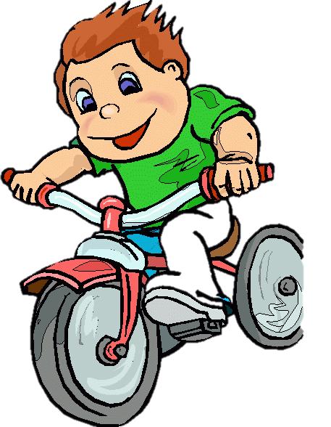
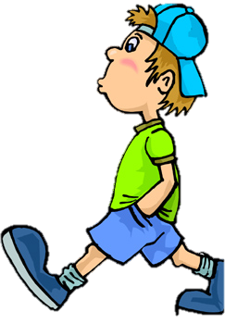
Superlative
Fast
Faster
Fastest

Slide 15
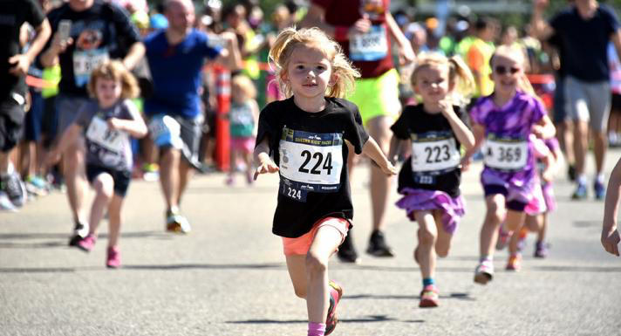
Nice work! Use the comparative and superlative to describe this picture

Slide 16
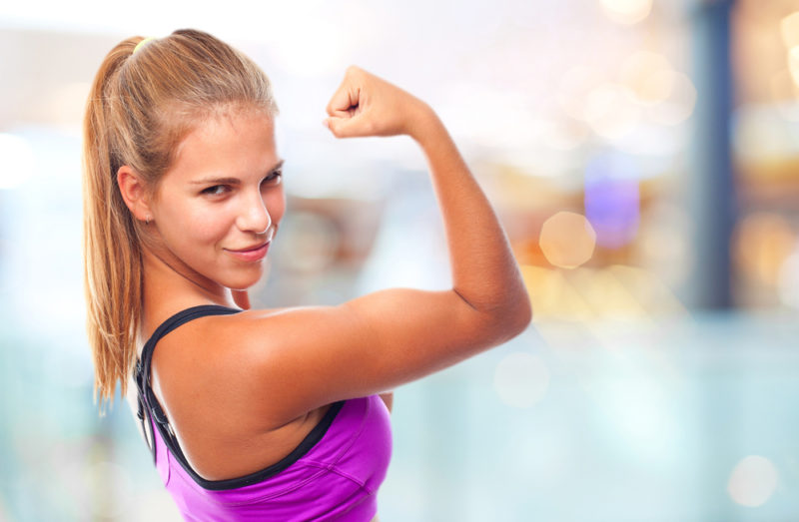
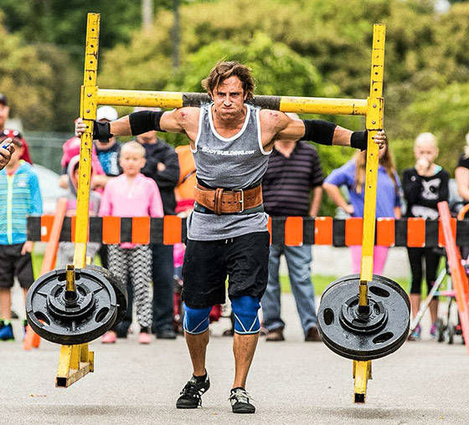
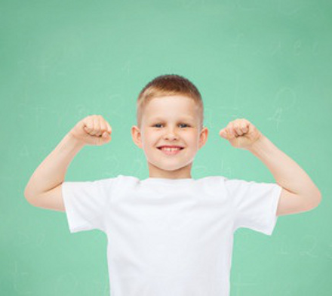
Use these words to describe the people in the photos
Strong Stronger Strongest

Slide 17

Here are some more examples
COMPARATIVE |  | SUPERLATIVE
Quick | Quicker | Quickest
Smart | Smarter | Smartest
Great | Greater | Greatest
Good | Better | The Best
Tall | Taller | Tallest
Hot | Hotter | Hottest
Fat | Fatter | Fattest

Slide 18

Write a sentence and draw a picture using the comparative and superlative
COMPARATIVE |  | SUPERLATIVE
Quick | Quicker | Quickest
Smart | Smarter | Smartest
Great | Greater | Greatest
Good | Better | The Best
Tall | Taller | Tallest
Hot | Hotter | Hottest
Fat | Fatter | Fattest

Slide 19
Great work!
Describe something that is in the same room as you using the comparative and superlative
Example: “This pen is large. This pen is larger. This pen is largest”

Slide 20
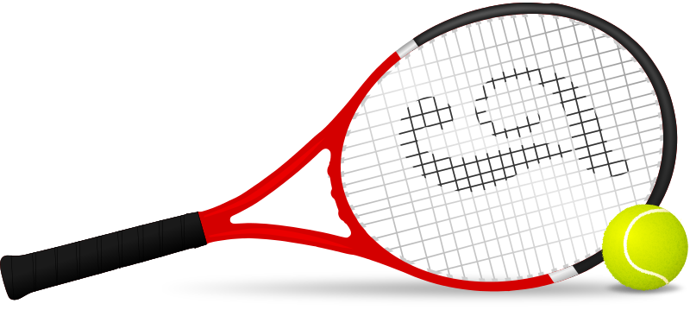
Tell us about a time you played a sport. Describe the players using comparative.

Slide 21
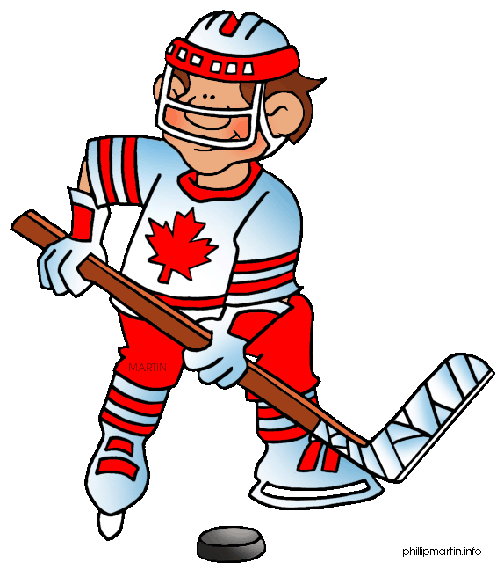
Great work!

Slide 22

What did we learn today?
Summer Olympic sports
Using the comparative and superlative

Slide 23

Homework time! Do you have any questions?

