Slide 1


SPORTS
Unit 7: Lesson 11

Slide 2


What are we learning this class?
Describing pictures and videos and making personal connections
Reading about the sport of Golf

Slide 3

Have you played Golf before?

Slide 4
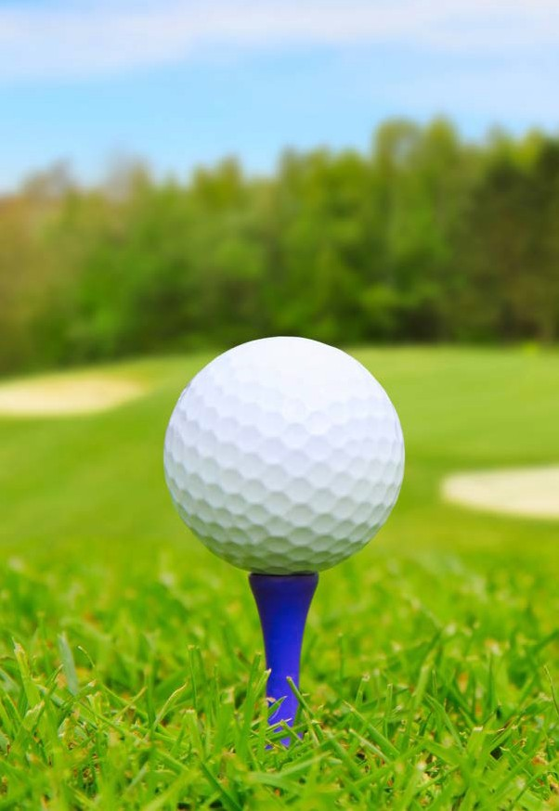
Words to Know
Golf
club contests course
events green traps
Front cover: A golfer swings on a teeing ground.
Title page: A golf tee steadies a golf ball,
Page 3: A young golfer tries to get out of a hazard.
Photo Credits:
Cover: © Fuse/Thinkstock; title page, page 5: © destillat/iStock/Thinkstock; page 3: © Sport Picture Library/Alamy; page 4: © Gerard Brown/DK Images; page 6:
© Adrian Sawvel/Hemera/Thinkstock; page 7: © andriocolt/iStock/Thinkstock; page 8 (top): © karamysh/iStock/Thinkstock; page 8 (bottom): © Andrew F
Kazmierski/iStock/Thinkstock; page 9: © ifong/Thinkstock; page 10: © Petr Novotny/iStock/Thinkstock; page 11 (top left): © Asplosh/Dreamstime.com; page 11 (right): © David Dea/iStock/Thinkstock; page 11 (left bottom): © Igor Skrynnikov/ Hemera/Thinkstock; page 13: © Matt Sullivan/Reuters/Landov; page 14 (top left):
© Leo Mason/Corbis; page 14 (top right): © Bettmann/Corbis; page 14 (bottom):
© Andy Altenburger/Icon SMI/Corbis; page 15 (top): © Tribune Content Agency LLC/Alamy; page 15 (center): © Kevin Higley/AP Images; page 15 (bottom): © Stock Connection/Stock Connection/SuperStock
Written by Curtis Thomas
www.readinga-z.com
Focus Question
Golf
Spectacular Sports Level I Leveled Book
© Learning A–Z
Written by Curtis Thomas All rights reserved.
Correlation LEVEL I
Fountas & Pinnell I
How is golf played, and why do people like it?
Reading Recovery
15–16
www.readinga-z.com
DRA
16

Slide 5

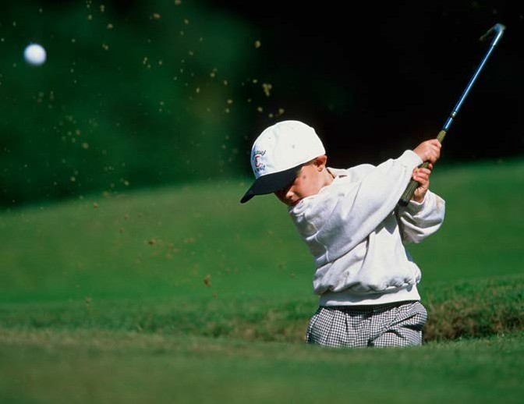
Table of Contents
A Quiet Sport . . . . . . . . . . . . . . . . 4
Playing the Game . . . . . . . . . . . . . 5
Golf Long Ago . . . . . . . . . . . . . . . . 11
Golf Around the World . . . . . . . . 12 Golf Contests . . . . . . . . . . . . . . . . . 13
Famous Golfers . . . . . . . . . . . . . . . 14
A Fun Game . . . . . . . . . . . . . . . . . . 15
Glossary . . . . . . . . . . . . . . . . . . . . . 16
A golfer uses a golf club to hit a golf ball.
A Quiet Sport
Golf is a quiet and fun sport. Players must be calm to play well. They must practice to be good.
Golf • Level I
3
4

Slide 6
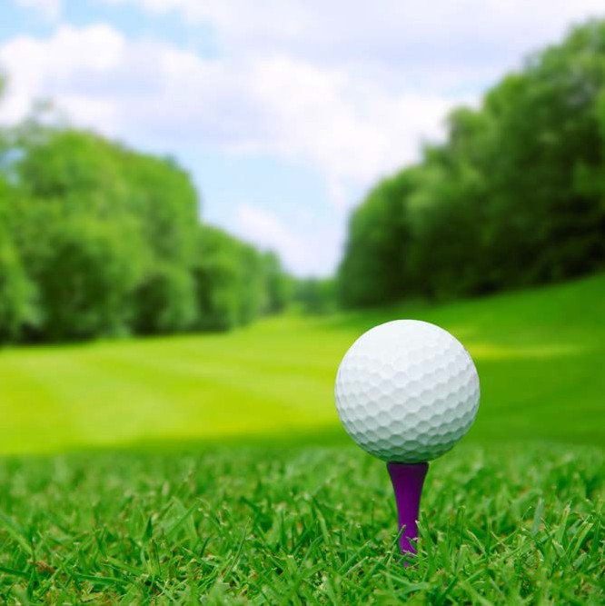












Golfers often put the ball on a tee before they hit it.
fringe – an area around the green that has longer grass
hole – marked with a flagstick
putting green
(“green” for short)
water trap –
a stream or pond
fairway
sand trap – a hole in the ground that
is filled with sand
Playing the Game Players hit a small, hard ball with a club.
They hit the ball into a small hole in the ground.
The player who gets the ball in the hole with the fewest hits wins.
rough – an area that has trees, shrubs, and long grass
teeing ground
Golf • Level I
5
6

Slide 7
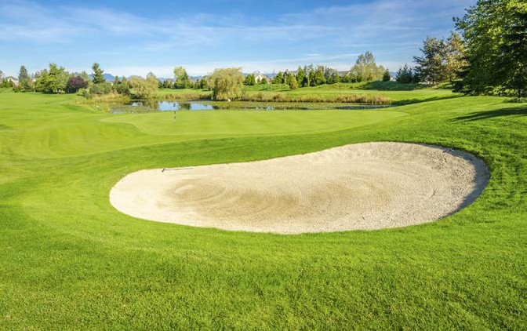
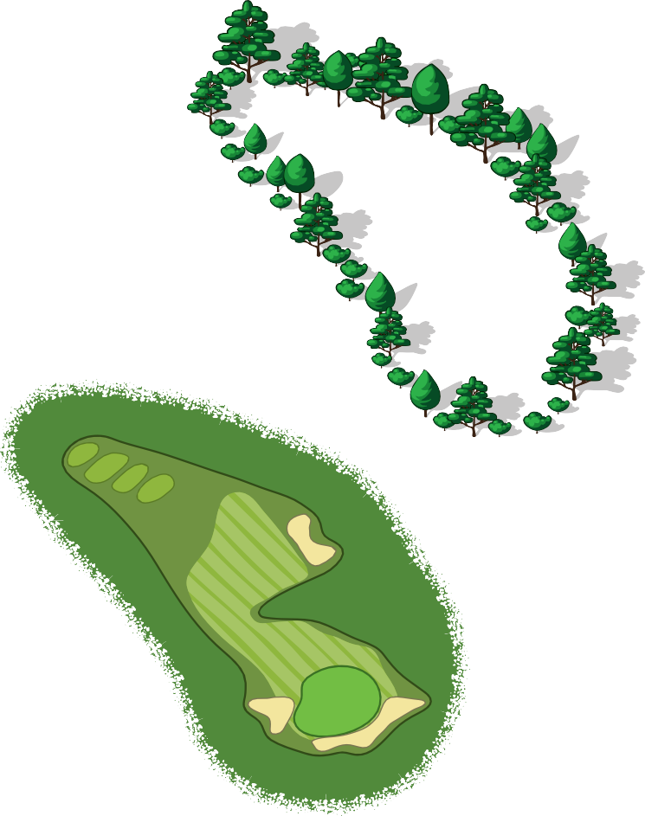
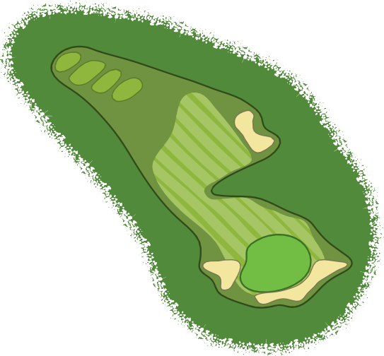

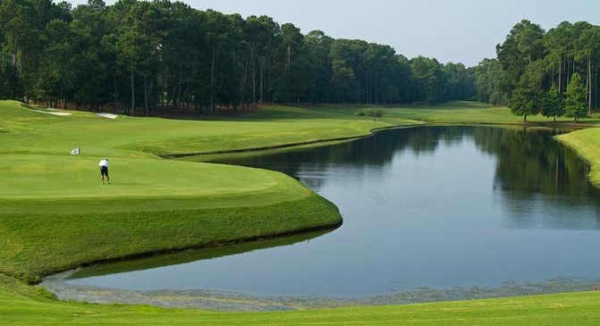
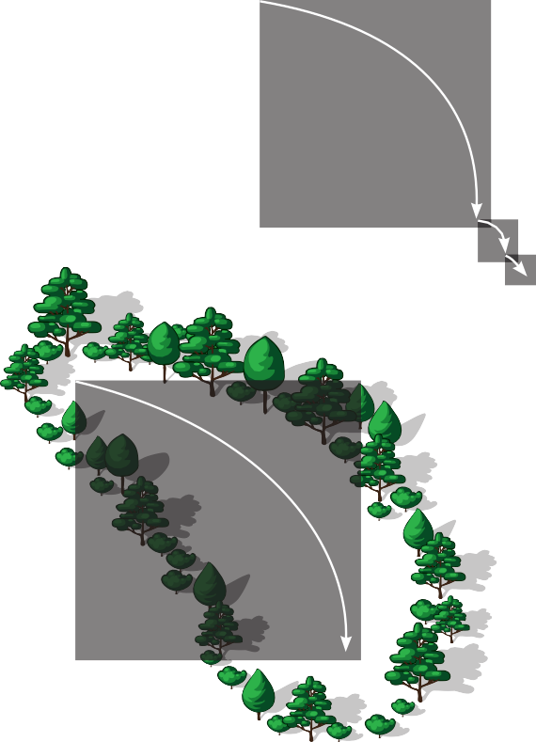



Players hit the ball hard to try to move it to the green.
They may need several hits to get it there.
Some golf holes have traps with sand.
A player hits the ball more than once to
get it to the hole.
A pond is another type of trap.
A golf course may have parts with rough grass.
The golf course may also have sand or water traps.
A player may need more hits
to get a ball out of these places.
A lucky player may get the ball into the hole in one hit.
Golf • Level I
7
8

Slide 8
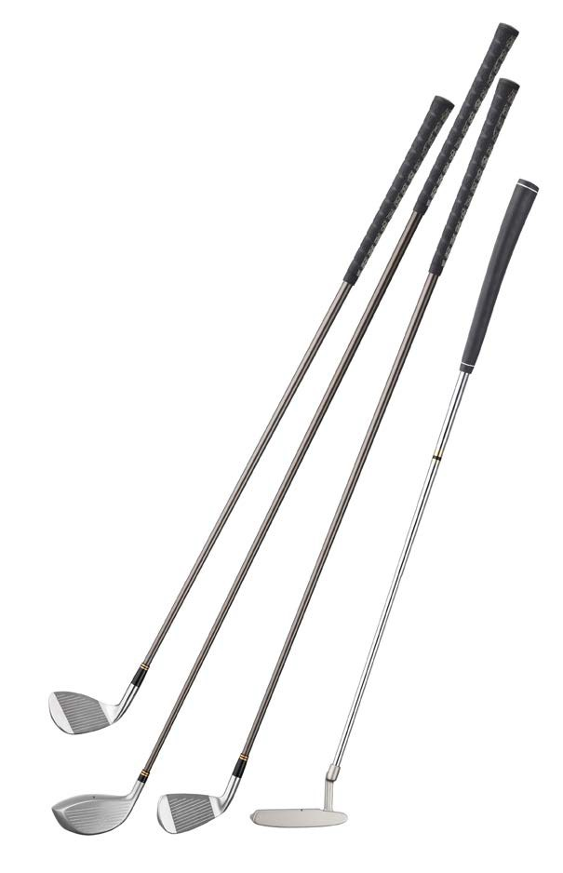
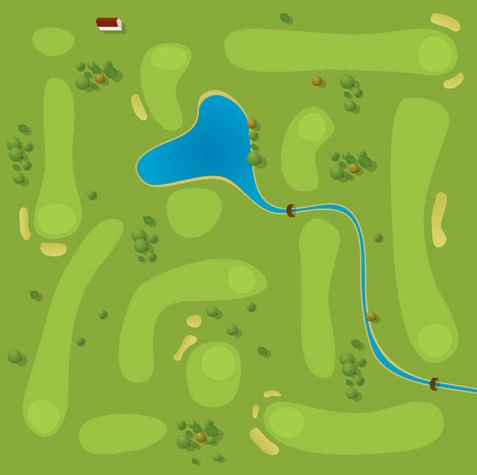






Each hole of a golf course has a starting place at one end.
The green with the small hole is at the other end.
A golf course has nine or eighteen holes.
Golfers use different kinds of clubs for
different kinds of shots.
tee area 1
5
tee area 6
6
9
tee area 7
1
tee area 5
tee area 2
4
tee area 4
tee area 9
7
3
Some clubs are good for hitting the ball far away.
Others are good for shorter shots.
2
tee area 3
8
tee area 8
A red flag marks each hole on a golf course. This course has nine holes.
Golf • Level I
9
10

Slide 9
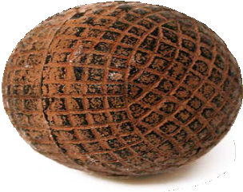

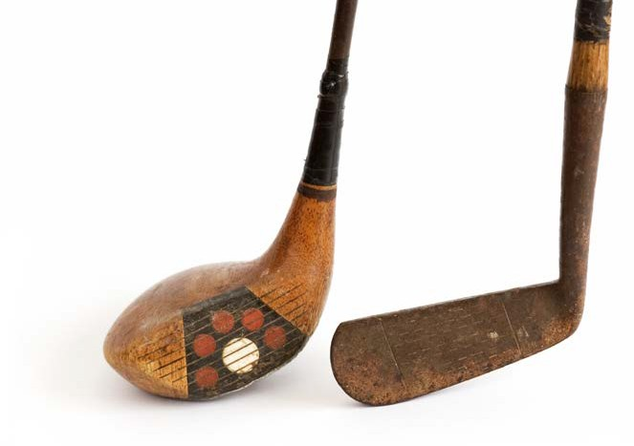
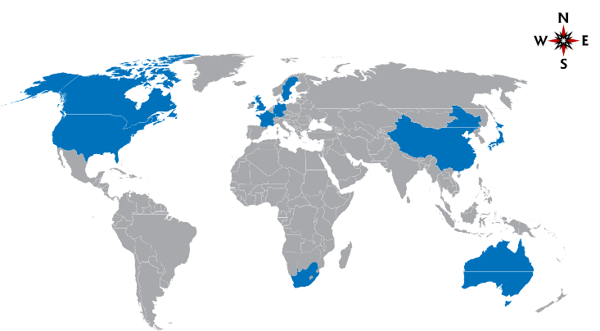
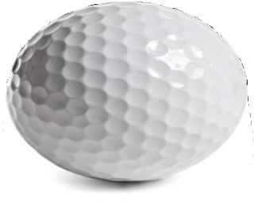
Golf Around the World Many people around the world love to play golf.
The sport is popular in countries where people speak English.
Golf Long Ago
Golf began hundreds of years ago.
The first golf balls were made of wood.
Now, golf balls are made of rubber and plastic.
4
1
2
7
ATLANTIC OCEAN
9
6
old golf ball and golf clubs
8
3
PACIFIC OCEAN
INDIAN OCEAN
10 ⁵
United States
United Kingdom
Japan
Canada
Australia
Germany
France
China
Sweden
South Africa
New golf balls fly higher and farther than old ones.
The United States has more places to play golf than any other country.
Golf • Level I
11
12

Slide 10
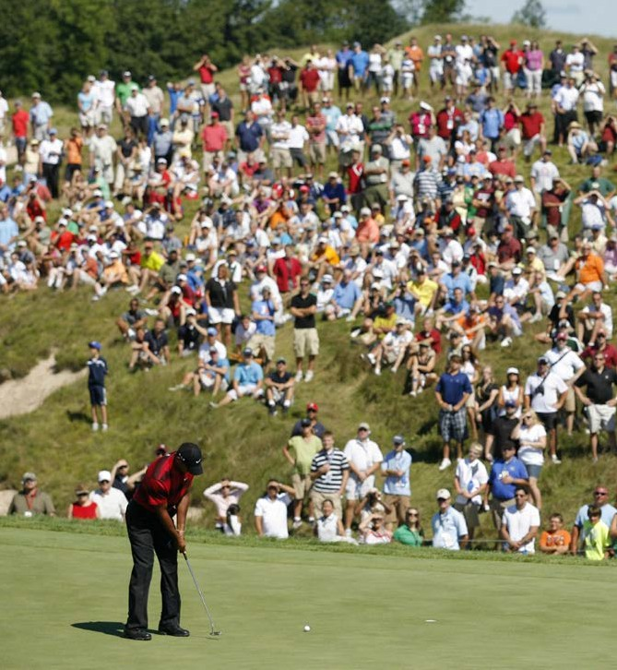
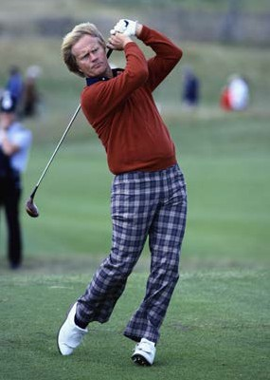
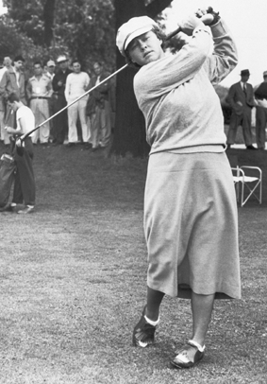
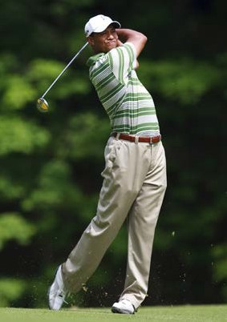
Famous Golfers
Jack Nicklaus is the best golfer ever to play the game.
Some big golf contests happen every year. Many people come to watch.
Patty Berg and Tiger Woods are two other great players.
Jack Nicklaus
Patty Berg
Tiger Woods
Golf Contests
Some people play in big events. Some events have many contests each year.
Men and women play in different golf events.
Golf • Level I
13
14

Slide 11
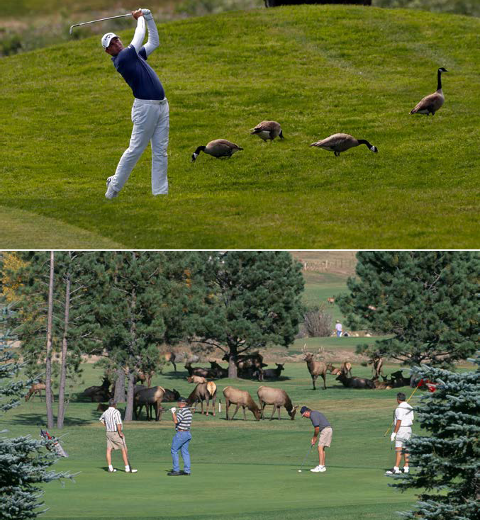
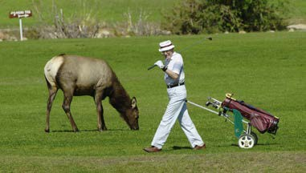
Glossary
a long stick used to hit a small ball in the game of golf (p. 5)
club (n.)
contests (n.) events where people do
something for the purpose of winning (p. 13)
course (n.)
a large area of land set aside for a sport such as golf or racing (p. 8)
important happenings (p. 13) a smooth area of very
short grass surrounding
each hole on a golf course (p. 7)
obstacles on a golf course usually filled with sand
or water (p. 8)
events (n.)
green (n.)
Geese share the golf course in California (top). Elk eat the grass on courses in Colorado (middle and bottom).
A Fun Game
Funny things can happen in golf. Animals can come very close.
Do you want to play?
If you practice hard, you can have fun playing golf!
traps (n.)
Golf • Level I
15
16

Slide 12

Let’s now watch a video!

Slide 13
What happened in the video?
Has this ever happened to you? Tell us about it.
You are making a personal connection!

Slide 14
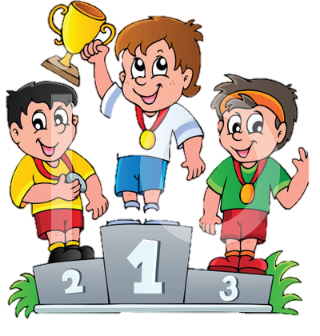
In the video, the boy was called a sore winner
Have you seen a sore winner before?
Have you been a sore winner before?

Slide 15
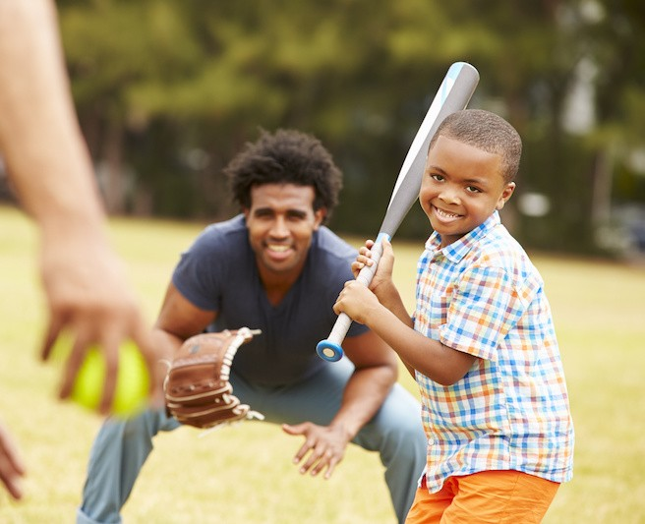
Look at this photo and ask your classmate a question!
Personal Connection Questions
What does this remind you of?
Has this happened to you before?
How is this similar to you?
How is this different from you?
What were your feelings when you saw this?
What have you learned from this?

Slide 16
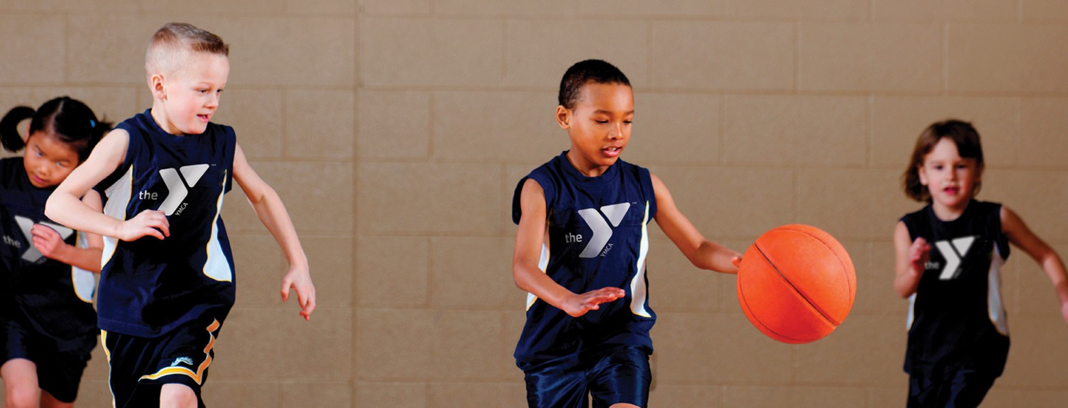
Personal Connection Questions
What does this remind you of?
Has this happened to you before?
How is this similar to you?
How is this different from you?
What were your feelings when you saw this?
What have you learned from this?
Ask your classmate another question!
Listen for their reply.

Slide 17







What did we learn today?
The sport of Golf
Making personal connections to video and photos

