Slide 1
SPORTS
Unit 7: Lesson 11

Slide 2
What are we learning this class?
Describing pictures and videos and making personal connections
Reading about the sport of Golf

Slide 3
Have you played Golf before?

Slide 12
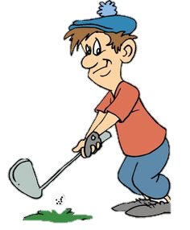
What did you learn about the sport of Golf?

Slide 13
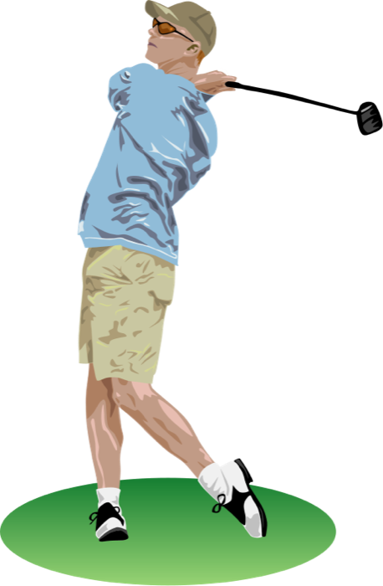
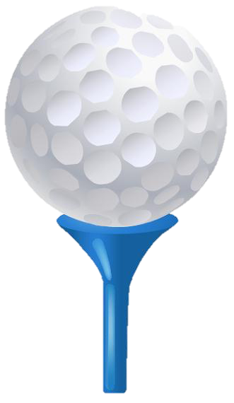
How is Golf different from other sports?

Slide 14
Great work! You now know all about Golf!

Slide 15
Let’s now watch a video!

Slide 16
What happened in the video?
Has this ever happened to you? Tell us about it.
You are making a personal connection!

Slide 17
Making personal connections help us to understand books, photos or videos better
Personal Connection Questions
What does this remind me of?
Has this happened to me before?
How is this similar to me?
How is this different from me?
What were my feelings when I saw this?
What have I learned from this?

Slide 18
In the video, the boy was called a sore winner
Have you seen a sore winner before?
Have you been a sore winner before?

Slide 19
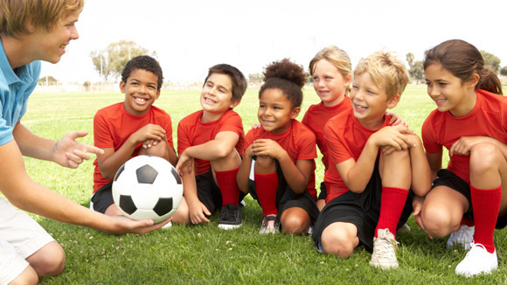
What did you learn from this video?
How should we act if we win a sports game?

Slide 20
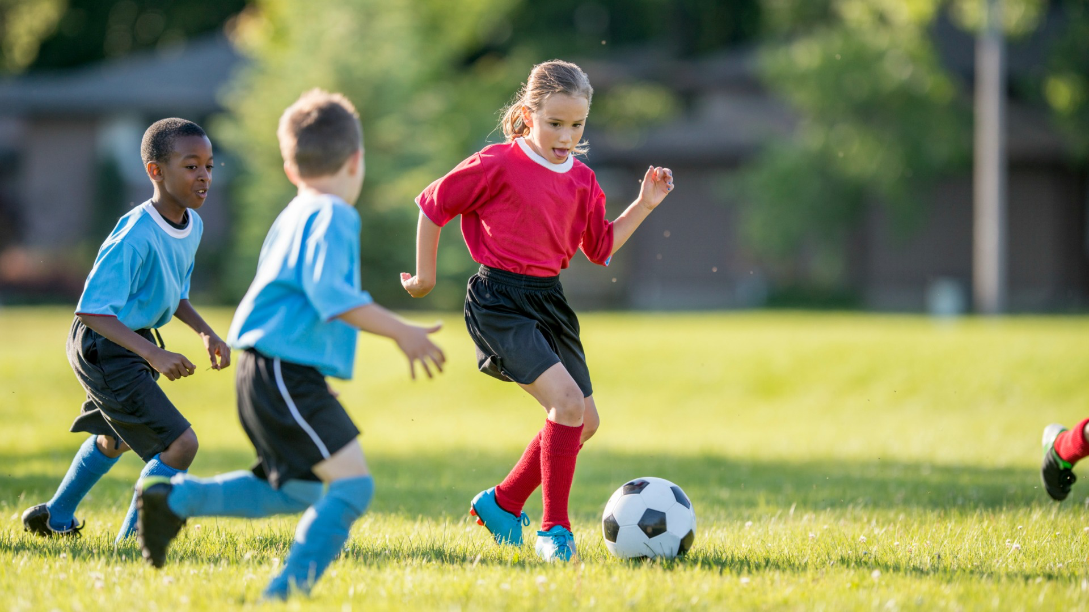
Now let’s look at some photos.

Slide 21
Look at this photo and answer the following question:
Have you experienced this before?

Slide 22
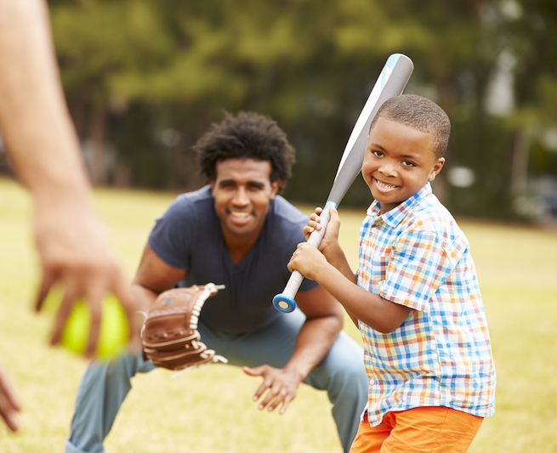
Look at this photo and ask your classmate a question!
Personal Connection Questions
What does this remind you of?
Has this happened to you before?
How is this similar to you?
How is this different from you?
What were your feelings when you saw this?
What have you learned from this?

Slide 23
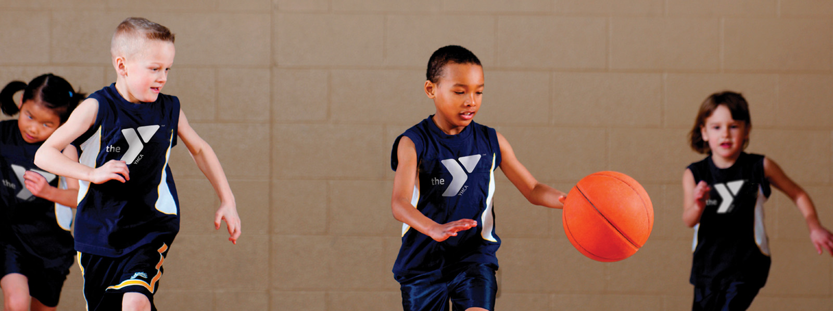
Personal Connection Questions
What does this remind you of?
Has this happened to you before?
How is this similar to you?
How is this different from you?
What were your feelings when you saw this?
What have you learned from this?
Ask your classmate another question! Listen for their reply.

Slide 24
Nice! You can now make great personal connections!

Slide 25
What did we learn today?
The sport of Golf
Making personal connections to video and photos

Slide 26
Homework time! Do you have any questions?

