Slide 1


SPORTS
Unit 7: Lesson 12

Slide 2













What are we learning this class?
A review class!
Making personal connections to photos Comparative and Superlative
Using “Why” and “Because” Synonyms

Slide 3

Do you remember? When do we use these questions?
Personal Connection Questions
What does this remind me of?
Has this happened to me before?
How is this similar to me?
How is this different from me?
What were my feelings when I saw this?
What have I learned from this?

Slide 4
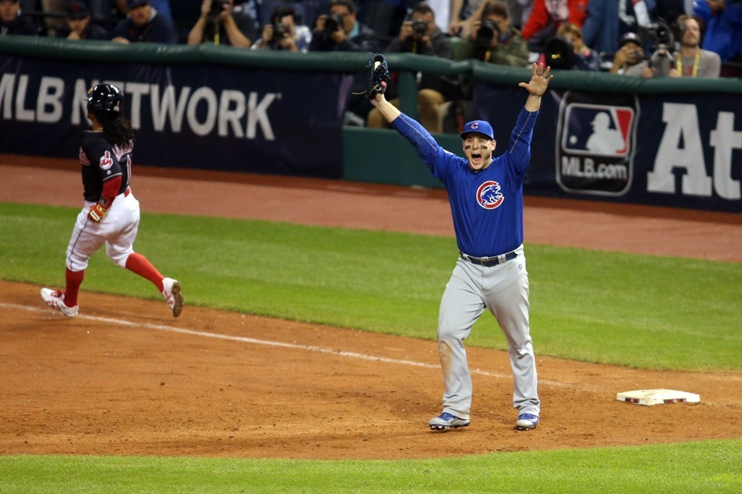
Look at this photo. What does it remind you of?

Slide 5
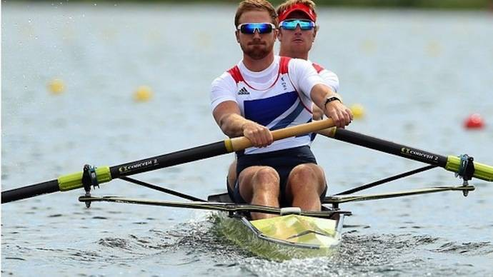
Look at this photo. Have you done this before? Tell us about it.

Slide 6
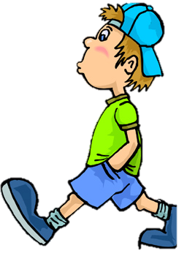
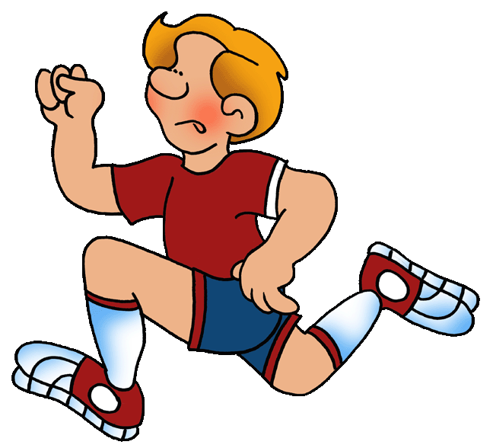
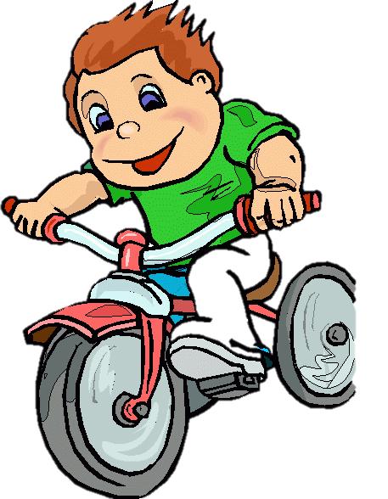
Let’s now look at the comparative and superlative
Do you remember? What do those words mean?

Slide 7
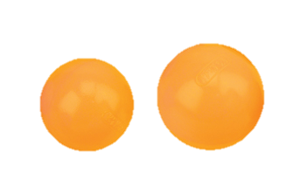
Tell us an example of a comparative word

Slide 8
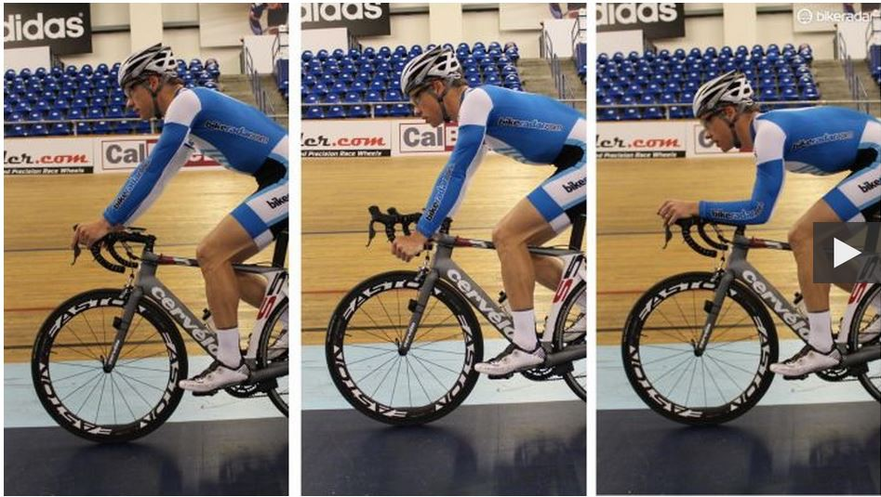
Tell us an example of a superlative word!

Slide 9
Nice work! Let’s fill in this chart together
COMPARATIVE SUPERLATIVE
Quick |  | Quickest
Smart | Smarter
 | Greater
Good
 |  | Tallest
Hot |  | Hottest
 | Fatter

Slide 10

Write your own comparative and superlative words and draw a picture to match!

Slide 11

Let’s now look at synonyms. Do
you remember what a synonym is?
Happy Joyful

Slide 12

Here is another example
Quick
Fast

Slide 13
Write a synonym for the word smart:

Slide 14
Write a synonym for the word angry:

Slide 15

Now, tell your classmate a word. Ask them to think of a synonym.

Slide 16
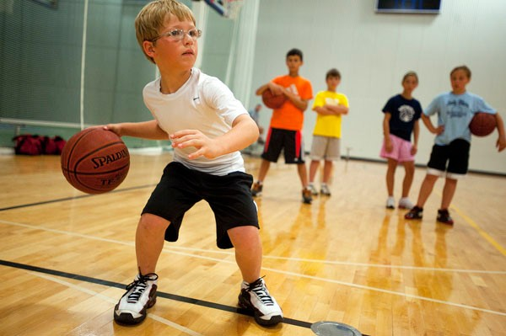
Answer this question:
Why do you play basketball?

Slide 17
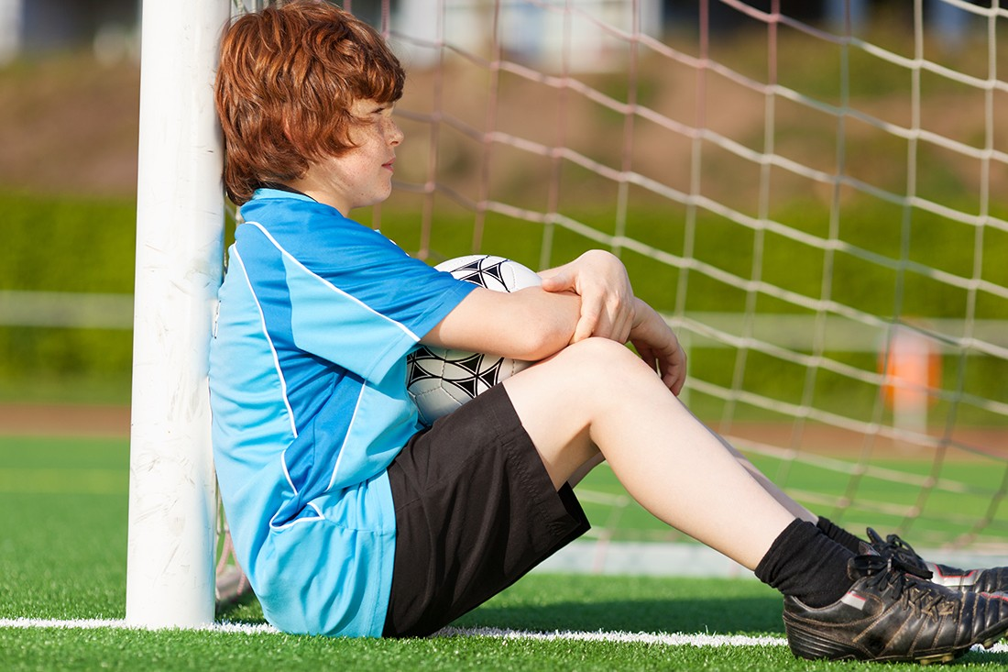
What would the question be to this answer?
Because I am tired!

Slide 18


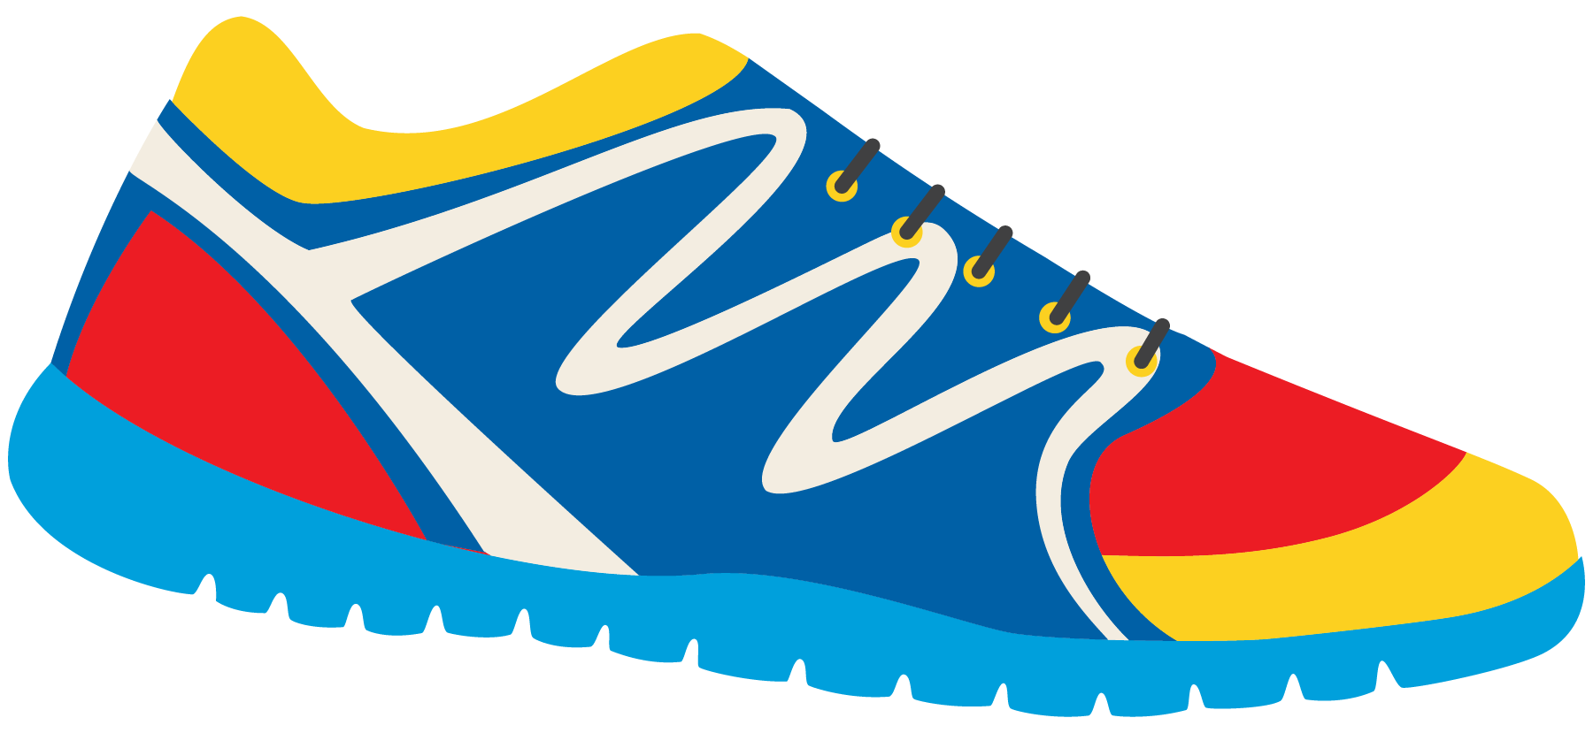
Great work! Write your own question and answer using “why” and “because”

Slide 19













What did we learn today?
A review of:
Making personal connections to photos
Comparative and Superlative Using “Why” and “Because” Synonyms

Slide 20

Homework time! Do you have any questions?

Slide 21
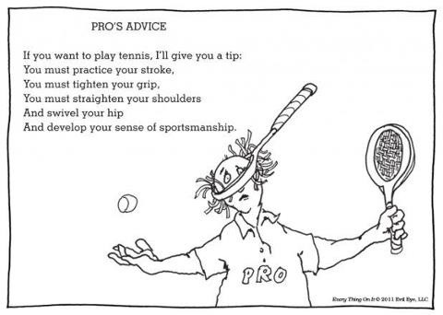

Slide 22
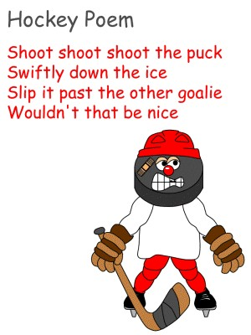

Slide 23
