Slide 1
SPORTS
Unit 7: Lesson 12

Slide 2
What are we learning this class?
A review class!
Making personal connections to photos
Comparative and Superlative
Using “Why” and “Because”
Synonyms

Slide 3
Do you remember? When do we use these questions?
Personal Connection Questions
What does this remind me of?
Has this happened to me before?
How is this similar to me?
How is this different from me?
What were my feelings when I saw this?
What have I learned from this?

Slide 4
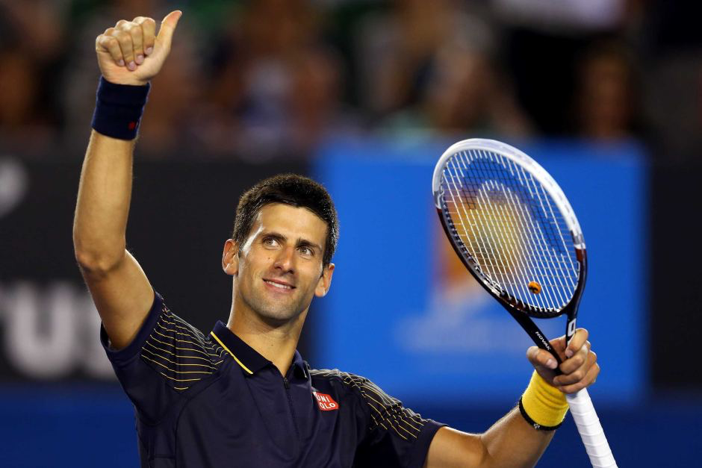
Correct! When we are making personal connections!

Slide 5
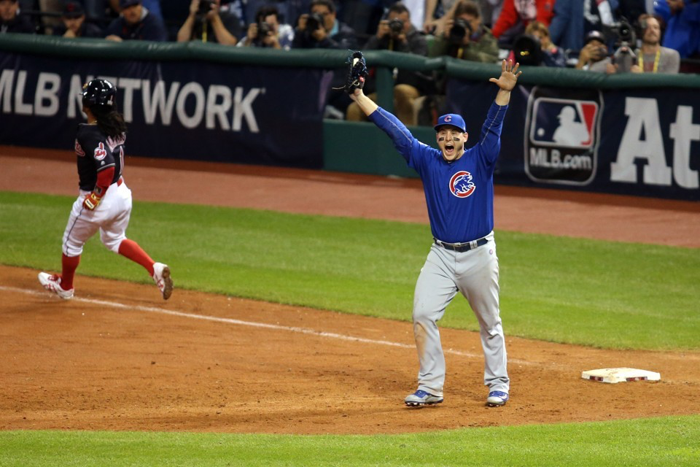
Look at this photo. What does it remind you of?

Slide 6
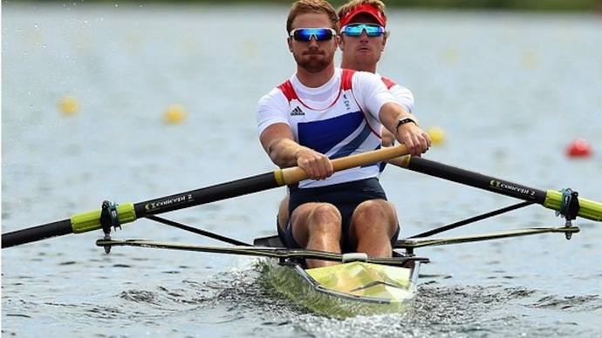
Look at this photo. Have you done this before? Tell us about it.

Slide 7
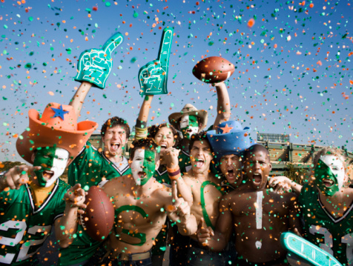
Great work! You can make personal connections!

Slide 8
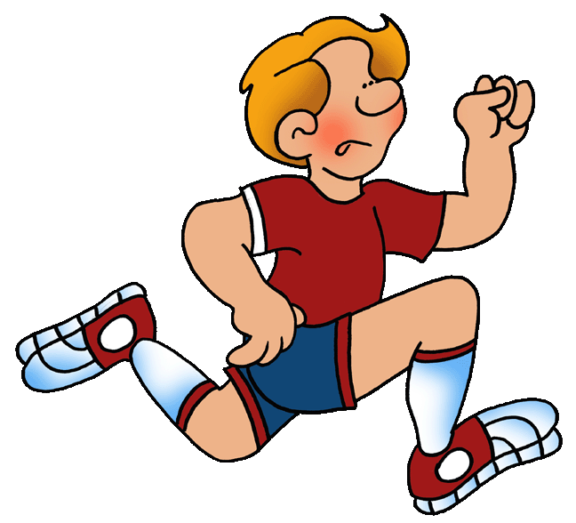
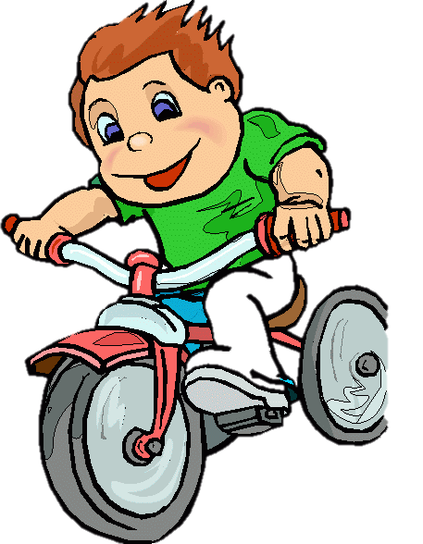
Let’s now look at the comparative and superlative
Do you remember? What do those words mean?

Slide 9
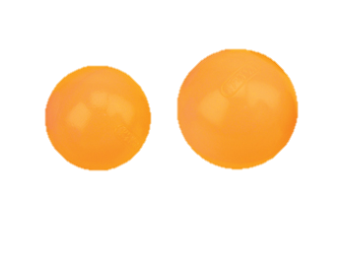
Tell us an example of a comparative word

Slide 10
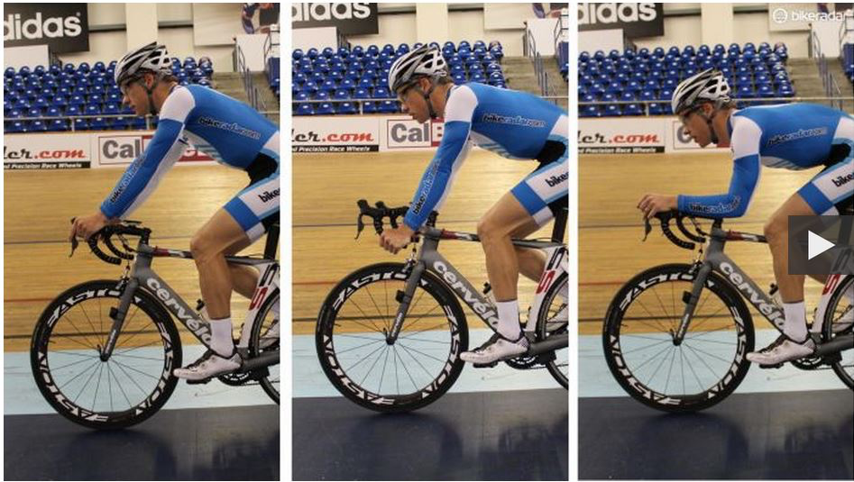
Tell us an example of a superlative word!

Slide 11
Nice work! Let’s fill in this chart together
COMPARATIVE |  | SUPERLATIVE
Quick |  | Quickest
Smart | Smarter
 | Greater
Good
 |  | Tallest
Hot |  | Hottest
 | Fatter

Slide 12
Write your own comparative and superlative words and draw a picture to match!

Slide 13
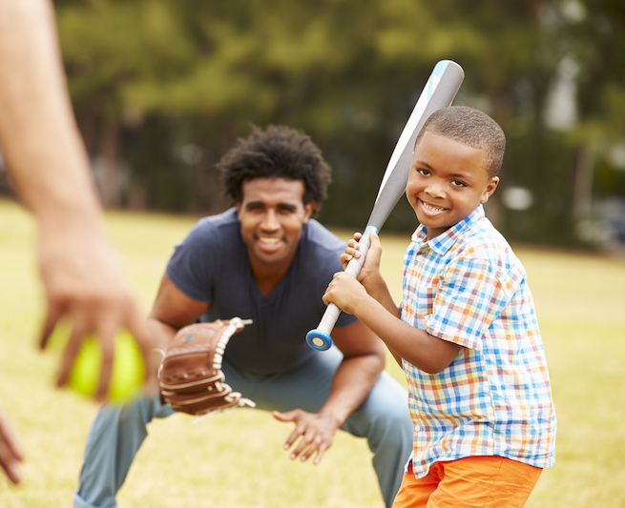
Nice work!

Slide 14
Let’s now look at synonyms. Do you remember what a synonym is?
Happy
Joyful

Slide 15
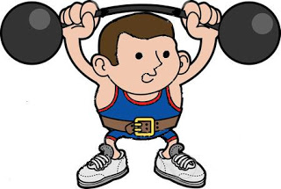
Strong Powerful
A synonym is two words that mean the same thing.

Slide 16
Here is another example
Quick
Fast

Slide 17
Write a synonym for the word smart:

Slide 18
Write a synonym for the word angry:

Slide 19
Now, tell your classmate a word. Ask them to think of a
synonym.

Slide 20
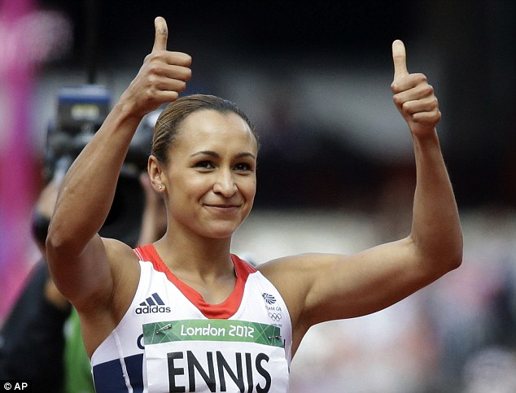
Nice work!
Why are we reviewing? Because reviewing helps us to remember!

Slide 21
Why is Lucy running?
“Why” is used in a question

Slide 22
Because she is the fastest.
“Because” is used in an answer
Bonus question: What do we know about the word fastest?

Slide 23
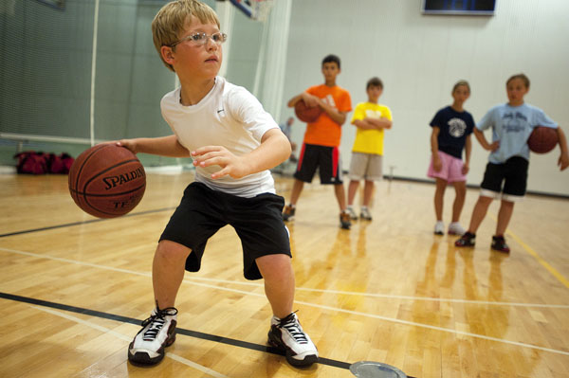
Answer this question:
Why do you play basketball?

Slide 24
What would the question be to this answer?
Because I am tired!

Slide 25
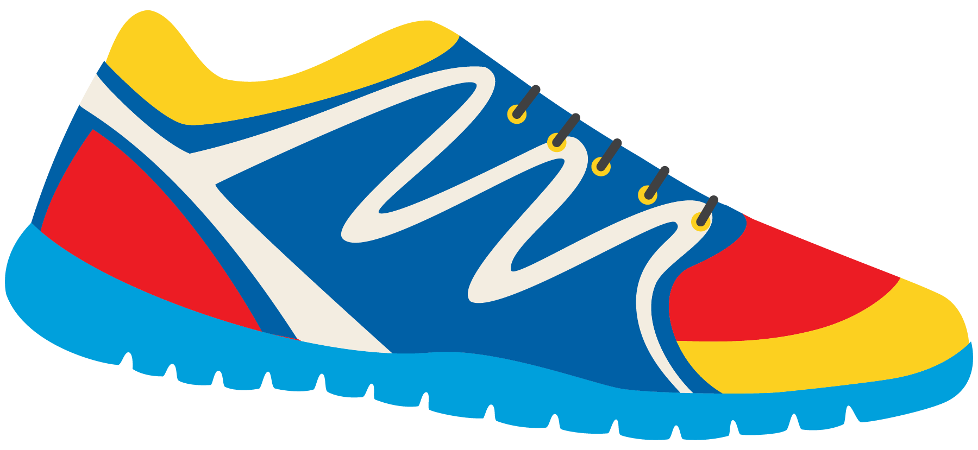
Great work! Write your own question and answer using “why” and “because”

Slide 26
What did we learn today?
A review of:
Making personal connections to photos
Comparative and Superlative
Using “Why” and “Because”
Synonyms

Slide 27
Homework time! Do you have any questions?

Slide 28
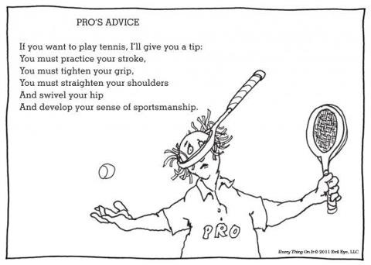

Slide 29
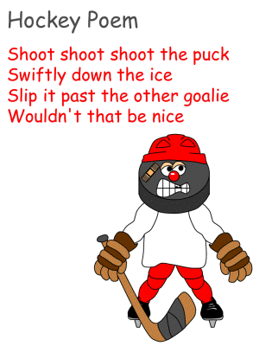

Slide 30
