Slide 1


SPORTS
Unit 7: Lesson 2

Slide 2


What do the letters V and E sound like together?

Slide 3

Fill in the blanks!
G

Slide 4

Fill in the blanks!
S E

Slide 5
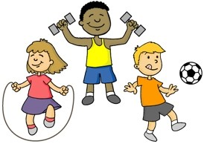
Fill in the blanks!
A C T I

Slide 6

Fill in the blanks!
G E T A B L E

Slide 7

Fill in the blanks!
D

Slide 8


Nice work! Can you think of any more “ve” words?
List them here

Slide 9

Nice work! Let’s write a sentence using these two words:
Glove
Football

Slide 10

Nice work! Let’s write a sentence using these two words:
Dive
Swimming

Slide 11

Nice work! Let’s write a sentence using these two words:
Serve
Volleyball

Slide 12

“Any” is a word used to tell us something that is not
specific, or to tell us when there is zero or none.
Any one of them could have scored the goal.

Slide 13
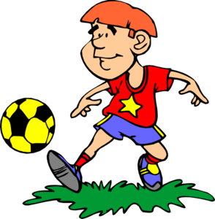
If any player is hurt, we will go home.

Slide 14
I don’t have any vegetables at home.

Slide 15
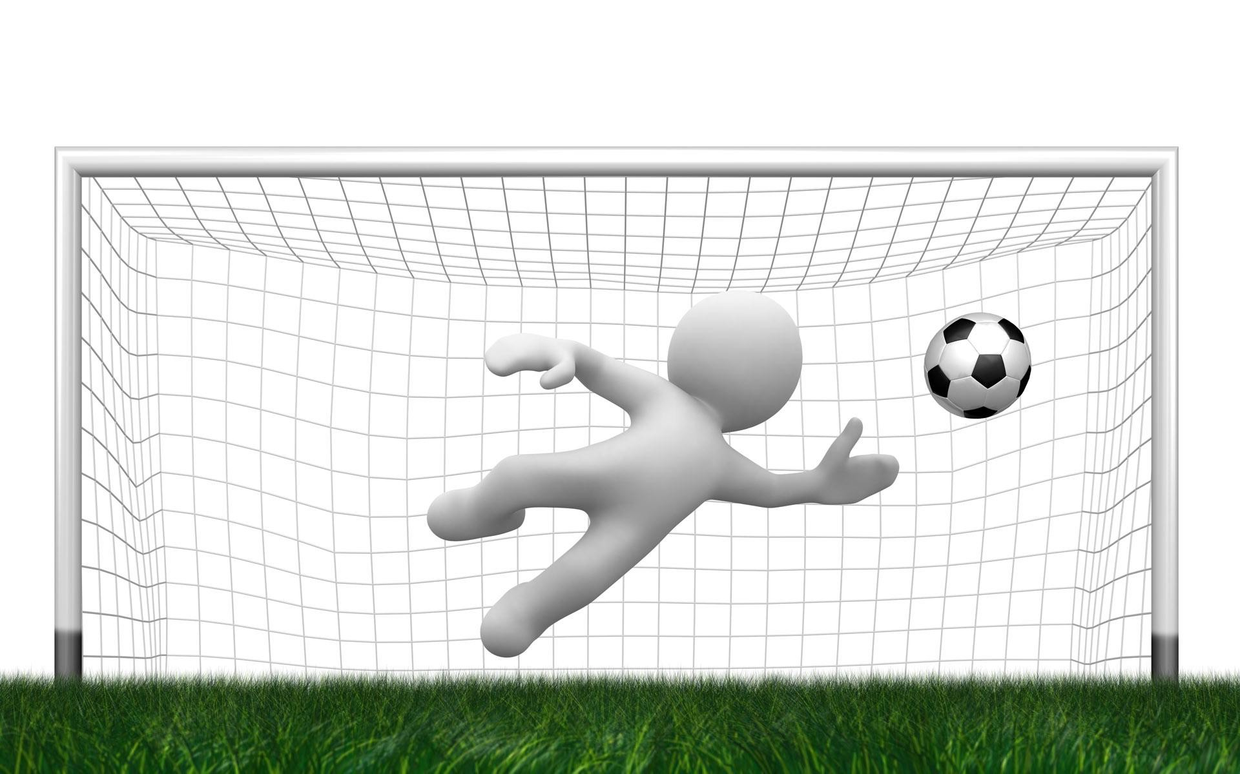
We play soccer together every night.

Slide 16

I eat every vegetable in my plate.

Slide 17
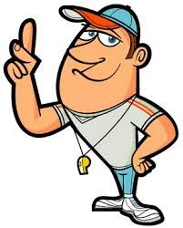
I heard every word the coach said.

Slide 18


Practice writing a sentence using the word “every”

Slide 19
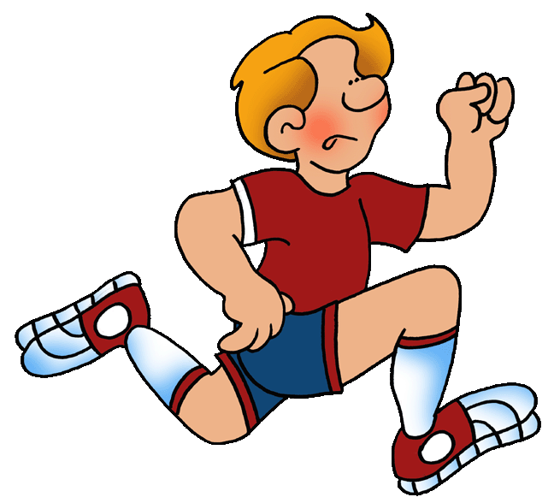
What does he do on the team?

Slide 20
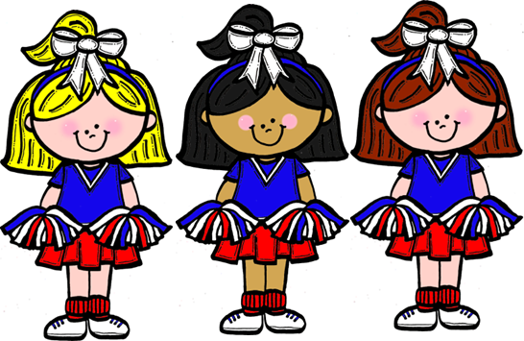
What does your sister do for fun?

Slide 21

Do you like soccer?

Slide 22

Write your own sentence using the word “do”

Slide 23
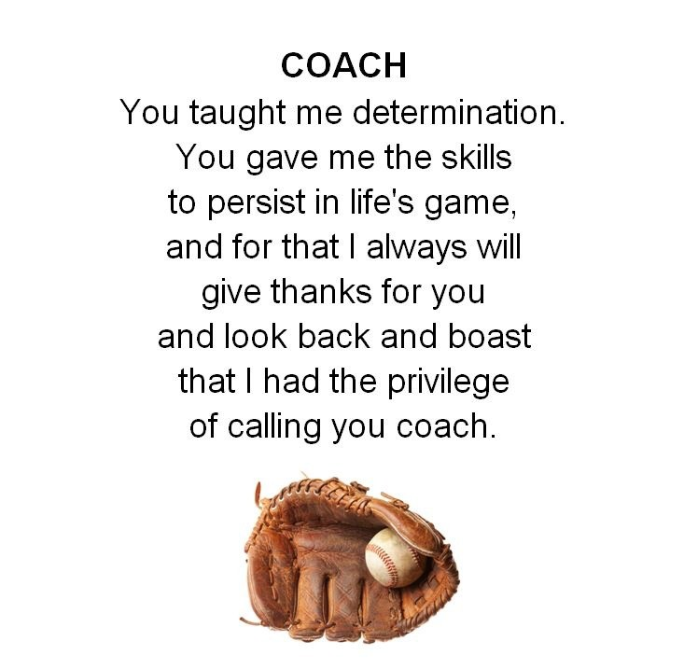

Slide 24
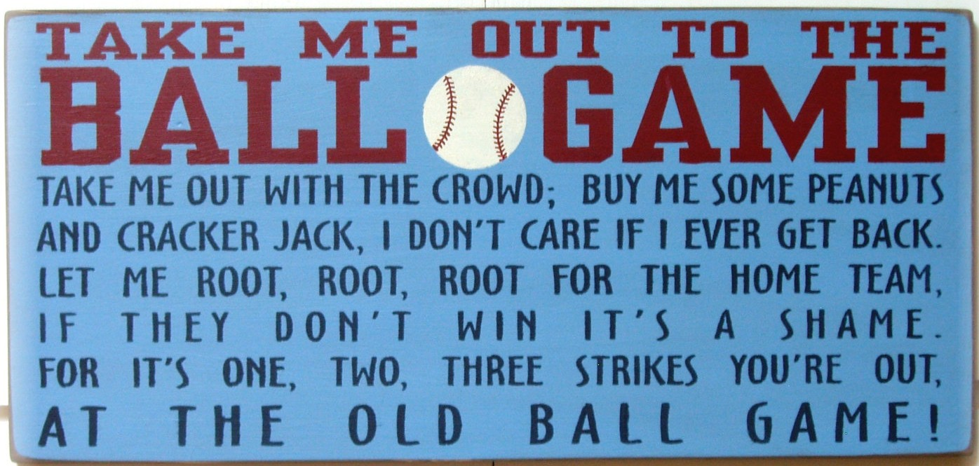

Slide 25
