Slide 1
SPORTS
Unit 7: Lesson 2

Slide 2
What are we learning this class?
“Ve” words
More adjectives: any, every…
How to use an auxiliary verb: do (What does he do? What do your sisters do?)

Slide 3


What do the letters V and E sound like together?

Slide 4

Correct! “Ve”!
What words do you know that have “VE” in them?

Slide 5

Fill in the blanks!
G ___ ___ ___ ___

Slide 6

Fill in the blanks!
S E ___ ___ ___

Slide 7

Fill in the blanks!
A C T I ___ ___

Slide 8

Fill in the blanks!
___ ___ G E T A B L E

Slide 9

Fill in the blanks!
D ___ ___ ___

Slide 10
Nice work! Can you think of any more “ve” words?
List them here

Slide 11

Nice work! Let’s write a sentence using these two words:
Glove
Football

Slide 12

Nice work! Let’s write a sentence using these two words:
Dive
Swimming

Slide 13

Nice work! Let’s write a sentence using these two words:
Serve
Volleyball

Slide 14
Nice work!

Slide 15

Now let’s look at the words “any” and “every”

Slide 16
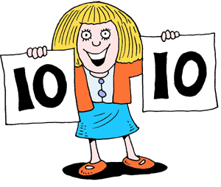
“Any” is a word used to tell us something that is not specific, or to tell us when there is zero or none.
Any one of them could have scored the goal.

Slide 17
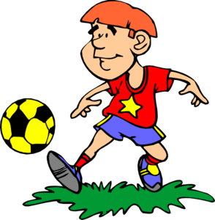
If any player is hurt, we will go home.

Slide 18
I don’t have any vegetables at home.

Slide 19
Practice writing a sentence using the word “any”

Slide 20
When would we use the word “every”?
This word includes each person or thing in a group, or describes how often something happens.

Slide 21
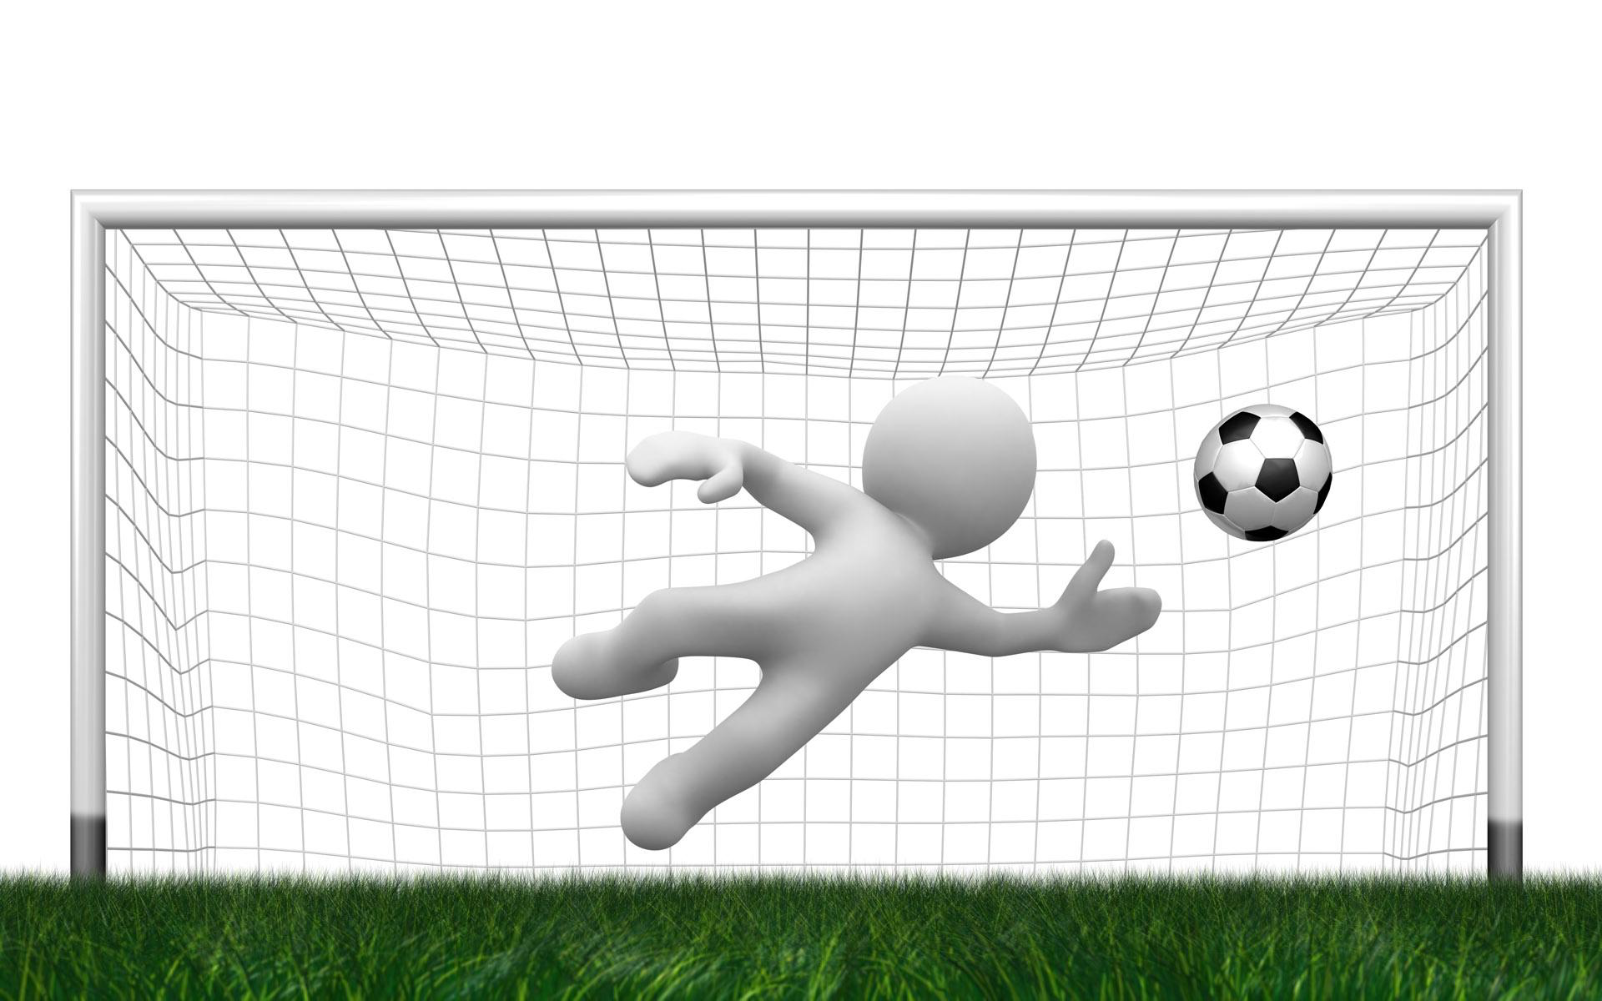
We play soccer together every night.

Slide 22

I eat every vegetable in my plate.

Slide 23
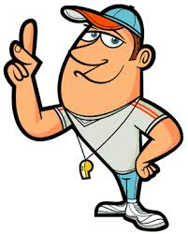
I heard every word the coach said.

Slide 24
Practice writing a sentence using the word “every”

Slide 25

Great work!

Slide 26

The word “do” is an auxiliary verb.
How can we use the word “do” in a sentence?

Slide 27
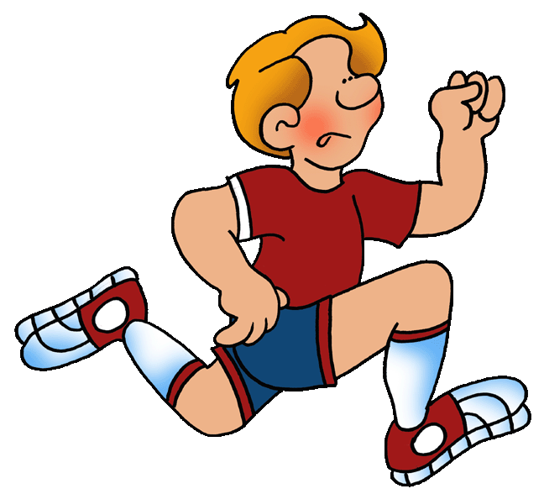
What does he do on the team?

Slide 28

What does your sister do for fun?

Slide 29

Do you like soccer?

Slide 30

Write your own sentence using the word “do”

Slide 31
Nice work! Let’s read some poems about sports!

Slide 32
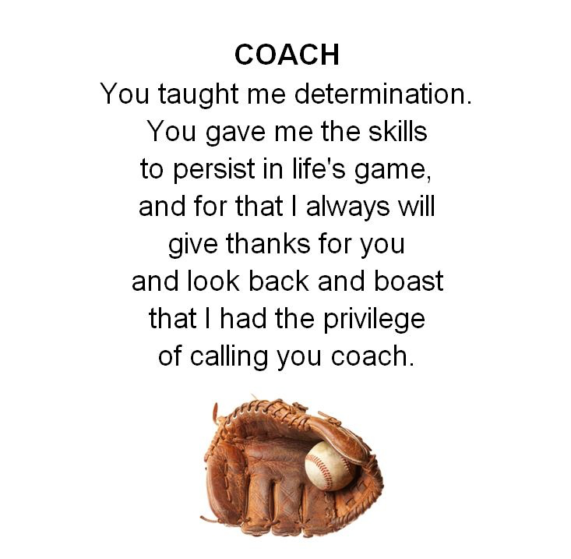

Slide 33
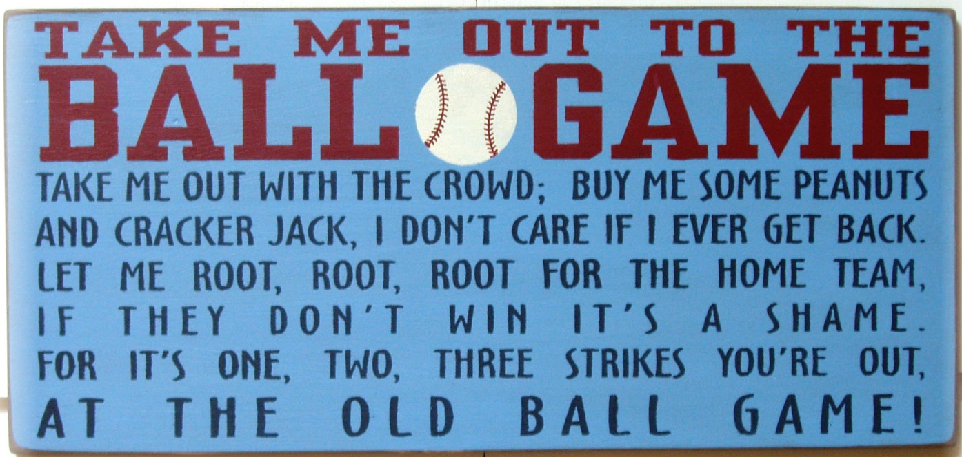

Slide 34


Slide 35
What did we learn today?
“Ve” words
“Any” and “every” adjectives
Using the word “do”

Slide 36
Nice work! Let’s look at the homework now

Slide 37
Do you have any questions?

