Slide 1


SPORTS
Unit 7: Lesson 3

Slide 2




What are we learning this class?
“Ph” words
Words of frequency: usually, often, sometimes, never, always…
Reading a book about basketball

Slide 3


What do the letters P and H sound like together?

Slide 4

List as many words as you know that have “ph” in them
1:00

Slide 5

Fill in the blanks!
After I won my game, I called my mom on the

Slide 6

Fill in the blanks!
My team won a
for winning the basketball game!

Slide 7

Fill in the blanks!
The photographer took a
of the team after we won.

Slide 8


Nice work! Try to write your own sentence
Use the words
Dolphin
Swimming

Slide 9
Nice work! Try to write your own sentence
Use the words
Dolphin
Swimming

Slide 10


One more time!
Use the words
Elephant
Basketball

Slide 11
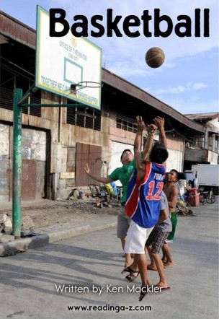

Slide 12
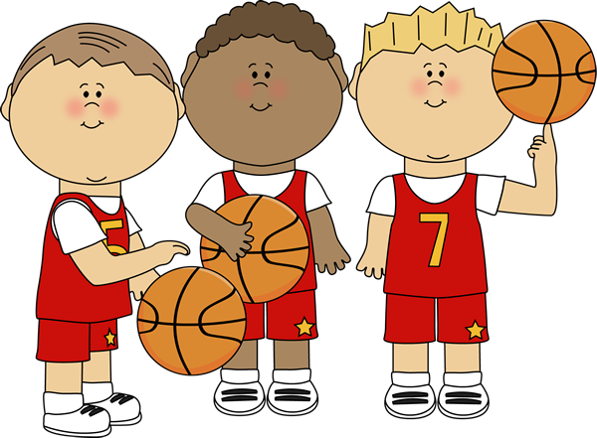
Great work! What did you learn about basketball?

Slide 13
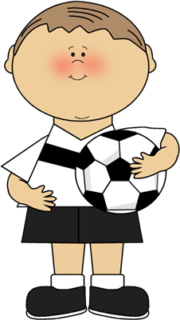
We will now look at words of frequency
How can we use the words “usually”, “often”, “sometimes”, “never”, or “always” in a sentence?

Slide 14


I usually score a goal when I play soccer.

Slide 15

I often cheer for my teammates when they score!

Slide 16
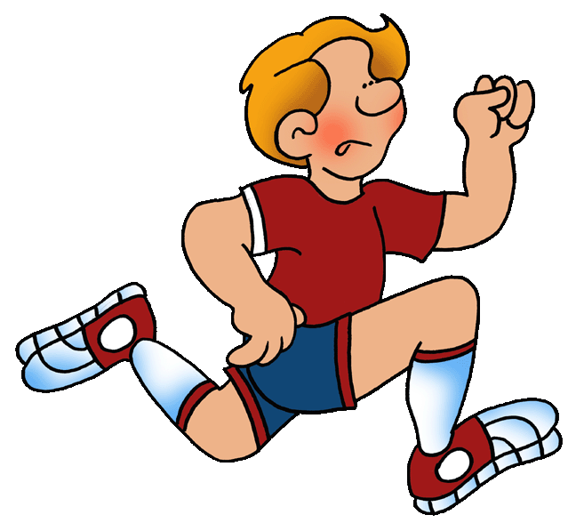
I sometimes eat a healthy meal before my basketball game.

Slide 17

I never play tennis.

Slide 18

I always stretch before playing badminton.

Slide 19
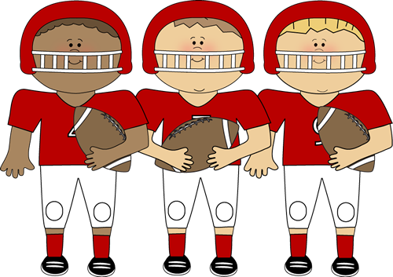










What did we learn today?
“Ph” words
Frequency Words
Reading a book about basketball

