Slide 1
SPORTS
Unit 7: Lesson 3

Slide 2
What are we learning this class?
“Ph” words
Words of frequency: usually, often, sometimes, never, always…
Reading a book about basketball

Slide 3
What do the letters P and H sound like together?

Slide 4
Correct! “F”!
The letters P and H make a F sound when they are together
Can you think of any words that have “ph” in them?

Slide 5
List as many words as you know that have “ph” in them
1:00

Slide 6
Great work! Here are some more words that have “ph” in them:

Slide 7
Fill in the blanks!
After I won my game, I called my mom on the _______________

Slide 8
Fill in the blanks!
My team won a _____________ for winning the basketball game!

Slide 9
Fill in the blanks!
The photographer took a _______________ of the team after we won.

Slide 10
Nice work! Try to write your own sentence
Use the words
Dolphin
Swimming

Slide 11
One more time!
Use the words
Elephant
Basketball

Slide 12
Great work! What is your favourite sport to play?

Slide 13
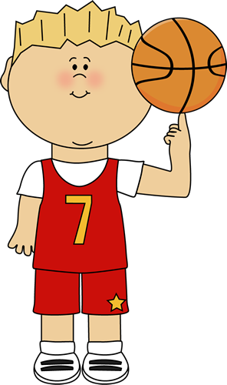
Basketball is a popular sport! Have you ever played it?
We are going to read a book about basketball!

Slide 22
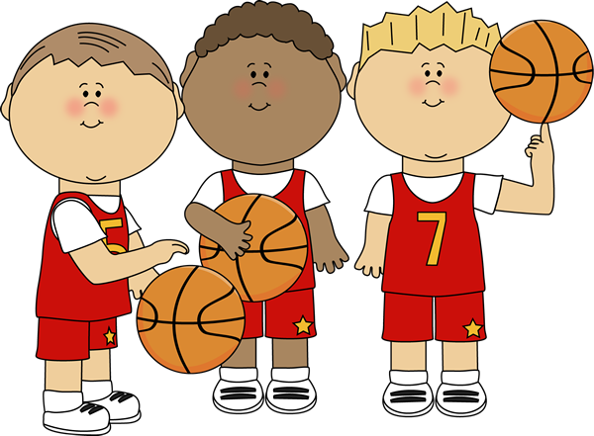
Great work! What did you learn about basketball?

Slide 23
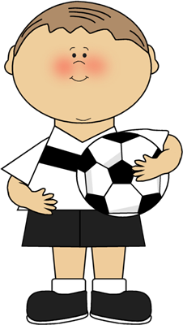
We will now look at words of frequency
How can we use the words “usually”, “often”, “sometimes”, “never”, or “always” in a sentence?

Slide 24
I usually score a goal when I play soccer.

Slide 25
I often cheer for my teammates when they score!

Slide 26
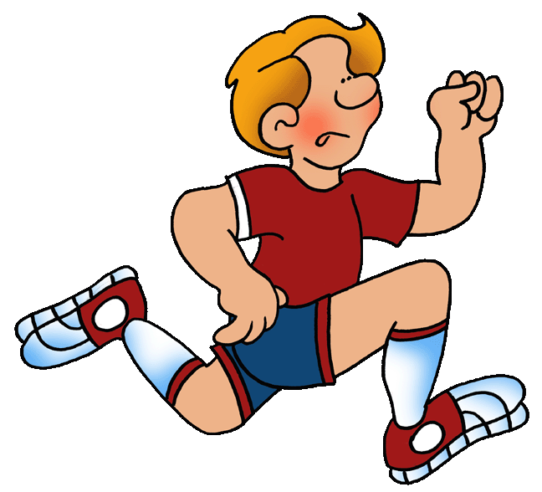
I sometimes eat a healthy meal before my basketball game.

Slide 27
I never play tennis.

Slide 28
I always stretch before playing badminton.

Slide 29
Write your own sentence using the word “never”

Slide 30
Write your own sentence using the word “sometimes”

Slide 31
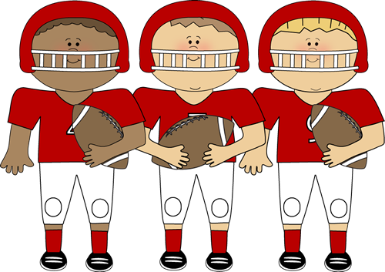
What did we learn today?
“Ph” words
Frequency Words
Reading a book about basketball

Slide 32
Nice work! Let’s look at the homework now

Slide 33
Do you have any questions?

