Slide 1
SPORTS
Unit 7: Lesson 4

Slide 2
What are we learning this class?
Review
“ve”, “er”, and “ph” words
Words of frequency
Adjectives

Slide 3
Review: What sounds do these letters make when they are together?

Slide 4
Correct!
Great work!

Slide 5
List as many words as you know that have “ve” in them
1:00

Slide 6
Find an item around you that has the “er” sound in its name
Tell us about it!

Slide 7
Create a sentence using a “ph” word:

Slide 8
Nice work!
Now, create a sentence that has a “ph” and “er” word in it.

Slide 9
Try to think of the “er” “ph” or “ve” word that fits!

Slide 10
Fill in the blank!
The photographer took a _______________ of the team after we won.

Slide 11
Fill in the blank!
I enjoy playing as the goalie in the sport of _________________.

Slide 12
Fill in the blank!
When I play volleyball, I ___________ over the net.

Slide 13
Nice work! You know your “er” “ph” and “ve” words!

Slide 14
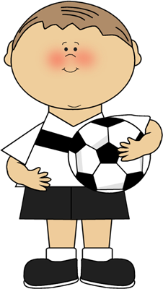
Lets now review words of frequency
How can we use the words “usually”, “often”, “sometimes”, “never”, or “always” in a sentence?

Slide 15
I usually score a goal when I play soccer.

Slide 16
I often cheer for my teammates when they score!

Slide 17
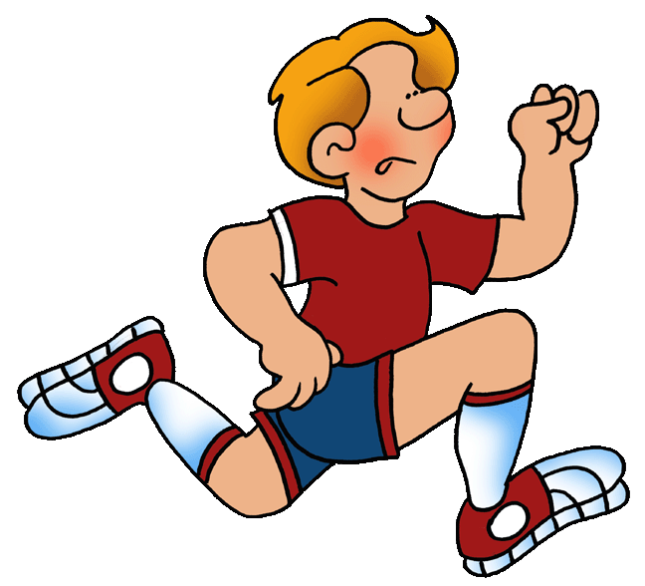
I sometimes eat a healthy meal before my basketball game.

Slide 18
I never play tennis.

Slide 19
I always stretch before playing badminton.

Slide 20
Write your own sentence using the word “never”

Slide 21
Write your own sentence using the word “sometimes”

Slide 22
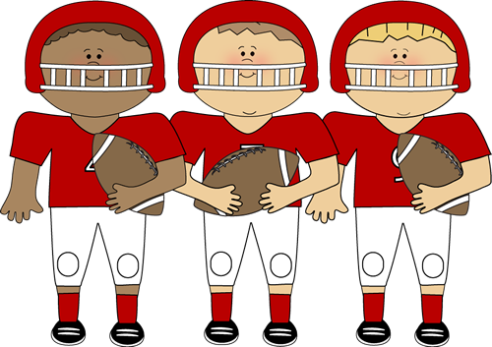
Great work! Now we will be reviewing adjectives!
Use an adjective to describe these football players!

Slide 23
Write as many adjectives as you can think of below:

Slide 24
Here are some more adjectives we can use
Speedy
Cheerful
Excellent
Quick
Impressive
Rough
Wonderful
Tall
Intense
Strong

Slide 25
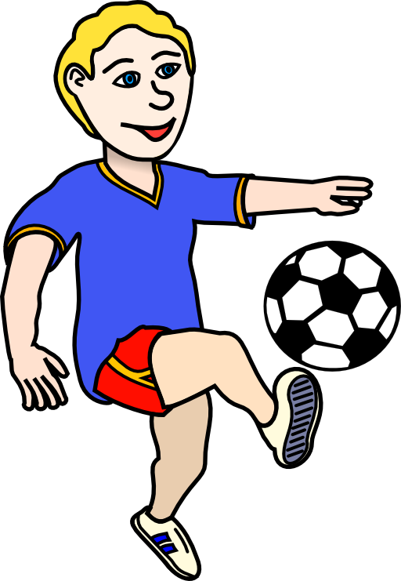
Write your own sentence using an adjective
Speedy
Excellent
Quick
Cheerful
Wonderful
Rough
Tall
Intense
Strong
Impressive

Slide 26
Great! What did we learn today?
A review of “ve”, “er”, and “ph” words
Reviewing words of frequency
Review of adjectives

Slide 27
Let’s dive into the homework now

Slide 28
Do you have any questions?

