Slide 1
SPORTS
Unit 7: Lesson 5

Slide 2
What are we learning this class?
“ks” words
Components of advertising flyers
Song with numbers up to 100

Slide 3
Today we are looking at more letters. What letters are these?
What sound do they make together?

Slide 4
Correct! K and S together make the “X” sound!
Can you think of any words that have “ks” in them?

Slide 5
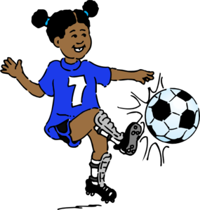
What would you call this?
Hint: It ends with “ks”
____ ____ ____ K S

Slide 6
Great work! Kicks! List another “ks” word below:

Slide 7
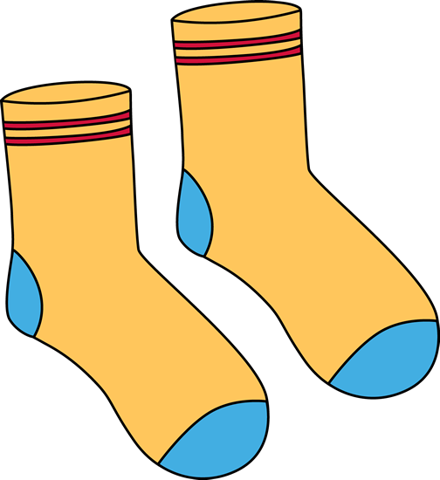
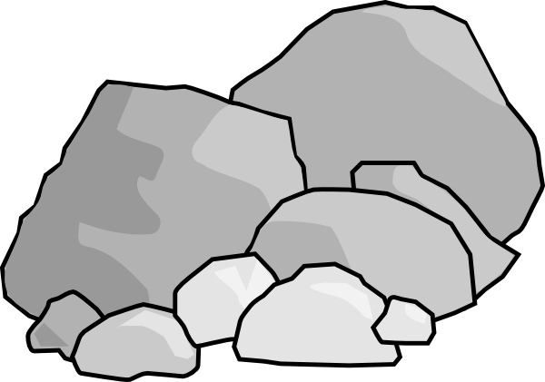
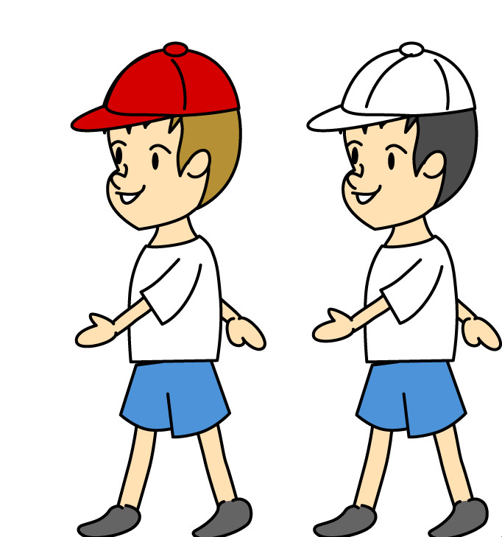
Here are some more “ks” words!

Slide 8
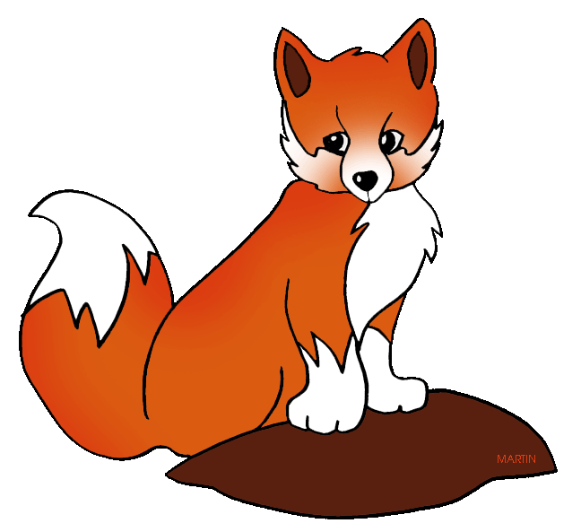
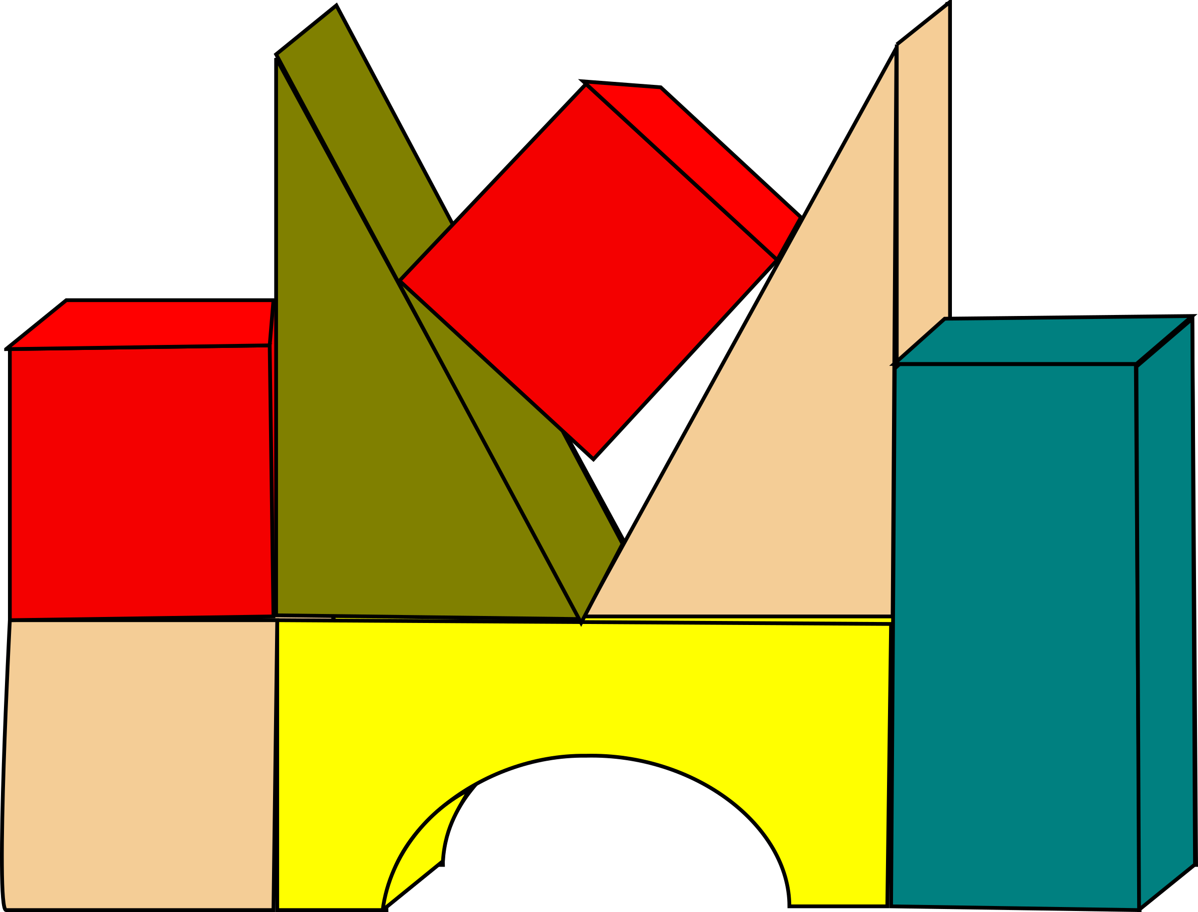
“X” and “KS” make the same sound
Which word has an X? Which has a KS?

Slide 9
Which word has an X? Which has a KS?

Slide 10
Nice work! Fill in the blank:
My coach _________ to my mom about my performance after every game.

Slide 11
Fill in the blank:
Billy’s _________ are much stronger than mine.

Slide 12
Fill in the blank:
Before I put on my shoes, I need my sports _____________.

Slide 13
Nice work! Try to write your own sentence
Use the words
Rocks
Walks

Slide 14
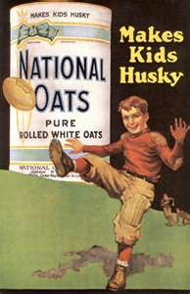
Great work! Now we will begin to look at advertisements!
What do you notice about this advertisement?

Slide 15
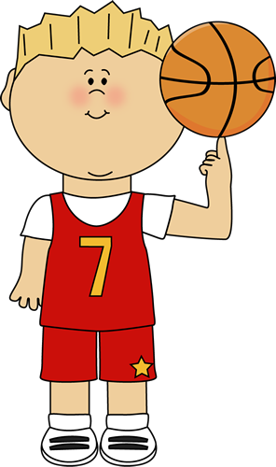
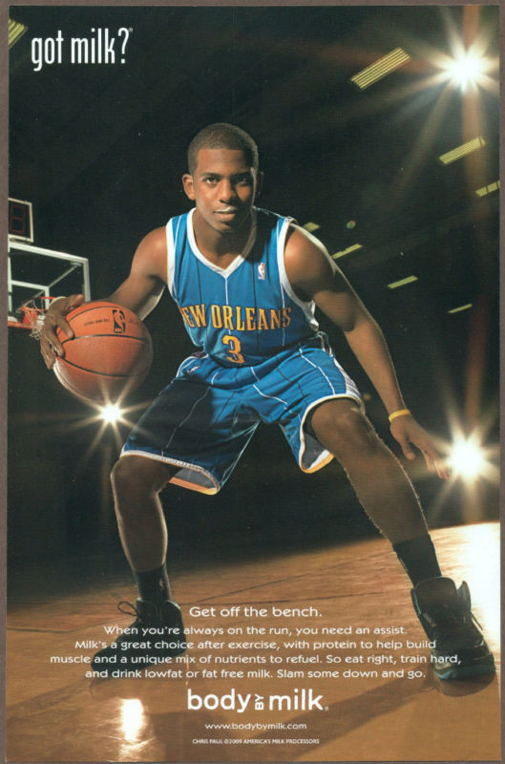
Let’s look at an advertisement used for milk.

Slide 16
What is an advertisement?

Slide 17
It is a commercial or flyer that makes a product popular and encourages people to buy it.

Slide 18
What is being advertised? How do you know?

Slide 20
Slogan
Image
Ad Copy

Slide 21
Slogan
Image
Ad Copy

Slide 22
A slogan:
A slogan is a simple or catchy short phrase used to make the product easy to remember

Slide 23
Slogan
Image
Ad Copy

Slide 24
Image:
An image shows someone using and enjoying the product. Often, famous people are used in advertising.

Slide 25
Slogan
Image
Ad Copy

Slide 26
Ad Copy:
This is a sentence or two that convinces readers that the product is great!

Slide 27
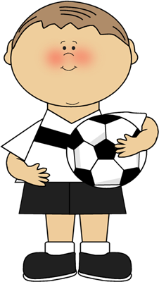
Pop Question! What three things are included in an advertisement?

Slide 28
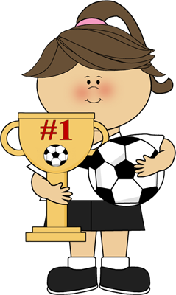
Great work!

Slide 29
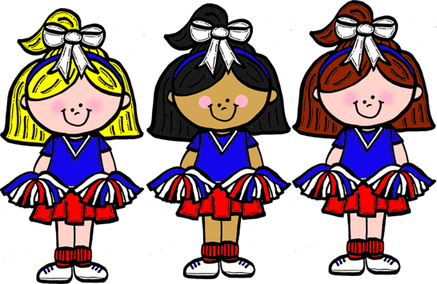
Let’s now practice counting to 100! Watch the following video:

Slide 30
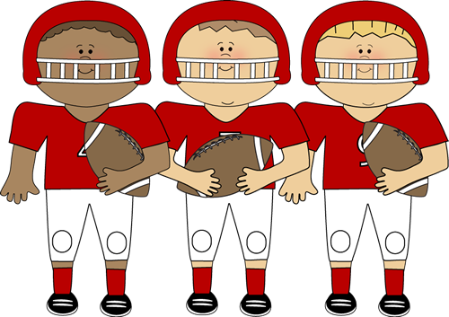
The singer included many stretches while he counted
Why are stretches important before we play a sport?

Slide 31
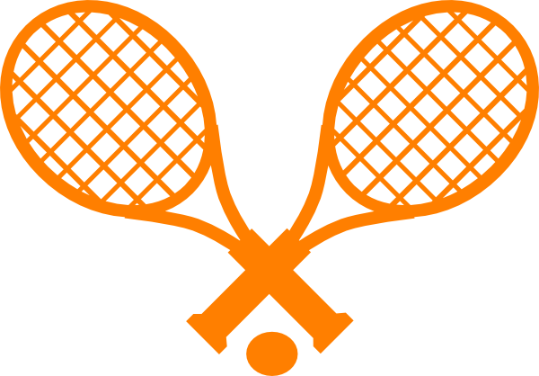
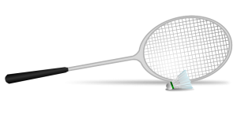
Stretching prepares our bodies before we move them when we play sports

Slide 32
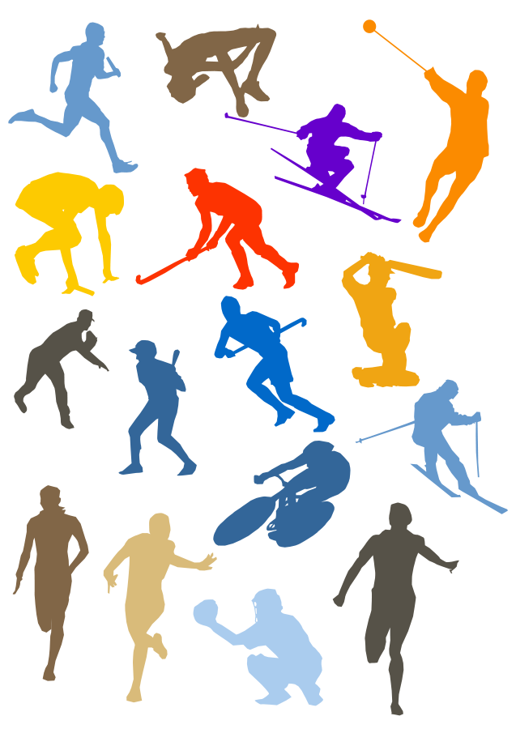
What did we learn today?
“Ks” words
Components of an advertisement
Counting to 100

Slide 33
Nice work! Let’s look at the homework now

Slide 34
Do you have any questions?

