Slide 1


SPORTS
Unit 7: Lesson 6

Slide 2


What do the letters G and E sound like together?

Slide 3

List as many words as you know that have “ge” in them
1:00

Slide 4
Great work! Here are some more words that have “ge” in them:
Wedge
Cage
Dodge
Huge
Fridge

Slide 5
What does this word mean?
Wedge
Cage
Dodge
Huge
Fridge

Slide 6
What does this word mean?
Wedge
Cage
Dodge
Huge
Fridge

Slide 7
What does this word mean?
Wedge
Cage
Dodge
Huge
Fridge

Slide 8
What does this word mean?
Wedge
Cage
Dodge
Huge
Fridge

Slide 9

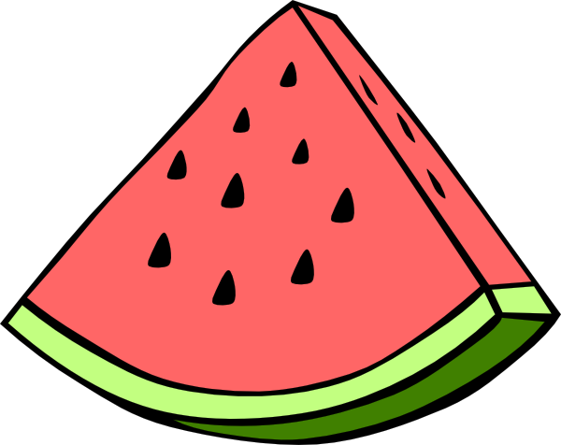
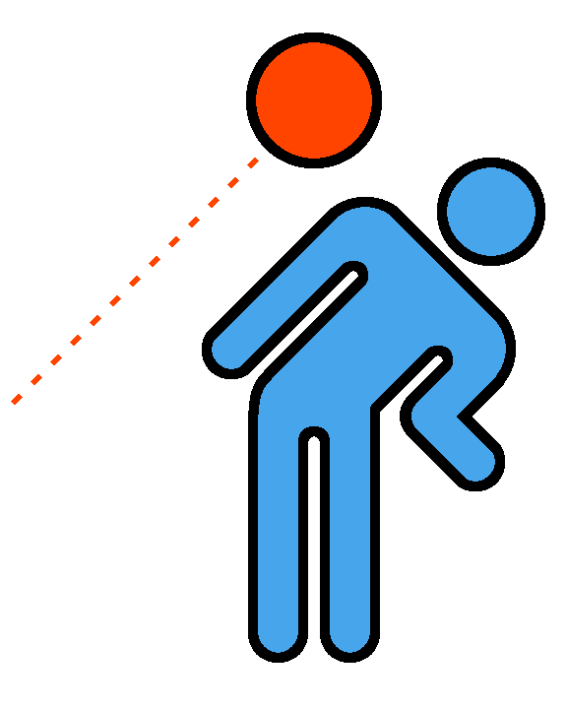
Nice work! Try to write your own sentence
Use one “ge” word!

Slide 10

Nice work! Now we will read a book about sports
in the summer time!
When is your favourite time of the year to play sports?

Slide 11
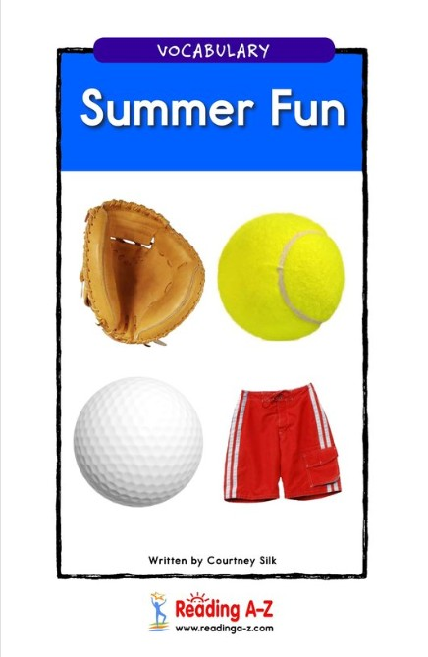

Slide 12
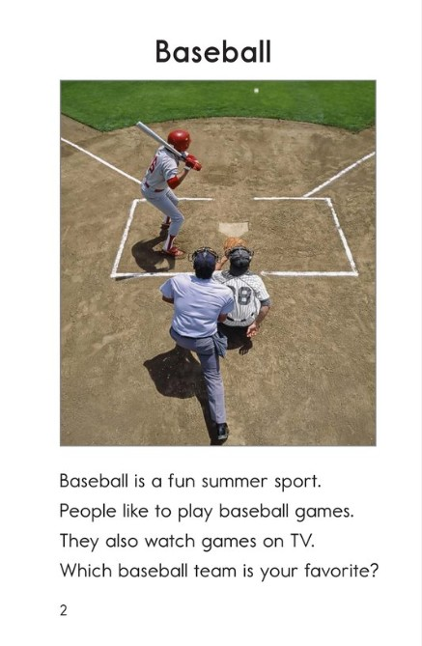

Slide 13
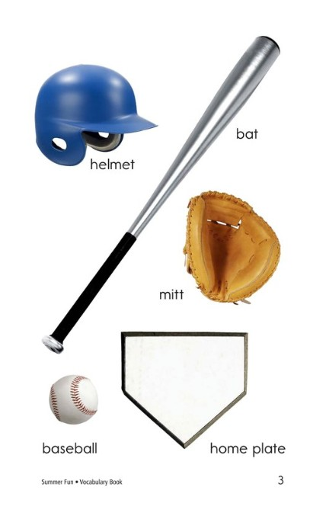

Slide 14
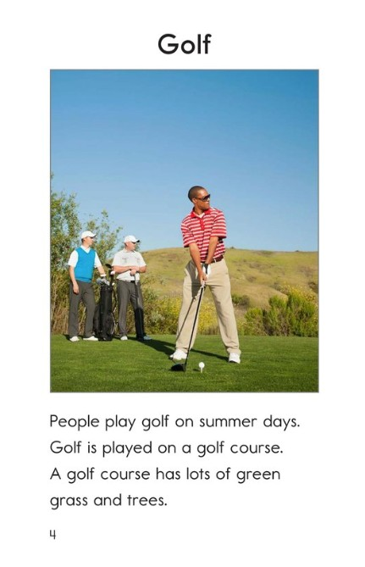

Slide 15
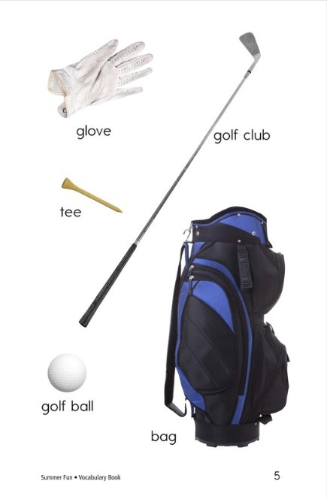

Slide 16
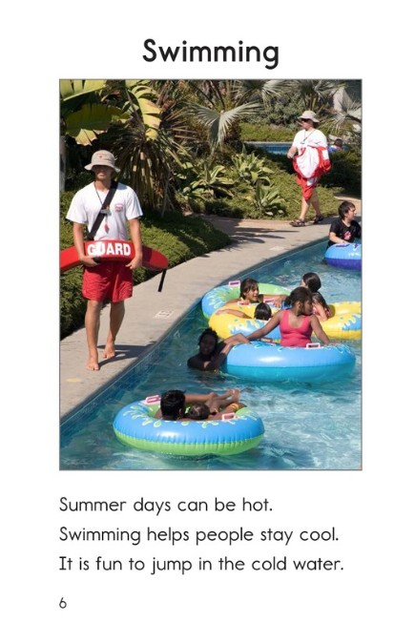

Slide 17
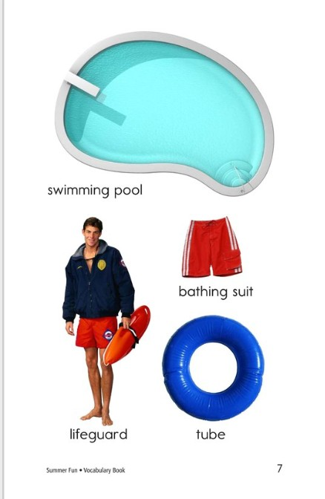

Slide 18
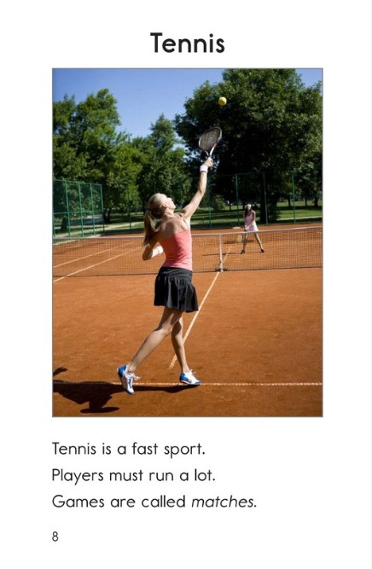

Slide 20
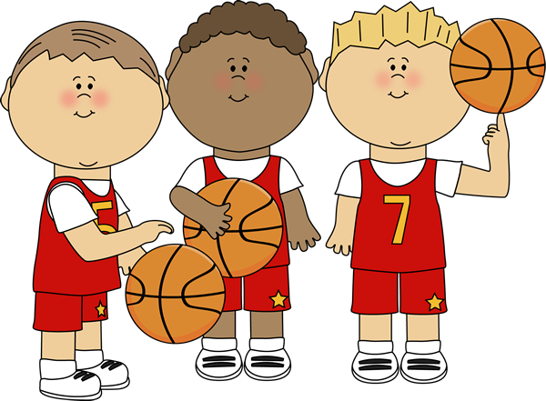
What is your favourite sport to play in the summer?

Slide 21
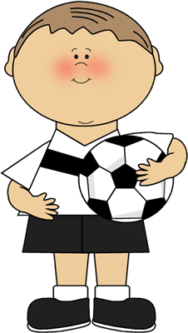
We will now look at using new phrases
How can we use the phrase “I am good at…”
or
“I am not good at...”

Slide 22
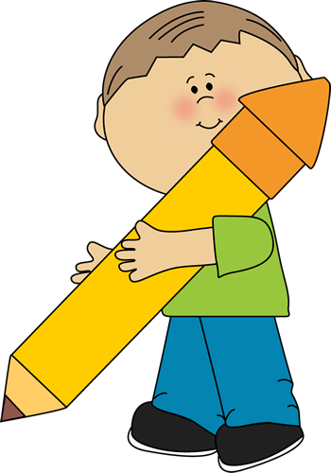


It is your turn. Tell me what you are good at.

Slide 23
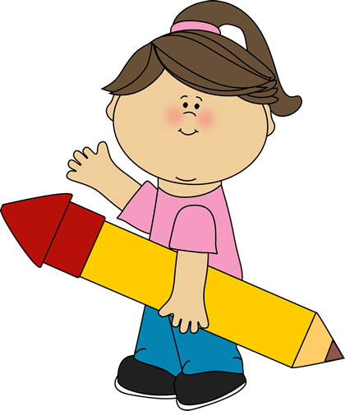
Tell me what you are not good at.

Slide 24
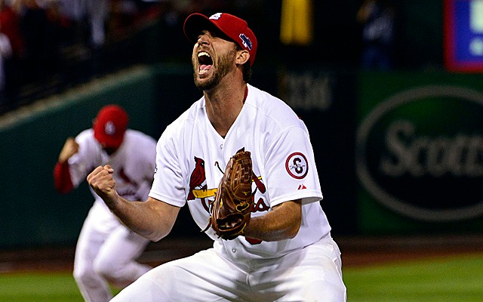
Nice work! Let’s look at the homework now

Slide 25

Do you have any questions?

