Slide 1
SPORTS
Unit 7: Lesson 6

Slide 2
What are we learning this class?
“Ge” words
Summer Sports
Using the phrases “I’m good at…” and “I’m not good at...”

Slide 3
What do the letters G and E sound like together?

Slide 4
List as many words as you know that have “ge” in them
1:00

Slide 5
Great work! Here are some more words that have “ge” in them:
Wedge
Cage
Dodge
Huge
Fridge

Slide 6
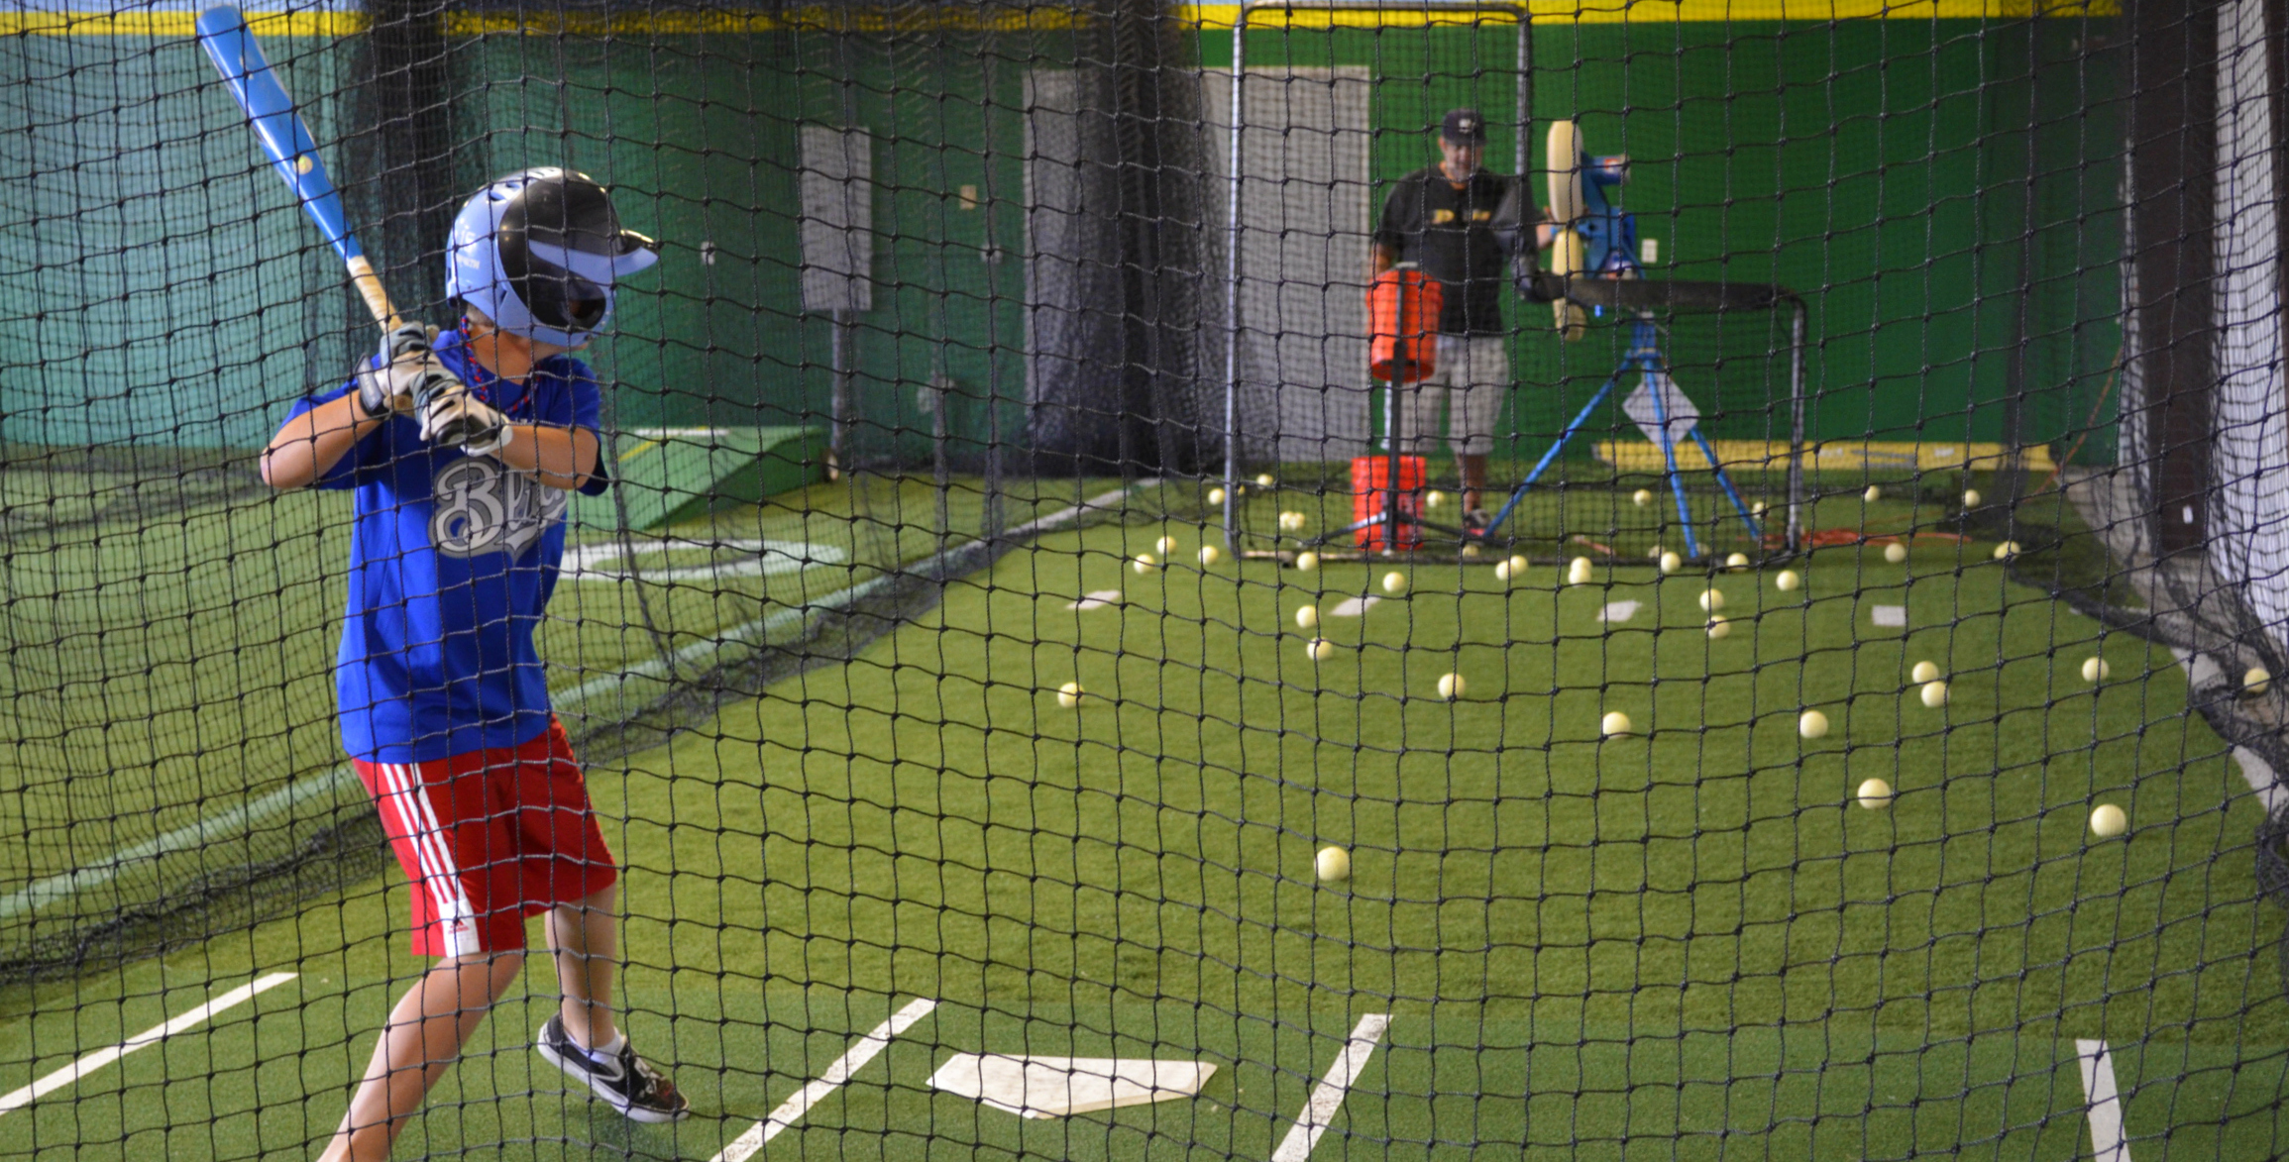
This is a baseball cage
The players hit the ball inside the cage

Slide 7
What does this word mean?
Wedge
Cage
Dodge
Huge
Fridge

Slide 8
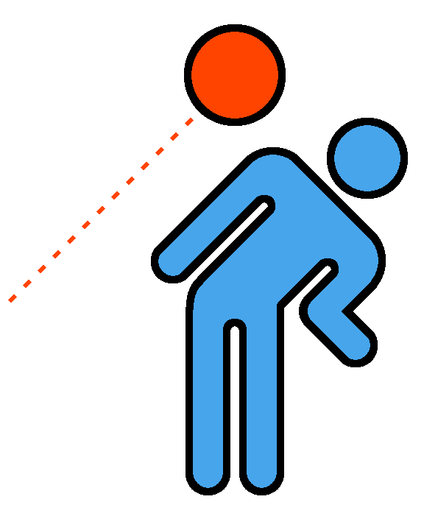
Dodge the ball. Move out of the way

Slide 9
What does this word mean?
Wedge
Cage
Dodge
Huge
Fridge

Slide 10
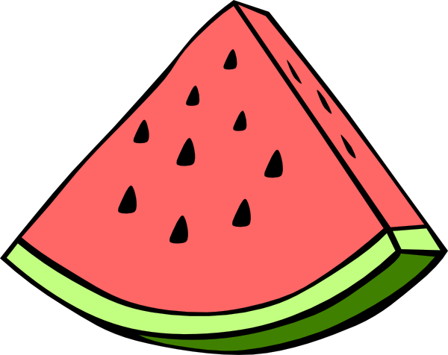
I ate a wedge of cold watermelon after my game.

Slide 11
What does this word mean?
Wedge
Cage
Dodge
Huge
Fridge

Slide 12
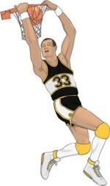
The players on the other team were huge, or very large.

Slide 13
What does this word mean?
Wedge
Cage
Dodge
Huge
Fridge

Slide 14
I got a cold water from the fridge for the goalie.

Slide 15
Nice work! Try to write your own sentence
Use one “ge” word!

Slide 16
Nice work! Now we will read a book about sports
in the summer time!
When is your favourite time of the year to play sports?

Slide 26
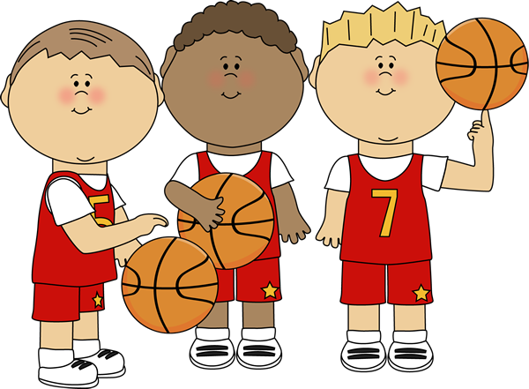
What is your favourite sport to play in the summer?

Slide 27
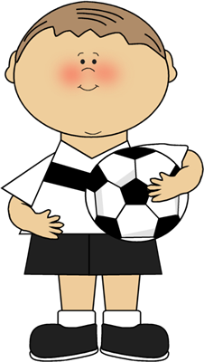
We will now look at using new phrases
How can we use the phrase “I am good at…” or “I am not good at...”

Slide 28
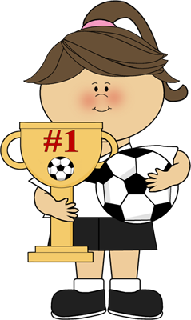
I am good at shooting the ball into the net.

Slide 29
I am not good at keeping the balls from coming in the net.

Slide 30
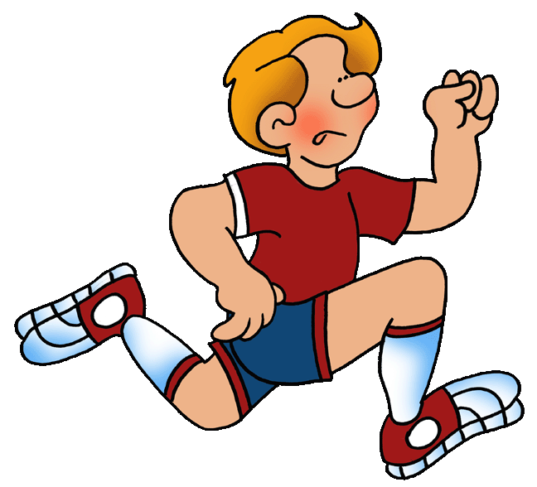
I am good at running across the field.

Slide 31
I am not good at shooting basketballs.

Slide 32
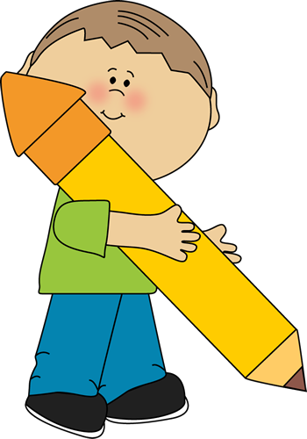
It is your turn. Tell me what you are good at.

Slide 33
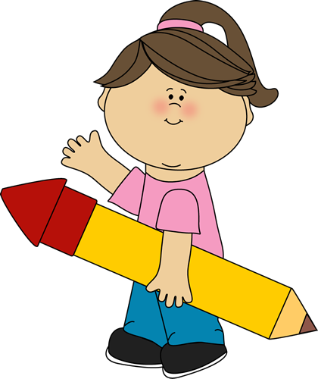
Tell me what you are not good at.

Slide 34
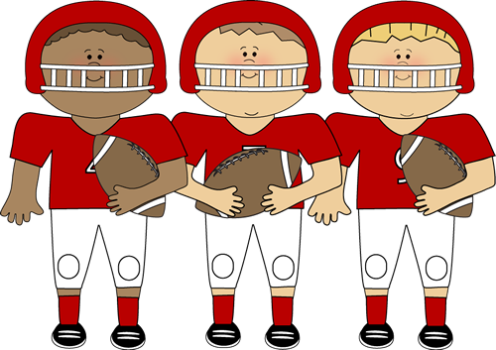
What did we learn today?
“Ge” words
Summer Sports
Using new phrases

Slide 35
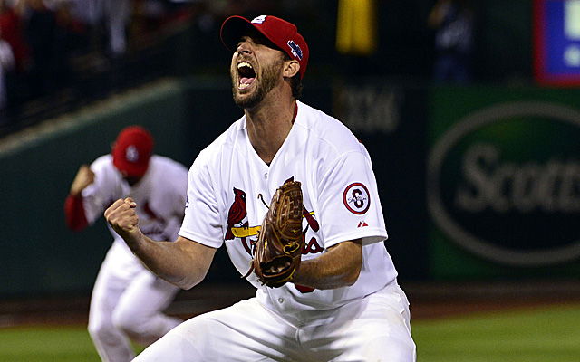
Nice work! Let’s look at the homework now

Slide 36
Do you have any questions?

