Slide 1
SPORTS
Unit 7: Lesson 7

Slide 2



What are we learning this class?
“Wh” words
Reading about Hockey
Using the impersonal in a sentence

Slide 3
What sound do you notice in the following words:
White
Whistle
Whale
Wheelchair
Whisper

Slide 4

Fill in the blank!
The mascot for our team is a large blue
.

Slide 5
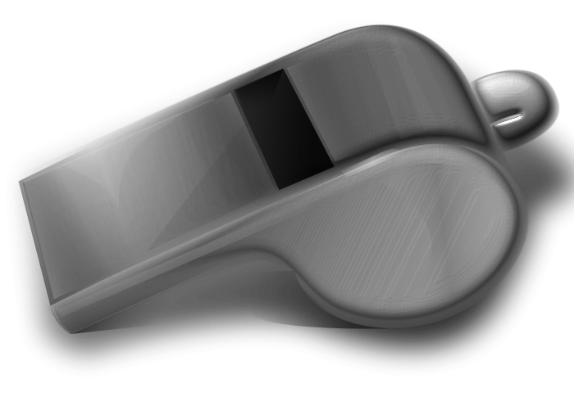
Fill in the blank!
When the game is over, the referee blows the
.

Slide 6
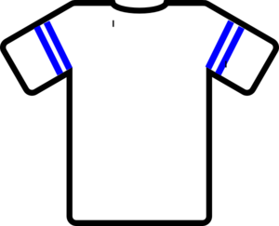
Fill in the blank!
My team’s jersey colour is
.

Slide 7

Fill in the blank!
John rolls in his
to play basketball

Slide 8
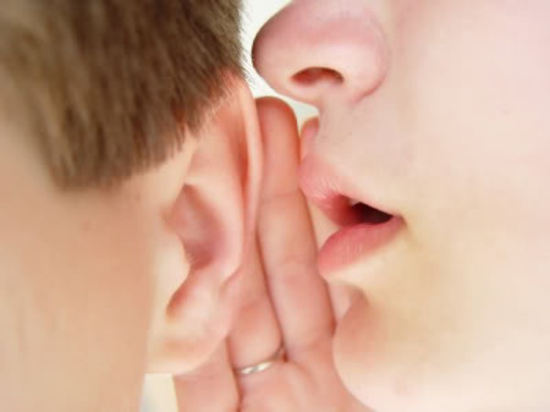
Fill in the blank!
Coach said the team
should our
plays quietly.

Slide 9

Now we will play hangman!
Pick a “wh” word.

Slide 10
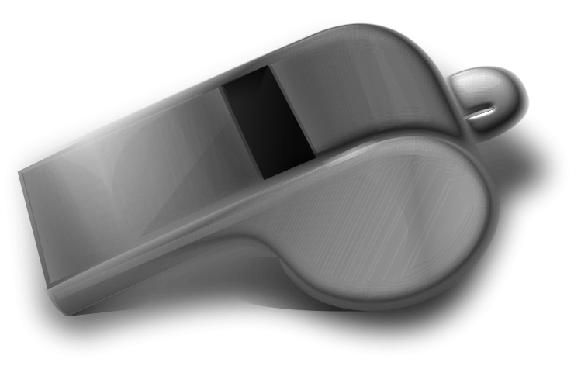

Nice work! Write a sentence using one “wh” word.

Slide 11

Great! Now we will be reading a book about hockey!
Have you played hockey before?

Slide 12

Nice job! Tell us one thing you learned about hockey!

Slide 13
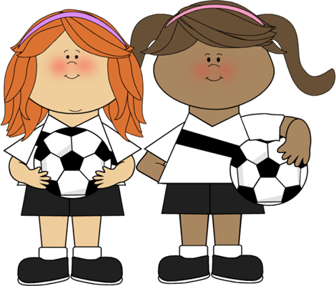
We will now look at using impersonal phrases

Slide 14
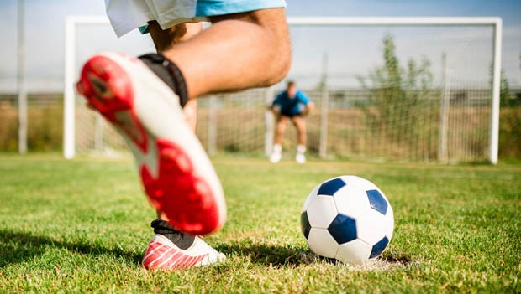
It is a hot day.

Slide 15
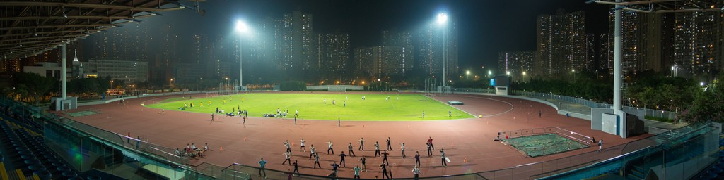
It is dark outside.

Slide 16
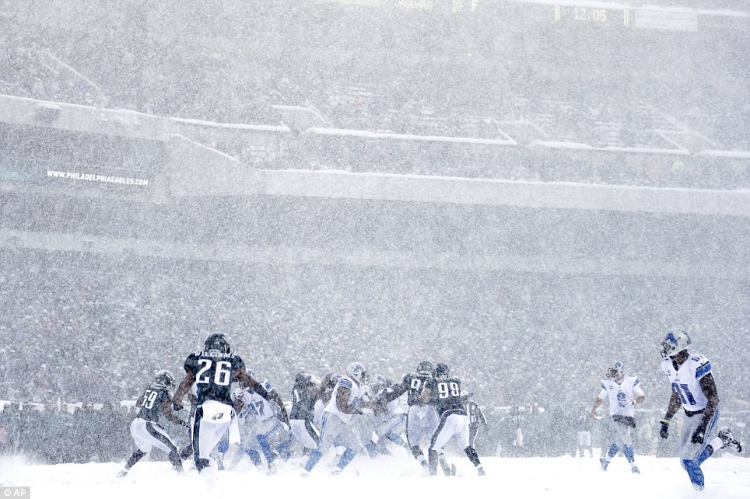
It is snowing.

Slide 17
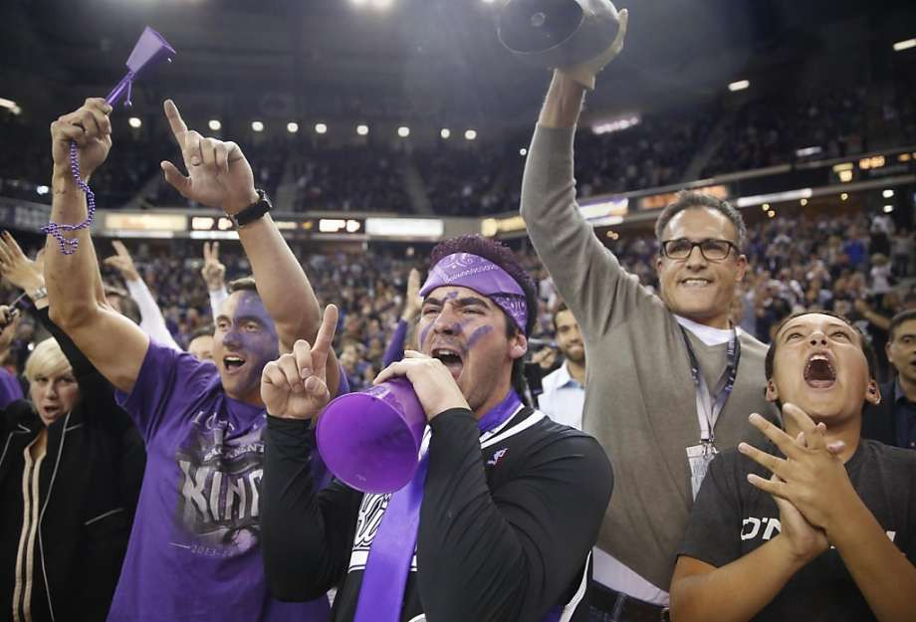
It is noisy.

Slide 18


It is . Write your own impersonal statement

Slide 19
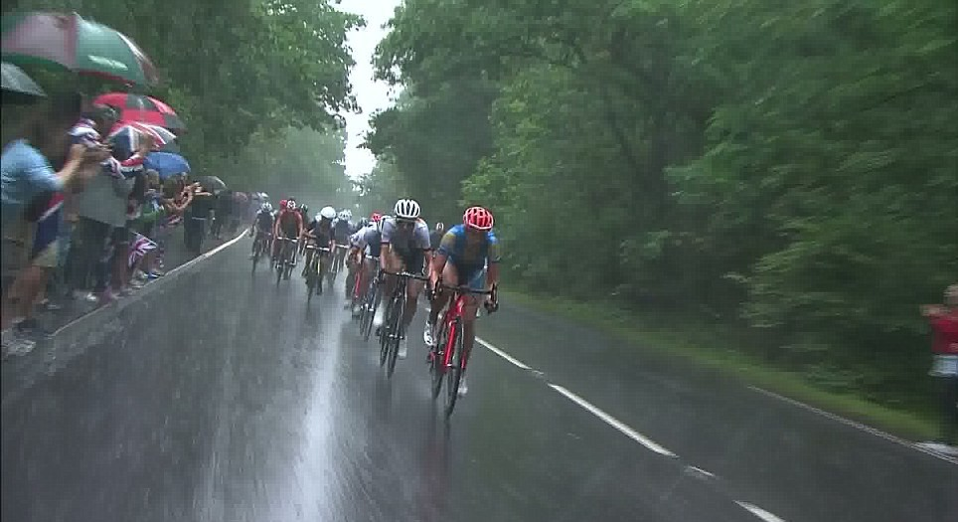
Write an impersonal statement about this photo.

Slide 20





What did we learn today?
“Wh” words
The rules of Hockey
Using impersonal statements

Slide 21
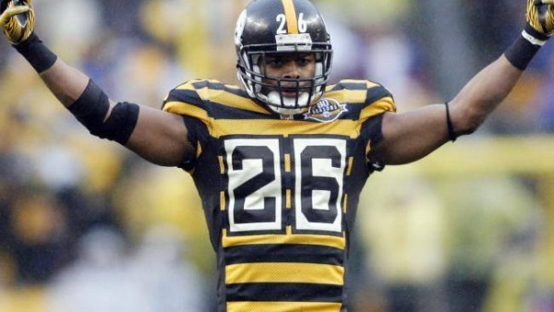
Nice work! Let’s look at the homework now

Slide 22

Do you have any questions?

