Slide 1
SPORTS
Unit 7: Lesson 7

Slide 2
What are we learning this class?
“Wh” words
Reading about Hockey
Using the impersonal in a sentence

Slide 3
What sound do you notice in the following words:
White
Whistle
Whale
Wheelchair
Whisper

Slide 4
Correct, they all start with “WH”

Slide 5
Fill in the blank!
The mascot for our team is a large blue _______________.

Slide 6
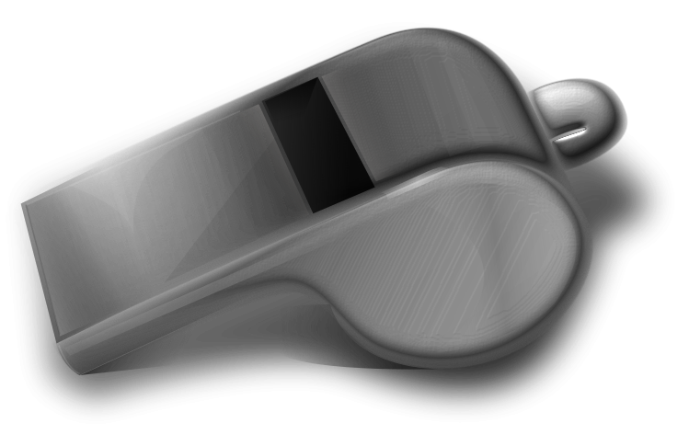
Fill in the blank!
When the game is over, the referee blows the _______________.

Slide 7
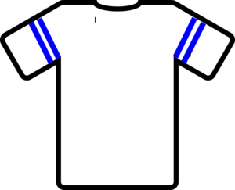
Fill in the blank!
My team’s jersey colour is _______________.

Slide 8
Fill in the blank!
John rolls in his _______________ to play basketball

Slide 9
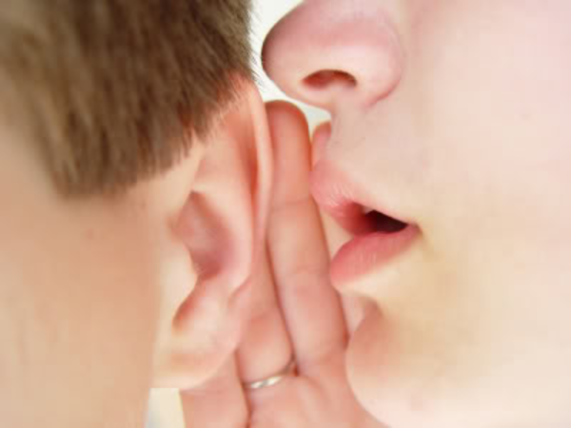
Fill in the blank!
Coach said the team should ___________ our plays quietly.

Slide 10
Now we will play hangman!
Pick a “wh” word.

Slide 11
Nice work! Write a sentence using one “wh” word.

Slide 12
Great! Now we will be reading a book about hockey!
Have you played hockey before?

Slide 21
Nice job! Tell us one thing you learned about hockey!

Slide 22
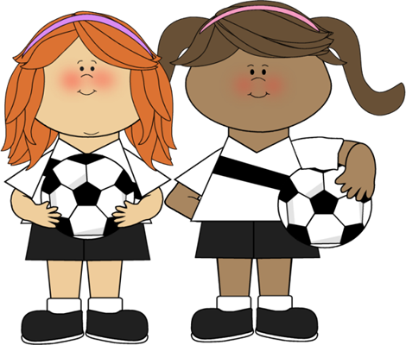
We will now look at using impersonal phrases

Slide 23
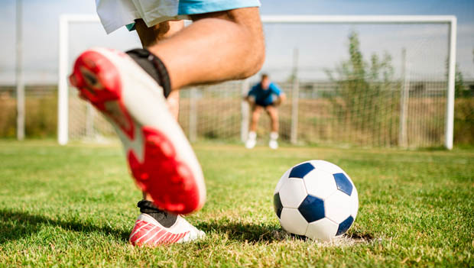
It is a hot day.

Slide 24
It is a hot day.
We use the word “it” to speak about something generally

Slide 25
It is dark outside.

Slide 26
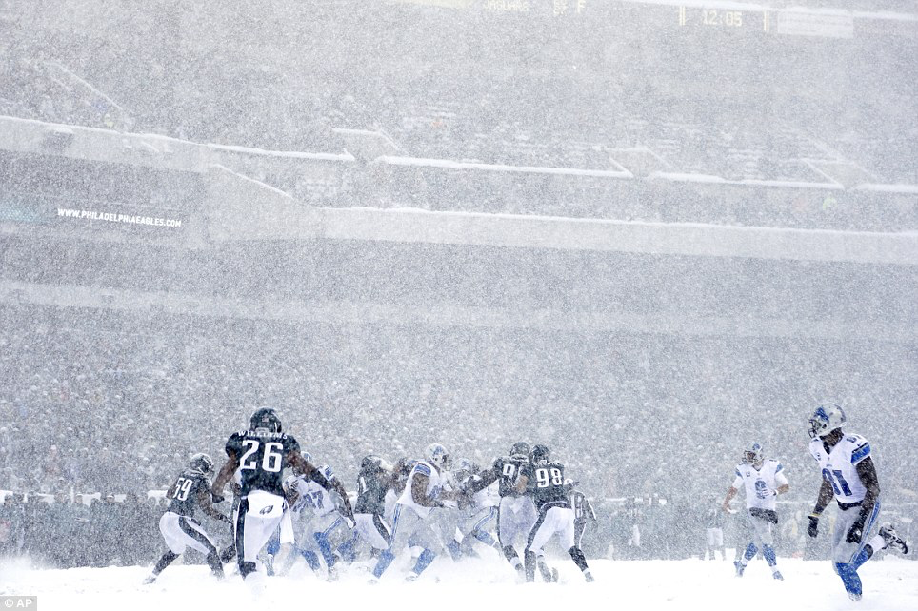
It is snowing.

Slide 27
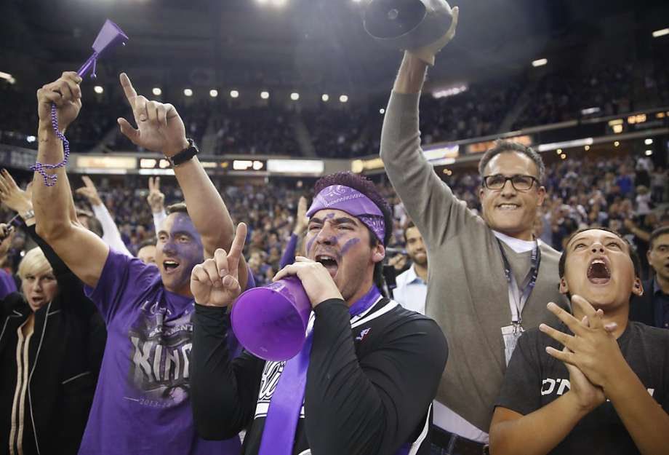
It is noisy.

Slide 28
It is ________. Write your own impersonal statement

Slide 29
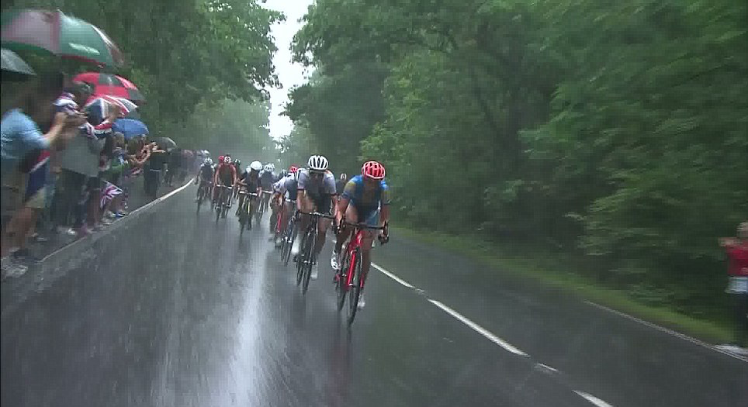
Write an impersonal statement about this photo.

Slide 30
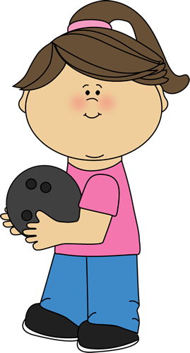
What did we learn today?
“Wh” words
The rules of Hockey
Using impersonal statements

Slide 31
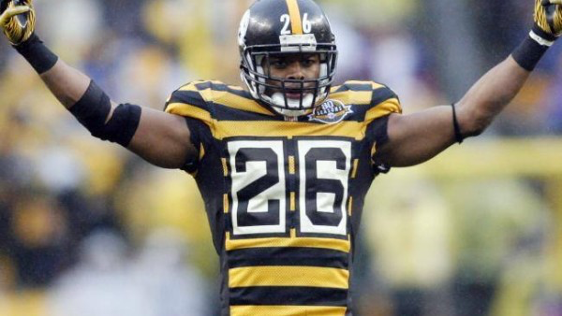
Nice work! Let’s look at the homework now

Slide 32
Do you have any questions?

