Slide 1


SPORTS
Unit 7: Lesson 8

Slide 2








What are we learning this class?
Review “ks”, “wh”, and “ge” words
Components of an advertising flyer Phrases “I am good at/I am not good at” Impersonal sentences

Slide 3
Let’s review our letter sounds
KS WH GE

Slide 4

Nice job!
Pick a “ge” word.
Write a sentence using that word.

Slide 5
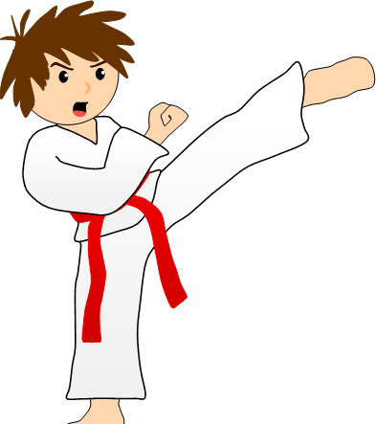
“Kicks” is a “ks” word. What sports do we kick in?

Slide 6
Find an item around you that has the
“wh” sound it its name
Tell us about it!

Slide 7
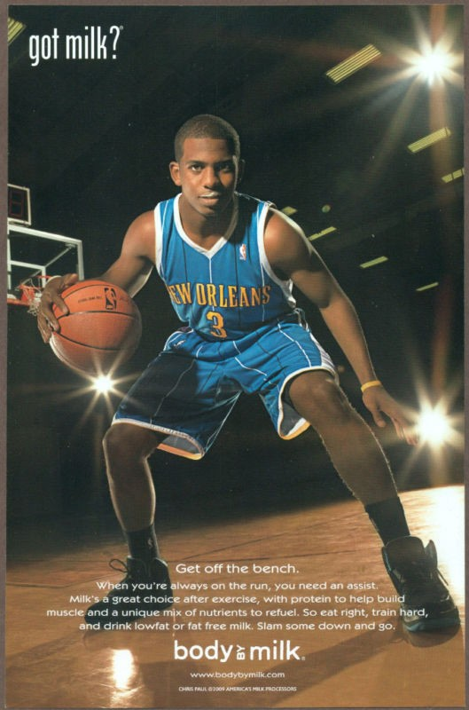

Slide 8

Great work! Identify what is on this advertisement.

Slide 9

Nice! What do you think is being advertised here?

Slide 10

I am good at cheering for other teams!

Slide 11
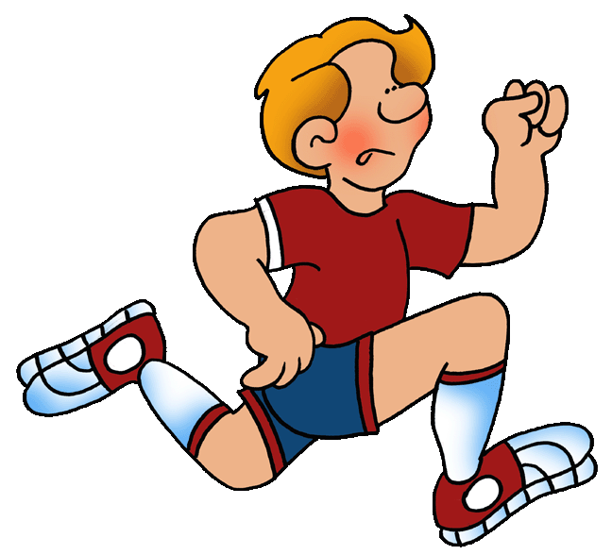
I am not good at running long distances.

Slide 12

Tell me a sentence. What are you good at?

Slide 13
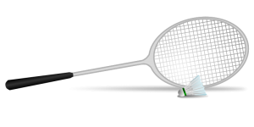
What are you not good at?

Slide 14


Write your own sentence telling me what you are or are not good at

Slide 15
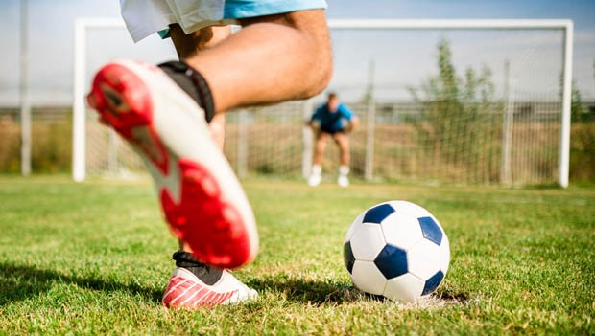
It is a hot day.

Slide 16
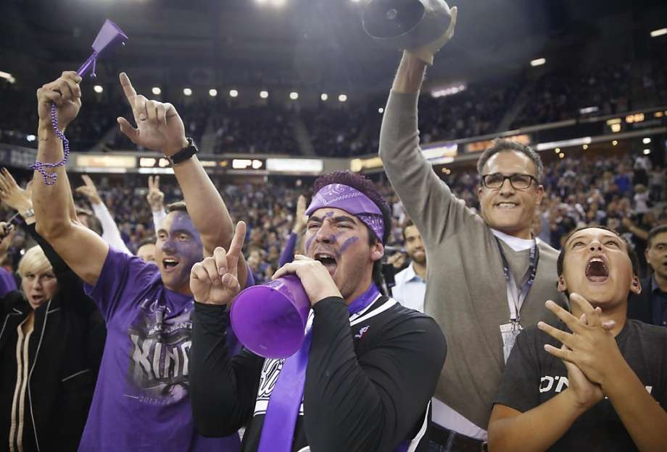
It is noisy.

Slide 17
It is . Write your own impersonal statement

Slide 18
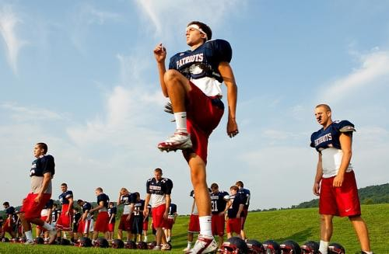
Look at this photo and write an impersonal statement about it

Slide 19
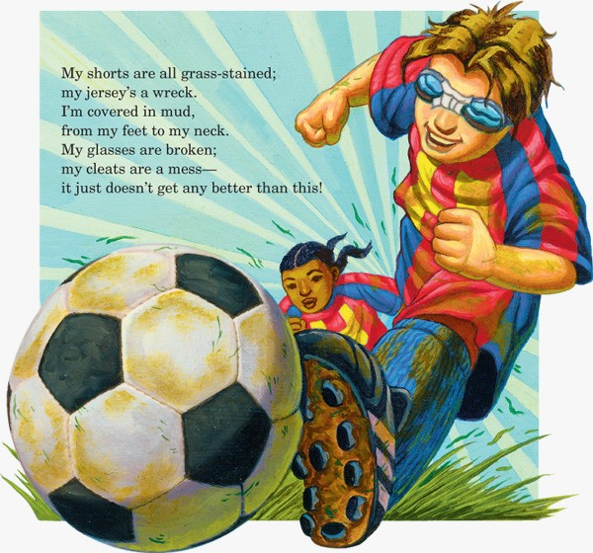

Slide 20
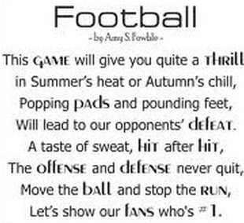

Slide 21
