Slide 1
SPORTS
Unit 7: Lesson 8

Slide 2
What are we learning this class?
Review
“ks”, “wh”, and “ge” words
Components of an advertising flyer
Phrases “I am good at/I am not good at”
Impersonal sentences

Slide 3
Let’s review our letter sounds
KS | WH | GE

Slide 4

Nice job!
Pick a “ge” word.
Write a sentence using that word.

Slide 5
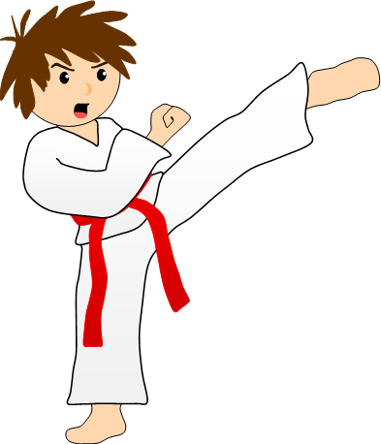
“Kicks” is a “ks” word. What sports do we kick in?

Slide 6
Find an item around you that has the “wh” sound it its name
Tell us about it!

Slide 7

Great work! You know your “ks”, “ge” and “wh” sounds

Slide 8
Nice work!
Now, let’s review advertising fliers. Can you name each part of the advertisement?

Slide 9
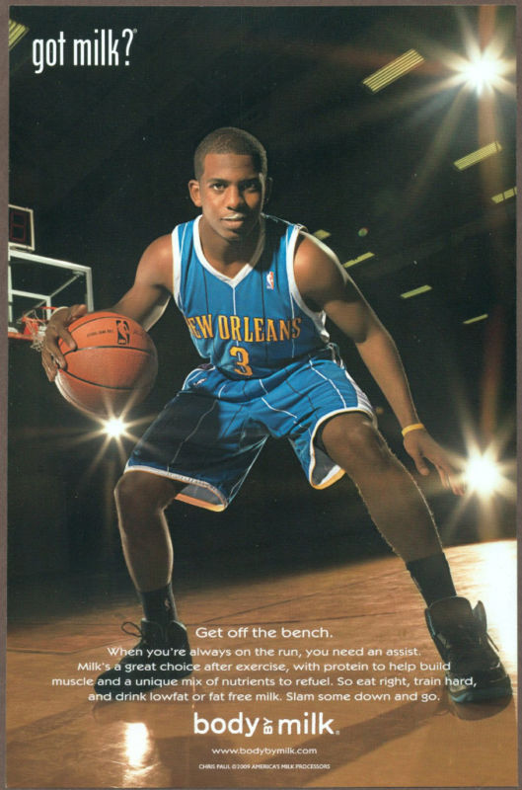

Slide 10
Slogan
Image
Ad Copy

Slide 11

Great work! Identify what is on this advertisement.

Slide 12

Nice! What do you think is being advertised here?

Slide 13
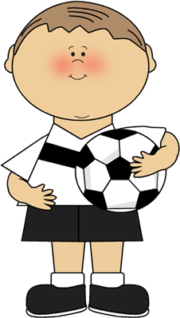
What did we just review?
Components of an advertisement

Slide 14

Let’s review the phrases “I am good at” and “I am not good at”

Slide 15

I am good at cheering for other teams!

Slide 16
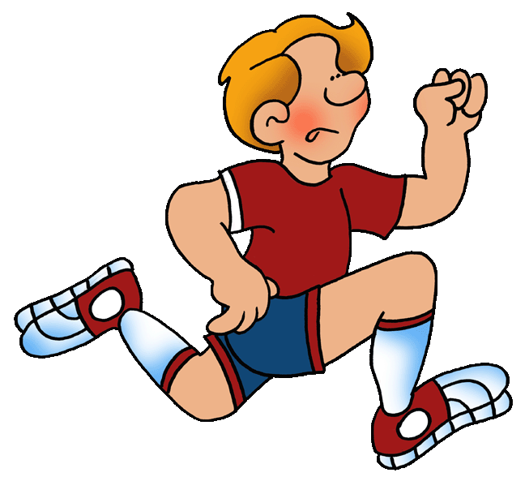
I am not good at running long distances.

Slide 17

Tell me a sentence. What are you good at?

Slide 18
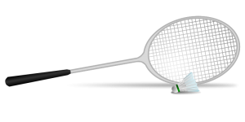
What are you not good at?

Slide 19
Write your own sentence telling me what you are or are not good at

Slide 20
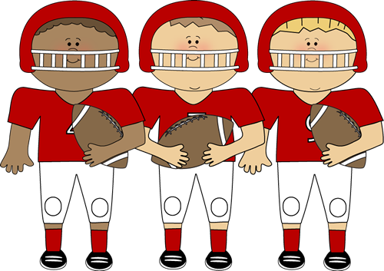
Great work! You know how to use these phrases!

Slide 21

Let’s now review impersonal sentences

Slide 22
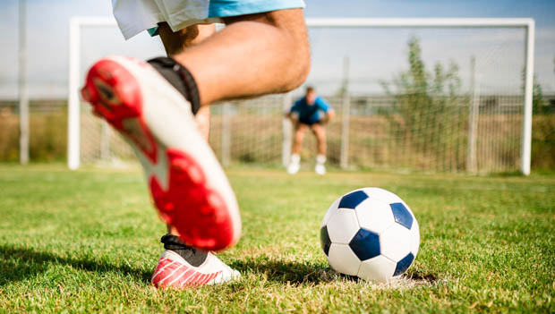
It is a hot day.

Slide 23
It is a hot day.
We use the word “it” to speak about something generally

Slide 24
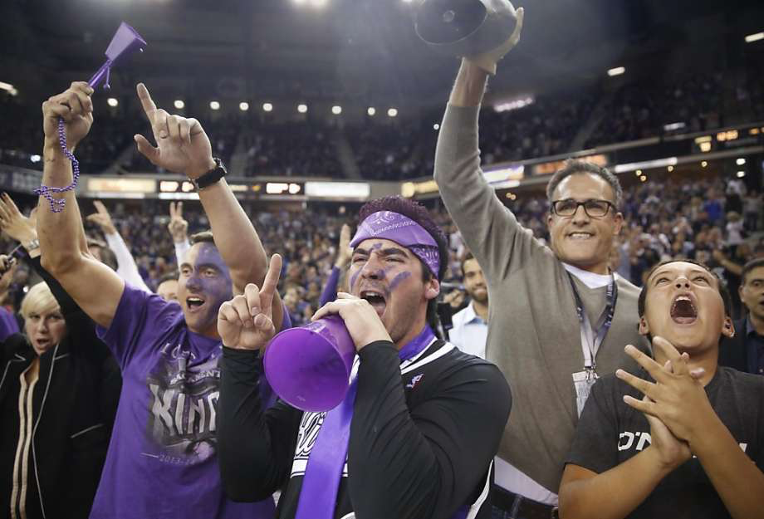
It is noisy.

Slide 25
It is ________. Write your own impersonal statement

Slide 26
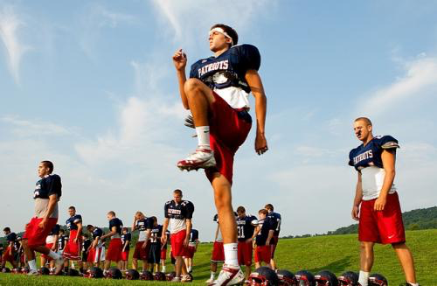
Look at this photo and write an impersonal statement about it

Slide 27
Great! What did we learn today?
A review of “ks”, “wh”, and “ge” words
Reviewing components of an advertisement
Phrases: I am good at/not good at…
Impersonal sentences

Slide 28
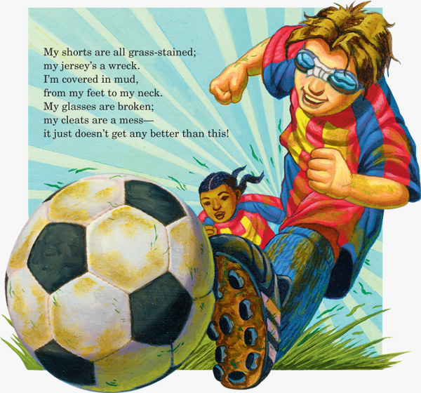

Slide 29
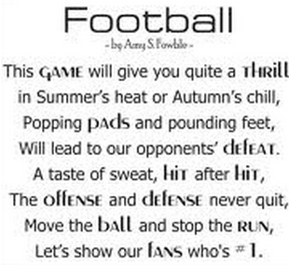

Slide 30
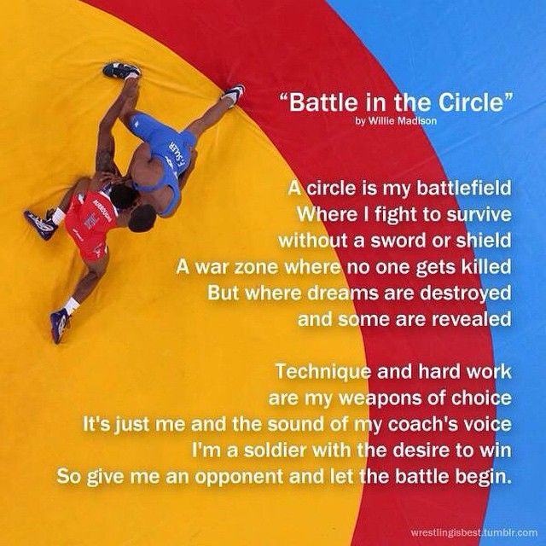

Slide 31
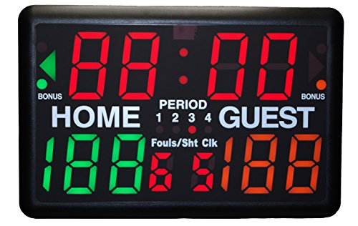
It is homework time!

Slide 32

Do you have any questions?

