Slide 1


SPORTS
Unit 7: Lesson 9

Slide 2
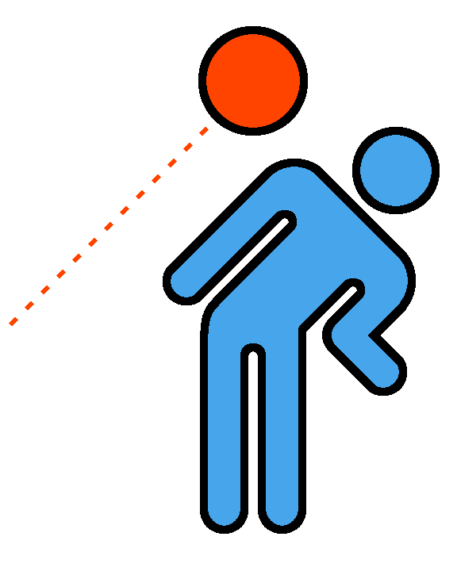
Quick! Dodge the ball!

Slide 3



Dodge is a “dge” word.
Can you think of any other “dge” words?

Slide 4

We all have a jerseys!
on our
B
E

Slide 5
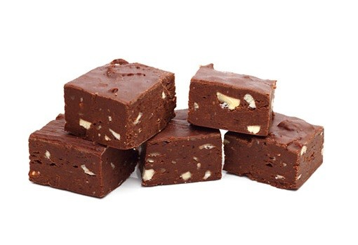
We eat chocolate after our games.
F U

Slide 6
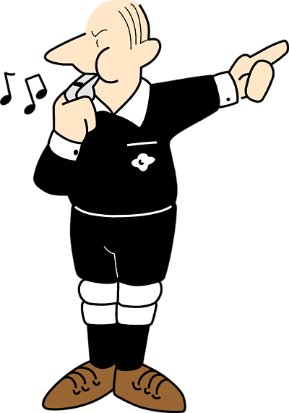
The referee is the the game.
of
J G

Slide 7
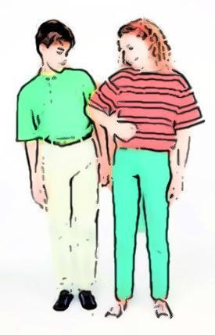
I had to
the player to
get the ball.
N
G E

Slide 8
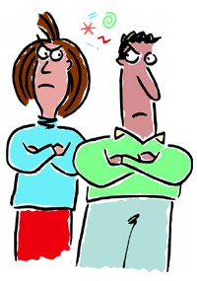
I held a on the team for losing our last game.
G U G

Slide 9
Have you ever held a grudge? Tell us
about it!
Grudge

Slide 10
Let’s play hangman using a “dge” word.

Slide 11

Here is another example
Quick
Fast

Slide 12
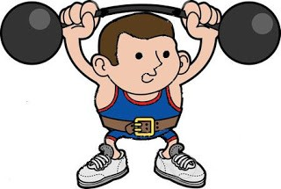
Another synonym:
Strong
Powerful

Slide 13

Great work! Try to think of a synonym for sad
She was sad because she lost the game.

Slide 14
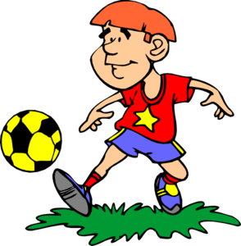
What is an synonym for good?
He was good at soccer.

Slide 15
Great! What did we just learn?
Synonyms and using them in a sentence

Slide 16
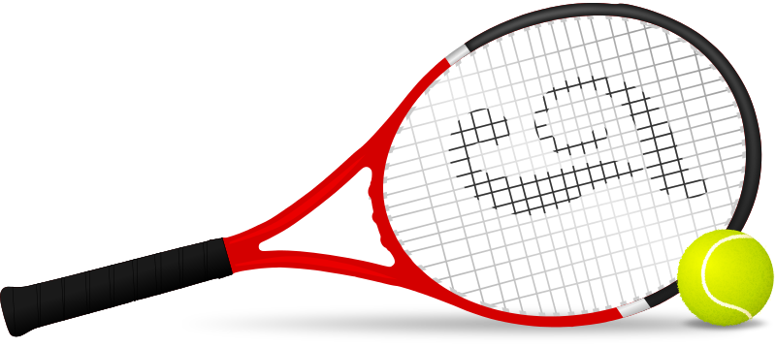
Why are tennis balls so bright? Because they are easier to see.

Slide 17
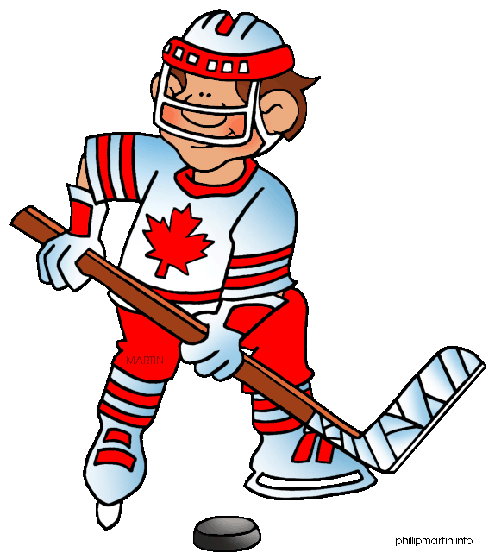
Why do hockey players wear skates?
Because they play on ice.

Slide 18


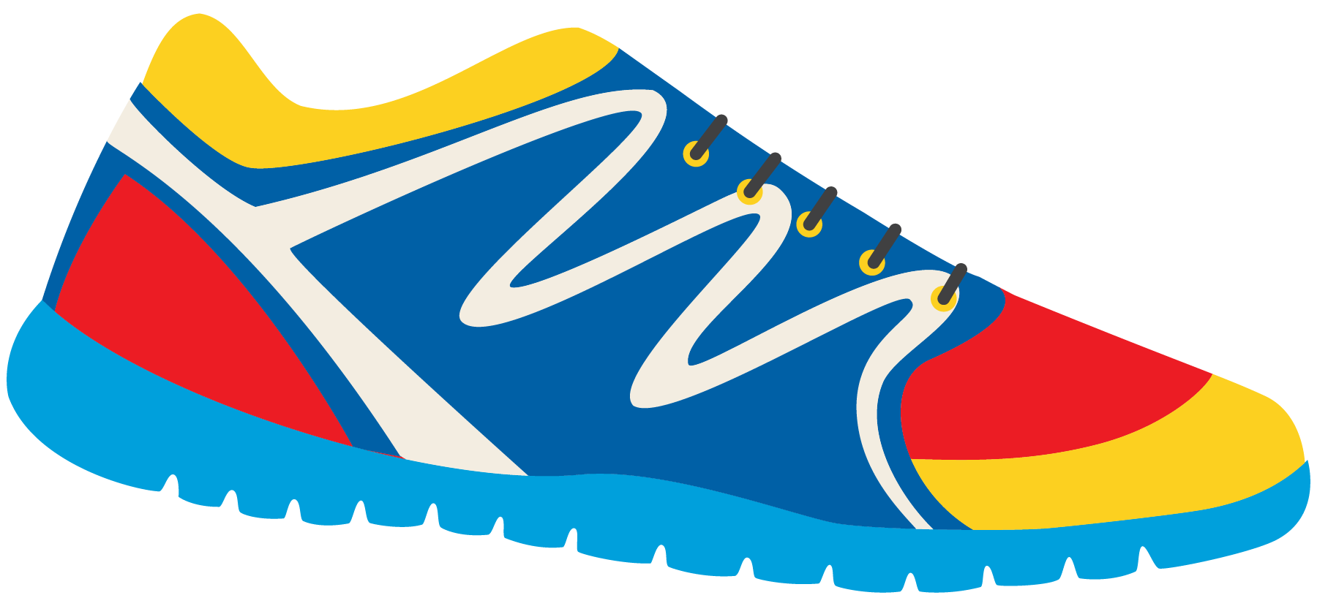
Great work! Write your own question and answer using “why” and “because”

Slide 19

Nice work! What other sport does cricket remind you of?

Slide 20
Homework time! Do you have any questions?

