Slide 1
SPORTS
Unit 7: Lesson 9

Slide 2
What are we learning this class?
“dge” words
A review of synonyms
“Why” and “Because” phrases

Slide 3
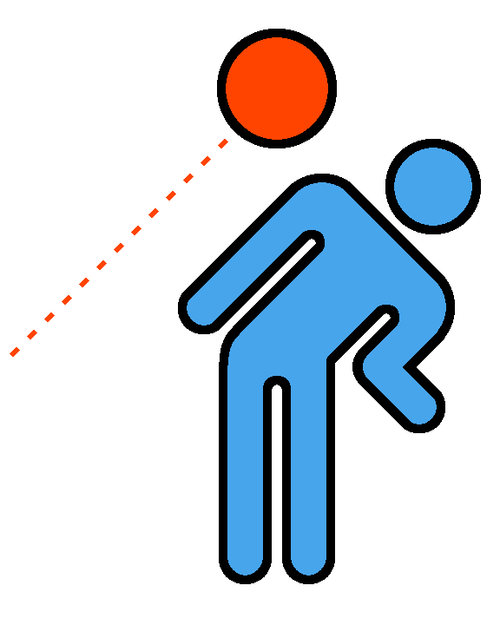
Quick! Dodge the ball!

Slide 4
Dodge is a “dge” word.
Can you think of any other “dge” words?

Slide 5
We all have a ______ on our jerseys!
B ___ ___ ___ E

Slide 6
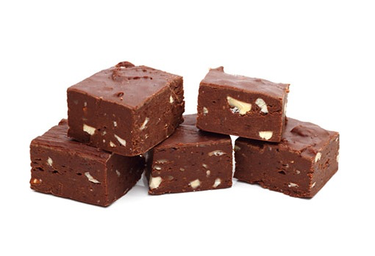
We eat chocolate ________ after our games.
F U ___ ___ ___

Slide 7
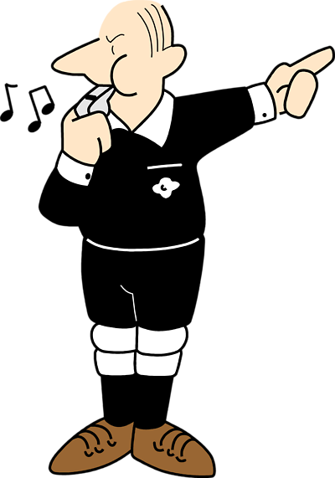
The referee is the ______ of the game.
J ___ ___ G ___

Slide 8
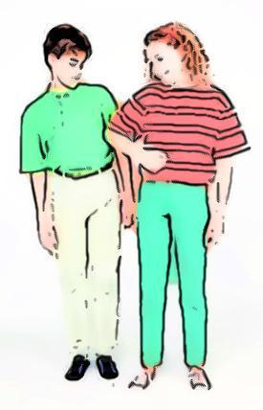
I had to ______ the player to get the ball.
N ___ ___ G E

Slide 9
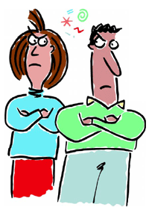
I held a ________ on the team for losing our last game.
G ___ U ___ G ___

Slide 10
Have you ever held a grudge? Tell us about it!
Grudge

Slide 11
Let’s play hangman using a “dge” word.

Slide 12
Great work! What did we just learn?
How to spell and use “dge” words

Slide 13
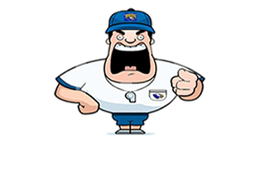
Now we will be reviewing synonyms
What is a synonym?

Slide 14
Correct! A synonym is two words that mean the same thing.
Example: Happy Joyful
These words mean the same thing!

Slide 15
Here is another example
Quick
Fast

Slide 16
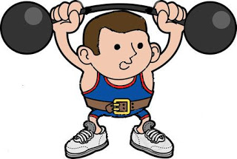
Another synonym:
Strong
Powerful

Slide 17
Great work! Try to think of a synonym for sad
She was sad because she lost the game.

Slide 18
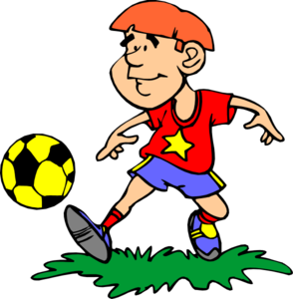
What is an synonym for good?
He was good at soccer.

Slide 19
Nice work! Write your own pair of synonyms down below!

Slide 20
Great! What did we just learn?
Synonyms and using them in a sentence

Slide 21
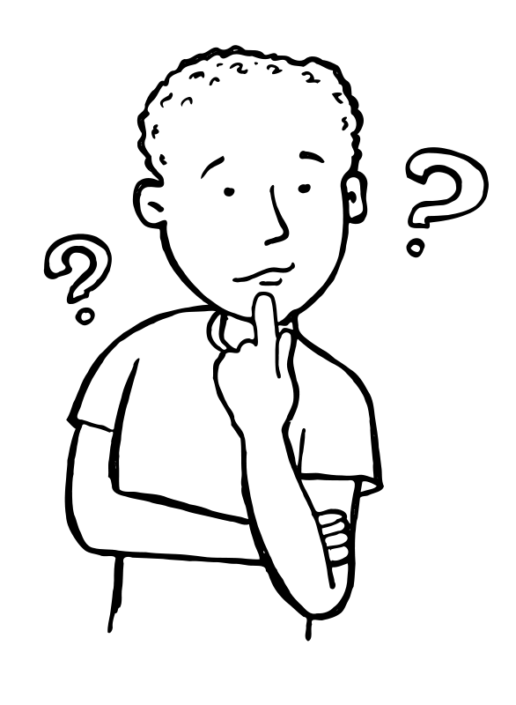
Now we will take a look at using the words “why” and “because”

Slide 22
Why is Lucy running?
“Why” is used in a question

Slide 23
Because she is the fastest.
“Because” is used in an answer

Slide 24
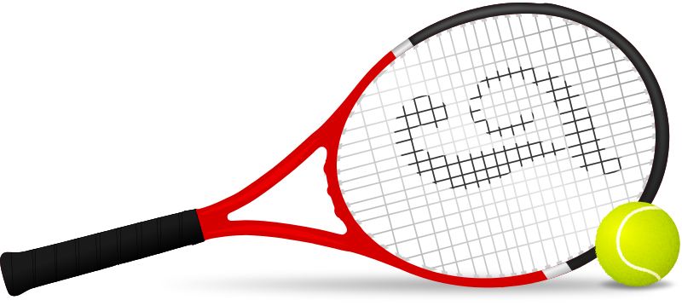
Why are tennis balls so bright? Because they are easier to see.

Slide 25
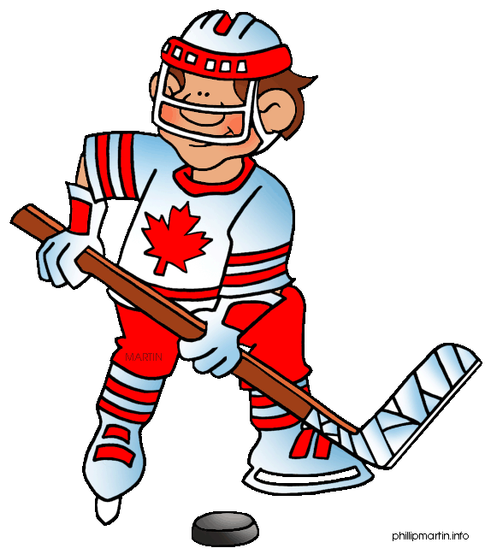
Why do hockey players wear skates? Because they play on ice.

Slide 26
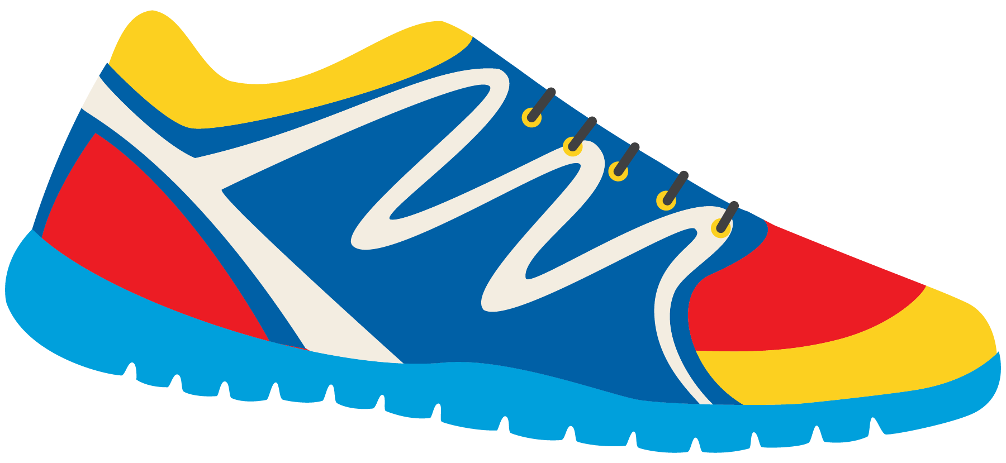
Great work! Write your own question and answer using “why” and “because”

Slide 27
What did we just learn?
How to use the words “why” and “because”

Slide 28
Nice work! Let’s read about the sport of cricket!

Slide 37
Nice work! What other sport does cricket remind you of?

Slide 38
What did we learn today?
“dge” words
Synonyms
Using the words “why” and “because

Slide 39
Homework time! Do you have any questions?

