Slide 1



Around the World
Unit 8 Lesson 1

Slide 2



What will we be learning this class?
An overview of the unit
A look into the country of France
A review of “ough” words

Slide 3


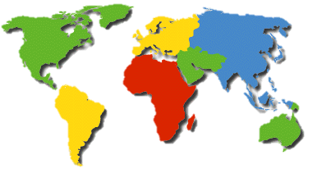
We will be looking into different countries.
What is a country?
A country is a land where people live, with it’s own laws or rules and foods or practices that are special to
each land.
  Here are some examples of countries:
    China
Canada
  France
    Japan

Slide 4


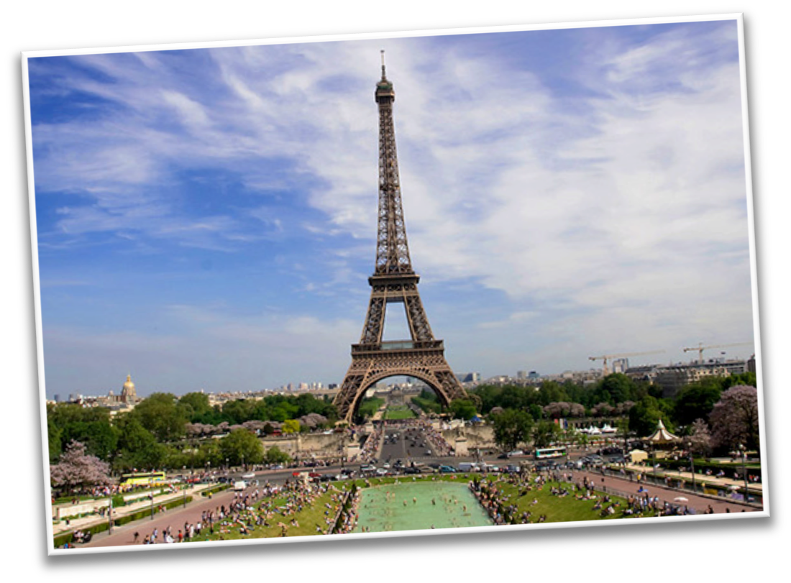




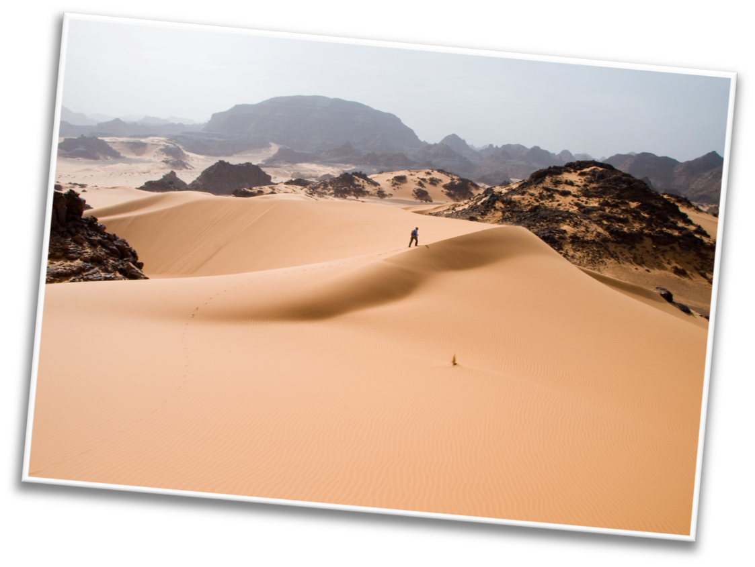




What countries have you been to?
Tell us about a country you have been to. What was special about that country?

Slide 5

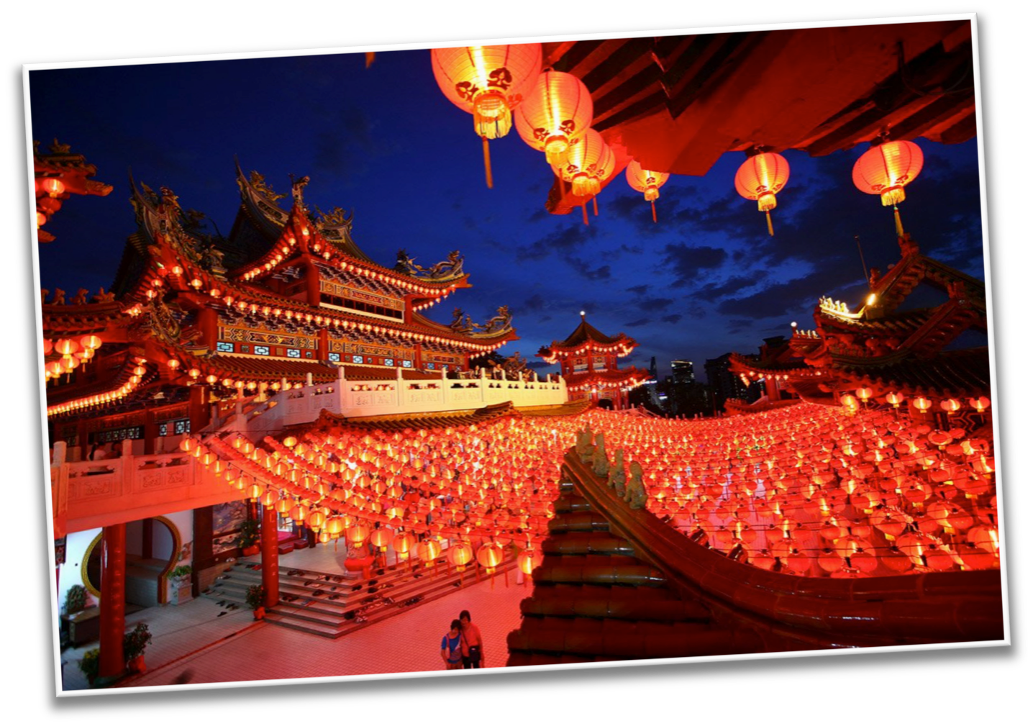
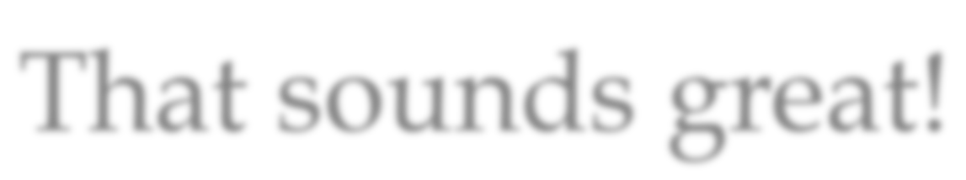
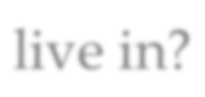
That sounds great!
What country do you live in right now? What is something special or different about the country you live in?

Slide 6
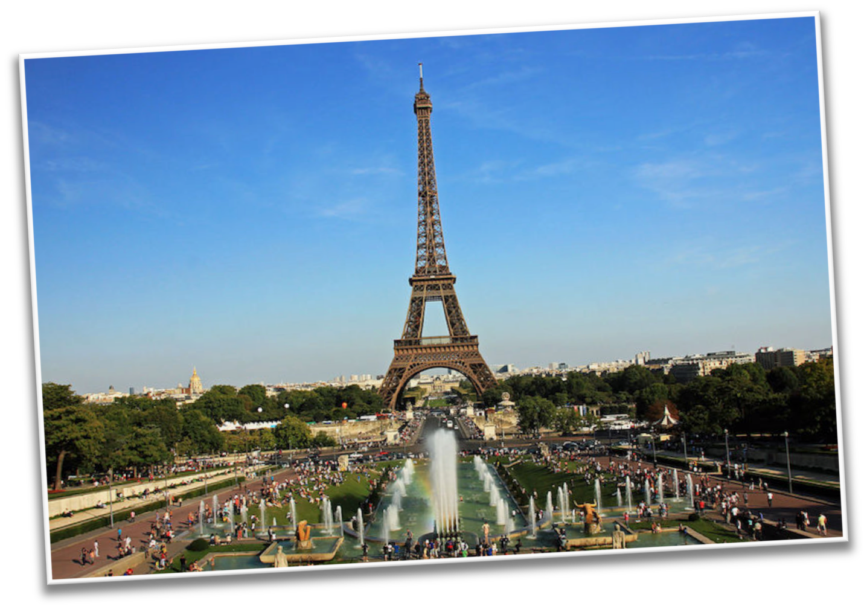

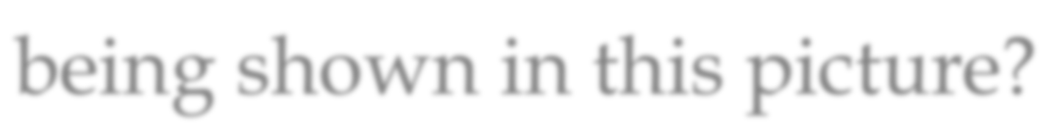
What country do you think is being shown in this picture?

Slide 7


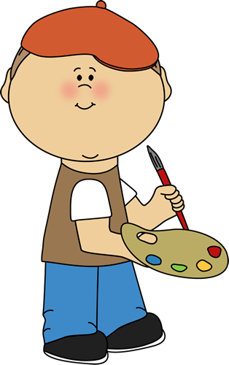
What do you know about France? Write it below

Slide 8


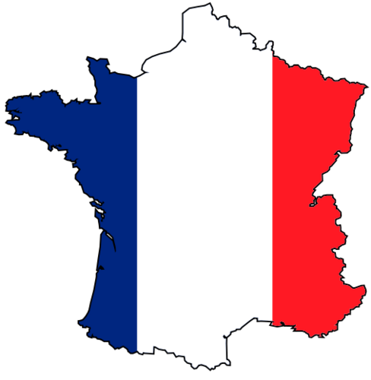
What did you like about France?

Slide 9

Let’s review the book
What is one food that France is known for?

Slide 10

Correct, bread!
Do you know what bread is made from?
*Hint* It is an “ough” word

Slide 11
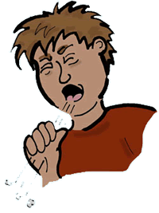

Do you remember? What sound does “ough” make?

Slide 12


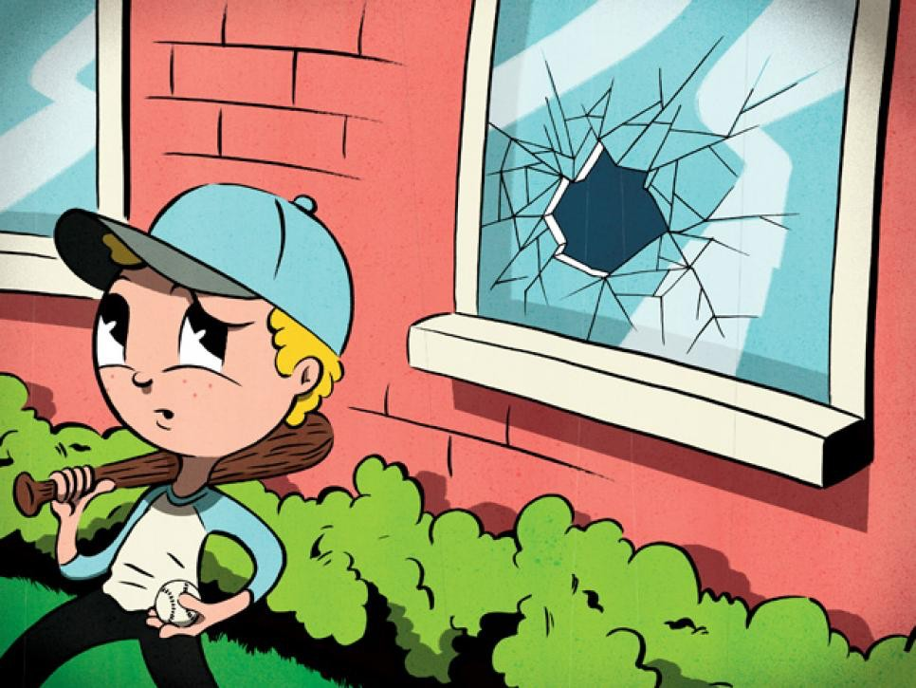
Let’s practice using some words in a sentence.
Knead the _______________ to make the pizza.
________________ I’m sick I’ll still go to work.
He kicked the ball ________________ the window.
Dough Through Although

Slide 13

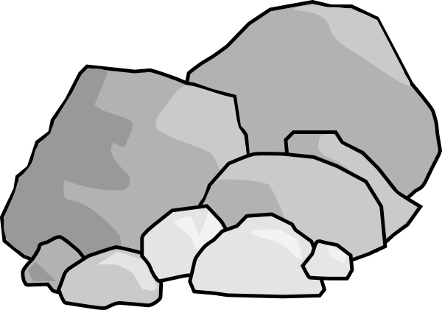
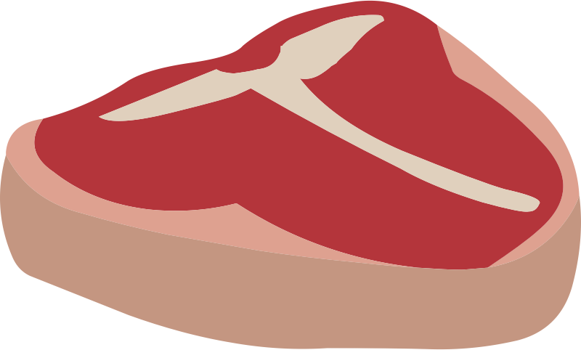
More practice!
The road was ________________ and rocky.
The meat was too ________________ to eat .
A dozen eggs will be ___________________.
Enough Rough Tough

Slide 14


Nice work! Now let’s play 20 questions.
One student will think of an “ough” word, and the others will ask yes or no questions to guess what word they are thinking of.
Enough
Rough
Tough
Dough
Through
Although
Though
Cough
Bough

Slide 15


Great, that was fun. What did we learn today?
An overview of the unit
A look into the country of France
A review of “ough” words

Slide 16

Let’s look at the homework now.
Do you have any questions?

Slide 17

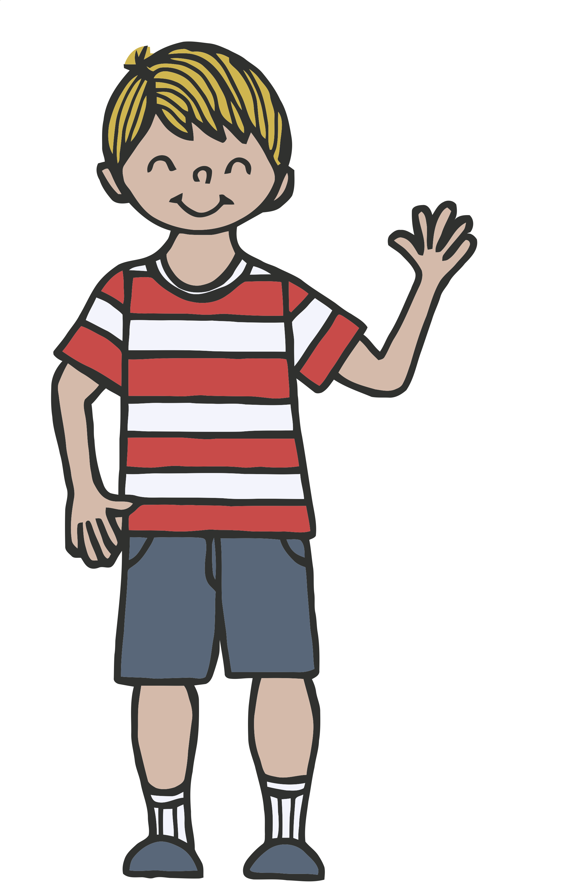
Thank you for a great class today.
As they say in France, Au-revoir!

