Slide 1
Around the World
Unit 8 Lesson 1

Slide 2

What will we be learning this class?
An overview of the unit
A look into the country of France
A review of “ough” words

Slide 3
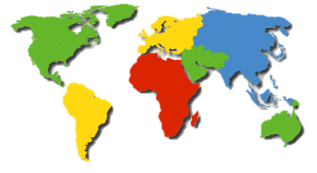
We will be looking into different countries.
What is a country?
A country is a land where people live, with it’s own laws or rules and foods or practices that are special to each land.
Here are some examples of countries:
China
Canada
France
Japan

Slide 4
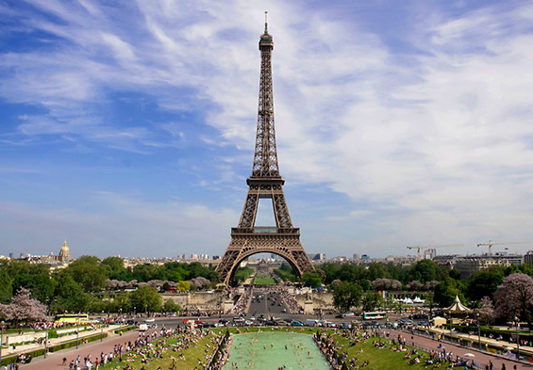
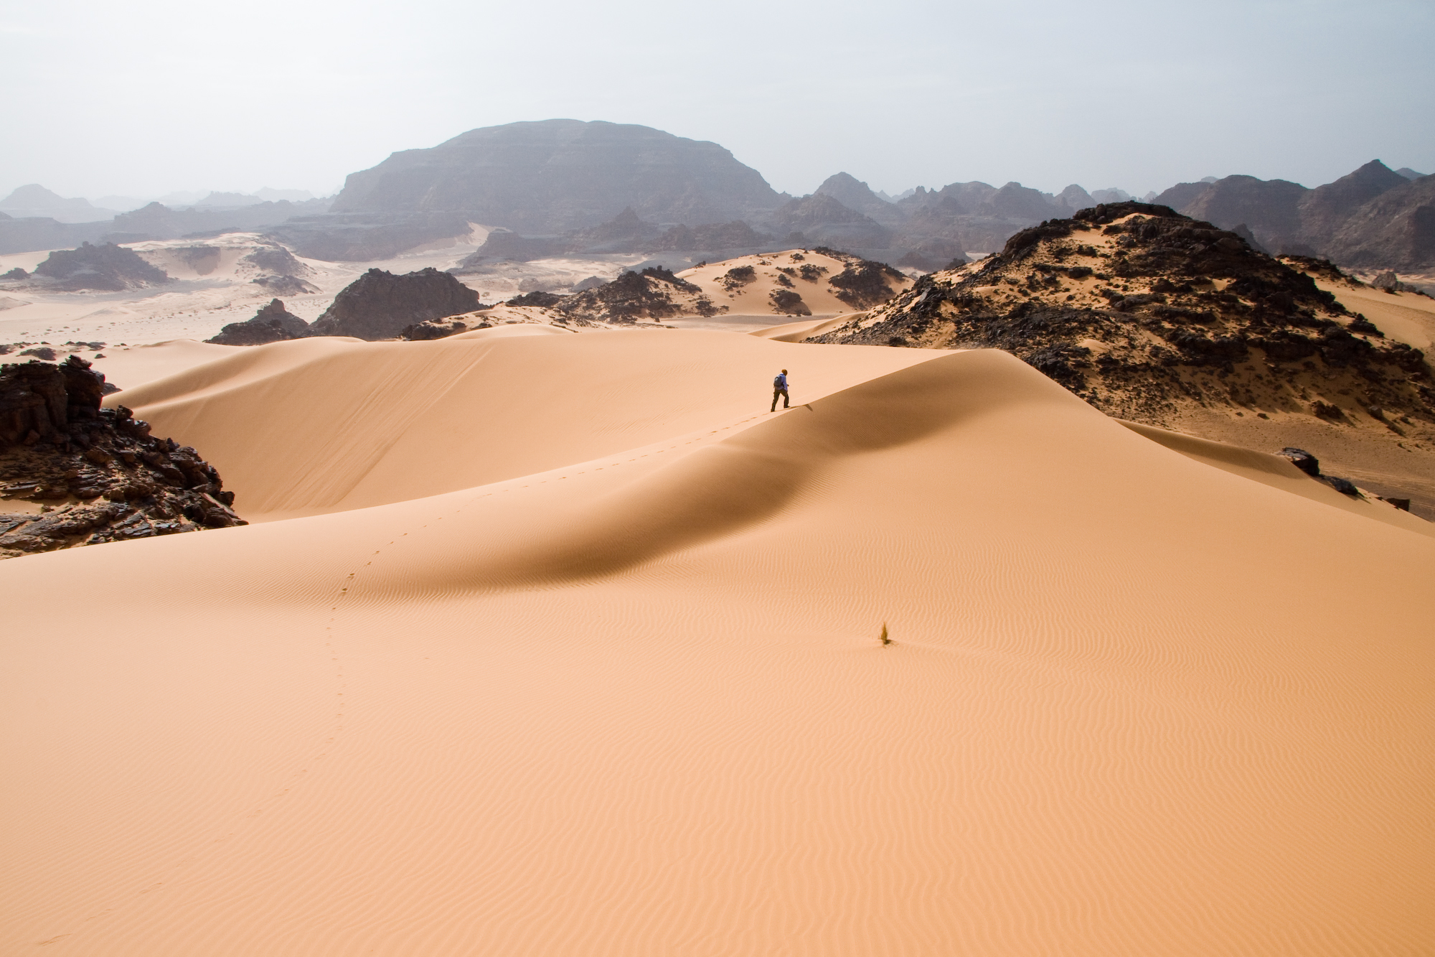

What countries have you been to?
Tell us about a country you have been to. What was special about that country?

Slide 5
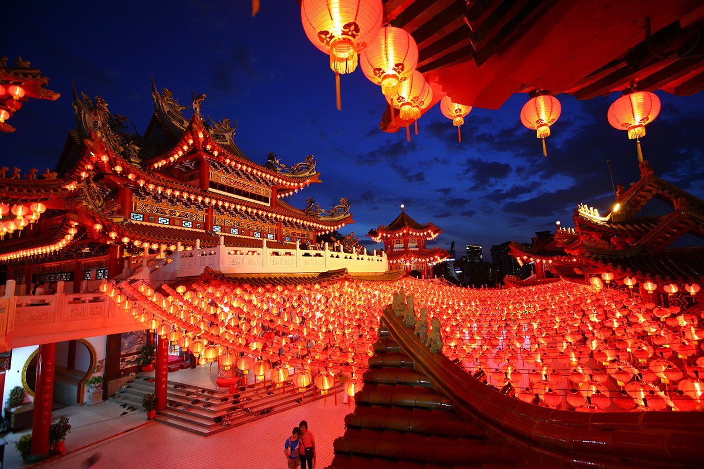
That sounds great!
What country do you live in right now? What is something special or different about the country you live in?

Slide 6
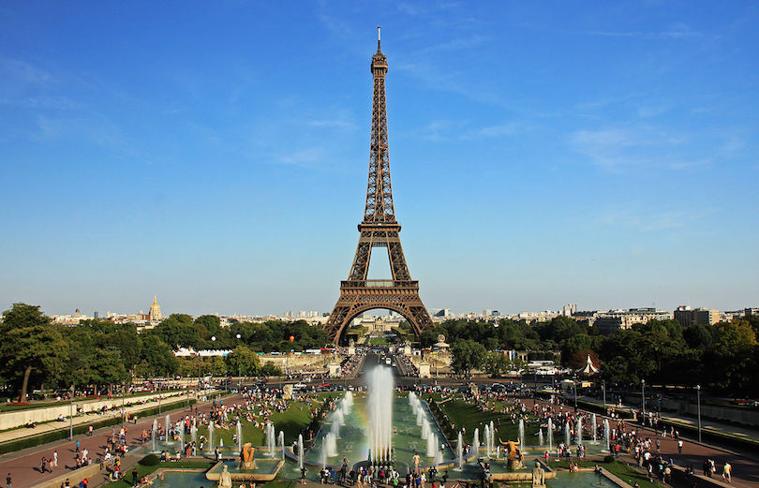
What country do you think is being shown in this picture?

Slide 7

You’re right, it’s France!

Slide 8
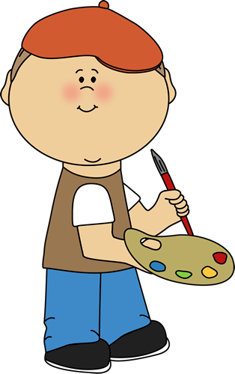
What do you know about France? Write it below

Slide 9

Let’s read a book about France!

Slide 10
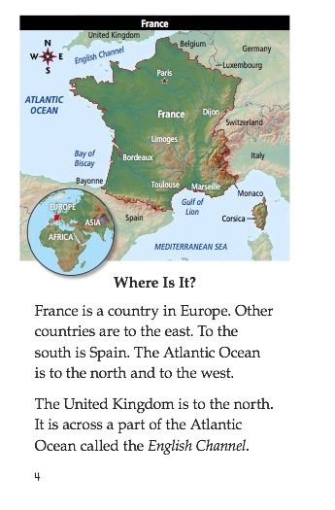

Slide 12
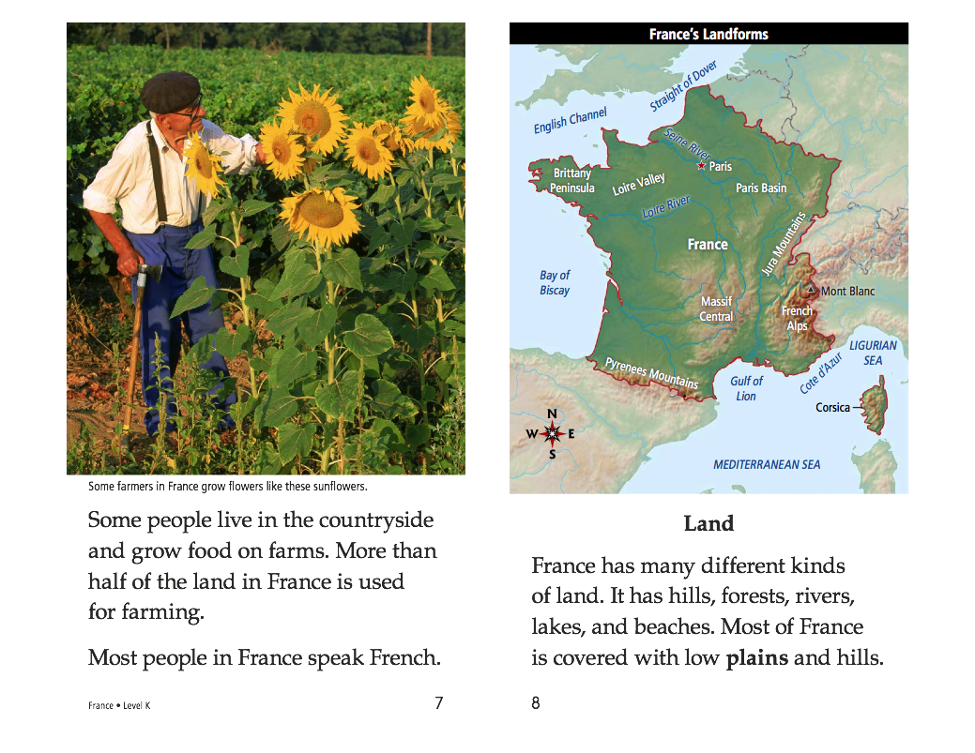

Slide 15
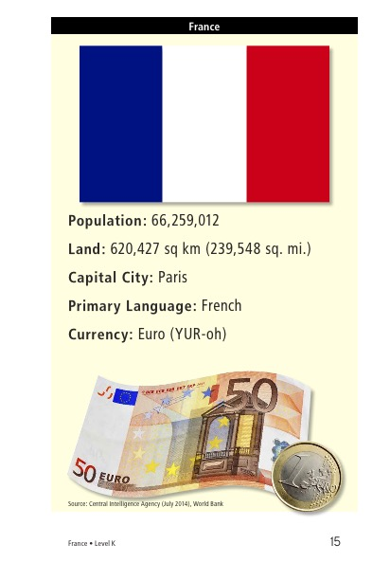

Slide 16

What did you like about France?

Slide 17

Let’s review the book
What is one food that France is known for?
_________________________________

Slide 18
Correct, bread!
Do you know what bread is made from?
*Hint* It is an “ough” word

Slide 19
Yes! Dough!
Use the word “dough” in a sentence.

Slide 20
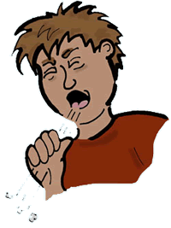

Do you remember? What sound does “ough” make?

Slide 21

Yes! It can make an
“oh” sound
an “ow”
or a
“F” sound

Slide 22
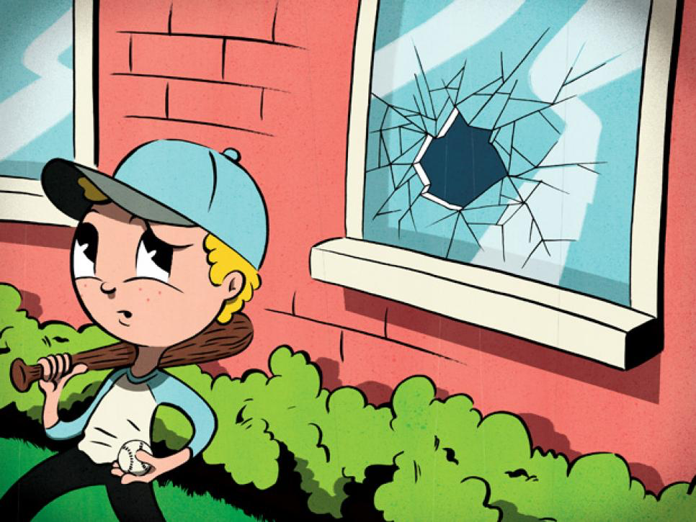
Let’s practice using some words in a sentence.
Knead the ______________ to make the pizza.
_________________ I’m sick I’ll still go to work.
He kicked the ball ________________ the window.
Dough Through Although

Slide 23
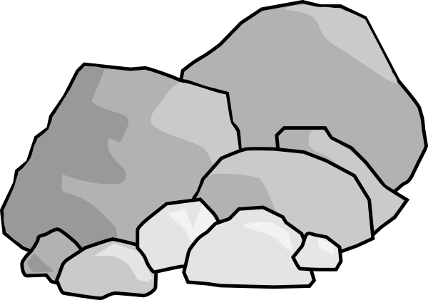
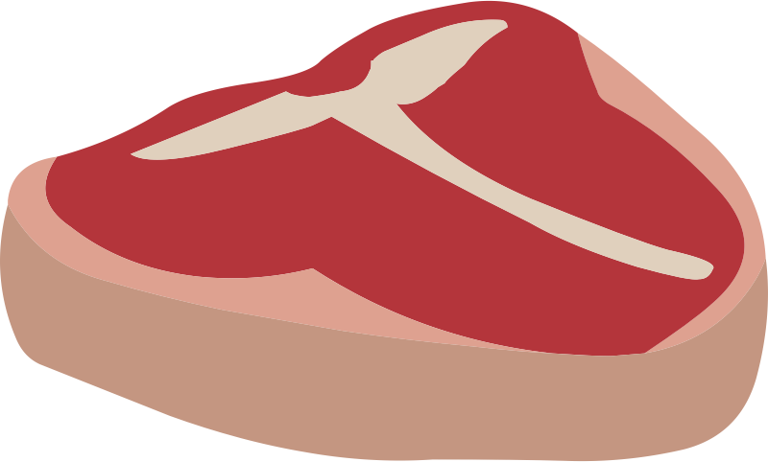
More practice!
The road was ______________ and rocky.
The meat was too ______________ to eat .
A dozen eggs will be ___________________.
Enough Rough Tough

Slide 24

Write a sentence using the word “through”

Slide 25
Nice work! Now let’s play 20 questions.
One student will think of an “ough” word, and the others will ask yes or no questions to guess what word they are thinking of.
Enough Rough Tough
Dough Through Although
Though Cough Bough

Slide 26
Great, that was fun. What did we learn today?
An overview of the unit
A look into the country of France
A review of “ough” words

Slide 27
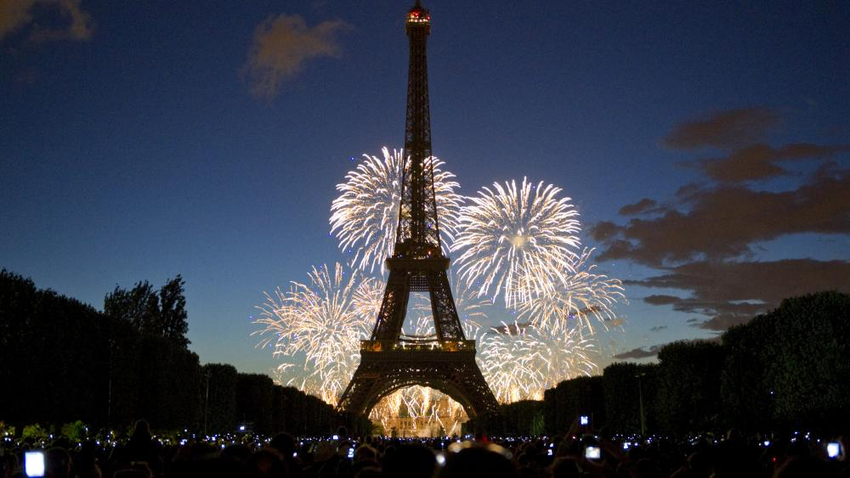
Let’s look at the homework now.
Do you have any questions?

Slide 28
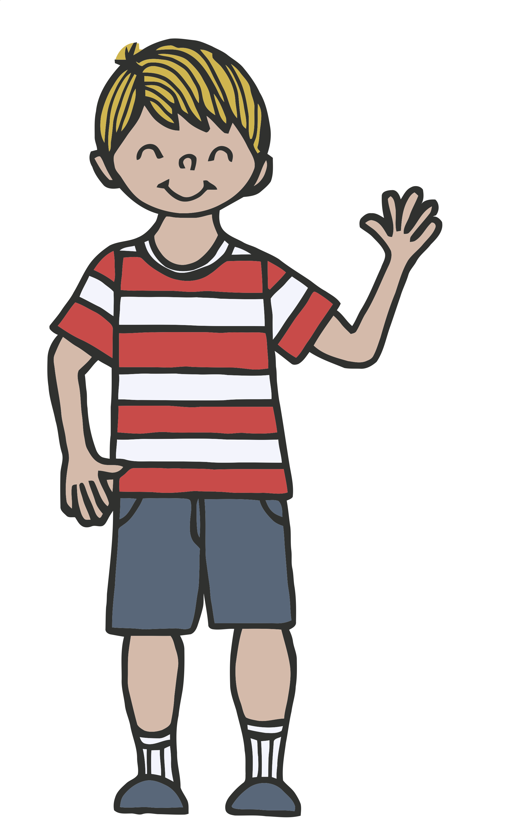
Thank you for a great class today.
As they say in France,
Au-revoir!

